Slide 1
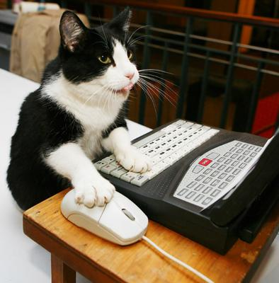
Heuristic evaluation 2 CSCI 5839 Fall 2014
Notes:
http://homrj.files.wordpress.com/2009/12/cat8_gallery__394x4000.jpg

Slide 2
Today
Heuristic evaluation practice

Slide 3
Assignments
Today: Paper prototypes and user testing plan
Will be getting feedback tonight/tomorrow
Next week: user testing w/ 3 users (due next Friday 5pm)
For next Thursday: sign up for an educational license of Axure (http://www.axure.com/edu)

Slide 4
Usability aspect report
Template available: http://shaunkane.info/classes/csci5839/files/uar.docx
We’ll go through and fill one out
Analyze:

