Slide 1
What is design?
CSCI 5839 Fall 2014

Slide 2
Today
Piazza/readings/inspirations
Introductions
More about project
Practicing design

Slide 3
Course updates
Posted outline of all assignments on web site
Dates may shift slightly for later assignments
Shorter course URL: http://bitly.com/ucdcolorado
Will highlight “to do” items in the lectures (and post lectures on the course calendar)

Slide 4
Due by EOD tomorrow
Read the syllabus on the course web page (questions/comments on Piazza)
Read Chapters 1 & 2 of “Don’t Make Me Think” (15-20 minutes)
Sign up for Piazza and leave a (brief) comment on the reading (5 minutes)
A0: Put together 2 introductory slides for Thursday’s class (10-20 minutes)
Start thinking about project ideas

Slide 5
Due before next class
Reading: The Deep Dive [video]
Comments on Piazza
Inspirations (optional, count as participation)
Coming up
Project pitches (due Weds at midnight)
CITI training (due Weds at midnight)

Slide 6
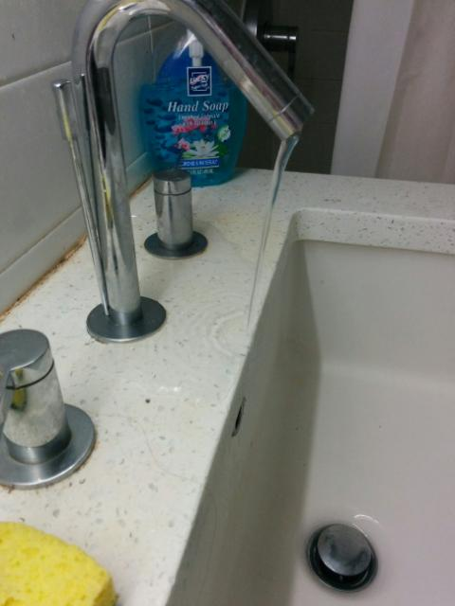
BETA warning
New version of this class
I’ll check in at the end of next week for early feedback
Notes:
http://www.reddit.com/r/CrappyDesign/comments/2ahk5l/what_1450_of_rent_gets_you_in_manhattan/

Slide 7
Inspirations
Fragmentation of messaging clients
Jacob, “notification range”
Robert, Use of maps in Denver
Srinjita, How Steve Jobs would sell a pen
Adam and Surbhi, how to give motivational pitches
We’ll revisit these later

Slide 8
Comments on the reading
Kelvin, would this work on a turbine?
Expert vs. novice
Ning, scanning is smart!
Jennings, “guessing is fun”
Adam: what if refactoring design is costly?
Everyone was positive!

Slide 9
Shaun’s takeaway
Friendly introduction to user-centered perspective
People think, sometimes lazily
We need to get inside their brains
Design can help

Slide 10
Introductions
If you have a slide:
We’ll present it
If not:
Say name, program, one skill, one passion

Slide 11
Reflections on introductions
Common ideas/themes for projects?

Slide 12
Reflections on introductions
Why designs were hated/loved?

Slide 13
About the project
Choosing projects
Timeline
Some examples from prior semesters

Slide 14
Introduction to HCI and Design

Slide 15
Vocabulary fun
Lots of new terms
HCI
HCC
Design
User-centered design

Slide 16
What is user-centered design?

Slide 17
What is UCD?

Slide 18
This class is mostly UCD for HCI
So what’s HCI?

Slide 19
What is HCI?
“Design, evaluation and implementation of interactive computing systems for human use and the study of the major phenomena surrounding them.”
–Special Interest Group on Human-Computer Interaction (SIGCHI) of the Association for Computing Machinery (ACM)

Slide 20
Interactive computing system?

Slide 21
Interactive computing systems
Single PC - capable of displaying web pages
Embedded devices, for example in cars and in cell phones
Handheld Global Positioning Systems for outdoor activities
Software that allows collaboration

Slide 22
HCI is Interdisciplinary
Behavioral Science
Design
HCI
Computer Science
Notes:
Mix of three disciplines

Slide 23
HCI is interdisciplinary
Computer Science
Implementation of website or other interface
Engineering
Faster, cheaper equipment
Ergonomics
Design for human factors
Graphic design
Visual communication
Technical writing
Textual communication

Slide 24
Fields that HCI builds on, continued
Linguistics, artificial intelligence
Speech recognition, natural language processing
Cognitive psychology
Perception, memory, mental models
Sociology
How people interact in groups
Anthropology
Study of people in their work settings
HCI is for misfits
Notes:
The challenge: students—and instructors—may feel that they have to learn graphic design and cognitive psychology to do HCI. Except for the students who know something about these fields—this can be intimidating.
The satisfaction: anybody can learn a lot about HCI without any formal background in much of anything.
Plus: some people find the combination fun.

Slide 25
Design

Slide 26
What is design?

Slide 27
What is design?
Practical, aesthetic considerations
Usability – how well, how efficiently it works
Understanding audience
Solving a Problem

Slide 28
Is design art?

Slide 29
Design IS art…
Design IS NOT art…

Slide 30
Is design subjective?

Slide 31
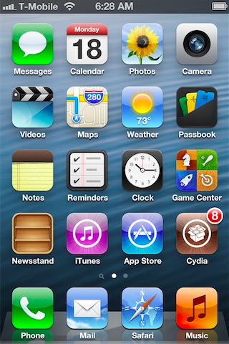
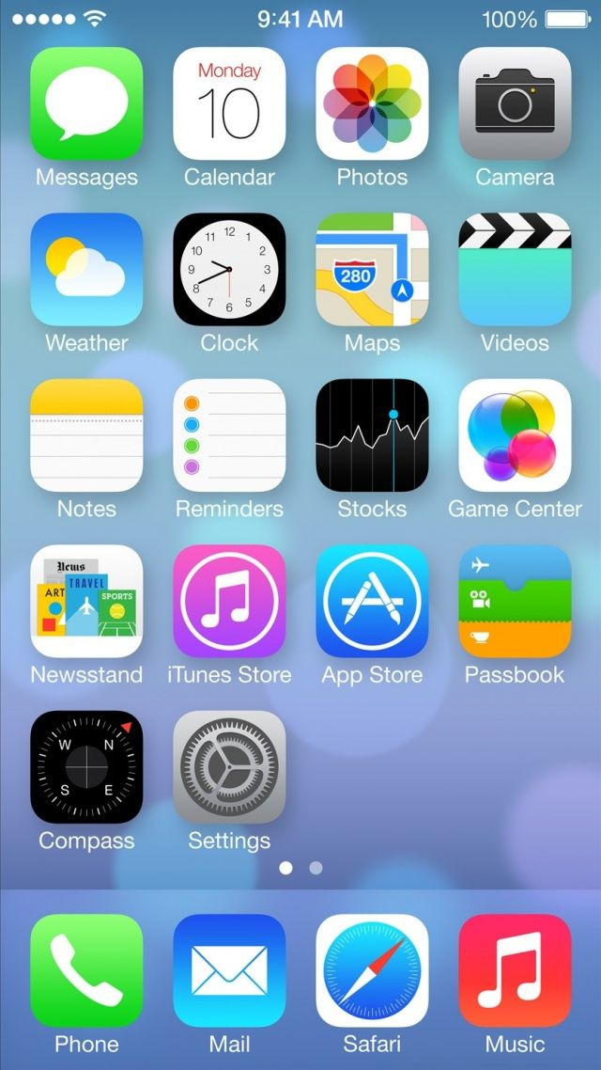

Slide 32
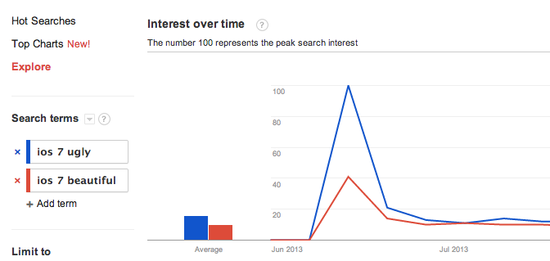
Is design subjective?
http://www.google.com/trends/

Slide 33
Is design SCIENCE?

Slide 34
Balancing science and intuition
Use known facts about human cognition, perception, ability
e.g., rule of thirds, 7 ± 2
Use empirical methods to test hypotheses, evaluate, and iterate
Design is not magic

Slide 35
Art vs. science
The Great Douglas Bowman leaves Google
“Yes, it’s true that a team at Google couldn’t decide between two blues, so they’re testing 41 shades between each blue to see which one performs better. I had a recent debate over whether a border should be 3, 4 or 5 pixels wide, and was asked to prove my case. I can’t operate in an environment like that. I’ve grown tired of debating such miniscule design decisions. There are more exciting design problems in this world to tackle.”
http://www.zeldman.com/2009/03/20/41-shades-of-blue/

Slide 36
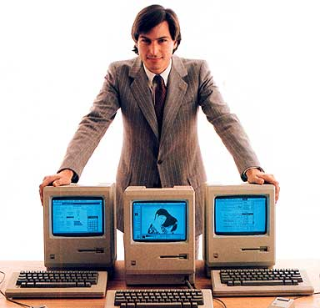
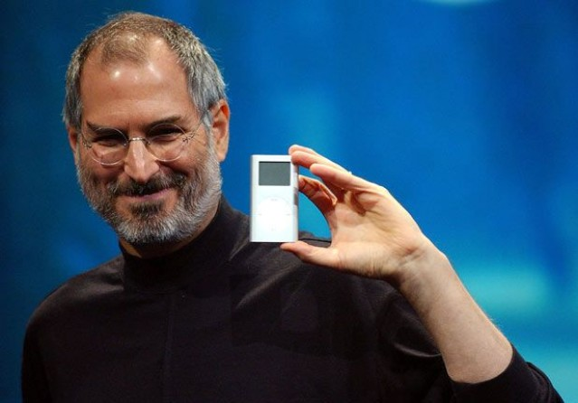
Quotes on design
“Design is not just what it looks like and feels like. Design is how it works.”
- Steve Jobs

Slide 37
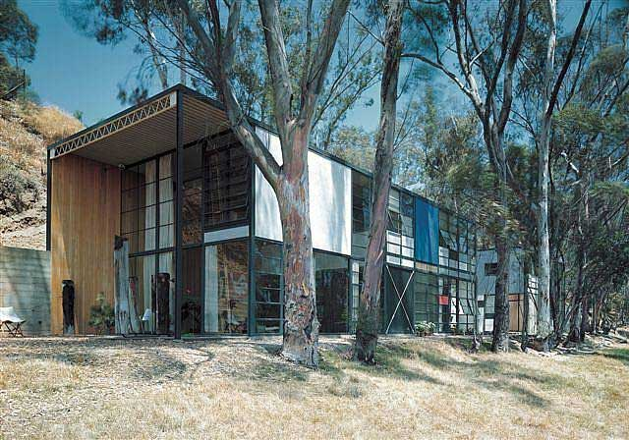
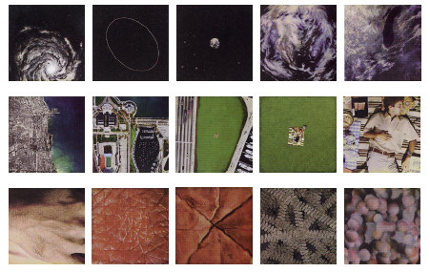
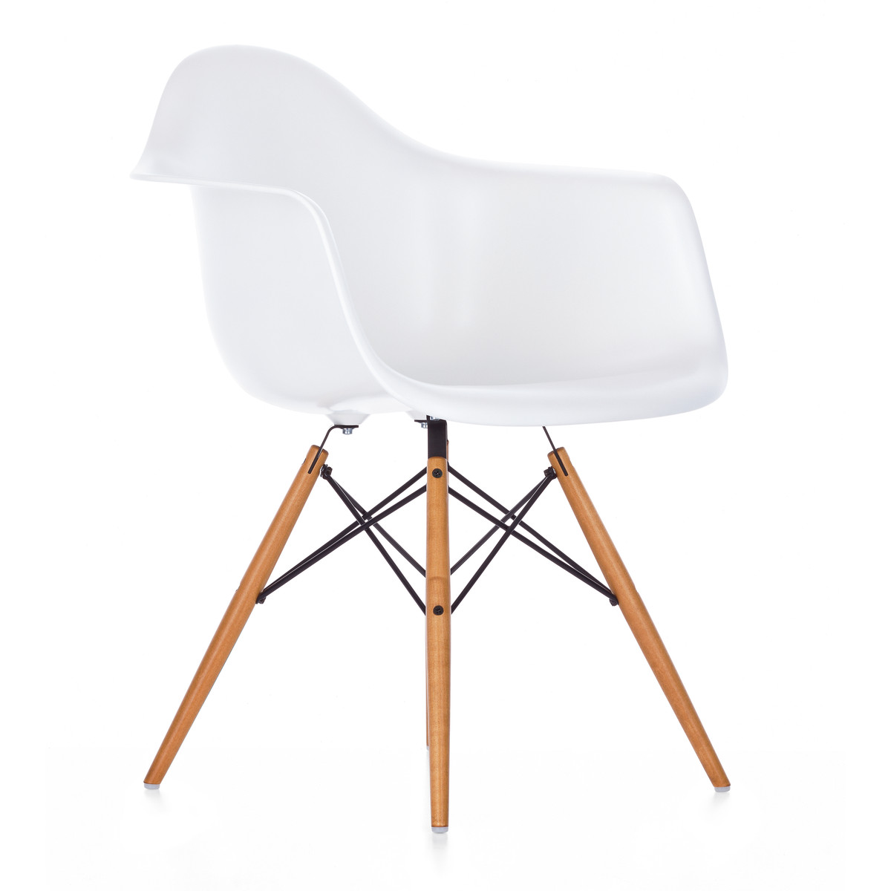
Quotes on design
“Design is a plan for arranging elements in such a way as best to accomplish a particular purpose.” – Charles Eames

Slide 38
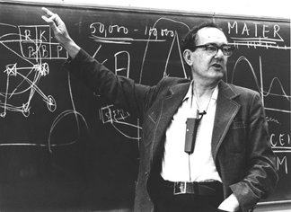
Quotes on design
“Engineering, medicine, business, architecture and painting are concerned not with the necessary but with the contingent - not with how things are but with how they might be - in short, with design.” – Herb Simon

Slide 39
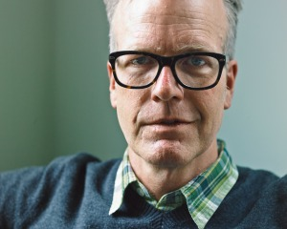
Quotes on design
“I’ve been amazed at how often those outside the discipline of design assume that what designers do is decoration—likely because so much bad design simply is decoration. Good design isn’t. Good design is problem solving.”
- Jeffrey Veen, The Art and Science of Web Design

Slide 40
Design process

Slide 41
(One) Design process
Make something
Done!

Slide 42
How do we know what to build?
requirements, users’ desires
User research
Make
Done!

Slide 43
How do we come up with ideas?
many failed ideas
User research
Ideate
Make
Done!
the best ideas

Slide 44
How do we know if we’re right?
User research
Ideate
Prototype
Evaluate
Done!

Slide 45
Closing the loop
User research
Ideate
Prototype
Evaluate
Done!

Slide 46
Design in miniature, Part 2
Last time we talked about problems facing new students
Some solutions:
Smart shoes
Drones
Talking markers
Augmented reality for finding buildings
Today: exploring how ideas become reality

Slide 47
Design in miniature, part 2
Groups of 3
Pick a project
Smart shoes
Drones
Talking markers
Augmented reality for finding buildings

Slide 48
Design in miniature, Part 2
See how we translate ideas to reality
The challenge: prepare a 60 second skit demonstrating the idea (imagine a TV commercial)
Take notes about your discussion
What questions come up?

Slide 49
Review

Slide 50
Next time
Professional brainstorming
Bring ideas for projects

