Slide 1
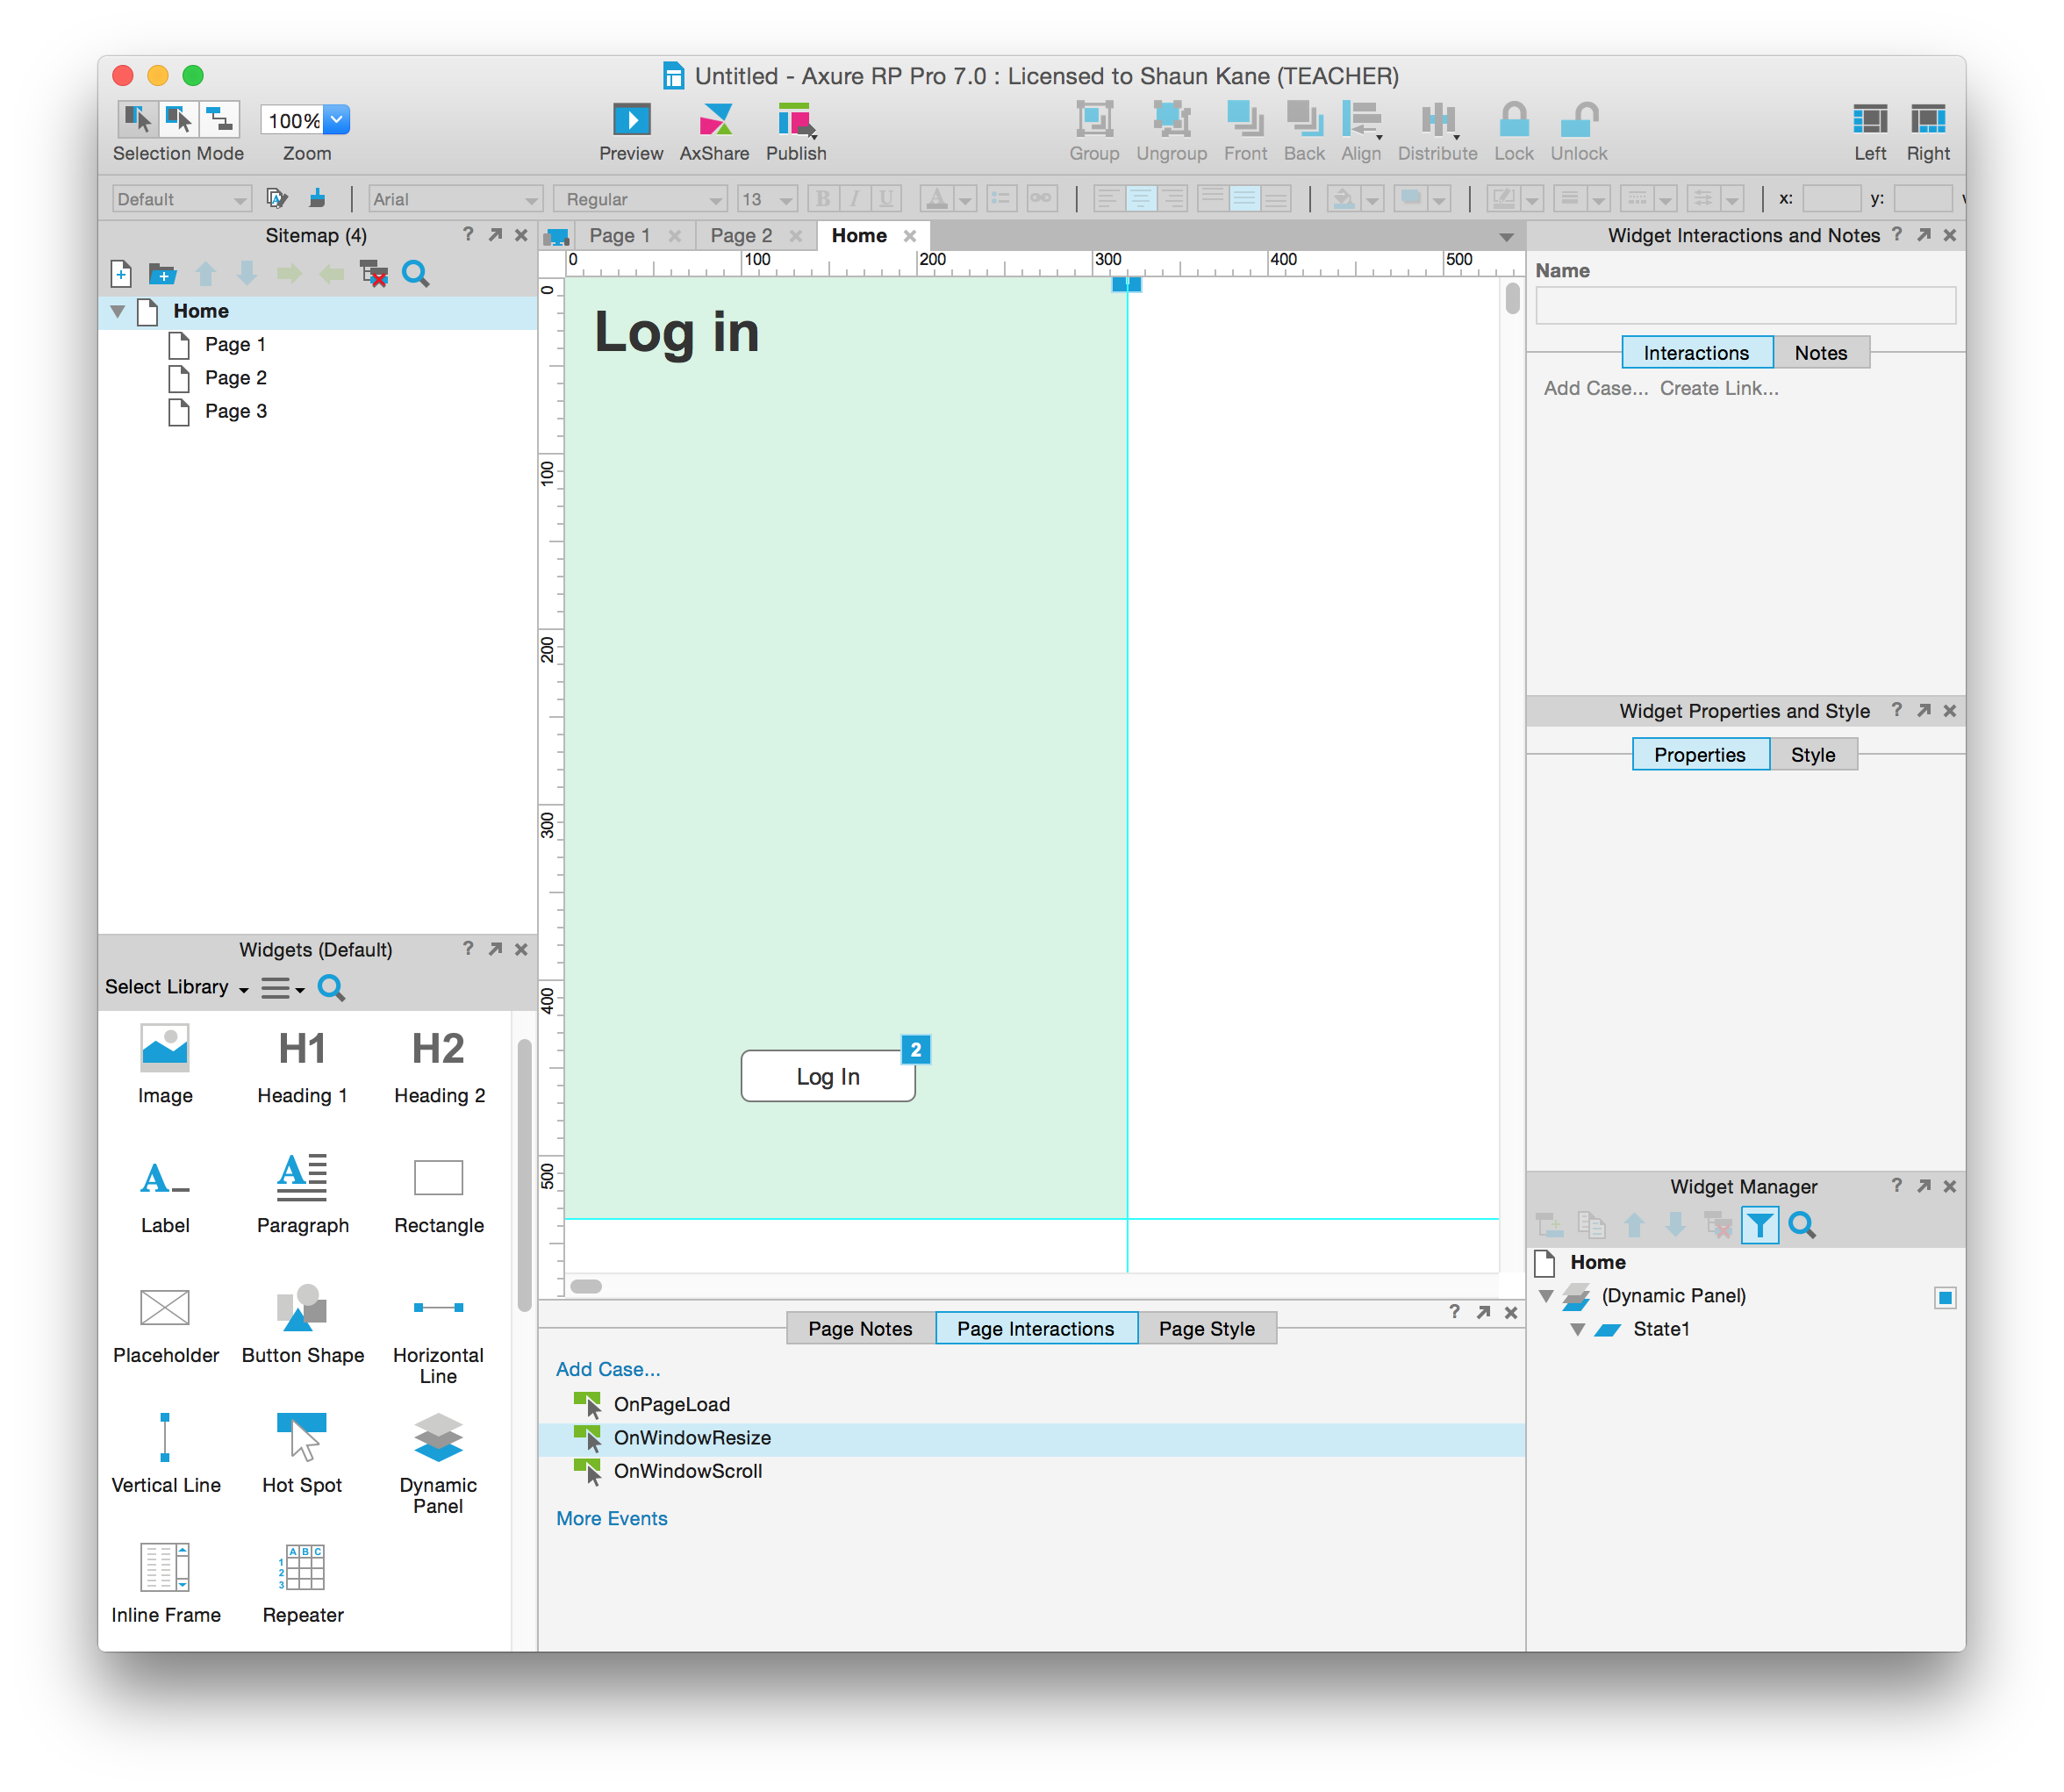
Mid-fidelity prototyping CSCI 5839 Fall 2014
Notes:
http://homrj.files.wordpress.com/2009/12/cat8_gallery__394x4000.jpg

Slide 2
Today
Practicing mid-fidelity prototyping with Axure

Slide 3
Why mid-fi?
Experience prototype on a real device
Start to test gestures/interactions/target sizes
Clarify anything sketchy about paper prototype

Slide 4
Helpful Axure links
Free license: http://www.axure.com/edu
Tutorials: http://www.axure.com/tutorials
Widget library: http://www.axure.com/community/widget-libraries
Exporting for mobile: http://www.axure.com/learn/iphone-app/viewing-and-settings
Collaboration? http://www.axure.com/learn/team-projects

Slide 5
Plan
Let’s whiteboard an app and design it in Axure
Then, time for mid-fidelity prototyping of projects
Post your prototypes at the end of class to Piazza

