Slide 1
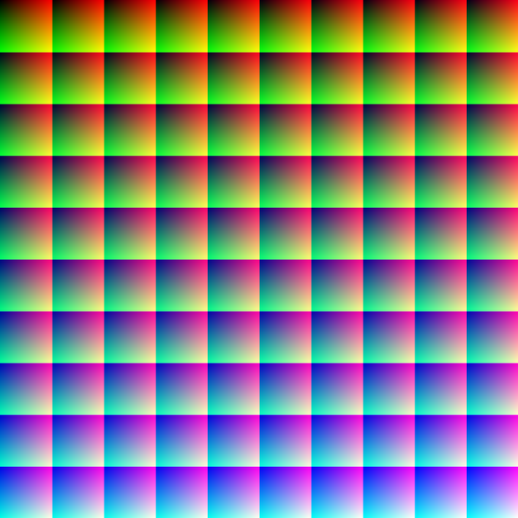
Working with color CSCI 5839 Fall 2014
Notes:
Image: http://en.wikipedia.org/wiki/Color_vision

Slide 2
Assignments etc.
Due Tuesday: mid-fidelity prototype based on your best version of paper prototype
Plan a ~60 sec walkthrough of your prototype
Dec 11: ATLAS Expo (see Piazza post)
Hoping to get representatives from each group to sign up

Slide 3
User testing progress update

Slide 4
Notes on user testing
Lots of groups discovering design tensions (this is good!)
Often this means making decisions about what to prioritize, what to remove
Make changes for round 2, but be careful of overcorrecting

Slide 5
Today
Screen design activity
Using color
Intro to Intro to visual storytelling

Slide 6
Recap from last time
Use spacing to separate out important sections of document
Change type characteristics (size, weight) to emphasize text
Pair typefaces with different characteristics to separate headings, body text, quotes, etc. (think about style sheets)

Slide 7

Thumbnail sketching
“Block out” the major sections of the design
Quickly sketch out design possibilities

Slide 8
Activity
Work in pairs
On an 8.5 x 11 sheet (or similar), sketch a layout for a new tablet-based web site
Thumbnail sketches of 4 distinct layouts
Then create 2 layouts at a larger size
You can use color, but focus on trying different text sizes, weights, margin sizes
10 minutes

Slide 9
What to design
Class search results page – how can we present class search results in a way that makes it easier to find the right courses?
For now, focus on the layout of the results (rather than radically changing the content)

Slide 10
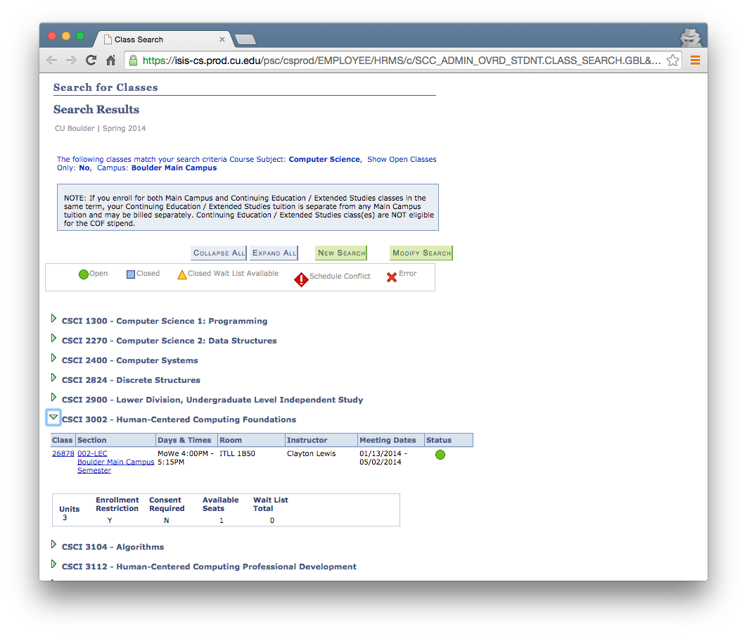

Slide 11
Designing with color

Slide 12
What to know about color
Color follows (mostly) clearly defined rules
Especially color pairings
Color is appreciated differently based on culture, and physiological differences

Slide 13
How we perceive light (and color)
Two types of light-sensing cells
Rods – detect monochromatic light, especially in low light
Cones – detect color in certain wavelengths; most human beings have three types (R, G, B)
Humans can perceive about 10 million colors (Judd and Wyszecki 1975)
These are JNDs, not identifiable colors (http://www.jnd.org/jnd.html)
Notes:
Judd, Deane B.; Wyszecki, Günter (1975). Color in Business, Science and Industry. Wiley Series in Pure and Applied Optics (3rd ed.). New York: Wiley-Interscience. p. 388. ISBN 0-471-45212-2.

Slide 14
How we talk about colors
Named colors (red, chartreuse, international Klein blue)
Color classification systems (Pantone 292)
Models for representing color (RGB, CMYK, LAB, HSB)
But what are the components of color?

Slide 15


Additive vs. subtractive color model
Additive
Subtractive

Slide 16
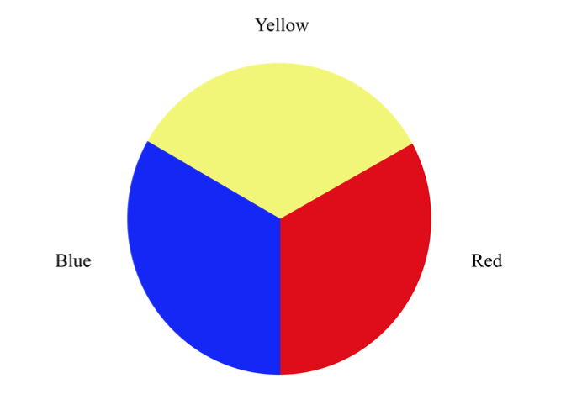
The artist’s model: primary colors

Slide 17
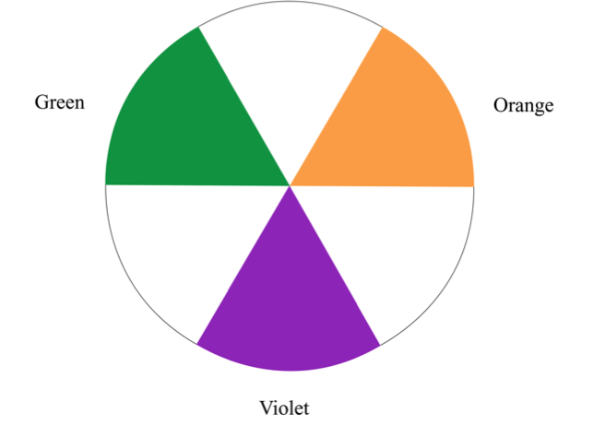
The Secondary Colors

Slide 18
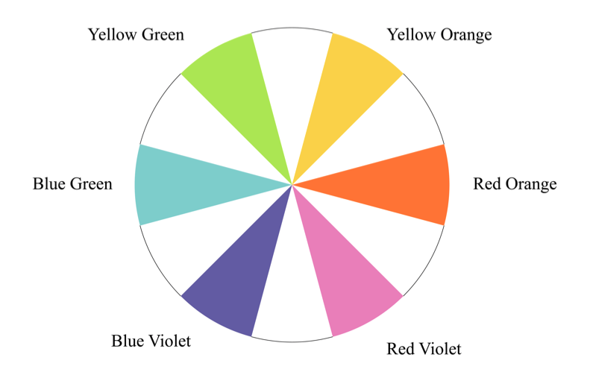
Tertiary Colors

Slide 19
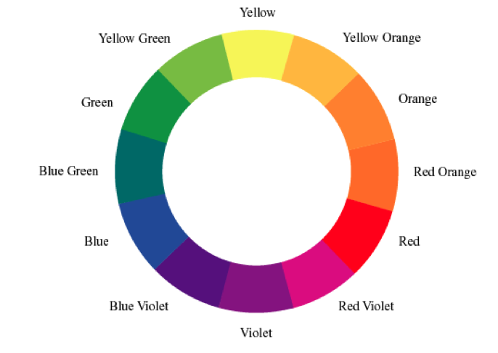
An artist’s color wheel

Slide 20
Color and computing: RGB Scheme
An additive color system, since you add light from the primary colors to make new colors.
The values for Red, Green, and Blue may be specified in percent (0–100); or in a scale from 0–255 (decimal) or 00–FF (hex)—where 255 or FF = 100%.
Remember: higher numbers mean more of each color of light.
More is lighter, less is darker!

Slide 21
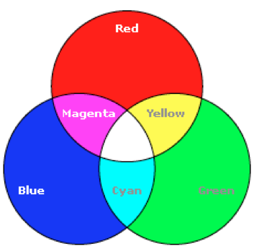
RGB Scheme
Red = (255,0,0)
Green = (0,255,0)
Blue = (0,0,255)
Magenta = (255,0,255)
Yellow = (255,255,0)
What’s #ff00ff?

Slide 22
HSB Scheme
This scheme is a device-independent way to describe color
 Hue
 Saturation
 Brightness (sometimes called Value)

Slide 23
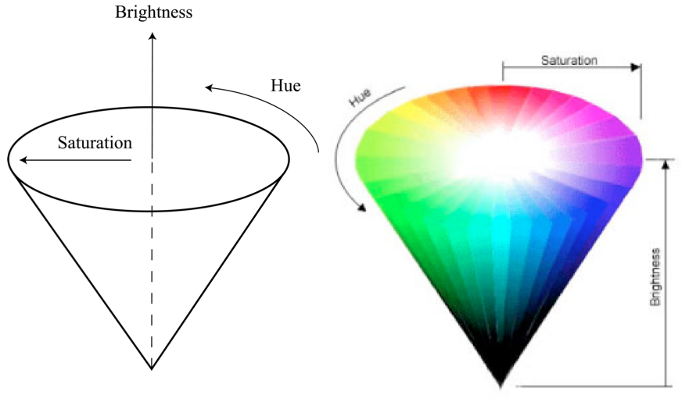
HSB Model

Slide 24
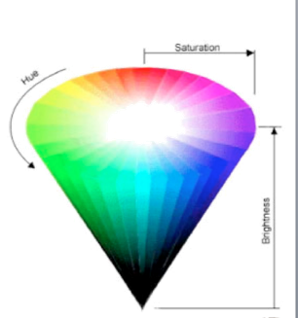
HSB Model
Hue is the actual color. Measured in angular degrees counter- clockwise around the cone starting and ending at red = 0 or 360 (yellow = 60, green = 120, etc.).
Saturation is the purity of the color, measured in percent from the center of the cone (0) to the surface (100).At 0% saturation, hue is meaningless.
Brightness is measured in percent from black (0) to white (100).At 0% brightness, both hue and saturation are meaningless.

Slide 25
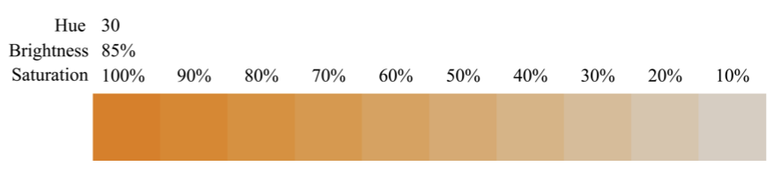
Vary saturation, constant brightness

Slide 26
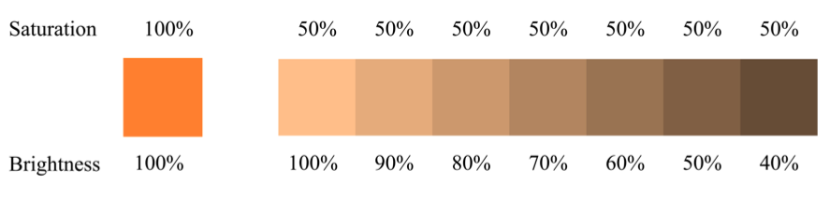
Vary brightness, constant saturation

Slide 27
CMYK model
Cyan, Magenta, Yellow, and Key (usually black)
Used in printing

Slide 28
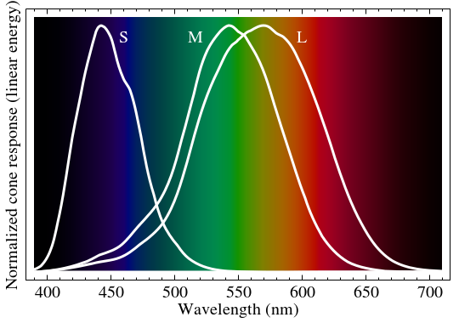
Human perception of color
It’s non-uniform
People have better discrimination of green than of red and blue
Affects image encoding schemes (some provide extra bits for green)
Notes:
http://en.wikipedia.org/wiki/Color_vision#mediaviewer/File:Cone-fundamentals-with-srgb-spectrum.svg

Slide 29
Colors are not universal
Influences on color perception
Physiological traits
Environmental factors (lighting, device characteristics)
Influences on color interpretation
Cultural norms
Individual preferences

Slide 30
Individual color perception
Color blindness affects a significant portion of the population (up to 8-10 percent of men, 0.5 percent of women)
Multiple common “types” of color blindness
And individual differences beyond that

Slide 31
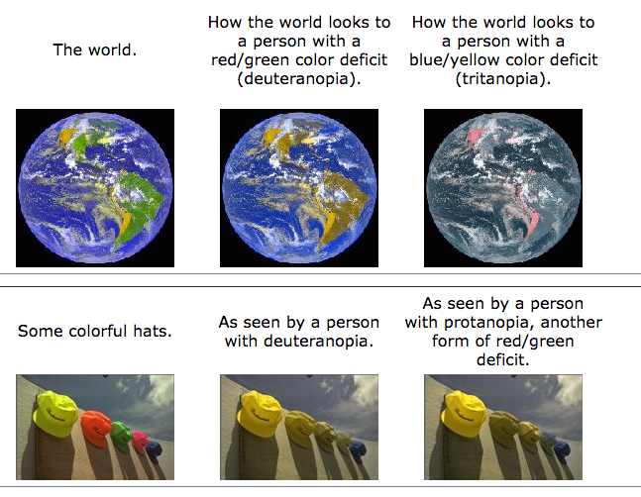
Notes:
http://www.vischeck.com/examples/

Slide 32
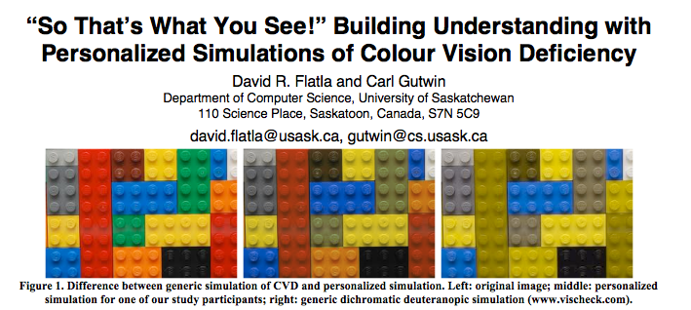
Notes:
http://hci.usask.ca/uploads/268-fp01-flatla.pdf

Slide 33
Superhuman color vision
Most human beings have three types of color-sensors (cones) – we are trichromats
Other animals (bees, mantis shrimp) see other parts of the visual spectrum
Fun listening: http://www.radiolab.org/story/211119-colors/
Individuals with altered retinas (e.g. after cataract surgery) can sometimes see UV light
It’s theorized that some human tetrachromats exist (but this is quite difficult to prove)

Slide 34
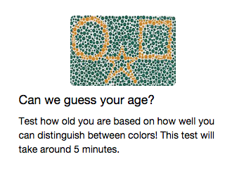
Play web games, contribute to science
http://labinthewild.org/

Slide 35
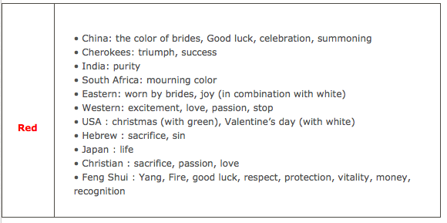
Cultural Significance of Colors
http://www.1stwebdesigner.com/design/colors-web-design-right-combination/

Slide 36
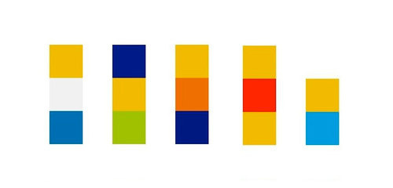
Color schemes
Notes:
http://www.gizmodo.com.au/2010/10/futurama-and-the-simpsons-in-three-pixels/

Slide 37
Understanding color schemes
There are mathematical relationships between colors (e.g. the color wheel)
Thus, we can pick “good” color schemes based on relationships between colors
This helps us determine hue; saturation and brightness follow different rules
(following examples from Duarte)

Slide 38
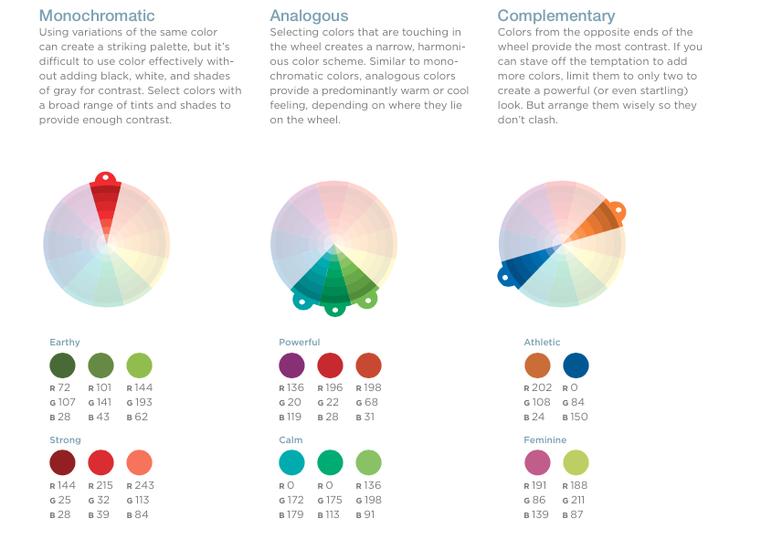

Slide 39
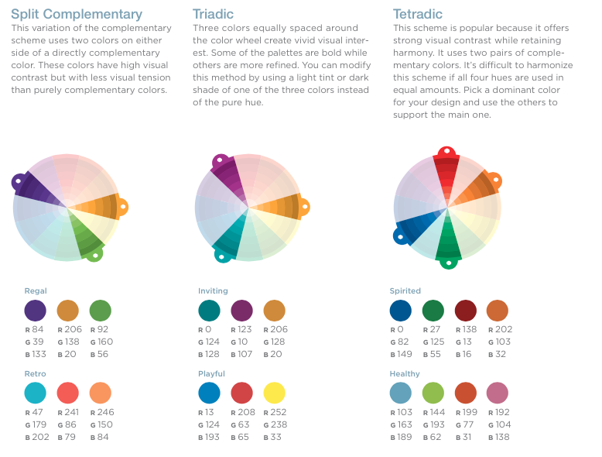

Slide 40
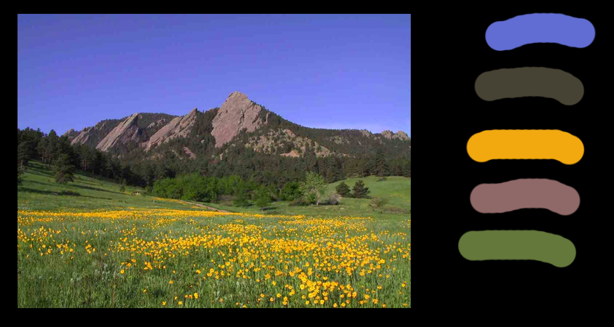
Picking colors from nature
Notes:
http://www.mendosa.com/flatirons.jpg
Still need to balance hue/saturation/brightness

Slide 41
Combining colors
Important to vary not just hue, but also saturation and brightness
Make sure that colors contrast in brightness/saturation, especially for text
Easy test: print it out (or convert to greyscale)
Essential for color blindness but helps everyone
It’s common to have cooler background colors and warmer foreground colors

Slide 42



Slide 43
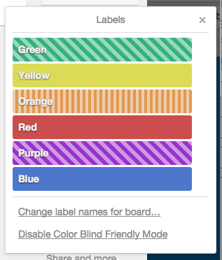
Accommodating color perception
Don’t use color alone to differentiate
Provide other cues
If you can, avoid “color blindness mode”
Notes:
Image from trello

Slide 44
More advice on colors
http://www.tigercolor.com/color-lab/color-theory/color-theory-intro.htm
http://speckyboy.com/2010/05/19/beginners-guide-to-using-the-power-of-color-in-web-design/
http://desource.uvu.edu/dgm/2740/in/steinja/lessons/03/l03_06.html

Slide 45
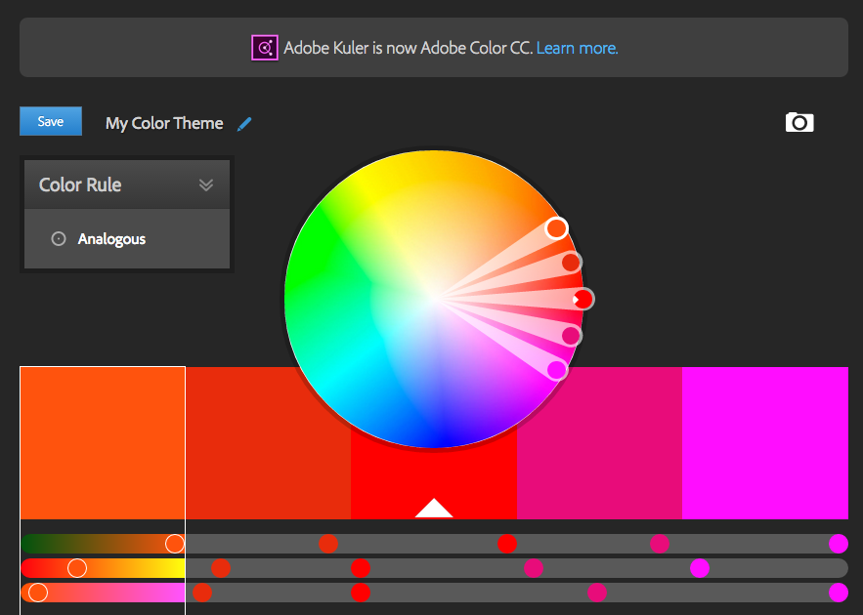
https://color.adobe.com/create/color-wheel/

Slide 46
Color activity
Pair up with your group
Go to http://color.adobe.com
Come up with 3-5 color schemes for your project (and post links to Piazza)

Slide 47
What’s next
Designing video scenarios

Slide 48
Designing video scenarios
Finding the best tools for conveying aspects of our design
Project idea: project pitch
Formative research: personas, scenarios
UI design and layout: sketches, storyboards
How can we convey our interaction design?
Interactive prototypes! But these are difficult to share, require active participation

Slide 49
Video scenarios
Combine what we’ve learned about usage scenarios with our design
Illustrate the problem and how the user uses the system to address the problem

Slide 50
For next time
We’ll cover converting our app/scenarios into a visual story
Storytelling practice
Using PowerPoint for low-fi video prototyping
In the meantime, post favorite/least favorite videos to Piazza
http://www.amazon.com/oc/echo/ref_=ods_dp_ae
https://www.youtube.com/watch?v=KHFZ9UUYed0
http://sandwichvideo.com

