Slide 1
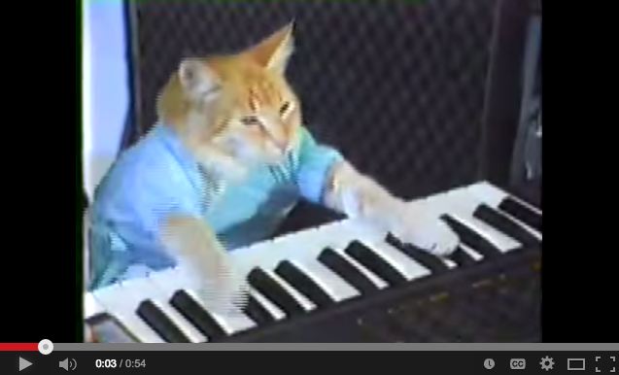
Video prototyping CSCI 5839 Fall 2014
Notes:
Source: google keyboard cat

Slide 2
Assignments etc.
Due today: mid-fidelity prototype
Dec 11: ATLAS Expo (see Piazza post)
Talk with your group about participating
Willing to discuss incentives (snacks? credit?)
T1+T2 grades back today (seriously!)
T3+T4 this week; T5 next week

Slide 3
Today
Mid-fidelity prototyping check-in
Visual storytelling and video prototypes

Slide 4
Storyboarding and video prototyping
Interactive prototypes are great (and necessary), but
Require effort from users
Difficult to share
Don’t necessarily convey the context of use
Video prototypes
Tell a compelling story
Show the context of use AND show the interactions that you’ve designed

Slide 5
Classic HCI videos
Apple’s Knowledge Navigator (1987): https://www.youtube.com/watch?v=HGYFEI6uLy0
Sun StarFire (1994): https://www.youtube.com/watch?v=w9OKcKisUrY
SK’s Bonfire (not classic; 2009): https://www.youtube.com/watch?v=O3MZYRAZJNk
DQ keypad tie (2009): https://www.youtube.com/watch?v=1HGX5V9pnEM
Vink et al., Autonomous Wandering Interface (2014): https://www.youtube.com/watch?v=cqU_hR2_ILU

Slide 6
Pitch videos
See Piazza post: https://piazza.com/class/hywaq7x7uvl26v?cid=81
One example (a bit too much of a commercial, but shows both context/motivation and interaction)
https://www.youtube.com/watch?v=vkRvvtWyxIM&list=UU8XWdXApGfNHTHSm1P9hLEQ

Slide 7
Prototyping our video prototypes
Storyboarding (which we’ve practiced before)
Now, focus on going from a storyboard to a movie
Figure out narration, timing
Storyboard “pitch”
https://www.youtube.com/watch?v=mqAIiVS5JAk
https://www.youtube.com/watch?v=bm91RYa1i-Y#t=1354

Slide 8
From storyboard to video
Animate storyboard images and set them to audio
Animators call this an animatic
Replace storyboard sketches with photographs and screenshots
May also add animation, video clips, screen recordings

Slide 9
The easy way
PowerPoint and narration (quick demo)
If you want to make something with real video – that’s GREAT
We can help
More time consuming
But more compelling too

Slide 10
Other video editing resources
iMovie on iOS is great for shooting and editing video
iMovie on Mac is decent too
For Android – VideoShow is highly rated (other recommendations?)
https://play.google.com/store/apps/details?id=com.xvideostudio.videoeditor

Slide 11
Tips
Keep it short and to the point (for showing a single feature, 30-60 seconds is plenty)
Show, don’t tell (but use text titles or narration for less important things)
Make the interaction clear
What is the user doing? How are they accomplishing it with your interface?

Slide 12
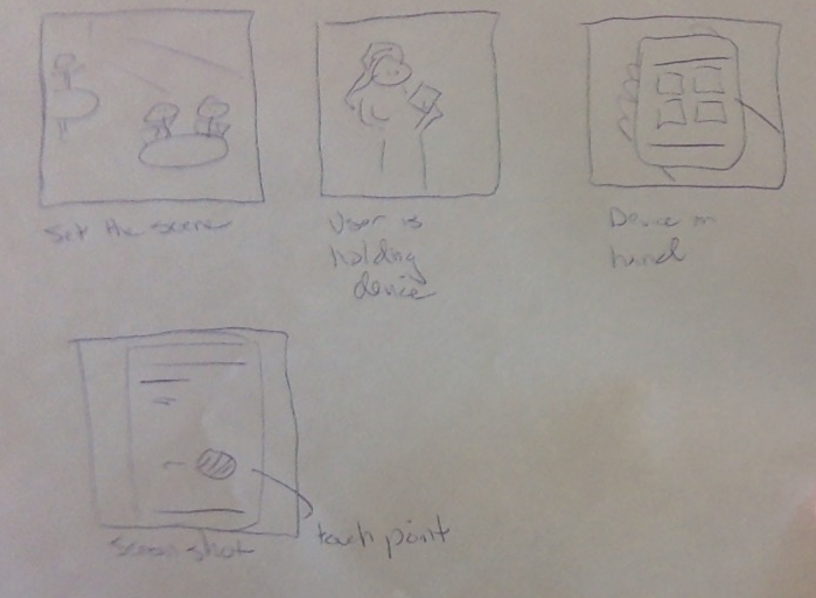
Remember standard camera shots

Slide 13
Example project videos
https://www.youtube.com/watch?v=IQUWGRdjxVo&feature=youtu.be
https://www.youtube.com/watch?v=Pzl0_bzNU3g&feature=youtu.be

Slide 14
Live demo
Shaun’s project: http://shaunkane.info/classes/csci5839/slides/24b-animatic.pptx
Exporting as video:
Mac: https://utah.instructure.com/courses/23633/pages/narrating-powerpoint-presentations
Windows: http://office.microsoft.com/en-001/powerpoint-help/save-your-presentation-as-a-video-HA102756627.aspx

Slide 15
Activity
Work with 1 partner (in your group)
Sketch out a storyboard for an interaction with your project
Set up motivation
Show interaction
We’ll practice some at the end

