Slide 1
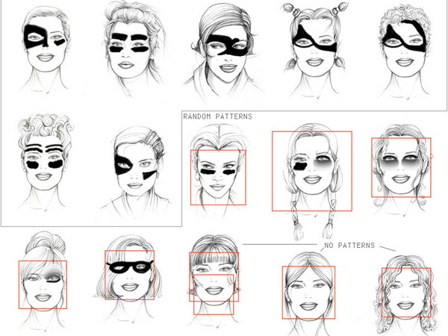
Values in design CSCI 5839 Fall 2014
Values in design
CSCI 5839 Fall 2014
Anti-facial-recognition makeup by Pepin Press.
http://animalnewyork.com/wp-content/uploads/2010/04/asbtract_makeup.jpg
Notes:
Anti-face recognition makeup by Pepin Press.
http://animalnewyork.com/wp-content/uploads/2010/04/asbtract_makeup.jpg

Slide 2
Administrivia
Today: talking about values in design
+ FCQs
Tuesday: Present your final work (our last class together!)
Accepting snack requests
Next Thursday: ATLAS Expo
Setup 3:30-4:30
Event 5-6:30
We’ll have a loop of project videos, and shared space for demos

Slide 3
Final assignments etc.
Grades for T4, T5, T7 back today
Reading responses: late reading responses do count – if you haven’t done them, it’s still worth it (and you might learn something)
In-class activities
On the calendar; if you’ve missed more than one (and haven’t made it up), come talk to us

Slide 4
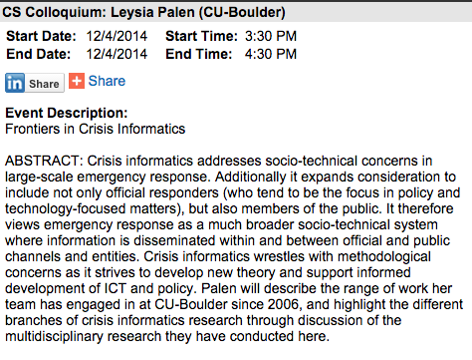

Today, After this class!

Slide 5
Today
Thinking beyond usability
How to incorporate users’ values into design

Slide 6
Background
User-centered design, and especially participatory design methodology, has ties to socialism and union activity (more on Tuesday)
Technology is becoming increasingly personal
Facebook, Snapchat, Google, Glass
More societal thought about systemic effects of technology
Impact on environment, surveillance vs. privacy, etc.

Slide 7
Value Sensitive Design
We have read one early perspective (from Friedman et al.)
In a general sense:
What are users’ “values” beyond usability and usefulness?
Does our design support or hinder these values?
In many ways, this seems obvious in hindsight
Less so historically
A major contribution from Friedman et al. is thinking about how to explicitly (and systematically) include values

Slide 8
Other perspectives on values in design
Mary Flanagan, Daniel C. Howe, and Helen Nissenbaum. 2005. Values at play: design tradeoffs in socially-oriented game design. In Proceedings of CHI '05. ACM, New York, NY, USA, 751-760. http://doi.acm.org/10.1145/1054972.1055076
Christopher A. Le Dantec, Erika Shehan Poole, and Susan P. Wyche. 2009. Values as lived experience: evolving value sensitive design in support of value discovery. In Proceedings of CHI '09. ACM, New York, NY, USA, 1141-1150. http://doi.acm.org/10.1145/1518701.1518875

Slide 9
Key concepts
Direct stakeholders (users) vs. indirect stakeholders
Who is affected by design?
Thinking about systemic effects
How will this technology change people and society
Value tensions or tradeoffs
Security vs. usability, privacy vs. ease of use
Case study: New ReCAPTCHA

Slide 10
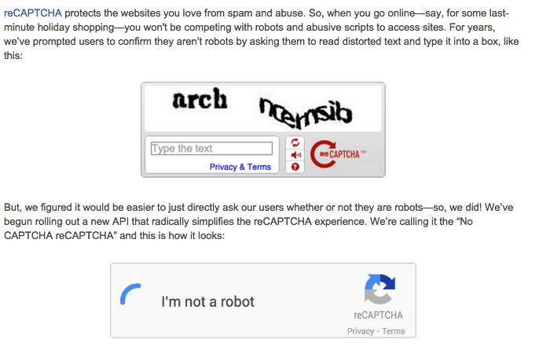
http://googleonlinesecurity.blogspot.com/2014/12/are-you-robot-introducing-no-captcha.html
Discussion: https://news.ycombinator.com/item?id=8693767

Slide 11
Tools to support values in design
Flanagan et al., Values at Play
http://valuesatplay.org/game-tools
Photo elicitation/design probe (LeDantec et al., http://doi.acm.org/10.1145/1518701.1518875)
Envisioning cards (Friedman, Nathan, Kane, Lin)
http://www.envisioningcards.com/
http://shaunkane.info/classes/csci5839/reading/envisioning_cards.pdf

Slide 12
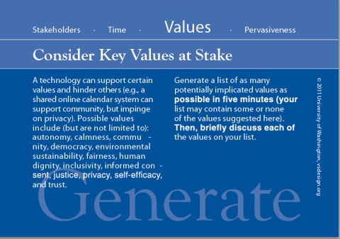
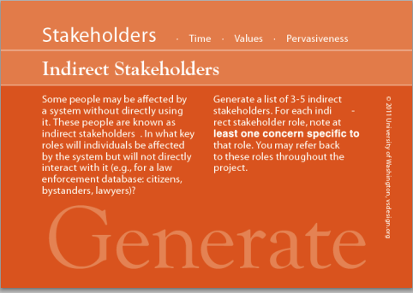

Slide 13
Design as activism
Design has the potential to impact social issues, intentionally or unintentionally
Environmental sustainability, anonymity, cultural change, empowering disempowered groups
FireChat local chat supports activism and protest in Hong Kong: http://www.berkeleytechreview.com/firechat-and-activism/
Facebook presents 56 gender options http://www.slate.com/blogs/lexicon_valley/2014/02/21/gender_facebook_now_has_56_categories_to_choose_from_including_cisgender.html

Slide 14
Activity: values in design
Let’s brainstorm with our groups about value issues in our design
10 minutes:
what human values might be impacted by your design?
who are potential indirect stakeholders in your design?
what feature could you add to your design to support these values?

