Slide 1

End of semester wrap-up
CSCI 5839 Fall 2014
Notes:
Lil Bub http://media3.popsugar-assets.com/files/2013/12/19/123/n/1922507/e0a7e992a737d24f_lilbubtext.jpg.xxxlarge/i/Fireplace-Videos-Loop.jpg

Slide 2
Last class!
Some wrap-up
Robert on UCD history
Project videos and snacks
Note: Shaun will be unavailable most of Thursday/Friday, spotty on weekend
If any issues unresolved, let me know ASAP or ask TAs
Will be available most of next week
ATLAS Expo Thursday – have you heard about it??

Slide 3
Some stats
Students: 30
Piazza contributions: 840
Reading assignments: 27
Other assignments: 19
New humans created: 1

Slide 4
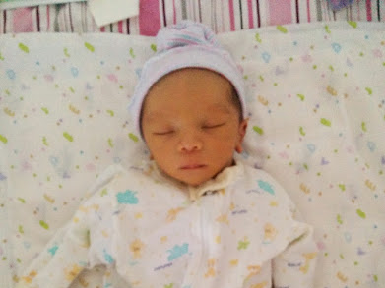

Slide 5
What we covered
Design principles – visual design, interaction design, usability
Design research methods – formative research, interviews/surveys/observation, personas and scenarios
Prototyping methods – brainstorming, sketching, storyboarding, paper prototyping, mid-fidelity prototyping, video prototyping
Evaluation methods – heuristic evaluation, wizard of oz testing, accessibility evaluation

Slide 6
What we did
Experience in completing an iterative user-centered design process
User research
Ideate
Prototype
Evaluate
Done!

Slide 7
Job outlook
From Stacy Branham @UMBC
See http://uxpa.org for more

Slide 8
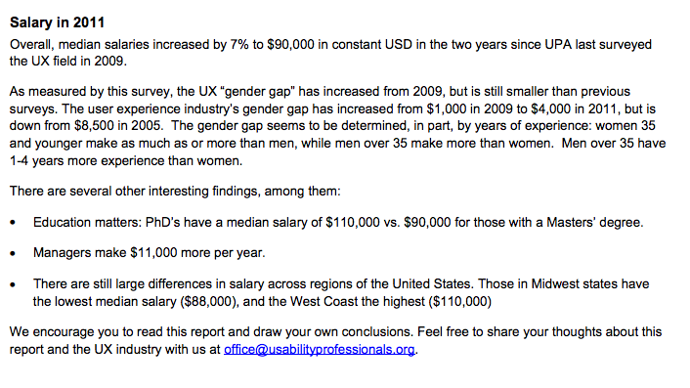
UXPA Report 2011: https://uxpa.org/sites/default/files/2011_UXPA_Salary_Survey_FULL.pdf

Slide 11
Next steps
Practice, practice, practice
Keep sketching!
Find projects to help out with
Consider HCI research
UI prototyping and development skills
Yeh UI development course Spring 2015 (angular.js)
Kane physical computing Spring 2015 (Arduino, 3d printing…)
Research and analysis skills
Experimental design
Statistical analysis
Qualitative research methods

Slide 12
Class feedback
Brief questionnaire on how the class could be improved in the future: http://goo.gl/forms/2QyB8a5vFQ

Slide 13

Notes:
http://www.quickmeme.com/img/c9/c9b138b788d67bbad6b5e4a5aefcc3fcce0e4250c73a7f9a0547449edb54177b.jpg
Students
Gena and david

