Slide 1
Brainstorming
CSCI 3002 Fall 2015
#3

Slide 2
Today
Check-in on course progress
Practicing brainstorming methods
Bootlegging

Slide 3
Course updates
Due next Tuesday: Project brainstorming
OK to start planning project ideas/groups now

Slide 4
Due for Thursday
Personas reading
(due today) Week 1 report

Slide 5
Today
EC: Jobs in UCD
Rules of brainstorming?
Brainstorming techniques
Bootlegging
Yes, and
Utilizing randomness

Slide 6
Jobs in UCD

Slide 7
Prior experiences brainstorming?
Notes:
In creative projects? From the deep dive?

Slide 8
Does brainstorming have rules? Why?

Slide 9
Brainstorming Process
Idea Generation
Idea Evaluation
Notes:
Brainstorming process has 2 stages: idea generation and idea evaluation

Slide 10
Brainstorming example from Stanford d.School
http://www.youtube.com/watch?v=W1h5L_0rFz8

Slide 11
(Some) rules of brainstorming
Capture all the ideas
Encourage wild ideas
Defer judgment
Build off the ideas of others
One conversation at a time (take notes; be visual)
Go for quantity

Slide 12
How not to brainstorm
https://www.youtube.com/watch?v=ttWhK-NO4g8

Slide 13
Brainstorming techniques
25 brainstorming techniques
http://personalexcellence.co/blog/25-brainstorming-techniques/
Examples include
Mind maps
Organize and present ideas in hierarchical tree
Free flow writing
Meditation
Write 101 ideas
But there are many other techniques…

Slide 14
Brainstorming games
Can help us get unstuck, loosen up
Fun way of adding constraints to creativity

Slide 15
Constraints in design
Common sense sometimes suggests that fewer constraints is better
But, more constraints can help ideas flow
Design a refrigerator vs.
Design a refrigerator to fit inside a car
Notes:
Example: Name

Slide 16
Lessons from improv comedy
What can improv teach us about design and brainstorming?

Slide 17
“Yes… and”
In order to keep the skit alive, you must trust your partner, agree with what they said and add something.
Avoid “conversation stoppers” and be sure to “hit the ball back”
Slides adapted from Catharine Robinson’s Refresh Baltimore Talk

Slide 18
Hitting the ball back
Accept whatever circumstances your team gives you
Add something of value to what you got
Help out your partners if they get stuck, but strive to have everyone participate equally
Example: http://www.ehow.com/video_4949232_improv-yes-and-marketing-brainstorm.html

Slide 19
Let’s Try It
A new mobile app for ________
Notes:
Practice conducted storytelling by having them repeat the lines to “I pledge allegiance…

Slide 20

Brainstorming Technique: Bootlegging
Brainstorming “mashups”
Process
Individual generation
Mixing categories
Brainstorming
Final idea
http://dl.acm.org/citation.cfm?id=1795260

Slide 21
Bootlegging Example: Everyday Robots
Categories
Type of robot (e.g. humanoid, wheeled robot, etc.)
Property of robot (e.g. autonomous behavior, collaboration with others, etc.)
Place or situation (e.g. in the kitchen, running, commuting to work, etc.)
User or user group (e.g. grandmothers, musicians, a secret agent, etc.)
Sample Outcomes
Type: Small flying robot
Property: Can perform face recognition
Place/situation: Plate
User: Dancer
Application idea: A flying plate at a discothèque offering drinks when it recognizes the face of customers
Type: Entertainment robot
Property: Wireless communication
Place/situation: Gym
User: Hyperactive kid
Application idea: A personal trainer or playmate for hyper-active children. The robot represents another friend some where else through wireless communication and lets the kids compete remotely

Slide 22
Let’s try bootlegging with wearables
Get in groups of 4, everyone gets 1 card
Write an adjective describing a user
Pass the card to your left
Write a task that could be performed with a wearable
Pass the card to your left
Add a location
Pass the card to your left
As a group: pick your favorite
Pick top 2 examples and flesh them out more – write out a pitch

Slide 23
Other tools
Toolkits for generating ideas
IDEO Method Cards
Oblique Strategies

Slide 24
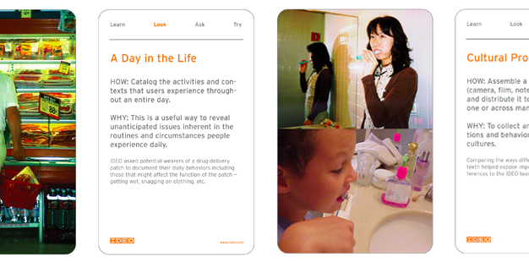
http://www.ideo.com/work/method-cards/

Slide 25
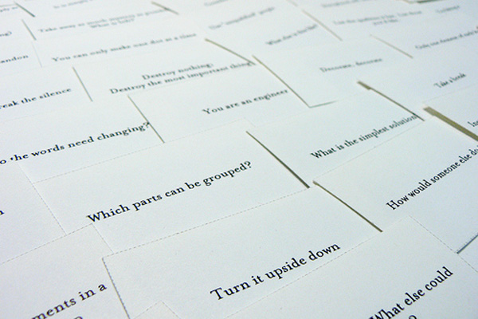
http://en.wikipedia.org/wiki/Oblique_Strategies

Slide 26
Example: Oblique Strategies
Using online generator from http://www.joshharrison.net/oblique-strategies/
Problem: Designing a restaurant search app

Slide 27
Demo

Slide 28
Coming up with project ideas
Semester long project
Interview users, design and test a prototype
4 person teams

Slide 29
Picking a project idea
What factors to consider?
Notes:
Type of app. Device. Where it is used. Who it is used by. Why is it different?

Slide 30
Some important factors
Who are the users?
What devices are they using?
What is the “big idea” of the app?
How does it compare with other similar projects?
Why is this a problem we care about?

Slide 31
How do we find a good problem?
Our users tell us (although they might not know about all solutions)
New technology makes new approaches possible
Combining disparate ideas

Slide 32
Judy Olson’s questions for research
What is the problem?
Who cares? Why should people care about this problem?
What have other people done about it? What is left?
What are YOU going to do about it?
What do you expect to find?
From https://beki70.wordpress.com/2010/09/30/judy-olsons-10-questions-and-some-commentary/

Slide 33
SMART Goals
Specific
Measurable
Achievable
Results focused (or relevant, realistic)
Time-bound
http://www.hr.virginia.edu/uploads/documents/media/Writing_SMART_Goals.pdf

Slide 34
Where promising designs go bad
Too ambitious for the time frame (do one thing well, go from there)
Trying to please too many people (becomes too complex, or too bland; The Homer: https://vimeo.com/121710409)
Avoid facing the hard problems early
Assuming you know what users want (or how users think) – “you are not your user”
Poor teamwork, time management

Slide 35
Brainstorming project ideas
Spend 3 minutes generating project ideas
Discuss them with your neighbor for 5 minutes
Discuss them with your other neighbor for 5 minutes
Share with the class?

