Slide 1
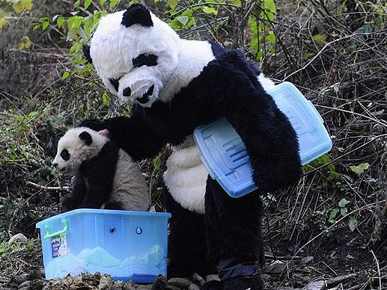
Observation CSCI 5839 Fall 2014 – Shaun Kane
Notes:
http://i.telegraph.co.uk/multimedia/archive/01778/panda620_1778939b.jpg

Slide 2
Today
Update on project pitches
Learning to observe, think about users

Slide 3
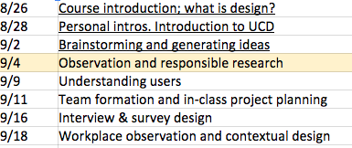
Admin
Coming up: user research methods
2nd week feedback form on web page

Slide 4
Due before next class
Week 2 feedback (optional)
Project pitches
Voting form posted by tomorrow 9am
Vote by the start of Tuesday’s class
Project teams finalized next Thursday
Longer reading (~50pp). Dix et al., “The Human”

Slide 5
Project pitches
Every submitted assignment will get feedback
Subset of projects (most unique and feasible) will be voted on

Slide 6
Sample project pitches
Games using wearable computers
Driving simulator for new CO drivers
Note taking app for students
Camera-based shopping list app

Slide 7
Reflections on coming up with pitches
Did you use any brainstorming techniques?
More difficult than expected? Easier?
Unexpected ideas?

Slide 8
Today’s class
CITI training
Observation
Small introduction to user centered research
Sensitizing ourselves to what to look for

Slide 9
Comments on CITI training?

Slide 10
Comments on CITI training?
Kelvin: "There is a ton involved in the process and I'm sure this is only a fraction of the policies in place for conducting these studies."

Slide 11
Ethical concerns in user research
Data collections – personally identifying information. Exposure.
Intervening with families
Sensitive issues
Physical danger – allergy, things blowing up, fatigue
Psychological damage –
Protected populations: young people
Employment / health
Notes:
Some ideas:
Deception can be considered fundamentally harmful
Privacy is big
Physical fatigue / pain

Slide 12
Observation
Understand what users actually do
Learn “how to see”
Today: informal observation
Later: More formal methods for collecting and coding observational data

Slide 13
Activity
Everyone take out a blank piece of paper
We need 2 brave volunteers.

Slide 14
Instructions
Brave volunteers: Come up with a list of the 3 best taco places in Boulder, and how long it will take us to get there
Everyone else: Take notes on what you see
I’d recommend trying a mind map

Slide 15
What we saw
We’ll make a mind map
https://coggle.it/diagram/5408a87abff9c7e814031190/f7ad5f6c09989519ffb37de9bdebdb9a30f0c587cbe2caa197eebf2b7d254f4e
Notes:
Breakdowns, workarounds

Slide 16
Reflections on the activity

Slide 17
Benefits of observation
Naturally – what people actually do
Vs. retrospective or self report
Real-time
Learning strategies
Free
Lots of information
Low demand on participant
Notes:
Less obtrusive (hopefully)
What people actually do
Inexpensive

Slide 18
Limitations
Possibility of influencing behavior (introduce bias)
Small sample
Observation affects performance
Distractions
Controlled
Task could be a bad fit
Don’t know what they’re thinking
Notes:
We don’t know what people are thinking
Really short

Slide 19
Informal observations
Inductive reasoning – seek out patterns
Typical vs. extreme behavior
Identify “scripts”, routines, procedures
Notes:
Inductive reasoning: from simple

Slide 20
How to observe
Find an unobtrusive place
Take well-structured notes
Be careful not to read too much into what you see
We can triangulate later
Be mindful of personal space and privacy

Slide 21
Further reading
Kawulich, B. B. (2005). Participant observation as a data collection method. In Forum Qualitative Sozialforschung/Forum: Qualitative Social Research (Vol. 6, No. 2).
http://www.qualitative-research.net/index.php/fqs/article/view/466/996

Slide 22
Tips for Collecting Useful Observation Data
be unobtrusive in dress and actions
become familiar with the setting before beginning to collect data
be honest, but not too technical or detailed, in explaining to participants what he/she is doing
pay attention, shifting from a "wide" to a "narrow" angle perspective, focusing on a single person, activity, interaction, then returning to a view of the overall situation
http://www.qualitative-research.net/index.php/fqs/article/view/466/996#g9

Slide 23
Extreme observation
Ethnography – “culture writing”
Ethnomethodology – “methods people use”
Contextual inquiry

Slide 24
Observation assignment (A3)
Work in pairs
Find a public place and conduct an observation
Identify one trend, pattern, etc. and write about it

Slide 25
Activity
Find a partner
Pick a context

Slide 26
Straw Poll: S15 class title
Physical and Tangible Computing
Physical and Quality of Life
Physical Computing for Health
Maker Technology and Healthy Living
Wearable Computing
Making Technology to Support Quality of Life
Wearable Technology for Good

