Slide 1
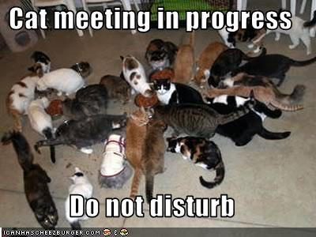
Project Planning CSCI 5839 Fall 2014 – Shaun Kane
Notes:
https://i.chzbgr.com/original/2122081536/BA1AAA00/1

Slide 2
Today
Group assignments

Slide 3
Feedback and inspirations
Great comments and examples on giving good talks
We’ll practice these skills as we proceed through the semester

Slide 4
Project overview
September
Project blog
Research questions
User research
October
Personas, scenarios
Paper prototypes
November
User testing
Refined prototype
Video sketch
December
Final video
Final report

Slide 5
Today: Project match-making
2:10 – 2:25 Project introductions, go over pitch, any changes or ideas?
2:25 – 2:45
List example users and any important characteristics
List tasks that users might perform using your project
List environment and environmental factors
2:45 – 3:00
Work with another group to get feedback on your ideas
3:00-3:15
Start working on T0 assignment

Slide 6
User/tasks/environmental analysis
Users – who are your users? What do you need to know about them?
Tasks – what are the tasks that users will perform? what steps are required to complete each task?
Environment – in what environment does the task take place?

Slide 7
For next time
Type up your notes from this meeting; post on Piazza
Reading on interview methods
Get started on T0 (due Thursday)

