Slide 1
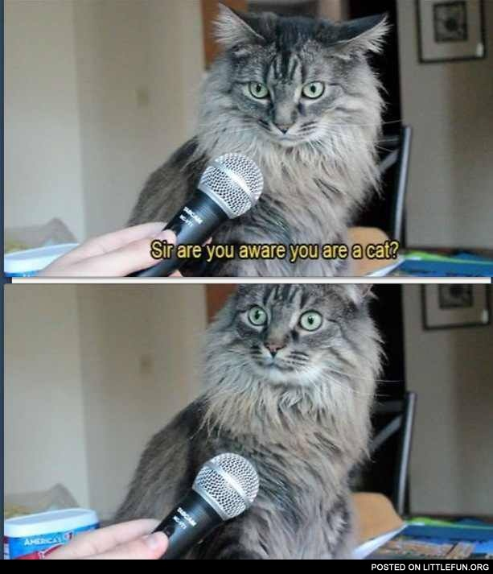
Interviews CSCI 5839 Fall 2014 Shaun Kane
Notes:
https://i.chzbgr.com/original/2122081536/BA1AAA00/1

Slide 2
Today
Designing good survey/interview questions

Slide 3
Comments on reading
Distilled article down into usable points – great!
Testing is key
Consequences of bad question design
People don’t respond

Slide 4

How I spent my weekend
Ubicomp (Ubiquitous Computing) / ISWC (wearable computing) conferences
http://ubicomp.org/ubicomp2014/
Papers available at http://dl.acm.org

Slide 5
Two papers
Wang, Rui, Fanglin Chen, Zhenyu Chen, Tianxing Li, Gabriella Harari, Stefanie Tignor, Xia Zhou, Dror Ben-Zeev, and Andrew T. Campbell. "StudentLife: Assessing Mental Health, Academic Performance and Behavioral Trends of College Students using Smartphones." In Proceedings of the ACM Conference on Ubiquitous Computing. 2014. Nominated for the best paper award (top 5% of all papers)
Mingming Fan, Alexander Travis Adams, and Khai N. Truong. 2014. Public restroom detection on mobile phone via active probing. In Proceedings of the 2014 ACM International Symposium on Wearable Computers (ISWC '14). ACM, New York, NY, USA, 27-34. DOI=10.1145/2634317.2634320 http://doi.acm.org/10.1145/2634317.2634320

Slide 6
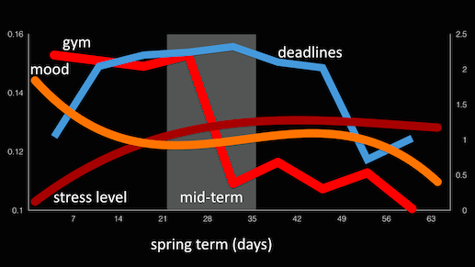
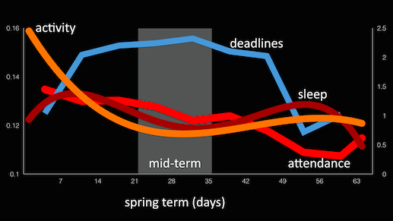
StudentLife
http://studentlife.cs.dartmouth.edu/

Slide 7
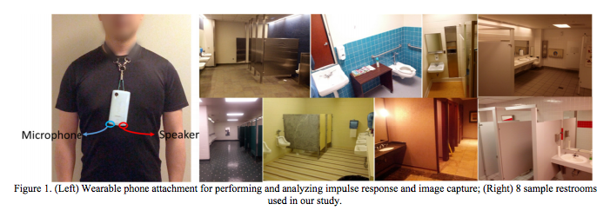
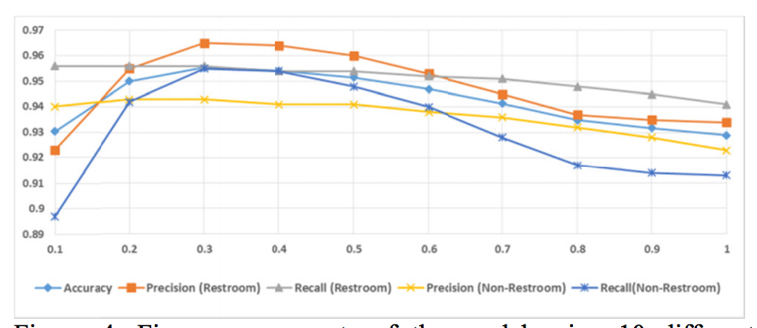
Public Restroom Detection on Mobile Phone via Active Probing
Mingming Fan, Alexander Travis Adams, Khai N. Truong, ISWC ‘14
http://dl.acm.org/citation.cfm?id=2634320

Slide 8
Asking questions
Lots of ways to ask questions
Interviews
Surveys / questionnaires
Focus groups
Polls
Other data gathering techniques (contextual interview, diary study) on Thursday

Slide 9
Designing questions
Be specific
“do you trust your dog?”
Do you trust the dog to guide you across the street?
Yes / no / kinda
Have you ever had a close call crossing the street? “breakdowns”
Avoid double-barreled questions
How old is your husband?
Ask one question at a time!
Avoid leading questions
Do you dislike this feature?
Notes:
Be specific: how long have you worked here? Vs. how many have worked here?
Db: do you like it here or do you find it boring?
Leading: do you agree that washington fatcats have gone too far?

Slide 10
Critical incident technique
“Do you have troubles with your computer?”
vs.
“Describe a time that you had trouble with your computer”

Slide 11
Informant biases
How are our informants biased?
Power dynamic
Limited perspective
Sampling bias / self selection
Upbringing / culture
Agenda / political bias
Squeaky wheel / extreme users / Yelp
Pleasing the researcher
Hawthorne effect
Participants don’t want to look bad / incompetent
Inertia / what people know is good enough
Notes:
Biased to please us
Biased to look good
Different to insiders vs. outsiders
Don’t know prospective behavior

Slide 12
What do people know about themselves?
People know
Specific incidents and how they have responded to them
Things that happened recently
People don’t always know
How regularly they do something
The distant past
What they would do

Slide 13
Interviews vs. self-administered questionnaires
How are they different?
Voice inflection “did you like it?”
Interpretation
Ask more questions
Out of your control?
More flexibility / go off track
Questionnaires more honest
Design our paper forms
Notes:
Should be shorter
What if they misinterpret a question. “what do you like about this application?”
Closed ended questions

Slide 14
Designing closed-ended questions
Designing response scales
“Likert scale” – 5 or 7 point
Other response scales
Important questions: how many points, is there a middle option?
Can statistically analyze these (but consider them ordinal scales; nonparametric analysis)

Slide 15
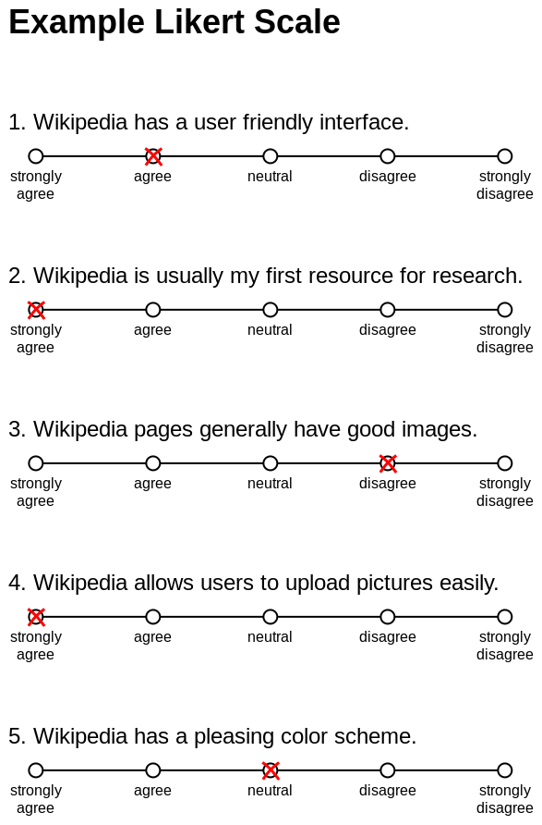
Notes:
http://en.wikipedia.org/wiki/Likert_scale

Slide 16
Most important tip
Think about what questions you want to be able to say in your report
Ask the questions that will give you the answers to these questions
Don’t ask much/anything else

Slide 17
Guidelines: interviews
Pick a comfortable, distraction free location
Allocate enough time (don’t rush)
Listen and don’t talk over informant
Watch your body language

Slide 18
Guidelines: questionnaires
Keep it short (and give feedback)
Few questions
Iterate on questions; keep them concise
Highlight important parts of questions
Did you find the share to snapchat feature useful?
Don’t change the polarity of scales
If 5 is good, don’t make 5 bad
Notes:
No one is thinking about this stuff as much or as carefully as you are

Slide 19
Activity
Work with your project group
Come up with bad questions and fix them
We’ll start with interview questions

Slide 20
Turn it in
Sign + take a picture of your notes
Upload to Piazza (or turn in the paper one and email to peers)

Slide 21
Upcoming deadlines
Thursday
T0: Collaboration plan and blog
In two weeks:
T1: Formative research

