Slide 1
Participatory Design:
a 5-minute intro

Slide 2
Context
PD originated through joint research between British and Scandinavian academics in the 1960s and 70s
Computers were new to the workplace, their impacts seen as potentially dehumanizing to workers – how to counteract this?
Participatory Action Research (PAR) being developed as a method elsewhere in social science

Slide 3
Core Principles
Design is inescapably political – “We encounter the deep questions of design when we recognize that in designing tools we are designing ways of being (Winograd and Flores, 1986).”
Users of technology should play a role in its design
Equal respect for tacit and formal knowledge and mutual learning
Design in context

Slide 4
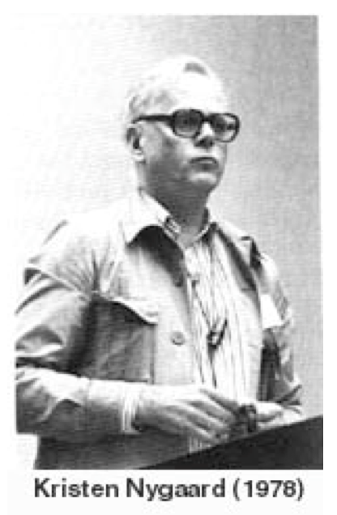
Early Days
Split between British and Scandinavian Traditions and parallel development
Not much interest in North America outside of Xerox PARC, focus instead was on Joint Application Design (JAD) as an alternative to life-cycle design

Slide 5
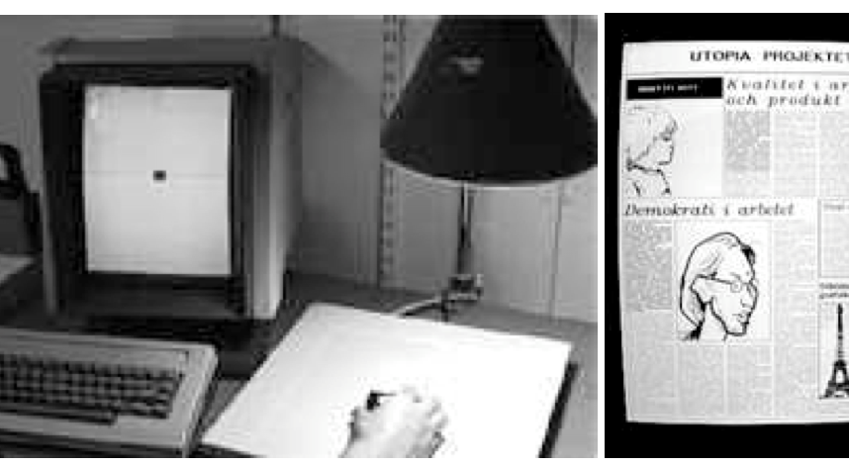
Utopia Project: 1981-1985
Partnership between academic
researchers and the Nordic Graphic
Union - comprised of workers who
made newspaper graphics.
The concrete task was to design
computer workstations to assist in
graphic design
The research goals was to develop
a suite of methods "for involving end
users in all phases of design and
development of IT support for their
Activities.”
Methods included: ethnographic study of workers, low and medium fidelity mockups, pilot tests of systems in real production environments, study tours and other joint learning activities

Slide 6
Results of Utopia
The possibility of involving users in design
A very early example of design in context
Bringing the idea of design to software
Pioneered a set of methods that have been widely adopted in design research

Slide 7

Rise of UCD and Adoption of PD in North America
PD an active area of research in HCI – biannual conference, new handbook released in 2012
User Centered Design coined by Don Norman in the Psychology of Everyday Things, not always in favor of user research
Human-centered design, Design research, other strands of work that incorporate some element of participation.
Often more inspired by technological rationality rather than the overtly political nature of participatory design

