Slide 1

Sizzling SageMaker
QS Cloud Foundation Series

Slide 2

Content
By the end of the training, you should be able to:
Launch a data processing Job
Launch a Training Job
Deploy an Endpoint
Launch a Batch Transform Job

Slide 3
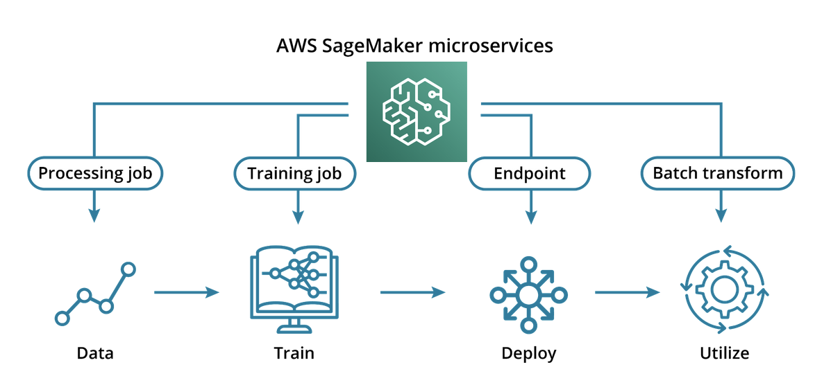
How can AWS help with the model deployment?
Before cloud computing, machine learning engineers(MLE) need to be responsible for the infrastructure concerns:
maintain servers to run our trained algorithms
disk storage for our datasets
AWS manages the infrastructure for us:
Training servers replaced by training jobs, powered by EC2
Inference servers replaced by Endpoints, also powered by EC2
Data storage is replaced by S3
free the MLEs from hardware, OS and networking, less fixed cost

Slide 4
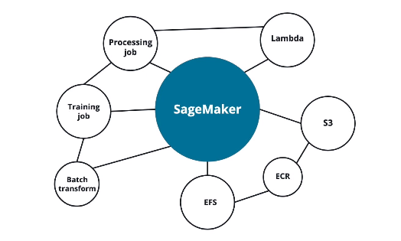
Intuition about SageMaker
SageMaker is a set of interconnected microservices meant to be used in conjunction with one another for general use.
Keep the following principles in mind when working in SageMaker:
Outputs of most services are meant to be inputs to other services
Interfaces are designed to be very similar of each other
Data is encouraged to stay ‘in-house’
Common use-cases are often premade

Slide 5

Training Jobs
A training job includes the following information:
The location of training data to use in S3
Which compute resources to use for model training
The location of the training code in Elastic Container Service(ECS)
The location of where to put job output artifacts in S3
Metadata (Including Version # and Tags)
Ways to Launch a Training Job
AWS Console - For debugging and initial set-up
CLI (Command Line Interface) - For one-off jobs.
AWS SDK (Source Development Kit) - For programmatic access
Notes:
https://docs.aws.amazon.com/sagemaker/latest/dg/xgboost.html

Slide 6

Customised Training
Script mode allows you to create execute a custom script for your training jobs using popular machine learning frameworks like Scikit-learn.
This mode allows you to specify custom libraries, run a custom script, and define a model on your own terms while still providing a stable managed container.
You can also construct a custom image (copies of a computing system) that meets your specification and upload it to Elastic Container Registry(ECR) and invoke that container through SageMaker.

Slide 7

Model Artifacts
The training result will be a model artifact. This model artifact will be stored in S3 and will consist both of a set of trained parameters and a set of instructions for inference.
For trained model outside of AWS to work in the SageMaker environment, you can do so through the CreateModel Application Programming Interface(API). The result of calling this API is also a model artifact.
This model artifact is a required parameter for an endpoint, which is how AWS deploys a model to production.
Notes:
https://docs.aws.amazon.com/sagemaker/latest/APIReference/API_CreateModel.html

Slide 8

Demo
Console
SDK

Slide 9

Endpoints
RESTful API
An interface is a shared methodology through which you can interact with different objects in computing. An API is an interface between a user and a backend of an application. A RESTful API is an API that follows specific architectural boundaries, which is called the REST architectural style.
4 HTTP operations that are supported are:
GET - Used to retrieve resources
PUT - Used to update existing resources
POST - Used to create a new resource
DELETE - Used to delete a resource

Slide 10
Endpoint
In SageMaker, an endpoint is an interface to a model in production. The endpoint allows us to send user data to the model and receives predictions back from the model-based upon that user data.
SageMaker endpoints support the POST definition. Within this POST definition, you can provide a sample that you wish to be processed by your model. The POST request is asking for the ‘creation’ of inference.
The configuration for an endpoint includes:
- A model artifact stored in S3
- A configuration for how data is formatted
- Metadata (Version data/Tags)
- Specified computing resources. (Machine type and # of machines)

Slide 11

Deploying on AWS
Production is a general term used to describe the stage of ML development when your trained model is evaluated against new data. Deployment is the practice of configuring and establishing computing resources to serve your model on a wider scale.
Multi-Availablity Zone (Multi-AZ) Deployment is deploying the same endpoint on different machines that are geographically isolated from each other. This increases the availability of your endpoint.
Autoscaling is the configuration of additional machines to serve your endpoint to meet demand. Enabling autoscaling increases the scalability of your endpoint. This is also sometimes referred to as elasticity.

Slide 12

Inference/Batch Transform
Batch Transform is a compute job that performs inference on a dataset. To invoke Batch Transform, you will need the following:
Input path in S3 to the bucket containing the datasets.
Output path in S3 for the result of the inference.
Description of computing resources
S3 URI of the model artifact.

Slide 13

Demo
Console
SDK

Slide 14

Processing Job
A processing job is a compute job that performs a processing operation on data.
A processor object is required for a compute job. Some managed processor objects, like SKLearnProcessor, are managed containers with preinstalled popular libraries, and ScriptProcessor objects allow you to define your own code from scratch.
The following is required for a processing job:
The S3 URIs of the input and expected local location during the job.
The desired S3 URIs of the output and expected local location during the job.
Entry point, which is the script that's launched, as well as input parameters.
Your desired container. (Implicit with managed processor objects.)
Description of desired compute resources.

Slide 15

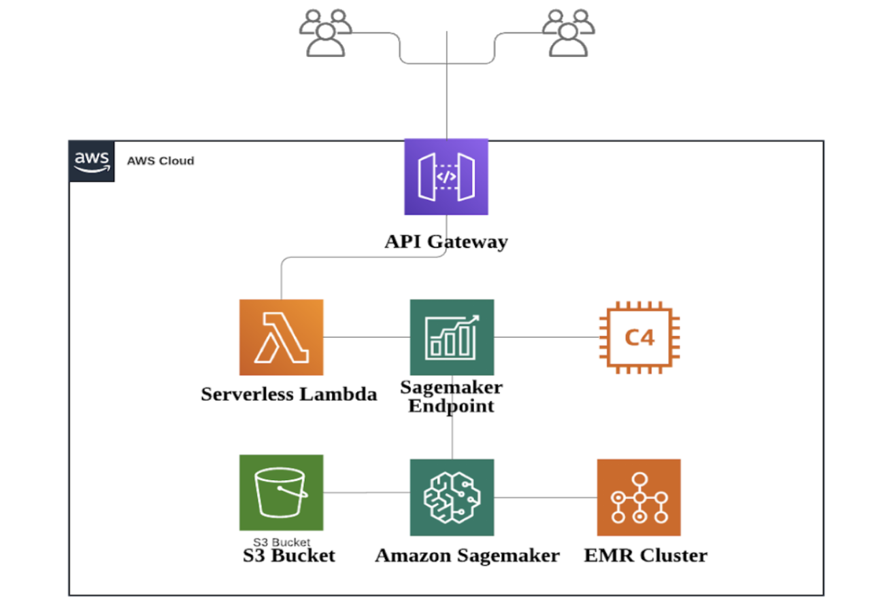
More Complex Case

Slide 16

Moving Beyond Notebook
SageMaker Studio offers some of the MLops Components:
Model Pipeline
Feature Store
Experiment Tracking
Clarify

