Slide 1
Keyword Search over Structured Data
Anyone who has used a computer knows how to use keyword search
  No need to understand logic or query languages
  No need to understand (or have) structure in the data
Database-style queries are more precise, but:
  Are more difficult for users to specify
  Require a schema to query over!
Constructing a mediated, queriable schema is one of the major challenges in getting a data integration system deployed
  Can we use keyword search to help?

Slide 2
The Foundations
Keyword search was studied in the database context before being extended to data integration
We’ll start with these foundations before looking at what is different in the integration context
  How we model a database and the keyword search problem
  How we process keyword searches and efficiently return the top-scoring (top-k) results

Slide 3
Outline
Basic concepts
  Data graph
  Keyword matching and scoring models
Algorithms for ranked results
Keyword search for data integration

Slide 4
The Data Graph
Captures relationships and their strengths, among data and metadata items
Nodes
  Classes, tables, attributes, field values
  May be weighted – representing authoritativeness, quality, correctness, etc.
Edges
  is-a and has-a relationships, foreign keys, hyperlinks, record links, schema alignments, possible joins, …
  May be weighted – representing strength of the connection, probability of match, etc.

Slide 5
Querying the Data Graph
Queries are expressed as sets of keywords
We match keywords to nodes, then seek to find a way to “connect” the matches in a tree
The lowest-cost tree connecting a set of nodes is called a Steiner tree
  Formally, we want the top-k Steiner trees
  … However, this is NP-hard in the size of the graph!

Slide 6
Data Graph Example – Gene Terms, Classifications, Publications
Term
Term2
Ontology
Entry2
Pub
Pubs
Standard
abbrevs
acc
name
...
go
_
id
entry
_
ac
entry
_
ac
...
pub
_
id
pub
_
id
...
title
abbrev
term
pub
publication
GO
:
00059
plasma membrane
...
Entry
entry
_
ac
...
name
Blue nodes represent tables
  Genetic terms, record link to ontology, record link to publications, etc.
Pink nodes represent attributes (columns)
Brown rectangles represent field values
Edges represent foreign keys, membership, etc.

Slide 7
Querying the Data Graph
membrane
title
publication
Term
Term2
Ontology
Entry2
Pub
Pubs
Standard
abbrevs
acc
name
...
go
_
id
entry
_
ac
entry
_
ac
...
pub
_
id
pub
_
id
...
title
abbrev
term
pub
publication
GO
:
00059
plasma membrane
...
Entry
An index to tables,
not part of results
entry
_
ac
...
name
Relational query 1 tree: Term, Term2Ontology, Entry2Pub, Pubs
Relational query 2 tree: Term, Term2Ontology, Entry, Pubs

Slide 8
Trees to Ranked Results
Each query Steiner tree becomes a conjunctive query
  Return matching attributes, keys of matching relations
  Nodes ➔ relation atoms, variables, bound values
  Edges ➔ join predicates, inclusion, etc.
  Keyword matches to value nodes ➔ selection predicates
Query tree 1 becomes:
    q1(A,P,T) :- Term(A, “plasma membrane”), Term2Ontology(A, E), Entry2Pub(E, P), Pubs(P, T)
Computing and executing this query yields results
  Assign a score to each, based on the weights in the query and similarity scores from approximate joins or matches

Slide 9
Where Do Weights Come from?
Node weights:
  Expert scores
  PageRank and other authoritativeness scores
  Data quality metrics
Edge weights:
  String similarity metrics (edit distance, TF*IDF, etc.)
  Schema matching scores
  Probabilistic matches
In some systems the weights are all learned

Slide 10
Scoring Query Results
The next issue: how to compose the scores in a query tree
  Weights are treated as costs or dissimilarities
  We want the k lowest-cost
Two common scoring models exist:
  Sum the edge weights in the query tree
    The tree may have a required root (in some models), or not
    If there are node weights, move onto extra edges – see text
  Sum the costs of root-to-leaf edge costs
    This is for trees with required roots
    There may be multiple overlapping root → leaf paths
    Certain edges get double-counted, but they are independent

Slide 11
Outline
Basic concepts
Algorithms for ranked results
Keyword search for data integration

Slide 12
Top-k Answers
The challenge – efficiently computing the top-k scoring answers, at scale
Two general classes of algorithms
  Graph expansion -- score is based on edge weights
    Model data + schema as a single graph
    Use a heuristic search strategy to explore from keyword matches to find trees
  Threshold-based merging – score is a function of field values
    Given a scoring function that depends on multiple attributes, how do we merge the results?
Often combinations of the two are used

Slide 13
Graph Expansion
membrane
title
Term
Term2
Ontology
Entry2
Pub
Pubs
acc
name
...
go
_
id
entry
_
ac
entry
_
ac
...
pub
_
id
pub
_
id
...
title
GO
:
00059
plasma membrane
...
Basic process:
Use an inverted index to find matches between keywords and graph nodes
Iteratively search from the matches until we find trees

Slide 14
What Is the Expansion Process?
Assumptions here:
  Query result will be a rooted tree -- root is based on direction of foreign keys
  Scoring model is sum of edge weights (see text for other cases)
Two main heuristics:
  Backwards expansion
    Create a “cluster” for each leaf node
    Expand by following foreign keys backwards: lowest-cost-first
    Repeat until clusters intersect
  Bidirectional expansion
    Also have a “cluster” for the root node
    Expand clusters in prioritized way

Slide 15
Querying the Data Graph
membrane
title
publication
Term
Term2
Ontology
Entry2
Pub
Pubs
Standard
abbrevs
acc
name
...
go
_
id
entry
_
ac
entry
_
ac
...
pub
_
id
pub
_
id
...
title
abbrev
term
pub
publication
GO
:
00059
plasma membrane
...
Entry
entry
_
ac
...
name

Slide 16
Graph vs. Attribute-Based Scores
The previous strategy focuses on finding different subgraphs to identify the tuples to return
  Assumes the costs are defined from edge weights
  Uses prioritized exploration to find connections
But part of the score may be defined in terms of the values of specific attributes in the query
  score = … + weight₁ * T₁.attrib₁ + weight₂ * T₂.attrib₂ + …
Assume we have an index of “partial tuples” by sort order of the attributes
  … and a way of computing the remaining results – e.g., by joining the partial tuples with others

Slide 17
Threshold-based Merging with Random Access
k best ranked results
Threshold-based Merge
cost = t(x₁,x₂,x₃,…, x_{m})
L₁: Index
on x₁
L₂: Index
on x₂
…
L_{m}: Index
on x_{m}
Given multiple sorted indices L₁, …, L_{m} over the same “stream of tuples” try to return the k best-cost tuples with the fewest I/Os
  Assume cost function t(x₁,x₂,x₃,…, x_{m}) is monotone, i.e.,
  t(x₁,x₂,x₃,…, x_{m}) ≤ t(x₁’,x₂’, x₃’, …, x_{m}’)
  whenever x_{i}’≤ x_{i}’ for every i
  Assume we can retrieve/compute tuples with each x_{i}

Slide 18
The Basic Thresholding Algorithm with Random Access (Sketch)
In parallel, read each of the indices L_{i}
  For each x_{i} retrieved from L_{i} retrieve the tuple R
    Obtain the full set of tuples R containing R
      this may involve computing a join query with R
    Compute the score t(R’) for each tuple R’ ∈ R
    If t(R’) is one of the k-best scores, remember R’ and t(R’)
      break ties arbitrarily
  For each index L_{i} let x_{i} be the lowest value of x_{i} read from the index
    Set a threshold value τ = t(x₁, x₂, …, x_{m})
  Once we have seen k objects whose score is at least equal to τ, halt and return the k highest-scoring tuples that have been remembered

Slide 19
An Example: Tables & Indices
Full data:
name | location | rating | price
Alma de Cuba | 1523 Walnut St. | 4 | 3
Moshulu | 401 S. Columbus bldv. | 4 | 4
Sotto Varalli | 231 S. Broad St. | 3.5. | 3
Mcgillin’s | 1310 Drury St. | 4 | 2
Di Nardo’s Seafood | 312 Race st. | 3 | 2
L_{rating}: Index by ratings
L_{price:} Index by (5 - price)
rating | name
4 | Alma de Cuba
4 | Moshulu
4 | Mcgillin’s
3.5 | Sotto Varalli
3 | Di Nardo’s Seafood
(5-price) | name
3 | McGillin’s
3 | Di Nardo’s Seafood
2 | Alma de Cuba
2 | Sotto Varalli
1 | Moshulu

Slide 20
Reading and Merging Results
Cost formula: t(rating,price) = rating * 0.5 + (5 - price) * 0.5
L_{ratings}
L_{price}
rating | name
4 | Alma de Cuba
4 | Moshulu
4 | Mcgillin’s
3.5 | Sotto Varalli
3 | Di Nardo’s Seafood
(5-price) | name
3 | McGillin’s
3 | Di Nardo’s Seafood
2 | Alma de Cuba
2 | Sotto Varalli
1 | Moshulu
t_{alma} = 0.5*4 + 0.5*2 = 3
t_{mcgillins} = 0.5*4 + 0.5*3 = 3.5
τ = 0.5*4 + 0.5*3 = 3.5
no tuples above τ!

Slide 21
Reading and Merging Results
Cost formula: t(rating,price) = rating * 0.5 + (5 - price) * 0.5
L_{ratings}
L_{price}
rating | name
4 | Alma de Cuba
4 | Moshulu
4 | Mcgillin’s
3.5 | Sotto Varalli
3 | Di Nardo’s Seafood
(5-price) | name
3 | McGillin’s
3 | Di Nardo’s Seafood
2 | Alma de Cuba
2 | Sotto Varalli
1 | Moshulu
t_{alma} = 0.5*4 + 0.5*2 = 3
t_{mcgillins} = 0.5*4 + 0.5*3 = 3.5
t_{moshulu} = 0.5*4 + 0.5*1 = 2.5
t_{dinardo’s} = 0.5*3 + 0.5*3 = 2.5
τ = 0.5*4 + 0.5*3 = 3.5
no tuples above τ!

Slide 22
Reading and Merging Results
Cost formula: t(rating,price) = rating * 0.5 + (5 - price) * 0.5
L_{ratings}
L_{price}
rating | name
4 | Alma de Cuba
4 | Moshulu
4 | Mcgillin’s
3.5 | Sotto Varalli
3 | Di Nardo’s Seafood
(5-price) | name
3 | McGillin’s
3 | Di Nardo’s Seafood
2 | Alma de Cuba
2 | Sotto Varalli
1 | Moshulu
t_{alma} = 0.5*4 + 0.5*2 = 3
t_{mcgillins} = 0.5*4 + 0.5*3 = 3.5
t_{moshulu} = 0.5*4 + 0.5*1 = 2.5
t_{dinardo’s} = 0.5*3 + 0.5*3 = 2.5
these have already been read!

Slide 23
Reading and Merging Results
Cost formula: t(rating,price) = rating * 0.5 + (5 - price) * 0.5
L_{ratings}
L_{price}
rating | name
4 | Alma de Cuba
4 | Moshulu
4 | Mcgillin’s
3.5 | Sotto Varalli
3 | Di Nardo’s Seafood
(5-price) | name
3 | McGillin’s
3 | Di Nardo’s Seafood
2 | Alma de Cuba
2 | Sotto Varalli
1 | Moshulu
t_{alma} = 0.5*4 + 0.5*2 = 3
t_{mcgillins} = 0.5*4 + 0.5*3 = 3.5
t_{moshulu} = 0.5*4 + 0.5*1 = 2.5
t_{dinardo’s} = 0.5*3 + 0.5*3 = 2.5
t_{sotto} = 0.5*3.5 + 0.5*2 = 2.75
τ = 0.5*3.5 + 0.5*2 = 2.75

Slide 24
Reading and Merging Results
Cost formula: t(rating,price) = rating * 0.5 + (5 - price) * 0.5
L_{ratings}
L_{price}
rating | name
4 | Alma de Cuba
4 | Moshulu
4 | Mcgillin’s
3.5 | Sotto Varalli
3 | Di Nardo’s Seafood
(5-price) | name
3 | McGillin’s
3 | Di Nardo’s Seafood
2 | Alma de Cuba
2 | Sotto Varalli
1 | Moshulu
t_{alma} = 0.5*4 + 0.5*2 = 3
t_{mcgillins} = 0.5*4 + 0.5*3 = 3.5
t_{moshulu} = 0.5*4 + 0.5*1 = 2.5
t_{dinardo’s} = 0.5*3 + 0.5*3 = 2.5
t_{sotto} = 0.5*3.5 + 0.5*2 = 2.75
τ = 0.5*3.5 + 0.5*2 = 2.75
3 are above threshold

Slide 25
Summary of Top-k Algorithms
Algorithms for producing top-k results seek to minimize the amount of computation and I/O
  Graph-based methods start with leaf and root nodes, do a prioritized search
  Threshold-based algorithms seek to minimize the amount of full computation that needs to happen
    Require a way of accessing subresults by each score component, in decreasing order of the score component
These are the main building blocks to keyword search over databases, and sometimes used in combination

Slide 26
Outline
Basic concepts
Algorithms for ranked results
Keyword search for data integration

Slide 27
Extending Keyword Search from
Databases to Data Integration
Integration poses several new challenges:
  Data is distributed
    This requires techniques such as those from Chapter 8 and from earlier in this section
  We cannot assume the edges in the data graph are already known and encoded as foreign keys, etc.
    In the integration setting we may need to automatically infer them, using schema matching (Chapter 5) and record linking (Chapter 4)
  Relations from different sources may represent different viewpoints and may not be mutually consistent
    Query answers should reflect the user’s assessment of the sources
    We may need to use learning on this
 
 ➔
 ➔

Slide 28
Scalable Automatic Edge Inference
In a scalable way, we may need to:
  Discover data values that might be useful to join
    Can look at value overlap
    An “embarassingly parallel” task – easily computable on a cluster
  Discover semantically compatible relationships
    Essentially a schema matching problem
  Combine evidence from the above two
    Roughly the same problem as within a modern schema matching tool
Use standard techniques from Chapters 4-5, but consider interactions with the query cost model and the learning model

Slide 29
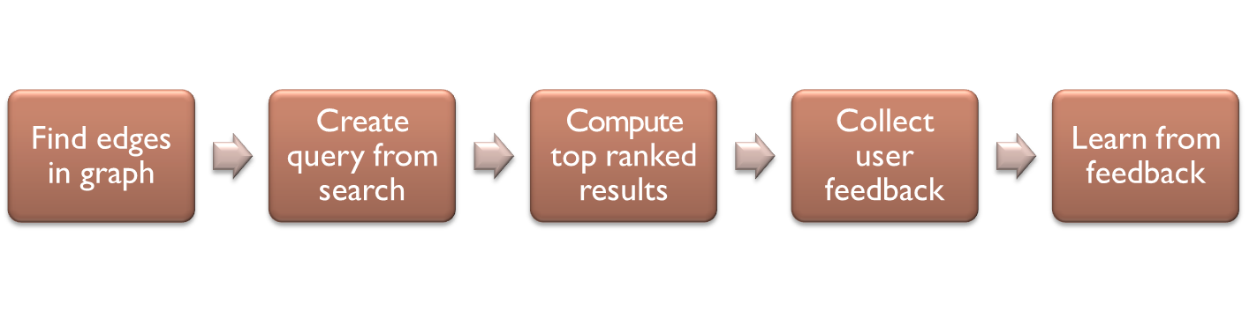
Learning to Adjust Weights
We may want to learn which sources are most relevant, which edges in the graph are valid or invalid
Basic idea: introduce a loop:

Slide 30
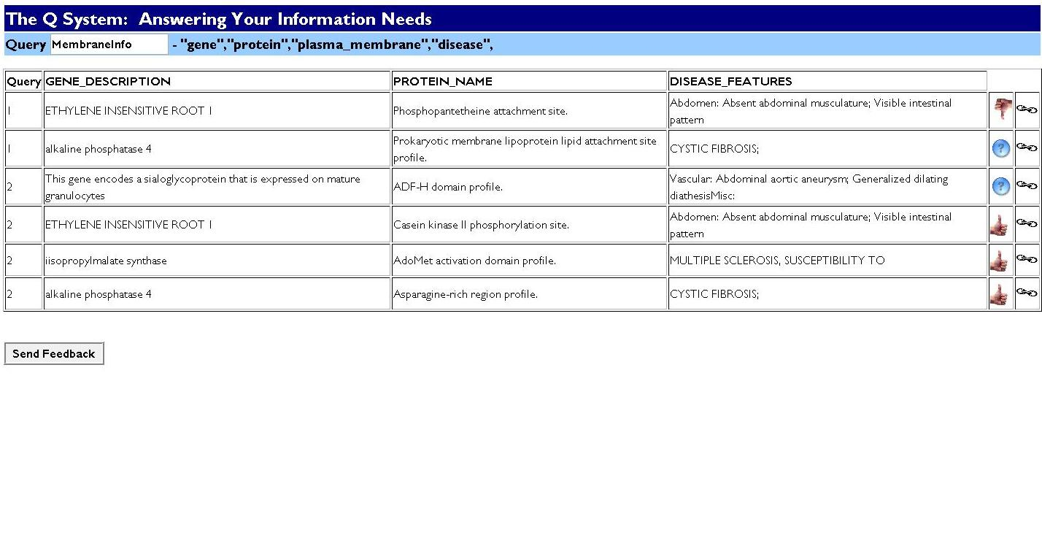
Example Query Results & User Feedback

Slide 31
How Do We Learn about Edge and Node Weights from Feedback on Data?
We need data provenance (Chapter 14) to “explain” the relationship between each output tuple and the queries that generated it
The score components (e.g., schema matcher values) need to be represented as features for a machine learning algorithm
We need an online learning algorithm that can take the feedback and adjust weights
  Typically based on perceptrons or support vector machines

Slide 32
Keyword Search Wrap-up
Keyword search represents an interesting point between Web search and conventional data integration
  Can pose queries with little or no administrator work (mediated schemas, mappings, etc.)
  Trade-offs: ranked results only, results may have heterogeneous schemas, quality will be more variable
Based on a model and techniques used for keyword search in databases
But needs support for automatic inference of edges, plus learning of where mistakes were made!

