Slide 1

Formatted Input, Output & File Input, Output

Slide 2
Formatting Output
Can control how output displays for numeric, string data:
  size
  position
  number of digits
Used to control how an output field is displayed
Requires iomanip header file

Slide 3
Formatting Output: setw
Used to ouput the value of an expression in a specific number of columns.
setw(x): outputs the value of the next expression in x columns.
The output is right-justified:
  For example: if you specify the number of columns to be 8 and the output requires only 4 columns, then the first four columns are left blank.
If the number of columns specified is less than the number of columns required by the output, the output automatically expands to the required number of columns.

Slide 4
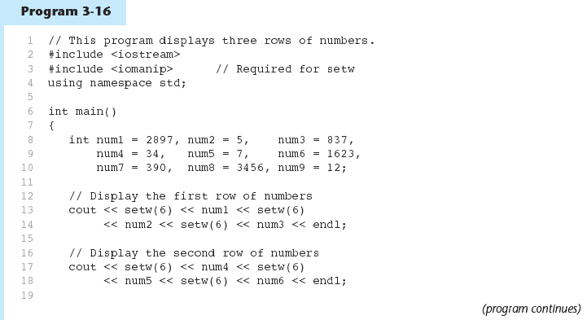
Example

Slide 5
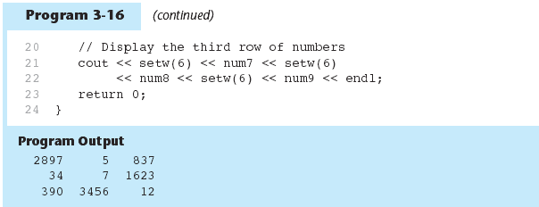

Slide 6
left manipulators
#include <iostream>
#include <iomanip>
using namespace std;
int main()
{ int x=15;
int y = 7634;
cout<<left;
cout<<setw(5)<<x<<setw(7)<<y<<setw(8)<<"Warm“
<<endl;
cout<<right;
cout<<setw(5)<<x<<setw(7)<<y<<setw(8)<<"Warm“
<<endl;
system("PAUSE"); return 0;}

Slide 7
Floating point number output formatting
fixed:
  use to output floating point numbers in a fixed decimal format.
  cout<<fixed;

Slide 8
Example
#include <iostream>
#include <iomanip>
using namespace std;
int main()
{ double x=15.674;
double y = 235.73;
double z = 9525.9874;
cout<<fixed;
cout<<x<<endl<<y<<endl<<z<<endl;
system("PAUSE");
return 0;
}
The Output:
15.674000
235.730000
9525.987400

Slide 9
showpoint Manipulator
To force the output to show the decimal point and trailing zeros.
#include <iostream>
#include <iomanip>
using namespace std;
int main()
{ double x=15.674;
double y = 235.73;
double z = 9525.9874;
cout<<showpoint;
cout<<x<<endl<<y<<endl<<z<<endl;
system("PAUSE"); return 0;}
The output:
15.6740
235.730
9525.99

Slide 10
Example 2
#include <iostream>
#include <iomanip>
using namespace std;
int main()
{ double x=15.674;
double y = 235.73;
double z = 9525.9874;
cout<<fixed<<showpoint;
cout<<x<<endl<<y<<endl<<z<<endl;
system("PAUSE");
return 0;
}
The output:
15.674000
235.730000
9525.987400

Slide 11
setprecision Manipulator
To control the output of floating-point numbers.
when used with fixed, print floating-point value using x digits after the decimal. Without fixed, print floating-point value using scientific notation.
General syntax:
  setprecision(n)
  Where n: the number of decimal places.
Example:
  To set the output of decimal numbers to 2 decimal places: cout<<setprecision(2);

Slide 12
Example
#include <iostream>
#include <iomanip>
using namespace std;
int main()
{ double x=15.674;
double y = 235.73;
double z = 9525.9874;
cout<<fixed<<showpoint;
cout<<setprecision(2);
cout<<x<<endl<<y<<endl<<z<<endl;
system("PAUSE");
return 0;
}
The output:
15.67
235.73
9525.99

Slide 13
Example 2
#include <iostream>
#include <iomanip>
using namespace std;
int main()
{ double x=15.674;
double y = 235.73;
double z = 9525.9874;
cout<<setprecision(2);
cout<<x<<endl<<y<<endl<<z<<endl;
system("PAUSE");
return 0;
}
The output:
16
2.4e+002
9.5e+003

Slide 14
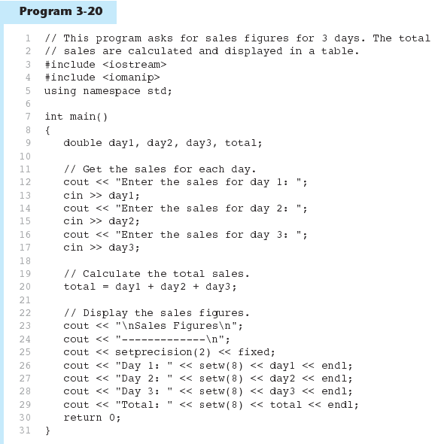

Slide 15
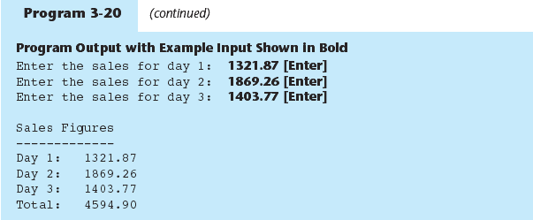

Slide 16
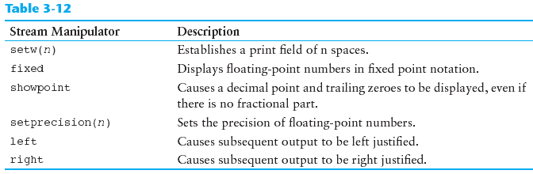
Stream Manipulators

Slide 17
In-Class Exercise
Do Lab 6, Exercise 2, No. 3 (pg. 76)
Do Lab 6, Exercise 2, No. 4 (pg. 77)
Do Lab 6, Exercise 3, No. 3 (pg. 80)

Slide 18
Formatted Input
Can format field width for use with cin
Useful when reading string data to be stored in a character array:
const int SIZE = 10;
  char firstName[SIZE];
  cout << "Enter your name: ";
  cin >> setw(SIZE) >> firstName;
cin reads one less character than specified with the setw() manipulator

Slide 19
#include <iostream>
#include <iomanip>
using namespace std;
int main()
{ const int SIZE = 10;
char firstName[SIZE];
cout << "Enter your name: ";
cin >> setw(SIZE) >> firstName;
cout<<firstName<<endl;
system("PAUSE");
return 0;
}
The output:
Enter your name: abcdefghij
abcdefghi
The output:
Enter your name: abc def
abc

Slide 20
#include <iostream>
#include <iomanip>
using namespace std;
int main()
{ string name;
cout << "Enter your name: ";
cin >> name;
cout<<name<<endl;
system("PAUSE");
return 0;
}
The output:
Enter your name: abc def
abc

Slide 21
Formatted Input
To read an entire line of input, use cin.getline();
  const int SIZE = 81;
  char address[SIZE];
  cout << "Enter your address: ";
  cin.getline(address, SIZE);
cin.getline takes two arguments:
  Name of array to store string
  Size of the array

Slide 22
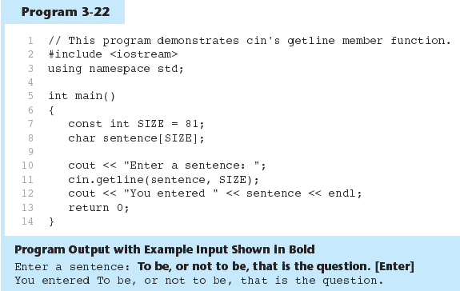

Slide 23
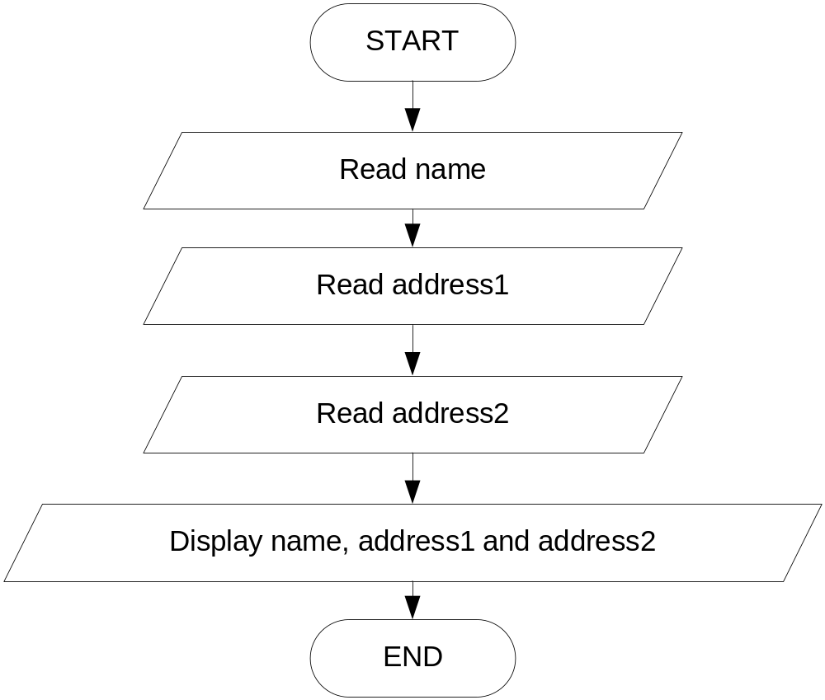
In-Class Exercise
Write C++ program to solve the flow chart.

Slide 24
Formatted Input
To read a single character:
  Use cin:
    char ch;
    cout << "Strike any key to continue";
    cin >> ch;
    Problem: will skip over blanks, tabs, <CR>
  Use cin.get():
    cin.get(ch);
    Will read the next character entered, even whitespace

Slide 25
In-Class Exercise
Refer to Lab 6, Exercise 2 No. 1 in pg. 74.
What will be displayed if the following characters are entered in Program 6.2 & 6.3? Explain the program output with the following input.
AV
TY

Slide 26
Formatted Input
Mixing cin >> and cin.get() in the same program can cause input errors that are hard to detect
To skip over unneeded characters that are still in the keyboard buffer, use cin.ignore():
  cin.ignore(); // skip next char
  cin.ignore(10, '\n'); // skip the next
  // 10 char. or until a '\n'

Slide 27
Hand Tracing a Program
Hand trace a program: act as if you are the computer, executing a program:
  step through and ‘execute’ each statement, one-by-one
  record the contents of variables after statement execution, using a hand trace chart (table)
Useful to locate logic or mathematical errors

Slide 28
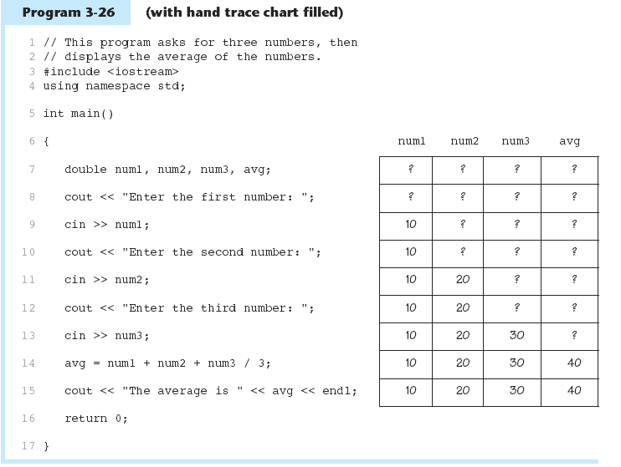

Slide 29
In-Class Exercise
Trace the following programs
void main(){ //Prog 6_41
int x, y, z;
x =10; y = 17;
z = x + y;
y = y - x;
cout<<"x: "<<x<< " y: “
<<y<<" z: "<<z;
x = y * z;
z = x / 20;
y = z % x;
cout<<"\nx: "<<x<< " y: “
<<y<<" z: "<<z;
}
void main(){//Prog 6_42
int n, m, x, y;
m=10;
n=m*2/(m+2);
m%=n+2;
cout <<"n: "<<n;
cout <<"\nm: "<<m;
x=4;
y=x*2+10%3-1*x;
x*=(y/m);
cout<<"\nx: "<< x;
cout<<"\ny: "<<y;
}

Slide 30
Introduction to File Input and Output
Can use files instead of keyboard, monitor screen for program input, output
Allows data to be retained between program runs
Steps:
  Open the file
  Use the file (read from, write to, or both)
  Close the file

Slide 31
Files: What is Needed
Use fstream header file for file access
File stream types:
  ifstream for input from a file
  ofstream for output to a file
  fstream for input from or output to a file
Define file stream objects:
  ifstream infile;
  ofstream outfile;

Slide 32
Opening Files
Create a link between file name (outside the program) and file stream object (inside the program)
Use the open member function:
  infile.open("inventory.dat");
  outfile.open("report.txt");
Filename may include drive, path info.
Output file will be created if necessary; existing file will be erased first
Input file must exist for open to work

Slide 33
Using Files
Can use output file object and << to send data to a file:
  outfile << "Inventory report";
Can use input file object and >> to copy data from file to variables:
  infile >> partNum;
  infile >> qtyInStock >> qtyOnOrder;

Slide 34
Closing Files
Use the close member function:
  infile.close();
  outfile.close();
Don’t wait for operating system to close files at program end:
  may be limit on number of open files
  may be buffered output data waiting to send to file

Slide 35
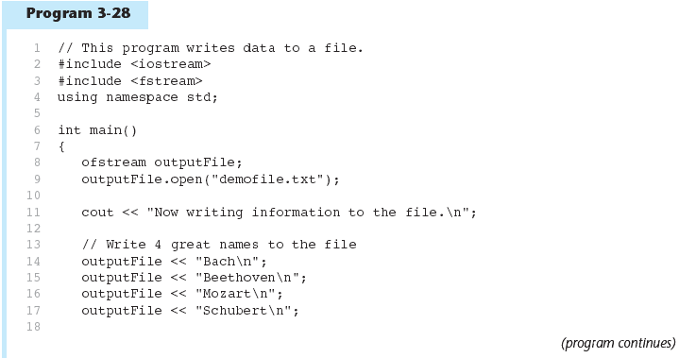

Slide 36
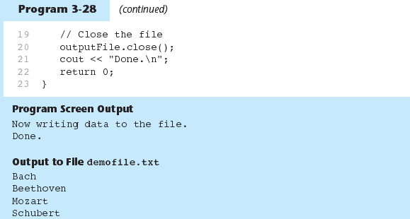

Slide 37
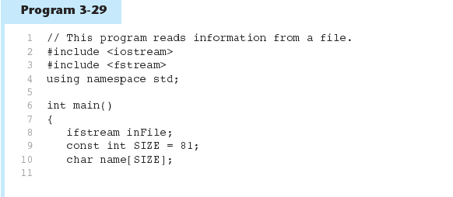
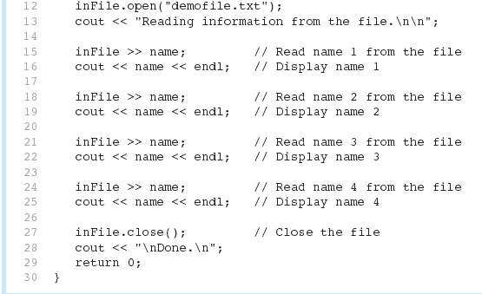

Slide 38
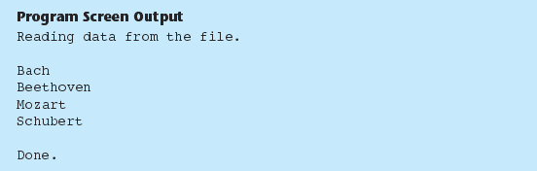

Slide 39
In-Class Exercise
Do Lab 6, Exercise 2 No. 2 (i-iv) in pg. 75-76.

