Slide 1

Arithmetic Expressions

Slide 2
The cin Object
Standard input object
Like cout, requires iostream file
Used to read input from keyboard
Information retrieved from cin with >>
Input is stored in one or more variables

Slide 3
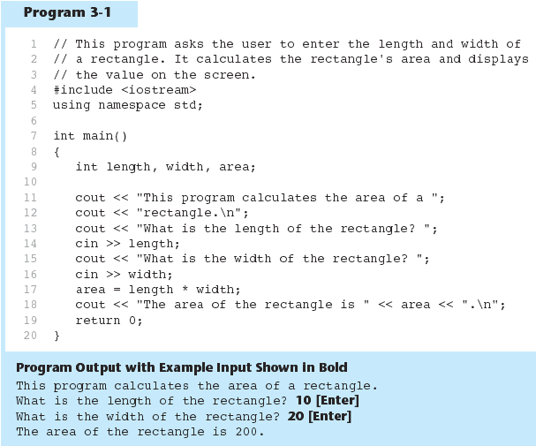

Slide 4
The cin Object
cin converts data to the type that matches the variable:
  int height;
  cout << "How tall is the room? ";
  cin >> height;

Slide 5
Displaying a Prompt
A prompt is a message that instructs the user to enter data.
You should always use cout to display a prompt before each cin statement.
cout << "How tall is the room? ";
cin >> height;

Slide 6
The cin Object
Can be used to input more than one value:
  cin >> height >> width;
Multiple values from keyboard must be separated by spaces
Order is important: first value entered goes to first variable, etc.

Slide 7
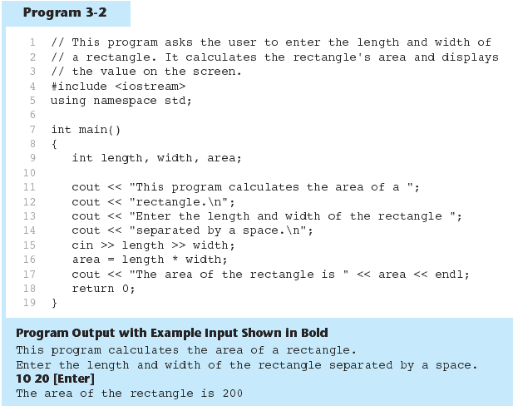

Slide 8
Reading Strings with cin
Can be used to read in a string
Must first declare an array to hold characters in string:
  char myName[21];
myName is a name of an array, 21 is the number of characters that can be stored (the size of the array), including the NULL character at the end
Can be used with cin to assign a value:
  cin >> myName;

Slide 9
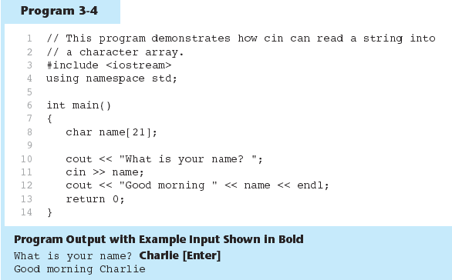

Slide 10
In-Class Exercise
Refer to Lab 6, Exercise 3 No. 1 (pg. 79).
Solve the problem.
Add array of characters to the output.
Sample of output:
Enter an integer: 7
Enter a decimal number : 2.25
Enter a single character : R
Enter an array of characters: Programming

Slide 11
Mathematical Expressions
Can create complex expressions using multiple mathematical operators
An expression can be a literal, a variable, or a mathematical combination of constants and variables
Can be used in assignment, cout, other statements:
  area = 2 * PI * radius;
  cout << "border is: " << 2*(l+w);

Slide 12
Order of Operations
In an expression with more than one operator, evaluation is in this order:
()
  - (unary negation), in order, left to right
  * / %, in order, left to right
  + -, in order, left to right
In the expression 2 + 2 * 2 – 2
evaluate
first
evaluate
third
evaluate
second

Slide 13
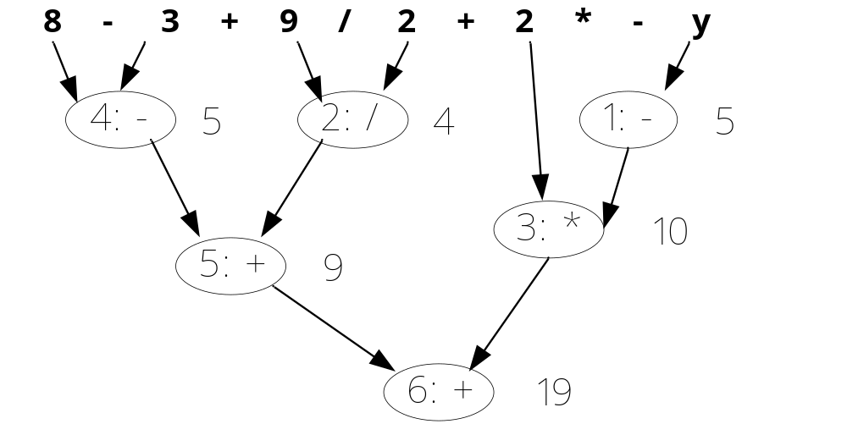
Example
int z, y=-5;
z= 8 - 3 + 9 / 2 + 2 * - y;
z= 8 - (3 + 9 / 2) + 2 * - y;// try this

Slide 14
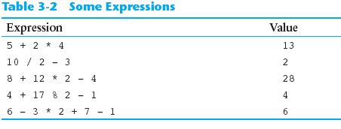
Order of Operations
Show prove for the following expression

Slide 15
Associativity of Operators
- (unary negation) associates right to left
*, /, %, +, - associate left to right
parentheses ( ) can be used to override the order of operations:
  2 + 2 * 2 – 2 = 4
  (2 + 2) * 2 – 2 = 6
  2 + 2 * (2 – 2) = 2
  (2 + 2) * (2 – 2) = 0

Slide 16
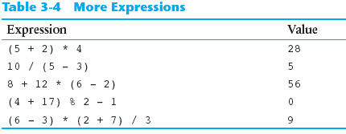
Grouping with Parentheses

Slide 17
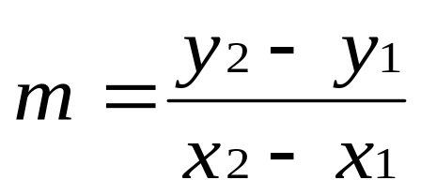
Algebraic Expressions
Multiplication requires an operator:
  Area=lw is written as Area = l * w;
There is no exponentiation operator:
  Area=s² is written as Area = pow(s, 2);
Parentheses may be needed to maintain order of operations:
  is written as
  m = (y2-y1) /(x2-x1);

Slide 18
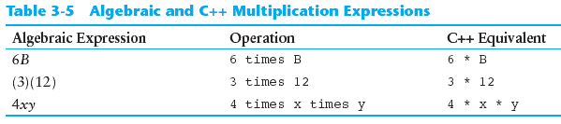
Algebraic Expressions

Slide 19
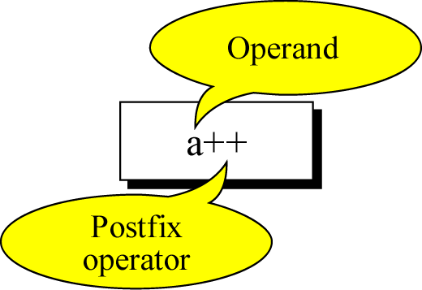
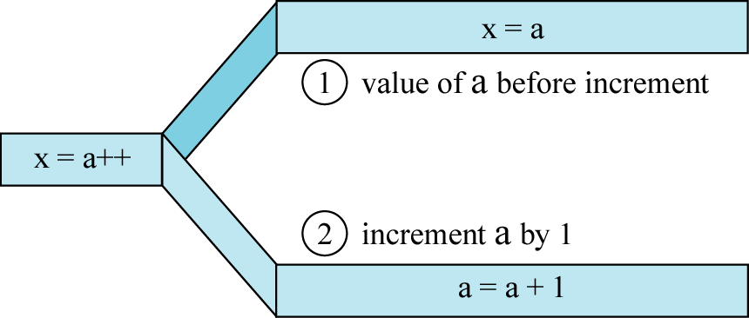
Postfix expression

Slide 20
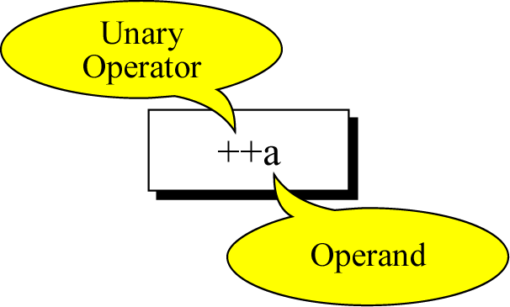
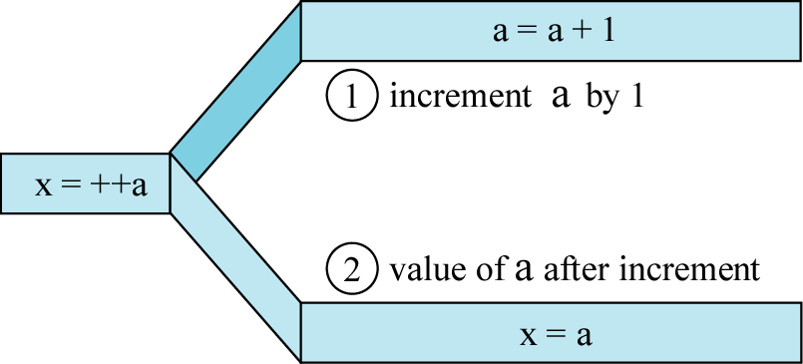
Prefix expression

Slide 21
In-Class Exercise
What would be the value of nilai_kedua:
  int kira = 5;
  int nilai_pertama = 10, nilai_kedua;
  nilai_kedua= 5* kira-- + nilai_pertama;
  nilai_kedua = 5* --kira +nilai+pertama;

Slide 22
Mathematical function library
Required header: #include <math.h>
Refer to “predefinefunction” notes in your elearning.
Example:
  #include <iostream>
  #include <math.h>
  using namespace std;
  int main()
  { int x;
  cin>>x;
  cout<<pow(x,2);
  system("PAUSE");
  return 0;
  }

Slide 23
In-class Exercise
Do Lab 5, Exercise 1, No. 5 (pg. 59)
Do Lab 5, Exercise 1, No. 6 (pg. 60)
Do Lab 5, Exercise 1, No. 7 (pg. 60)
Do Lab 5, Exercise 2, No. 2 (pg. 63)

Slide 24
When You Mix Apples and Oranges: Type Conversion
Operations are performed between operands of the same type.
If not of the same type, C++ will convert one to be the type of the other
This can impact the results of calculations.

Slide 25
Hierarchy of Types
Highest:
Lowest:
Ranked by largest number they can hold
long double
double
float
unsigned long
long
unsigned int
int

Slide 26
Type Conversion
Type Conversion: automatic conversion of an operand to another data type
Promotion: convert to a higher type
Demotion: convert to a lower type

Slide 27
Conversion Rules
char, short, unsigned short automatically promoted to int
  For arithmetic operation
  char c=‘A’; cout<<6+c; // int
When operating on values of different data types, the lower one is promoted to the type of the higher one.
int i=25; cout<<6.1+i; // float
When using the = operator, the type of expression on right will be converted to type of variable on left
int x, y =25; float z=2.5;
x=y+z; //int

Slide 28
In-Class Exercise
Do Lab 5, Exercise 1, No. 8 (pg. 61)

Slide 29
Type Casting
Used for manual data type conversion
Useful for floating point division using ints:
double m;
m = static_cast<double>(y2-y1)
/(x2-x1);
Useful to see int value of a char variable:
char ch = 'C';
cout << ch << " is "
<< static_cast<int>(ch);

Slide 30
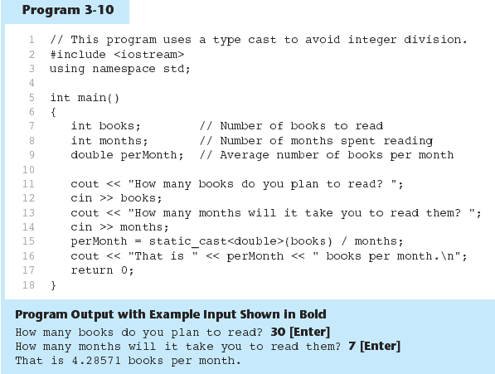
Example

Slide 31
C-Style and Prestandard Type Cast Expressions
C-Style cast: data type name in ()
cout << ch << " is " << (int)ch;
Prestandard C++ cast: value in ()
cout << ch << " is " << int(ch);
Both are still supported in C++, although static_cast is preferred

Slide 32
In-Class Exercise
Do Lab 5, Exercise 2, No. 3 (pg. 63)
Do Lab 5, Exercise 2, No. 4 (pg. 64)
Do Lab 5, Exercise 1, No. 5 (pg. 62)

Slide 33
Multiple Assignment and Combined Assignment
The = can be used to assign a value to multiple variables:
  x = y = z = 5;
Value of = is the value that is assigned
Associates right to left:
  x = (y = (z = 5));
value
is 5
value
is 5
value
is 5

Slide 34
Combined Assignment
Look at the following statement:
  sum = sum + 1;
  This adds 1 to the variable sum.

Slide 35
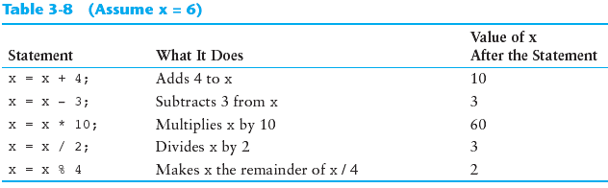
Other Similar Statements

Slide 36
Combined Assignment
The combined assignment operators provide a shorthand for these types of statements.
The statement
  sum = sum + 1;
  is equivalent to
  sum += 1;

Slide 37
Combined Assignment Operators
Operator | Example | Equivalent to
+= | i+=3 i += j +3 | i = i+3 i = i + (j+3)
-= | i-=3 i -= j +3 | i = i-3 i = i - (j+3)
*= | i*=3 i *= j +3 | i = i*3 i = i * (j+3)
/= | i/=3 i /= j +3 | i = i/3 i = i / (j+3)
%= | i%=3 i %= j +3 | i = i%3 i = i % (j+3)

Slide 38
In-Class Exercise
Assume that int a = 1 and double d = 1.0, and that each expression is independent. What are the results of the following expressions?
  a = 46/9;
  a = 46 % 9 + 4 * 4 – 2;
  a = 45 + 43 % 5 * (23 * 3 % 2);
  a %=3 / a + 3;
  d + = 1.5 * 3 + (++a);
  d -= 1.5 * 3 + a++;

Slide 39
In-Class Exercise
Do Lab 5 Exercise 1, No. 10 (pg. 62)
Do Lab 5, Exercise 3, No. 1 (pg. 65)
Do Lab 5, Exercise 3, No. 3 (pg. 66)

