Slide 1

Introduction to C++

Slide 2
What Is a Program Made Of?

Slide 3
What a Is a Program Made Of?
Common elements in programming languages:
  Key Words
  Programmer-Defined Identifiers
  Operators
  Punctuation
  Syntax

Slide 4
Example Program
#include <iostream>
using namespace std;
int main()
{
double num1 = 5,
num2, sum;
num2 = 12;
sum = num1 + num2;
cout << "The sum is " << sum;
return 0;
}
1-<number>

Slide 5
Key Words
Also known as reserved words
Have a special meaning in C++
Can not be used for another purpose
Written using lowercase letters
Examples in program (shown in green):
using namespace std;
int main()
1-<number>

Slide 6
Example Program
#include <iostream>
using namespace std;
int main()
{
double num1 = 5,
num2, sum;
num2 = 12;
sum = num1 + num2;
cout << "The sum is " << sum;
return 0;
}
1-<number>

Slide 7
Programmer-Defined Identifiers
Names made up by the programmer
Not part of the C++ language
Used to represent various things, such as variables (memory locations)
Example in program (shown in green):
double num1
1-<number>

Slide 8
Example Program
#include <iostream>
using namespace std;
int main()
{
double num1 = 5,
num2, sum;
num2 = 12;
sum = num1 + num2;
cout << "The sum is " << sum;
return 0;
}
1-<number>

Slide 9
Operators
Used to perform operations on data
Many types of operators
  Arithmetic: +, -, *, /
  Assignment: =
Examples in program (shown in green):
num2 = 12;
sum = num1 + num2;
1-<number>

Slide 10
Example Program
#include <iostream>
using namespace std;
int main()
{
double num1 = 5,
num2, sum;
num2 = 12;
sum = num1 + num2;
cout << "The sum is " << sum;
return 0;
}
1-<number>

Slide 11
Punctuation
Characters that mark the end of a statement, or that separate items in a list
Example in program (shown in green):
double num1 = 5,
num2, sum;
num2 = 12;
1-<number>

Slide 12
Example Program
#include <iostream>
using namespace std;
int main()
{
double num1 = 5,
num2, sum;
num2 = 12;
sum = num1 + num2;
cout << "The sum is " << sum;
return 0;
}
1-<number>

Slide 13
Lines vs. Statements
In a source file,
  A line is all of the characters entered before a carriage return.
  Blank lines improve the readability of a program.
  Here are four sample lines. Line 3 is blank:
  double num1 = 5, num2, sum;
  num2 = 12;
  sum = num1 + num2;
1-<number>

Slide 14
Lines vs. Statements
In a source file,
  A statement is an instruction to the computer to perform an action.
  A statement may contain keywords, operators, programmer-defined identifiers, and punctuation.
  A statement may fit on one line, or it may occupy multiple lines.
  Here is a single statement that uses two lines:
  double num1 = 5,
  num2, sum;
1-<number>

Slide 15
Variables
A variable is a named location in computer memory (in RAM)
It holds a piece of data
It must be defined before it can be used
Example variable definition:
  - double num1;
1-<number>

Slide 16
Example Program
#include <iostream>
using namespace std;
int main()
{
double num1 = 5,
num2, sum;
num2 = 12;
sum = num1 + num2;
cout << "The sum is " << sum;
return 0;
}
1-<number>

Slide 17
In-Class Exercise
Refer to Program 1.3 in pg. 15.
Identify the following elements
  Key Words
  Programmer-Defined Identifiers
  Operators
  Punctuation
  Syntax

Slide 18
Parts of a C++ Program

Slide 19
The Parts of a C++ Program
// sample C++ program
#include <iostream>
using namespace std;
int main()
{
cout << "Hello, there!";
return 0;
}
comment
preprocessor directive
which namespace to use
beginning of function named main
beginning of block for main
output statement
send 0 back to operating system
end of block for main
2-<number>

Slide 20
2.1 The Parts of a C++ Program
Statement | Purpose
// sample C++ program | comment
#include <iostream> | preprocessor directive
using namespace std; | which namespace to use
int main() | beginning of function named main
{ | beginning of block for main
cout << "Hello, there!"; | output statement
return 0; | send 0 back to the operating system
} | end of block for main
2-<number>

Slide 21
Special Characters
Character | Name | Description
// | Double Slash | Begins a comment
# | Pound Sign | Begins preprocessor directive
< > | Open, Close Brackets | Encloses filename used in #include directive
( ) | Open, Close Parentheses | Used when naming function
{ } | Open, Close Braces | Encloses a group of statements
" " | Open, Close Quote Marks | Encloses string of characters
; | Semicolon | Ends a programming statement
2-<number>
Notes:
See pr2-01.cpp

Slide 22
Important Details
C++ is case-sensitive. Uppercase and lowercase characters are different characters. ‘Main’ is not the same as ‘main’.
Every { must have a corresponding }, and vice-versa.
2-<number>

Slide 23
The cout Object
Displays information on computer screen
Use << to send information to cout
  cout << "Hello, there!";
Can use << to send multiple items to cout
  cout << "Hello, " << "there!";
  Or
  cout << "Hello, ";
  cout << "there!";
2-<number>
Notes:
See pr2-02.cpp and pr 2-03.cpp

Slide 24
Starting a New Line
To get multiple lines of output on screen
  - Use endl
  cout << "Hello, there!" << endl;
  Use \n in an output string
  cout << "Hello, there!\n";
Notice that the \n is INSIDE
the string.
Notes:
See pr2-04.cpp, pr2-05.cpp, and pr2-06.cpp

Slide 25
The #include Directive
Inserts the contents of another file into the program
Is a preprocessor directive
  Not part of the C++ language
  Not seen by compiler
Example:
#include <iostream>
No ; goes here
2-<number>

Slide 26
In-Class Exercise
Rearrange the following program statements in the correct order.
int main()
}
return 0;
#include <iostream>
cout<<"In 1492 Columbus sailed the ocean blue.";
{
using namespace std;
What is the output of the program when it is properly arranged?

Slide 27
Variables, Constants, and the Assignment Statement
Variable
  Has a name and a type of data it can hold
  char letter;
  Is used to reference a location in memory where a value can be stored
  Must be defined before it can be used
  The value that is stored can be changed, i.e., it can “vary”
variable name
data type
2-<number>

Slide 28
Variables
  If a new value is stored in the variable, it replaces the previous value
  The previous value is overwritten and can no longer be retrieved
  int age;
  age = 17; // age is 17
  cout << age; // Displays 17
  age = 18; // Now age is 18
  cout << age; // Displays 18
2-<number>
Notes:
See pr2-07.cpp

Slide 29
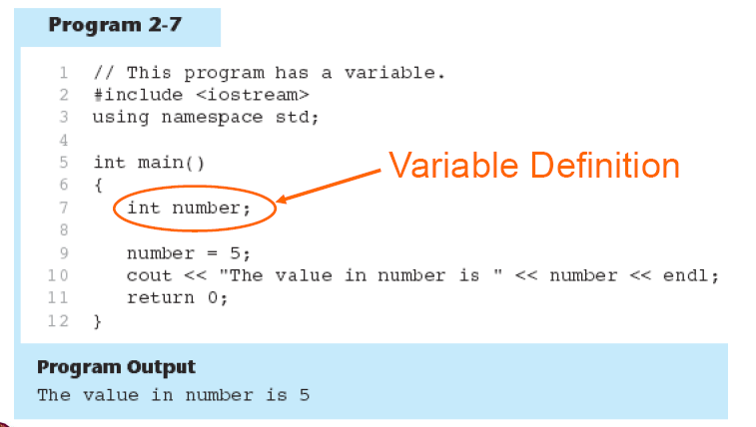
Variables: Example

Slide 30
Assignment Statement
Uses the = operator
Has a single variable on the left side and a value on the right side
Copies the value on the right into the variable on the left
item = 12;
2-<number>

Slide 31
Literals
Literal: a value that is written into a program’s code.
  "hello, there" (string literal)
  12 (integer literal)

Slide 32
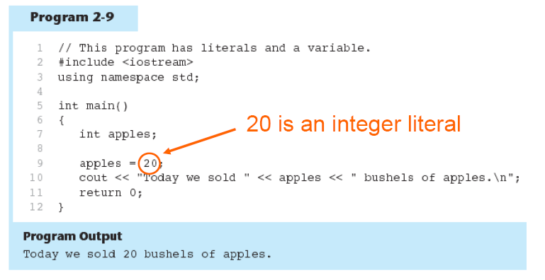
Literals: Example

Slide 33
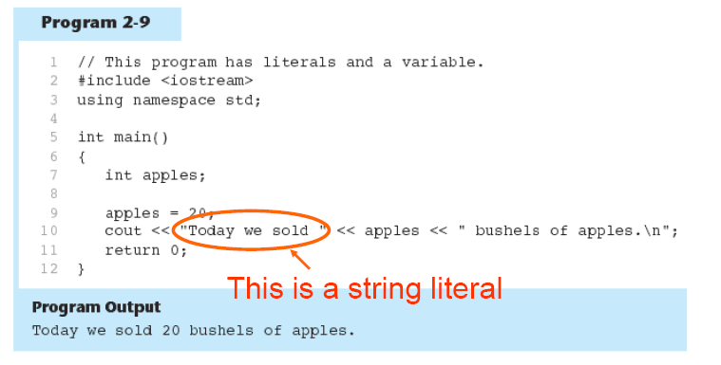
Literals: Example

Slide 34
In-Class Exercise
Examine the following program. List all the variables and literals that appear in the program.
#include <iostream>
using namespace std;
int main()
{ int little;
int big;
little = 2;
big = 2000;
cout<<"The little number is " <<little<<endl;
cout<<"The big number is "<<big<<endl;
return 0;
}
2-<number>
Notes:
See pr2-08.cpp

Slide 35
In-Class Exercise
What will the following program display on the screen?
#include <iostream>
using namespace std;
int main()
{
int num;
num = 712
cout<<"The value is " <<num<<endl;
return 0;
}

Slide 36
2.6 Identifiers
Programmer-chosen names to represent parts of the program, such as variables
Name should indicate the use of the identifier
Cannot use C++ key words as identifiers
Must begin with alphabetic character or _, followed by alphabetic, numeric, or _ . Alpha may be upper- or lowercase
2-<number>

Slide 37
Valid and Invalid Identifiers
IDENTIFIER | VALID? | REASON IF INVALID
totalSales
total_Sales
total.Sales
4thQtrSales
totalSale$
2-<number>

Slide 38
Number Systems
Numbers can be represented in a variety of ways.
The representation depends on what is called the BASE.
You write these numbers as:
  Number _{base}

Slide 39
Number Systems
The following are the four most common representations.
Decimal (base 10)
  Commonly used
  Valid digits are from 0 to 9
  Example: 12610 (normally written as just 126)
Binary (base 2)
  Valid digits are 0 and 1
  Example: 11111102

Slide 40
The following are the four most common representations.
Octal (base 8)
  Valid digits are from 0 to 7
  Example: 1768
Hexadecimal (base 16)
  Valid digits are from 0 to 9 and A to F (or from a to f)
  Example: 7E16

Slide 41


Slide 42
2.7 Integer Data Types
Designed to hold whole numbers
Can be signed or unsigned
  12 -6 +3
Available in different sizes (i.e., number of bytes): short, int, and long
Size of short ≤ size of int ≤ size of long
2-<number>

Slide 43
Defining Variables
Variables of the same type can be defined
  - In separate statements
  int length;
  int width;
  - In the same statement
  int length,
  width;
Variables of different types must be defined in separate statements
2-<number>
Notes:
See pr2-09.cpp and pr2-10.cpp

Slide 44
Integral Constants
To store an integer constant in a long memory location, put ‘L’ at the end of the number: 1234L
Constants that begin with ‘0’ (zero) are octal, or base 8: 075
Constants that begin with ‘0x’ are hexadecimal, or base 16: 0x75A
2-<number>

Slide 45
2.8 The char Data Type
Used to hold single characters or very small integer values
Usually occupies 1 byte of memory
A numeric code representing the character is stored in memory
SOURCE CODE MEMORY
char letter = 'C'; letter
67
2-<number>
Notes:
See pr2-11.cpp, pr2-12.cpp, and pr2-13.cpp

Slide 46
Summary of data types
Name | Description | Size | Range
char | Character or small integer. | 1byte | signed: -128 to 127 unsigned: 0 to 255
short int (short) | Short Integer. | 2bytes | signed: -32768 to 32767 unsigned: 0 to 65535
int | Integer. | 4bytes | signed: -2147483648 to 2147483647 unsigned: 0 to 4294967295
long int (long) | Long integer. | 4bytes | signed: -2147483648 to 2147483647 unsigned: 0 to 4294967295
bool | Boolean value. It can take one of two values: true or false. | 1byte | true or false
float | Floating point number. | 4bytes | +/- 3.4e +/- 38 (~7 digits)
double | Double precision floating point number. | 8bytes | +/- 1.7e +/- 308 (~15 digits)
long double | Long double precision floating point number. | 8bytes | +/- 1.7e +/- 308 (~15 digits)

Slide 47
String Constant
Can be stored a series of characters in consecutive memory locations
  "Hello"
Stored with the null terminator, \0, at end
Is comprised of characters between the " "
H | e | l | l | o | \0
2-<number>

Slide 48
A character or a string constant?
A character constant is a single character, enclosed in single quotes:
    'C'
A string constant is a sequence of characters enclosed in double quotes:
    "Hello, there!"
A single character in double quotes is a string constant, not a character constant:
    "C"
2-<number>

Slide 49
2.9 The C++ string Class
Must #include <string> to create and use string objects
Can define string variables in programs
string name;
Can assign values to string variables with the assignment operator
  name = "George";
Can display them with cout
  cout << name;
2-<number>
Notes:
See pr2-14.cpp

Slide 50
Named Constants
Named constant (constant variable): variable whose content cannot be changed during program execution
Used for representing constant values with descriptive names:
  const double TAX_RATE = 0.0675;
  const int NUM_STATES = 50;
Often named in uppercase letters

Slide 51
Defining constants
You can define your own names for constants that you use very often without having to resort to memory-consuming variables, simply by using the #define preprocessor directive.
Its format:
  #define identifier value
Example:
#include <iostream>
using namespace std;
#define PI 3.14159
#define NEWLINE '\n‘
int main ()
{ double r=5.0;
double circle;
circle = 2 * PI * r;
cout << circle;
cout << NEWLINE; return 0;}

Slide 52
Declared constants (const)
With the const prefix you can declare constants with a specific type in the same way as you would do with a variable
Example:
#include <iostream>
using namespace std;
int main ()
{ double r=5.0,circle;
const double PI = 3.14159;
const char NEWLINE = '\n';
circle = 2 * PI * r;
cout << circle;
cout << NEWLINE; return 0;}

Slide 53
In-Class Exercise
What is wrong with the following program?
#include <iostream>
using namespace std;
int main()
{ char letter;
letter = "Z";
cout<<letter<<endl;
return 0;
}

Slide 54
2.10 Floating-Point Data Types
Designed to hold real numbers
  12.45 -3.8
Stored in a form similar to scientific notation
Numbers are all signed
3 data types to represent floating-point numbers: float, double, and long double
Size of float ≤ size of double
≤ size of long double
2-<number>
Notes:
See pr2-15.cpp

Slide 55
Floating-point Constants
Can be represented in
  Fixed point (decimal) notation:
  31.4159 0.0000625
  E notation:
  3.14159E1 6.25e-5
Are double by default
Can be forced to be float 3.14159F or long double 0.0000625L
2-<number>

Slide 56
Assigning Floating-point Values to Integer Variables
If a floating-point value is assigned to an integer variable
  The fractional part will be truncated (i.e., “chopped off” and discarded)
  The value is not rounded
  int rainfall = 3.88;
  cout << rainfall; // Displays 3
2-<number>

Slide 57
The bool Data Type
Represents values that are true or false
bool values are stored as short integers
false is represented by 0, true by 1
  bool allDone = true;
  bool finished = false;
allDone finished
1
0
2-<number>
Notes:
See pr2-16.cpp

Slide 58
Determining the Size of a Data Type
The sizeof operator gives the size of any data type or variable
double amount;
cout << "A float is stored in "
<< sizeof(float) << " bytes\n";
cout << "Variable amount is stored in "
<< sizeof(amount) << " bytes\n";
2-<number>
Notes:
See pr2-17.cpp

Slide 59
More on Variable Assignments and Initialization
Assigning a value to a variable
  Assigns a value to a previously created variable
  A single variable name must appear on left side of the = symbol
  int size;
  size = 5; // legal
  5 = size; // not legal
2-<number>

Slide 60
Variable Assignment vs. Initialization
Initializing a variable
  Gives an initial value to a variable at the time it is created
  Can initialize some or all variables of definition
  int length = 12;
  int width = 7, height = 5, area;
2-<number>
Notes:
See pr2-18.cpp

Slide 61
Scope
The scope of a variable is that part of the program where the variable may be used
A variable cannot be used before it is defined
  int a;
  cin >> a; // legal
  cin >> b; // illegal
  int b;
2-<number>
Notes:
See pr2-19.cpp

Slide 62
In-Class Exercise
Trace the following program. Can it be compiled?
#include <iostream>
using namespace std;
int main()
{
cout<<value;
int value;
return 0;
}

Slide 63
2.15 Arithmetic Operators
Used for performing numeric calculations
C++ has unary, binary, and ternary operators
  unary (1 operand) -5
  binary (2 operands) 13 - 7
  ternary (3 operands) exp1 ? exp2 : exp3
2-<number>

Slide 64
Binary Arithmetic Operators
SYMBOL | OPERATION | EXAMPLE | ans
+ | addition | ans = 7 + 3; | 10
- | subtraction | ans = 7 - 3; | 4
* | multiplication | ans = 7 * 3; | 21
/ | division | ans = 7 / 3; | 2
% | modulus | ans = 7 % 3; | 1
2-<number>
Notes:
See pr2-20.cpp

Slide 65
/ Operator
C++ division operator (/)performs integer division if both operands are integers
  cout << 13 / 5; // displays 2
  cout << 2 / 4; // displays 0
If either operand is floating-point, the result is floating-point
  cout << 13 / 5.0; // displays 2.6
  cout << 2.0 / 4; // displays 0.5
2-<number>

Slide 66
% Operator
C++ modulus operator (%) computes the remainder resulting from integer division
  cout << 9 % 2; // displays 1
% requires integers for both operands
  cout << 9 % 2.0; // error
2-<number>

Slide 67
2.16 Comments
Are used to document parts of a program
Are written for persons reading the source code of the program
  Indicate the purpose of the program
  Describe the use of variables
  Explain complex sections of code
Are ignored by the compiler
2-<number>

Slide 68
Single-Line Comments
Begin with // through to the end of line
  int length = 12; // length in inches
  int width = 15; // width in inches
  int area; // calculated area
  // Calculate rectangle area
  area = length * width;
2-<number>
Notes:
See pr2-21.cpp

Slide 69
Multi-Line Comments
Begin with /* and end with */
Can span multiple lines
  /*----------------------------
  Here's a multi-line comment
  ----------------------------*/
Can also be used as single-line comments
  int area; /* Calculated area */
2-<number>

Slide 70
In-Class Exercise
Identify as many syntax errors as you can in the following program
*/ what is wrong with this program?/*
#include iostream
using namespace std;
int main();
}
int a, b, c
a=3
b=4
c=a+b
Cout<"The value of c is "<C;
return 0;
{

Slide 71
In-Class Exercise
Do Lab 4, Exercise 2, No. 1-6 (pg. 53-54)

Slide 72
From pseudo code / flowchart to code
#include <iostream>
using namespace std;
int main()
{ int a, b,c ;
cin>>a;
cin>>b;
c=a*b;
cout<<"Value of C: <<c;
return 0;
}
Start
Get A
Get B
Calculate result:
C= A*B
5. Display C
6. End

Slide 73
In-Class Exercise
Do Lab 4, Exercise 1, No 1 (pg. 47)
Do Lab 4, Exercise 1, No. 4 (pg. 49)
Do Lab 4, Exercise 3, No. 1 (pg. 54)

