Slide 1

Control Structure: Selection

Slide 2
Relational logic: Revision
Do Lab 7, Exercise 1, No. 1 (pg. 82)
Do Lab 7, Exercise 1, No. 4 (pg. 83)
Do Lab 7, Exercise 1, No. 5 (pg. 83)

Slide 3
One-Way Selection
General Format:
  if (expression)
  statement;
expression
true
statement
false

Slide 4
if statement – what happens
To evaluate:
  if (expression)
  statement;
If the expression is true, then statement is executed.
If the expression is false, then statement is skipped.

Slide 5
#include <iostream>
#include<iomanip>
using namespace std;
int main()
{ int score1, score2;
double avg;
cin>>score1>>score2;
avg=(score1+score2)/2;
cout<<fixed<<showpoint<<setprecision(2);
cout<<avg<<endl;
if(avg>95)
cout<<"Congrats! High Score"<<endl;
system("PAUSE");
return 0;
}

Slide 6
#include <iostream>
#include<iomanip>
using namespace std;
int main()
{ int score1, score2;
double avg;
cin>>score1>>score2;
avg=(score1+score2)/2;
cout<<fixed<<showpoint<<setprecision(2);
cout<<avg<<endl;
if(avg>95)
cout<<"Congrats!"<<endl;
cout<<"High Score"<<endl;
system("PAUSE");
return 0;
}

Slide 7
if statement notes
Do not place ; after (expression)
Place statement; on a separate line after (expression), indented:
  if (score > 90)
  grade = 'A';
Be careful testing floats and doubles for equality
0 is false; any other value is true

Slide 8
In-Class Exercise
Do Lab 7, Exercise 1, No. 6 (pg. 85)
Do Lab 7, Exercise 1, No. 11 (pg. 86)

Slide 9
Flags
Variable that signals a condition
Usually implemented as a bool variable
As with other variables in functions, must be assigned an initial value before it is used

Slide 10
Example
Trace the following programs if the input is 22 and 68
int main()
{
double mark;
bool pass=false; //this conditon does not yet exist
cout<<"Enter your mark>>";
cin>>mark;
if (mark >=30)
pass=true;
if (pass)
cout<<"You pass the test"<<endl;
if (!pass)
cout<<"You fail the test"<<endl;
cout<<"Program end";
return 0;
}

Slide 11
Expanding the if Statement
To execute more than one statement as part of an if statement, enclose them in { }:
  if (score > 90)
  {
  grade = 'A';
  cout << "Good Job!\n";
  }
{ } creates a block of code

Slide 12
In-Class Exercise
Identify the logic errors, and correct them
  The program will display “Pass” message, calculate the carry mark and display the carry mark if the student pass the test.
  If the student fail the test the program will display “Fail” message and display a message to instruct the student to re-sit the test
int main()
{
double mark, final20p = 0;
cout << “Enter your mark >> “;
cin >> mark;
if (mark >= 30)
cout << “TEST 1 -> Pass” << endl;
final20p = ((20.0/100.0) * mark);
cout << “Contribution to final mark “ << final20p;
if (mark < 30)
cout << “TEST 1 -> Fail” << endl;
cout << “Please re-sit TEST 1” << endl;
system (“pause”);
return 0;
}

Slide 13
Two-Way Selection
Provides two possible paths of execution
Performs one statement or block if the expression is true, otherwise performs another statement or block.

Slide 14
The if/else Statement
expression
true
statement
false
General Format:
  if (expression)
  statement1; // or block
  else
  statement2; // or block
statement

Slide 15
if/else – what happens
To evaluate:
  if (expression)
  statement1;
  else
  statement2;
If the expression is true, then statement1 is executed and statement2 is skipped.
If the expression is false, then statement1 is skipped and statement2 is executed.

Slide 16
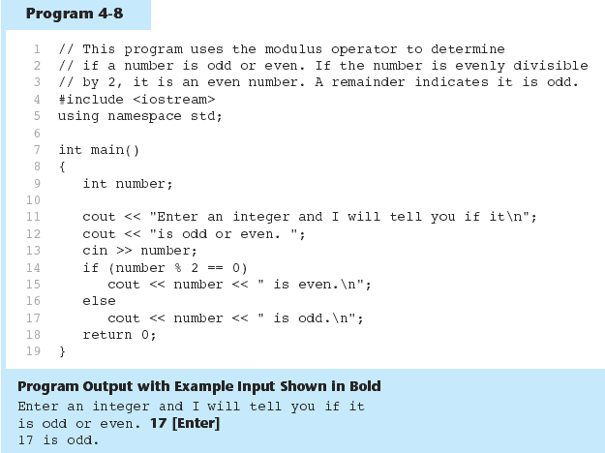

Slide 17
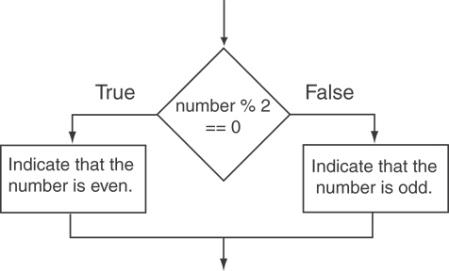
Flowchart

Slide 18
#include <iostream>
#include<iomanip>
using namespace std;
int main()
{ int score1, score2;
double avg;
cin>>score1>>score2;
avg=(score1+score2)/2;
cout<<fixed<<showpoint<<setprecision(2);
cout<<avg<<endl;
if(avg>95)
cout<<"High Score"<<endl;
else
cout<<"Average score"<<endl;
system("PAUSE");
return 0;}

Slide 19
In-Class Exercise
Do Lab 7, Exercise 1, No. 13 (pg. 88)
Do Lab 7, Exercise 1, No. 12 (pg. 88)
Do Lab 7, Exercise 2, No. 3(i) (pg. 98)

Slide 20
The if/else if Statement
Chain of if statements that test in order until one is found to be true
Also models thought processes:
  “If it is raining, take an umbrella,
  else, if it is windy, take a hat,
  else, take sunglasses”

Slide 21
expression
true
statement
false
expression
true
statement
false
statement

Slide 22
if/else if format
  if (expression)
  statement1; // or block
  else if (expression)
  statement2; // or block
  .
  . // other else ifs .
  else if (expression)
  statementn; // or block
  else
  statementn; // or block

Slide 23
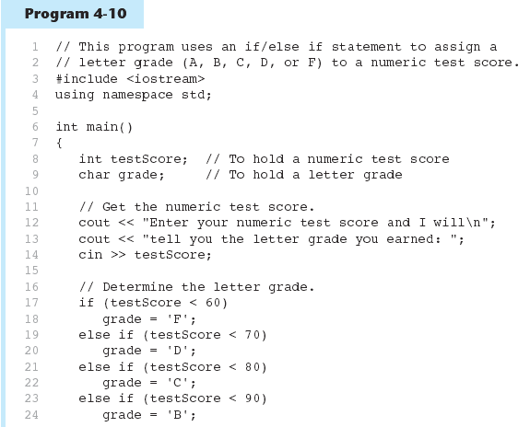
(Program Continues)

Slide 24
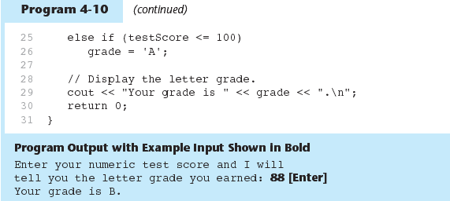

Slide 25
In-Class Exercise
Do Lab 7, Exercise 1, No. 11 (pg. 86)
  Change the if statements to if..else statements
  What is the different?

Slide 26
Using a Trailing else
Used with if/else if statement when none of the expressions are true
Provides default statement/action
Used to catch invalid values, other exceptional situations

Slide 27
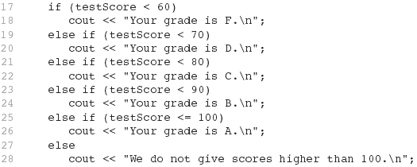
From Program 4-12

Slide 28
Nested if Statements
An if statement that is part of the if or else part of another if statement
Can be used to evaluate more than one condition:
  if (score < 100)
  {
  if (score > 90)
  grade = 'A';
  }

Slide 29
Notes on coding nested ifs
An else matches the nearest if that does not have an else:
  if (score < 100)
  if (score > 90)
  grade = 'A';
  else ...// goes with second if,
  // not first one
Proper indentation helps greatly

Slide 30
In-Class Exercise
Write nested if statements that perform the following test:
If amount1 is greater than 10 and amount2 is less than 100, display the greater of the two.
What is the ouput of the following C++ code :
  #include <iostream>
  #include<iomanip>
  using namespace std;
  int main()
  { int x = 100, y=200;
  if(x>100 && y<=200)
  cout<<x<<" "<<y<<" "<<x+y<<endl;
  else
  cout<<x<<" "<<y<<" "<<2*x-y++<<endl;
  return 0;}

Slide 31
In-Class Exercise
Do Lab 7, Exercise 1, No. 18 (pg. 93)
Do Lab 7, Exercise 2, No. 2 (pg. 97)
Do Lab 7, Exercise 2, No. 5 (pg. 100)
Do Lab 7, Exercise 3, No. 2 (pg.102)

Slide 32
The switch Statement
Used to select among statements from several alternatives
In some cases, can be used instead of if/else if statements

Slide 33
switch statement format
switch (expression) //integer
{
case exp1: statement1;
case exp2: statement2;
...
case expn: statementn;
default: statementn+1;
}

Slide 34
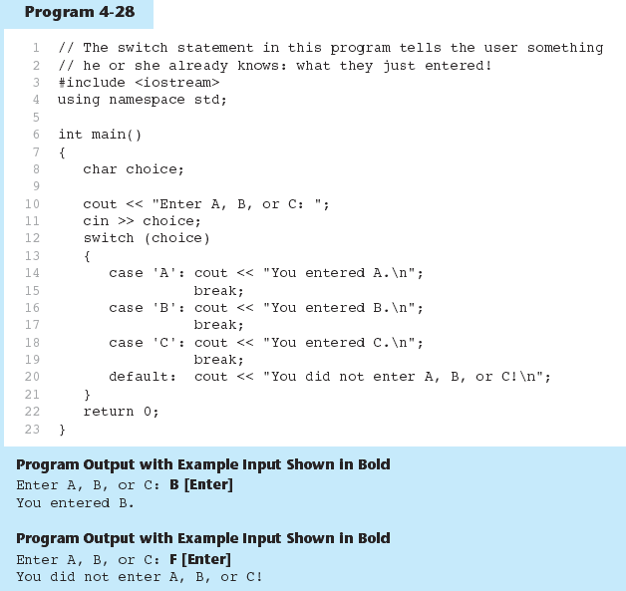

Slide 35
switch statement requirements
1) expression must be an integer variable or an expression that evaluates to an integer value
exp1 through expn must be constant integer expressions or literals, and must be unique in the switch statement
default is optional but recommended

Slide 36
switch statement – how it works
1) expression is evaluated
The value of expression is compared against exp1 through expn.
If expression matches value expi, the program branches to the statement following expi and continues to the end of the switch
If no matching value is found, the program branches to the statement after default:

Slide 37
break statement
Used to exit a switch statement
If it is left out, the program "falls through" the remaining statements in the switch statement

Slide 38
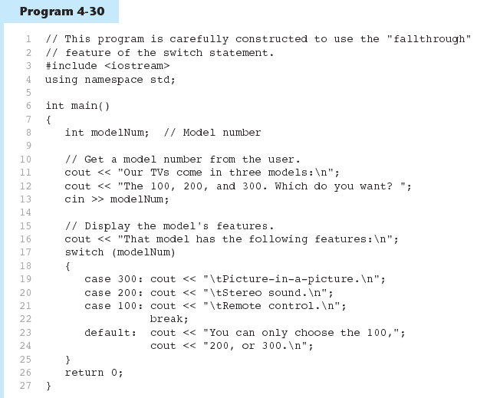

Slide 39
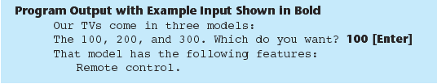
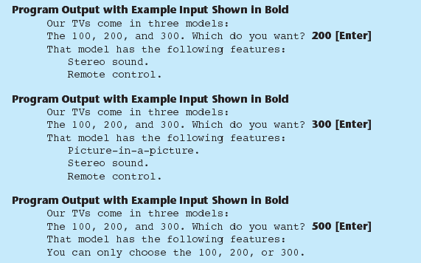

Slide 40
switch(score/10)
{ case 0:
case 1:
case 2:
case 3:
case 4:
case 5:
grade = 'F’; break;
case 6:
grade = 'D'; break;
case 7:
grade = 'C'; break;
case 8:
grade = 'D'; break;
case 9:
case 10:
grade = 'A'; break;
default:
cout<<"Invalid grade"<<endl;
}

Slide 41
In-Class Exercise
Do Lab 7, Exercise 1, No. 19 (pg. 95)
Do Lab 7, Exercise 2, No. 3 (iii), (iv) (pg 99)
Do Lab 7, Exercise 2, No. 4 (pg.100)
Do Lab 7, Exercise 3, No. 1 (pg. 101)

Slide 42
In-Class Exercise
Suppose the input is 6. What is the value of a after the following C++ code executes?
    cin>>a;
    if(a>0)
    switch(a)
    { case 1: a=a+3;
    case 3: a++;
    break;
    case 6: a+=6;
    case 8: a*=8;
    break;
    default: a--;
    }
    else
    a+=2;

Slide 43
Menus
Menu-driven program: program execution controlled by user selecting from a list of actions
Menu: list of choices on the screen
Menus can be implemented using if/else if statements

Slide 44
Menu-driven program organization
Display list of numbered or lettered choices for actions
Prompt user to make selection
Test user selection in expression
  if a match, then execute code for action
  if not, then go on to next expression

Slide 45
Using switch with a menu
switch statement is a natural choice for menu-driven program:
  display the menu
  then, get the user's menu selection
  use user input as expression in switch statement
  use menu choices as expr in case statements

Slide 46
The Conditional Operator
Can use to create short if/else statements
Format: expr ? expr : expr;
x<0 ? y=10 : z=20;
First Expression:
Expression to be
tested
2nd Expression:
Executes if first
expression is true
3rd Expression:
Executes if the first
expression is false

Slide 47
The Conditional Operator
The value of a conditional expression is
  The value of the second expression if the first expression is true
  The value of the third expression if the first expression is false
Parentheses () may be needed in an expression due to precedence of conditional operator

Slide 48
The Conditional Operator
Condition operator vs if/else statements
if (x<0)
y=10;
else
z=20;
(x<0)?(y=10):(z=20);
if (x>100)
a=0;
else
a=1;
a=x>100?0:1;
if (score<60)
cout<<“Your grade is FAIL”;
else
cout<<“Your grade is PASS”;
cout<<“Your grade is “ << ((score<60)? “FAIL”: “Pass”);

Slide 49
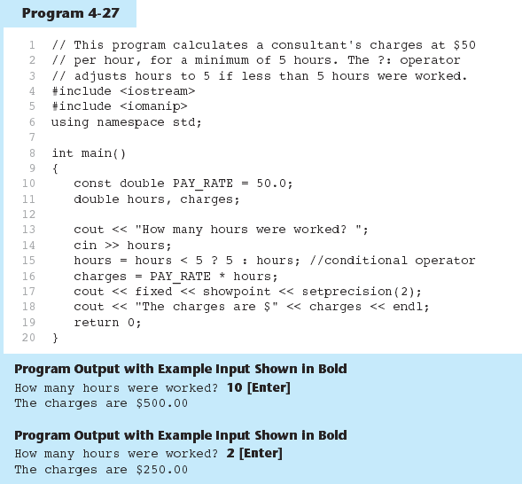

Slide 50
In-Class Exercise
Rewrite the following if/else statements as conditional expressions
Rewrite the following conditional expressions as if/else statements
if (x>y)
z = 1;
else
z = 20;
if (hours> 40)
wages *= 1.5;
else
wages *= 1;
if (result >= 0)
cout «"The result is +ve";
else
cout «"The result is -ve";
j = k > 90 ? 57 : 12;
total += count == 1 ? sales : count * sales;
cout « (((num % 2) == 0) ? "Even\n" : "Odd\n");

Slide 51
In- Class Exercise
Do Lab 7, Exercise 1, No. 14 (pg. 89)
Do Lab 7, Exercise 1, No. 15 (pg. 89)
Do Lab 7, Exercise 3, No. 4 (pg. 106)
Do Lab 7, Exercise 3, No. 3 (pg. 103-105)
Do Lab 7, Exercise 3, No. 5 (pg. 106)

Slide 52
Validating User Input
Input validation: inspecting input data to determine whether it is acceptable
Bad output will be produced from bad input
Can perform various tests:
  Range
  Reasonableness
  Valid menu choice
  Divide by zero

Slide 53
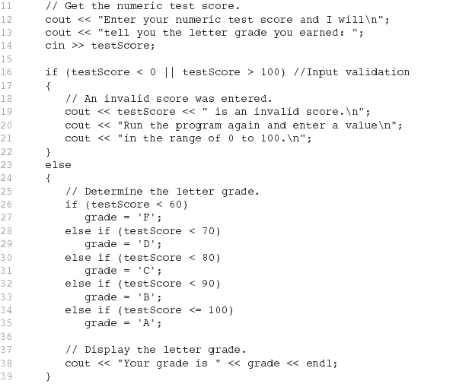

Slide 54
More About Variable Definitions and Scope
Scope of a variable is the block in which it is defined, from the point of definition to the end of the block
Usually defined at beginning of function
May be defined close to first use

Slide 55
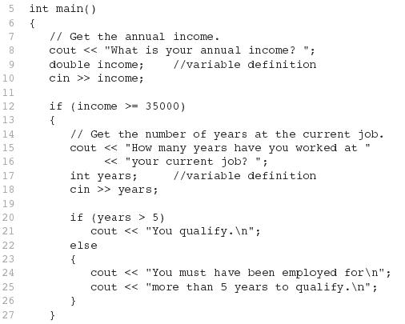

Slide 56
Still More About Variable Definitions and Scope
Variables defined inside { } have local or block scope
When inside a block within another block, can define variables with the same name as in the outer block.
  When in inner block, outer definition is not available
  Not a good idea

Slide 57
In-Class Exercise
What will the following program display if user enter test1 40 and test2 30?
if (sum>60) {
int bonus=10;
test1+=bonus; test2+=bonus;
int sum=test1+test2;
cout<<"Test 1 with bonus:“
<<test1<<endl;
cout<<"Test 2 with bonus:“
<<test2<<endl;
cout<<"Sum with bonus:“
<<sum<<endl;
}
cout<<"Test 1 : “
<<test1<<endl;
cout<<"Test 2 : “
<<test2<<endl;
cout<<"Sum : "<<sum<<endl;
return 0;
}
int main ()
{
int test1;
cout<<"Enter Test 1 score: ";
cin>>test1;
int test2;
cout<<"Enter Test 2 score: ";
cin>>test2;
int sum=test1+test2;

Slide 58
Comparing Strings
You cannot use relational operators with C-strings
Must use the strcmp function to compare C-strings
strcmp compares the ASCII codes of the characters in the C-strings. Comparison is character-by-character

Slide 59
Comparing Strings
The expression
strcmp(str1, str2)
compares the strings str1 and str2
    It returns 0 if the strings are the same
    It returns a negative number if str1 < str2
    It returns a positive number if str1 > str2

Slide 60
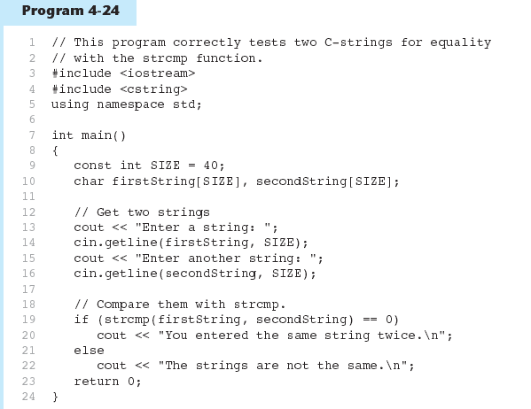

Slide 61


Slide 62
In-Class Exercise
Refer back to Lab 7, Exe. 1, No. 19, Program 7.5 in pg. 95.
Change the program that you wrote previously:
  Change variable choice to variable iceCream[20]
  Instead of using menu, use getline so the user can enter the flavor and use strcmp to if / else…if statement.

Slide 63
Testing for File Open Errors
Can test a file stream object to detect if an open operation failed:
  infile.open("test.txt");
  if (!infile)
  {
  cout << "File open failure!";
  }
Can also use the fail member function

Slide 64
In-Class Exercise
Refer to Program 6.4 in pg. 75.
Modify the program to detect if the open files operation failed.

