Slide 1

SCJ 1013: PROGRAMMING TECHNIQUE 1: C++
SECTION 01

Slide 2
Lecturer’s Details
Dr. Radziah Mohamad
Webpage: http://kpnet.fsksm.utm.my/radziah
Email: radziahm@utm.my / drradziah@gmail.com
Room: N28 306-17
Tel: 5532013

Slide 3
Course Outline
Download from: http://elearning.utm.my
Course Learning Outcomes:
  Solve problems systematically using problem solving methods.
  Construct a C++ program correctly from the analyzed problems using structured approach.
  Construct or develop complete C++ programs for simple to moderate problems individually.
  Solve problems in a given time frame using C++ programming language and tools.

Slide 4
Reference Books
Main Text:
  Tony Gaddis, Barret Krupnow, Starting out with C++, 6th edition update. 2009. Pearson Addison-Wesley. (Brief Version)
    Price: RM75
Lab Module:
  Faculty of Computer Science and Information Systems, Programming Technique I – C++ Workbook (English – Malay), 4th. edition, 2010.
    Price: RM20

Slide 5
Grading
No. | Assessment | Number | % each | % total
1 | Assignments | 3 | 8.33% | 25
2 | Quizzes | 2 | 5% | 10
3 | Lab Exercises | 2 | 2.5% | 5
4 | Skill-Based Test | 2 | 2.5% | 5
5 | Problem solving test | 1 | 5% | 5
6 | Mid-Semester Exam | 1 | 20% | 20
7 | Final Exam | 1 | 30% | 30
 | Overall Total |  |  | 100

Slide 6
UTM Grade System
Grade | Point | Marks
A+ | 4.00 | 90-100
A | 4.00 | 80-89
A- | 3.67 | 75-79
B+ | 3.33 | 70-74
B | 3.00 | 65-69
B- | 2.67 | 60-64
C+ | 2.33 | 55-59
C | 2.00 | 50-54
C- | 1.67 | 45-49
D+ | 1.33 | 40-44
D | 1.00 | 35-39
D- | 0.67 | 30-34
E | 0.00 | 00-29

Slide 7
Important Dates
Problem Solving Test (5%)
  Date: 4/8/2010
  Day: Wednesday
  Time: 2.30-3.30p.m
  Venue: BK5, N28.
Mid-Semester Exam (20%)
  Date: 28/8/2010
  Day: Saturday
  Time: 9 – 11 a.m
  Venue: BK5, N28

Slide 8
UTM Attendance Policy
To be allowed to sit for final exam, a student must have an attendance more than 80%.
First warning letter will be issued for the first 4 hours not attending the class.
Second warning letter for the subsequent 4 hours.
Letter to forbid seating for final exam will be issued for the subsequent 3 hours.

Slide 9
E-Learning Session
Go to: http://elearning.utm.my
Log in to your account:
  Username: Your Student ID Number
  Password: Your IC Number
Go to SCJ1013.

Slide 10

INTRODUCTION TO COMPUTERS & PROGRAMMING

Slide 11
What is a computer?
Machine that processes data to produce a desired output.
Programmable machine designed to follow instructions

Slide 12
What is a computer program?
The instructions required to achieve a desired end result.
Instructions in computer memory to make it do something.
A computer program is a set of statements or instructions to be used directly or indirectly in a computer in order to bring about a certain result.
Examples of computer program or computer application?????

Slide 13
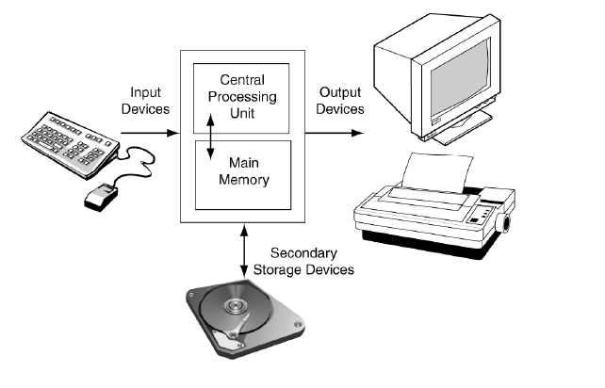
Computer Components: Hardware
The physical components of a computer

Slide 14
Computer Components: Software
Programs that run on a computer
Categories of software:
  System software
    programs that manage the computer hardware and the programs that run on them.
  Application software
    programs that provide services to the user
  Compilers
    Translates computer programs to machine language.
    Machine language: the only language the computer can understand. It is in binary machine code (0’s/1’s).

Slide 15
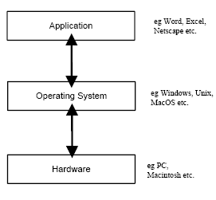
Layers of software

Slide 16
Programs & Programming Language
A program is a set of instructions that the computer follows to perform a task
Programming Language: a language used to write programs
We start with an algorithm, which is a set of well-defined steps.

Slide 17
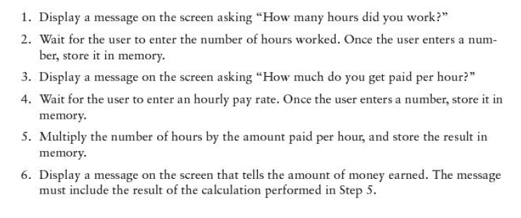
Algorithm Example: Calculating Gross Pay

Slide 18
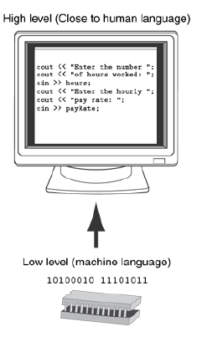
Type of Programming Language
Low-Level Programming Language / Assembly Language
  Similar to machine languages, but they are much easier to program.
  Each CPU has its own assembly language.

Slide 19
Type of Programming Language
High-Level Programming Language
  A language that people can read, write, and understand.
  A programming language that is more user-friendly, to some extent platform-independent
  Need to be translated into one or several machine instructions by a compiler.
  Example: Java, C, C++

Slide 20
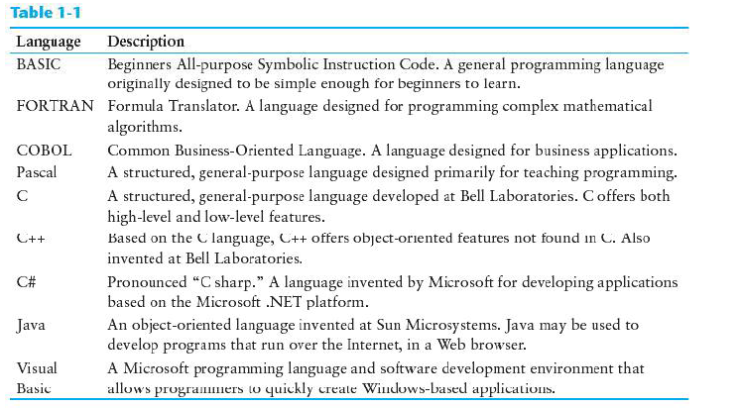
Some well-know programming language

Slide 21
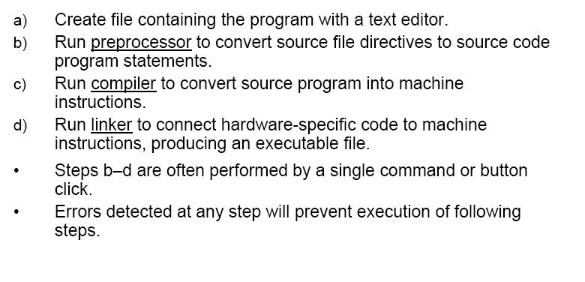
From High-Level to Executable File

Slide 22
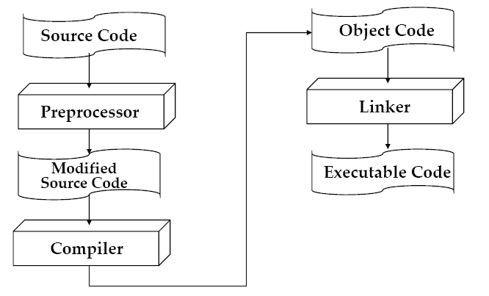
From High-Level to Executable File

Slide 23
Integrated Development Environment (IDE)
An integrated development environment, or IDE, combine all the tools needed to write, compile, and debug a program into a single software application.
Examples are Microsoft Visual C++, Borland C++ Builder, CodeWarrior, etc.

Slide 24
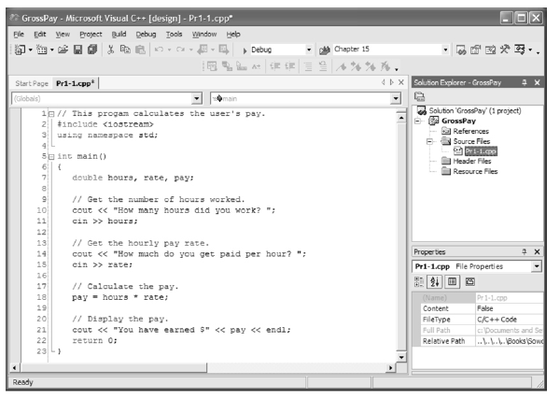
IDE

Slide 25
FYE Program Reminder: Mini Explorace
Date & Day: 14/7/2010 & Wednesday
Time: 1.45 p.m
Venue: Dewan Seminar, D07
Attire: Sports Attire

