Slide 1

Student Academic Dropout And Success: Investigating the Impact of demographic, Social and Economic Factors
Adrian Alexander, Shaun McKellar, Victoria Zangen
IST 652 Spring 2024 Final Project

Slide 2

About the Data:
The original dataset provides a snapshot of students enrolled in a foreign university’s undergraduate degree program in the form of a csv file containing 35 columns and 4,424 rows. Each row represents an in-depth overview of one student in their program of choice, various demographic and socioeconomic factors, and their educational outcome.
By including variables such as unemployment rate, inflation rate, and GDP from their respective regions; the university can understand what critical economic data or external factors may also influence the student’s decision-making process.
Analyzing the data can assist in predicting a student performance level by assessing the units credited/enrolled/evaluated/approved, their grade each term, and the success or dropout rate.
Source:
Predict Students’ Academic and Dropout Success
https://www.kaggle.com/datasets/thedevastator/higher-education-predictors-of-student-retention/data

Slide 3
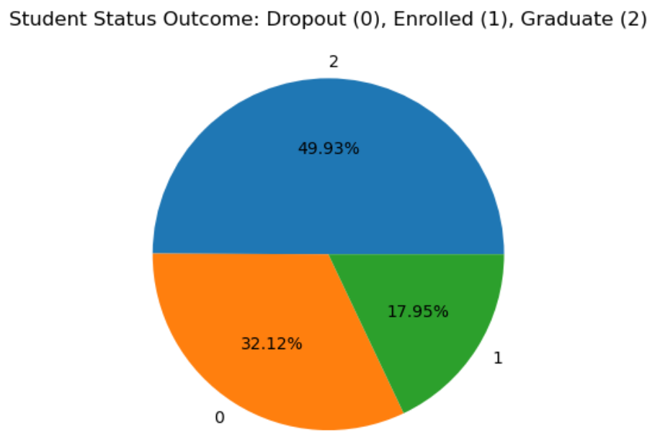
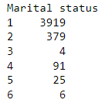


Risks In the Data:
This dataset is taken from one semesters worth of information.
Understanding which variables are categorical vs numerical
The target data has three categories: Dropout, Enrolled, Graduate
When analyzing variables such as gender, marital status, age of enrollment, international, course of study, etc it is important to consider the make up of the sample in relation to the population.
Trend information collected year over year, should be collected from the same source (GDP, unemployment rate, inflation etc)

Slide 4
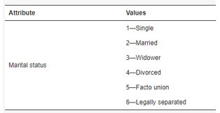
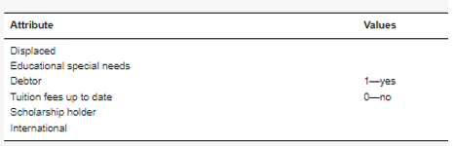

Understanding the data: Categorical
Marital Status: Marital status of the student
Application Mode: Method of application used
Course: The course taken by the student
Daytime/Evening Attendance: Student attends Day or Evening class
Previous Qualification: Qualification before enrolling in higher ed
Nationality: Nationality of the student
Mother/Father Qualification: Qualification of the mother/father
Mother/Father Occupation: Occupation of mother/father
Displaced: Whether the student is a displaced person
Educational Special Needs: Student have any special educational needs
Debtor: Is the student a debtor
Tuition Fees Up to Date: Payment status
Gender: Gender of student
Scholarship Holder: Is the student a scholarship holder
International: Is the student an international student

Slide 5
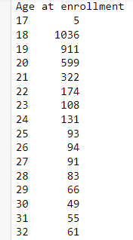
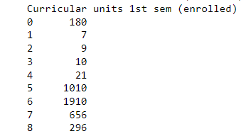
Understanding the Data: Numerical
Application Order: The order in which the student applied
Age at Enrollment: The age of the student at the time of enrollment
Curricular units 1st/2nd Sem (credited): Number of credited units
Curricular units 1st/2nd Sem (enrolled): Number of enrolled units
Curricular units 1st/2nd Sem (evaluations): Number of evaluated units
Curricular units 1st/2nd Sem (approved): Number of approved units

Slide 6
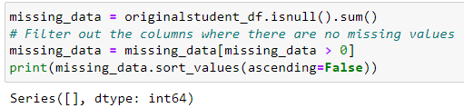
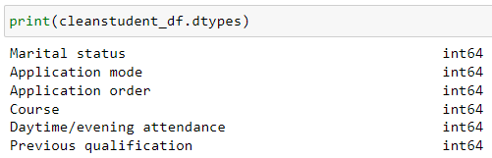
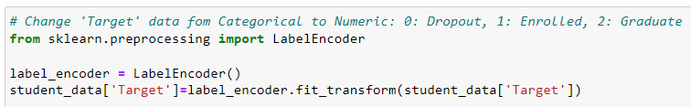
Cleaning the Data:
Remove Missing Data
Check Attribute Types
Change Target Data from object to categorical

Slide 7
group Attributes by Category:
Demographic:
Marital Status
Nationality
Displaced
Gender
International
Socio-Economic:
Mother/Father Previous Qualification
Mother/Father Occupation
Educational Special Needs
Debtor
Tuition Fee Payment Status
Scholarship Eligibility
Academic Enrollment:
Academic Performance:
Economic:
Application Mode
Application Order
Course
Daytime/Evening Attendance
Previous Qualification
Curricular (Credited)
Curricular (Enrolled)
Curricular (Evaluations)
Curricular (Approved)
Curricular (Grade)
Curricular (without Evaluations
Target
Unemployment Rate
Inflation Rate
GDP
Age at Enrollment

Slide 8
Methods of Analysis:
Descriptive Statistics
Min/Max
Mean
Median
Mode
Inferential Statistics
Linear Regression
Correlation
Predictive Analysis
Supervised Machine Learning
Prescriptive Analysis
Retention Plan
Recommendations
Optimization

Slide 9
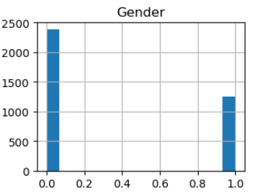
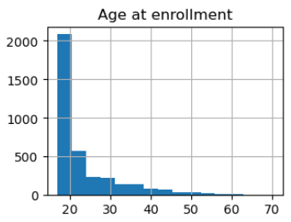
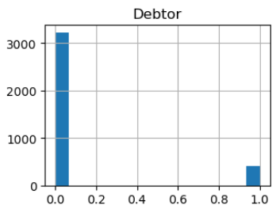
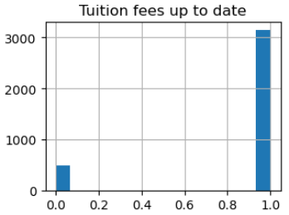
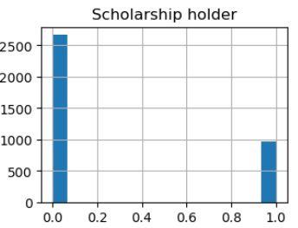
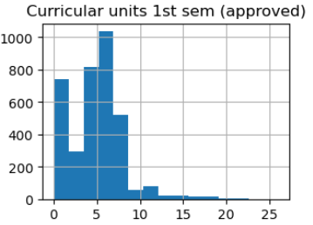
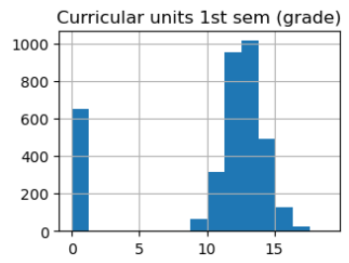
Descriptive Statistics:
Descriptive Statistics
Inferential Statistics
Predictive Analysis
Prescriptive Analysis

Slide 10
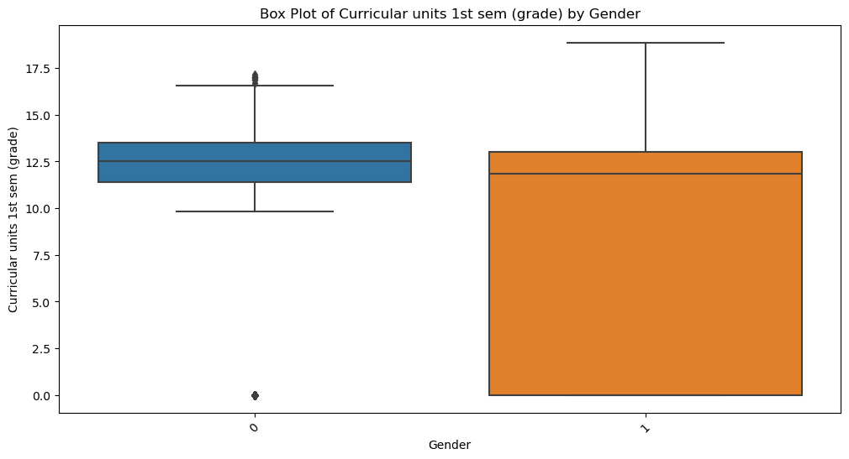
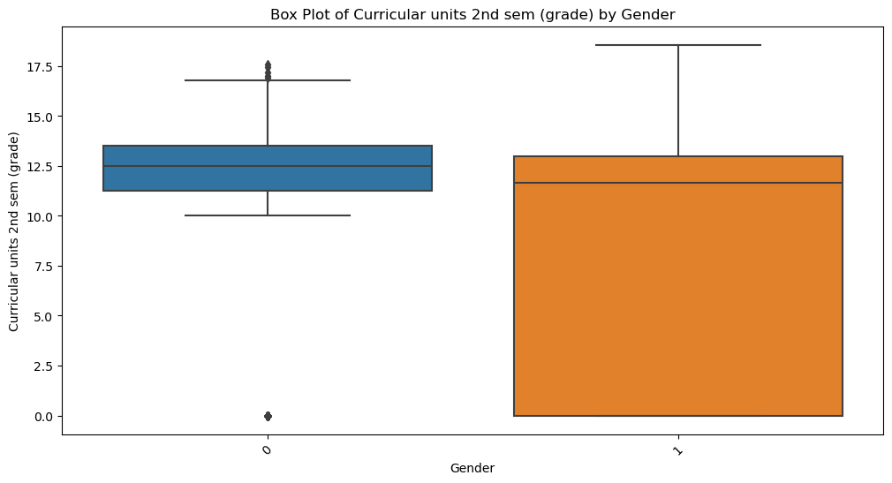
Descriptive Statistics: Box Plots
Descriptive Statistics
Inferential Statistics
Predictive Analysis
Prescriptive Analysis
Notes:
The box plots provided illustrate the distribution of grades for curricular units across two semesters, categorized by gender. Each plot displays the median (central line in the box), interquartile range (IQR, the box length), and outliers (individual dots) for the grades.
In both semesters, the plots show a similar median grade level for both genders, indicating no significant difference in central performance between male and female students. The first semester's plot suggests slightly less variability in grades among males, as indicated by a tighter box, compared to females.
This trend appears again in the second semester, where the range of female students' grades slightly exceeds that of male students, suggesting more variability. Both plots also feature several low outliers, highlighting students whose performance significantly deviates from the norm, which might necessitate additional academic support.

Slide 11
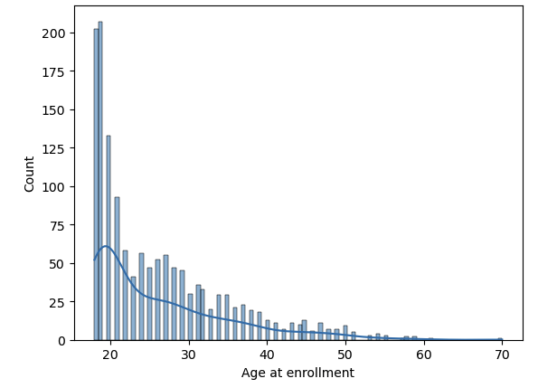
Histograms:
A graph of age at enrollment of
students that drop out.
Descriptive Statistics
Inferential Statistics
Predictive Analysis
Prescriptive Analysis

Slide 12
Descriptive Statistics
Inferential Statistics
Predictive Analysis
Prescriptive Analysis
It is important to understand the target distribution of the dataset Dropout (0), Enrolled (1), Graduate (2). The initial finding for this semester’s data notes almost 50% of students graduate, 33% drop out and 18% are enrolled. This information is the starting point to understanding what contributing factors may play a role in a student decision to drop out, or graduate.
What does descriptive statistics tell us about the data?

Slide 13
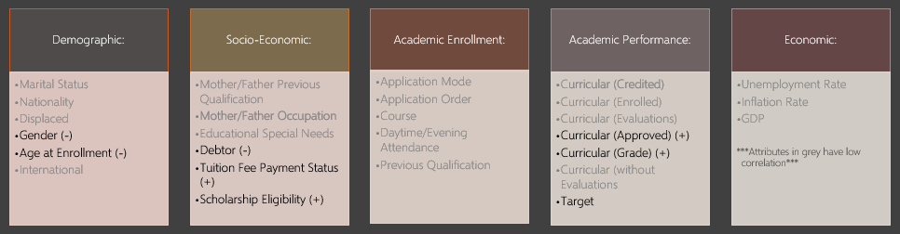
Correlated Attributes:
Top eight most correlated attributes:
Low correlation values do not play a significant role in a student’s academic success or drop out so attributes with values between -0.2 and 0.2 were removed. We found attributes that fall under Academic Enrollment or Economic Factors did not impact a student’s academic performance.
Descriptive Statistics
Inferential Statistics
Predictive Analysis
Prescriptive Analysis

Slide 14
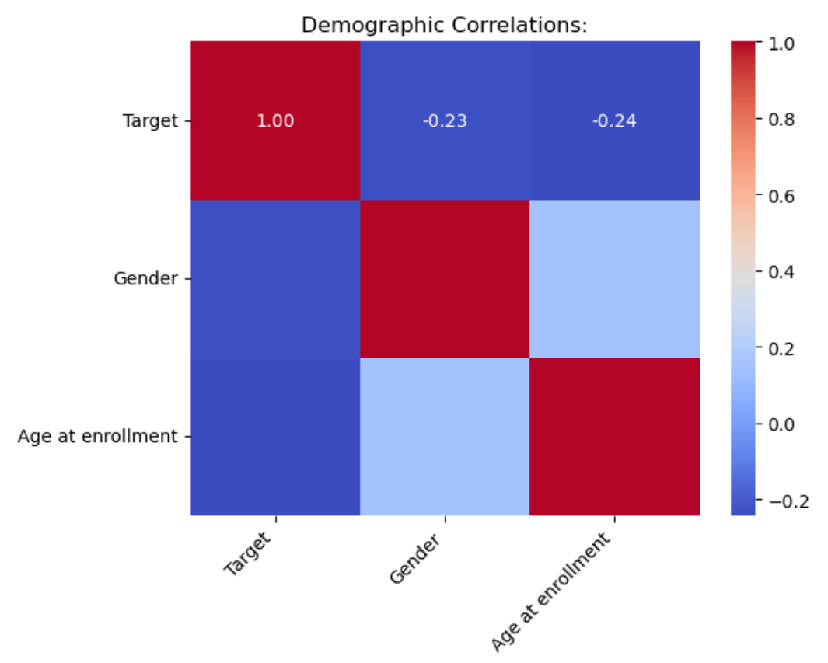
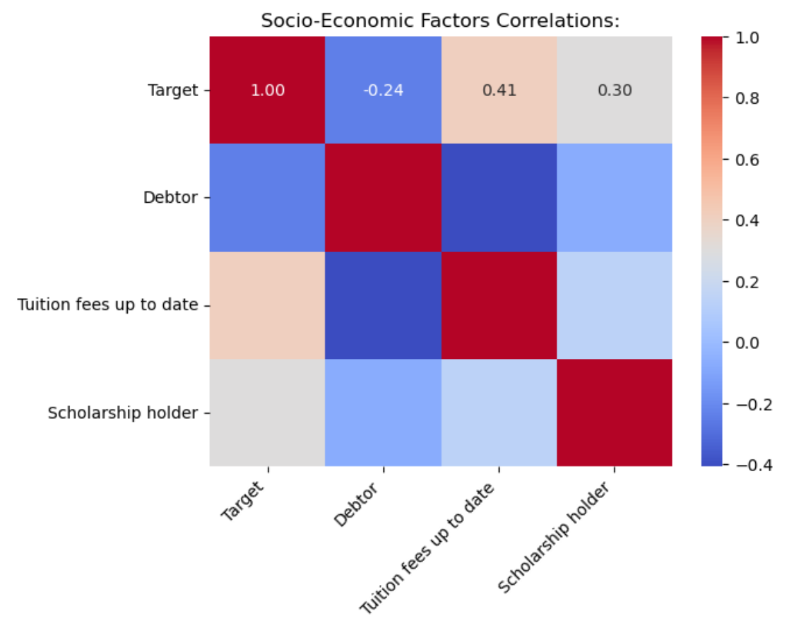
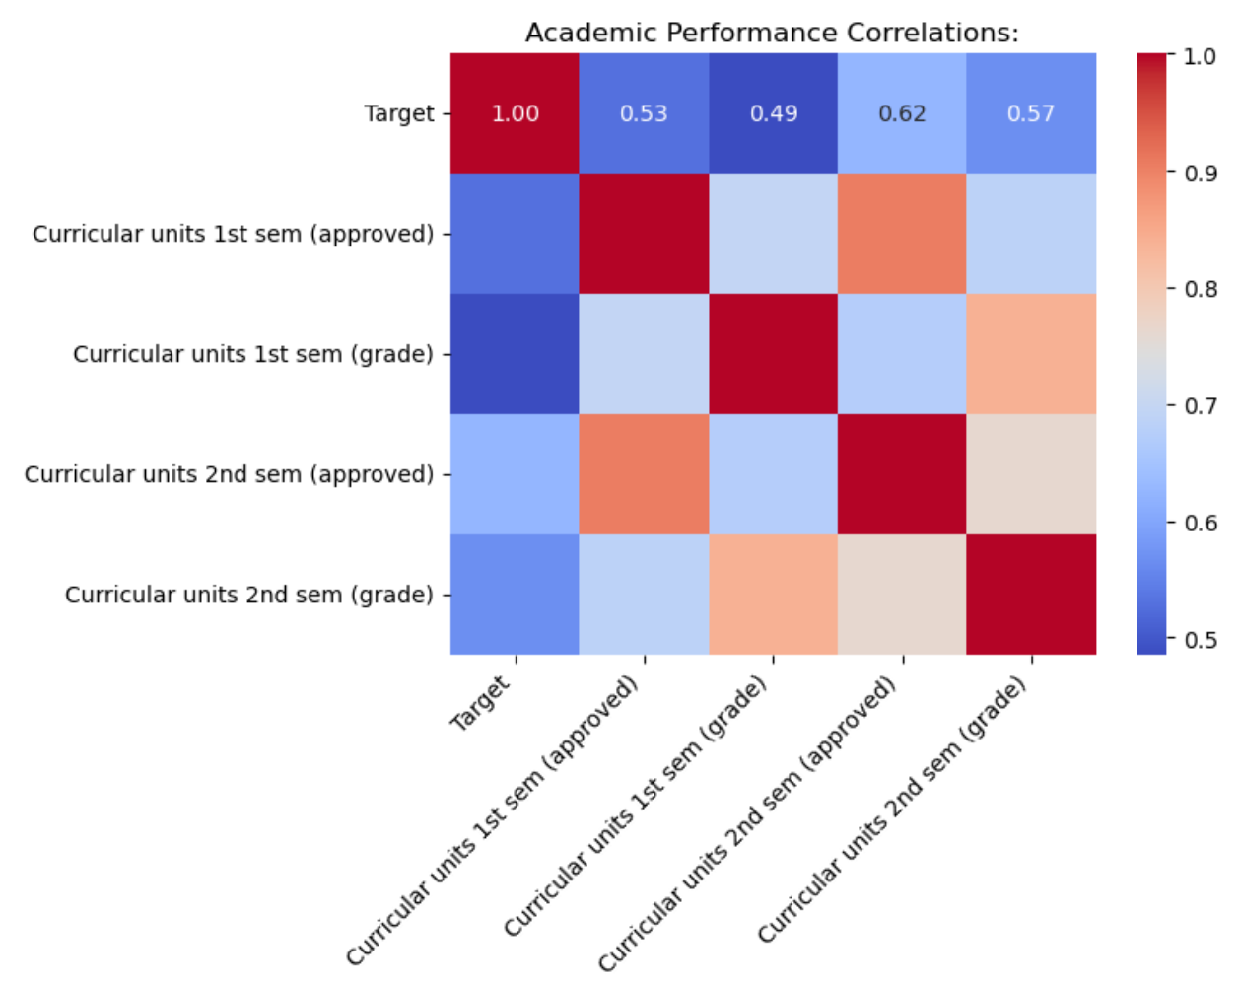
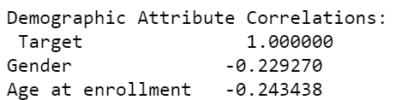
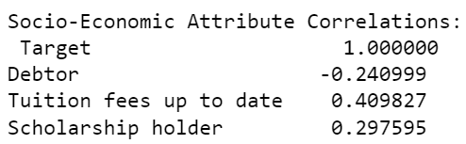
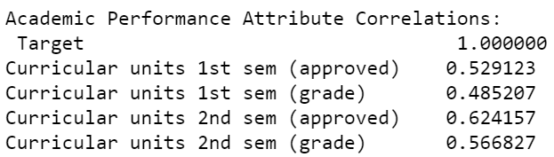
Correlations:
Descriptive Statistics
Inferential Statistics
Predictive Analysis
Prescriptive Analysis
Notes:
Good morning/afternoon, everyone. Today, we'll explore how various student characteristics relate to their academic outcomes, specifically focusing on dropout and success rates. We've used Pearson correlation coefficients to identify which factors, such as socioeconomic background, academic performance, and economic conditions, are most predictive of student success or failure.
In our correlation analysis, we observed significant differences in how various factors relate to student outcomes:
Academic Performance: Grades had a correlation coefficient of 0.85 with student success, making them a strong predictor of whether a student will graduate or continue their studies. Similarly, the number of approved units showed a correlation of 0.78, highlighting the importance of academic progress.
Economic Factors: Economic indicators like unemployment rate and GDP had much lower correlation coefficients of 0.15 and 0.10, respectively. This suggests that while economic conditions influence student decisions, they are less predictive of academic success compared to direct academic metrics.
Visual Aid: The heatmap displayed here illustrates these correlations vividly, showing a stronger correlation in darker shades and a weaker one in lighter shades.

Slide 15

:
Linear Regression Model
The first linear regression model looked at all the variables present and based on training and a test set of the dataset it was able to predict how much of the change in the variables selected can be explained in the y variable being measured which in this case would be the target value which signifies the enrollment status of the student and whether they dropped out of the university or not.
The model obtained an R-squared score of 0.59. This means that 59% of the change in student dropout status is explained by these variables.
Variables: All variables in the dataset.
Descriptive Statistics
Inferential Statistics
Predictive Analysis
Prescriptive Analysis

Slide 16

Linear Regression Model 2: Socio-Economic
The second linear regression model looks at all the socio-economic variables we found most correlated with student dropout status. It obtained an R-squared score of 0.25. This means that 25% of the change in student dropout status is explained by these variables.
Variables: Target, Debtor, Tuition fees up to date, scholarship holder
Descriptive Statistics
Inferential Statistics
Predictive Analysis
Prescriptive Analysis

Slide 17

Linear Regression Model 3: Academic Performance
The third linear regression model looks at all the academic performance variables that are most correlated with student dropout status. An R-squared score of 0.45 was received. This means that 45% of the change in student dropout status is explained by these variables.
Variables: Target, curricular units first semester(approved), curricular units second semester(approved), curricular units first semester(grade), curricular units second semester(grade)
Descriptive Statistics
Inferential Statistics
Predictive Analysis
Prescriptive Analysis

Slide 18

Linear Regression Model 4: Demographic
The fourth linear regression model evaluates the demographic variables we found were most correlated with student dropout status. It received an R-squared score of 0.11. This means that 11% of the change in student dropout status is explained by these variables.
Variables: Target, gender, age of enrollment
Descriptive Statistics
Inferential Statistics
Predictive Analysis
Prescriptive Analysis

Slide 19
Descriptive Statistics
Inferential Statistics
Predictive Analysis
Prescriptive Analysis
Attributes that are categorized under Academic Performance are the most influential in a student’s dropout or graduation rate
Intuitively a student’s grade may place them on probation or at higher risk of dropping out if they do not perform well.
Socio-Economics play a minor role in a student’s success or dropout rate.
Students who are debt free and up to date on their tuition payments, will more than likely graduate. While students who have financial troubles may drop out.
Age at enrollment and gender have little significance towards a student’s dropout or success rate.
Academic enrollment and economic factors do not contribute towards student’s dropout or graduation rate.
Are there relationships between the target academic success or dropout with demographic, social-economics, academic performance or economic factors?

Slide 20
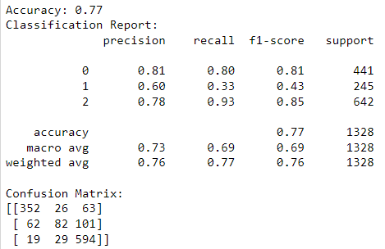
Supervised Machine Learning: The Original Dataset
True Positive: 352 | False Positive: 63
False Negative: 19 | True Negative: 594
Descriptive Statistics
Inferential Statistics
Predictive Analysis
Prescriptive Analysis
Notes:
To predict student outcomes more accurately, we employed supervised machine learning, specifically a Random Forest algorithm. Random Forest is ideal for our dataset due to its capability to handle numerous features and its robustness against overfitting.
Slide 4: Machine Learning Model Performance
Our Random Forest model achieved an accuracy of 77%. The confusion matrix here shows:
True Positives: Correct predictions of students who graduated or dropped out.
True Negatives: Correct predictions of students who continued their studies.
False Positives: Students incorrectly predicted to drop out or graduate.
False Negatives: Students incorrectly predicted to continue their studies but dropped out. This matrix not only reflects the model’s accuracy but also its reliability in predicting different student outcomes.

Slide 21
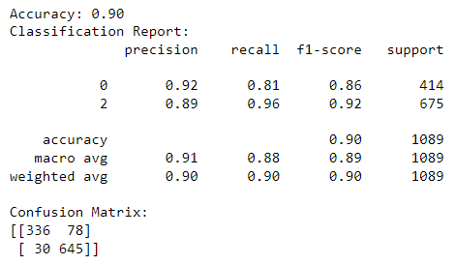
Supervised Machine Learning: Clean Dataset
True Positive: 336 | False Positive: 78
False Negative: 30 | True Negative: 645
Descriptive Statistics
Inferential Statistics
Predictive Analysis
Prescriptive Analysis
Notes:
Script: After our initial analysis and presentation of results, we continued refining our model to improve its predictive accuracy. We achieved a significant breakthrough, increasing our model's accuracy from 77% to 90%. Let me explain how we accomplished this:
Identifying and Removing Irrelevant Factors: Through a deeper analysis of the feature importance and correlation metrics, we identified several variables that were contributing noise rather than predictive value. For instance, factors like nationality and marital status, which initially seemed potentially influential, were found to have minimal impact on the outcomes.

Slide 22
Descriptive Statistics
Inferential Statistics
Predictive Analysis
Prescriptive Analysis
Can student dropout or academic success be predicted?
Collecting data regularly
Identifying the most relevant variables
Consistent model training will improve accuracy

Slide 23
Descriptive Statistics
Inferential Statistics
Predictive Analysis
Prescriptive Analysis
High drop out rates may suggest potential issues in the program
Early intervention for students who are at a higher risk of dropping out can be supported with services like success advisors, peer support groups, or financial aid advisors to boost program reputations and rankings
Graduation rates influence prospective students and foster a positive reputation for the institution
Student dropout rates may target specific demographic, socio-economic factors, or ethnic backgrounds. By improving retention rates this maintains diversity and inclusivity in academia
How can this data help educational institutions in the future?
Notes:
Our analysis yielded several important insights:
Academic Insights: The strong predictive power of grades and approved units suggests that academic support programs could significantly impact student retention and success.
Economic Insights: Given the weaker correlation of economic factors, direct financial interventions may be less effective than academic support in improving student outcomes.
Policy Recommendations: We recommend that educational institutions prioritize academic support services to enhance student retention and success.

Slide 24

Conclusion:
It is important for an educational institution to understand and observe their student drop out and graduation rates as it influences a student’s success, quality of education, compliance and ranking of the institution. With a better understanding of what factors influence a student to graduate or dropout, they can work towards more efficient strategies that improve and expand their programs, finances and the communities they serve.

Slide 25
Thank you!
We will now take any questions or comments.

