Slide 1
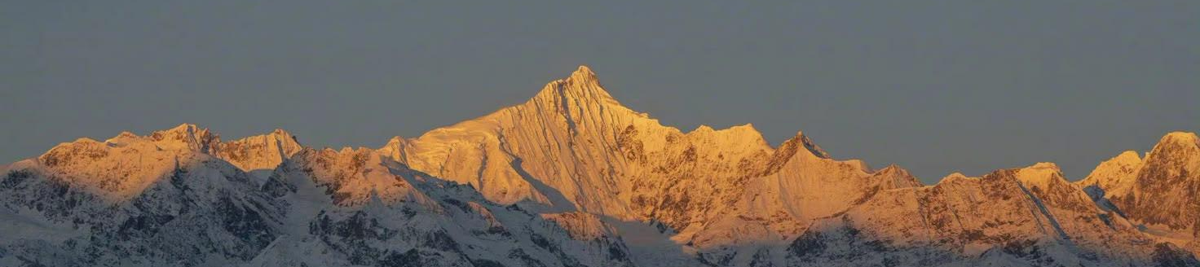


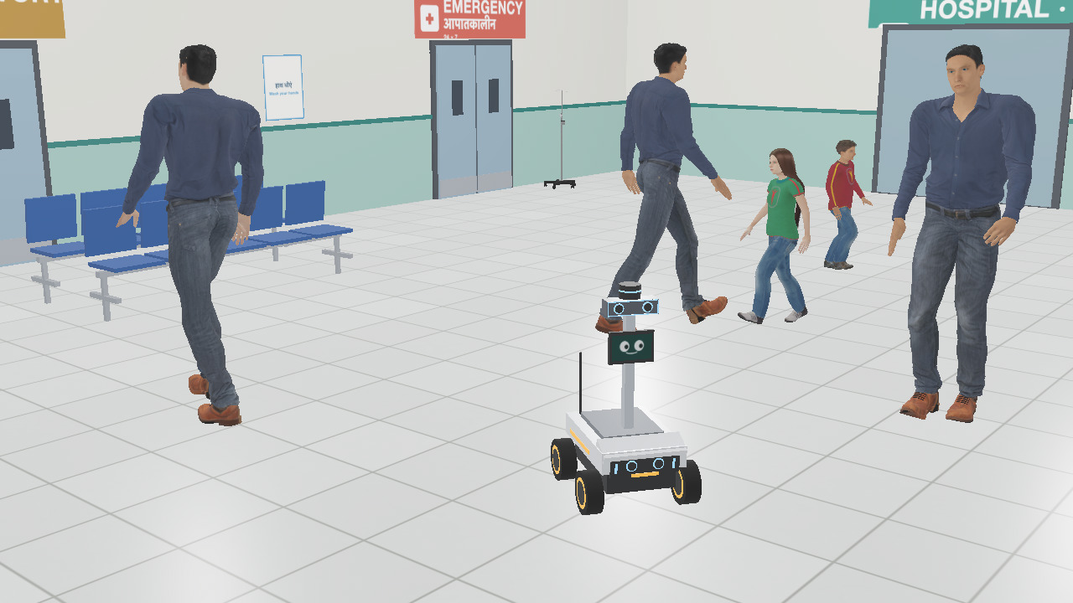
SAATHI
TEAM
A robot guide that reads Indian hospital crowds
PS-01 · Vision-Based Autonomous Robot · shown in a Webots hospital simulation
• TEAM NAME: Team Glitch
• MEMBERS & ROLES:
Ayush Kumar
Lead: robot & simulation, vision & AI, shared memory, Hindi voice
Soumya Raghuwanshi
Research: Indian hospital data and sources
Simran Kumari Keshri
Testing and pitch: voice tests, demo video

Slide 2
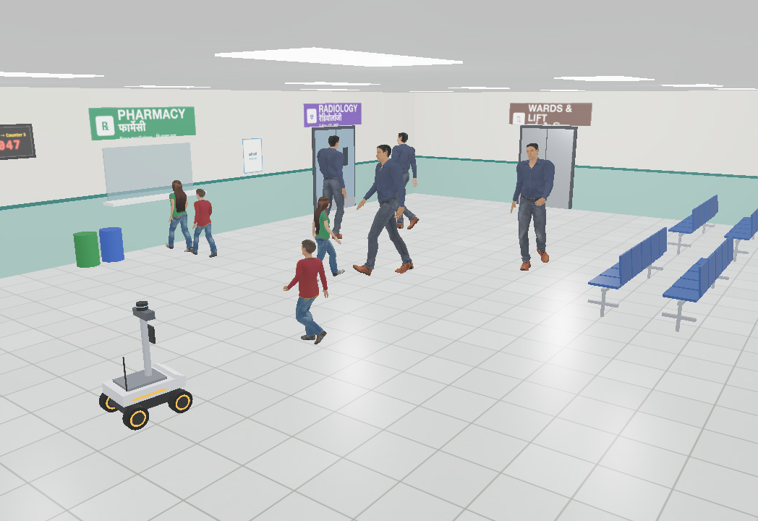
PROBLEM STATEMENT & THEME
PROBLEM
Big Indian OPDs are packed, confusing and signed in English. First-time, elderly and low-literacy patients get lost, and staff leave their work to show them the way.
14–15k
OPD patients a day at AIIMS Delhi
69.6%
of first-time OPD visitors needed a person to find their way (GMC Bhopal)
3 h+
total OPD wait for 58% of 400 patients (RIMS Ranchi, 2026)
IMPACT
Hours lost and appointments missed. Help desks and nurses pulled away from care. A fall in a packed hall is noticed late. And today's robot planners either freeze in dense crowds or cut straight through people.
Our simulated OPD hall in Webots: Hindi + English signs, token display, pharmacy queue
THEME ALIGNMENT · PS-01 VISION-BASED AUTONOMOUS ROBOT
• AI vision finds and tracks people and objects (YOLO11 + depth camera)
• Drives itself to a goal (any department) while avoiding obstacles and people
• Decides in real time: slow down, give way, side-step, stop
• Shown in a realistic simulated hospital (Webots), which PS-01 allows
THE GAP
Our 2024–26 search found no wayfinding robot working in an Indian OPD. Guide robots already work in airports abroad (SPENCER at Amsterdam Schiphol); Indian OPD crowds are denser.
Sources: AIIMS OPD load: UNI and Free Press Journal, Sep 2026 · GMC Bhopal: IJCMPH 2026 (336 first-time visitors) · RIMS Ranchi: Cureus, 20 Sep 2026

Slide 3
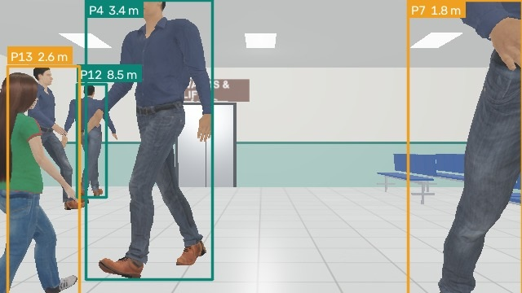
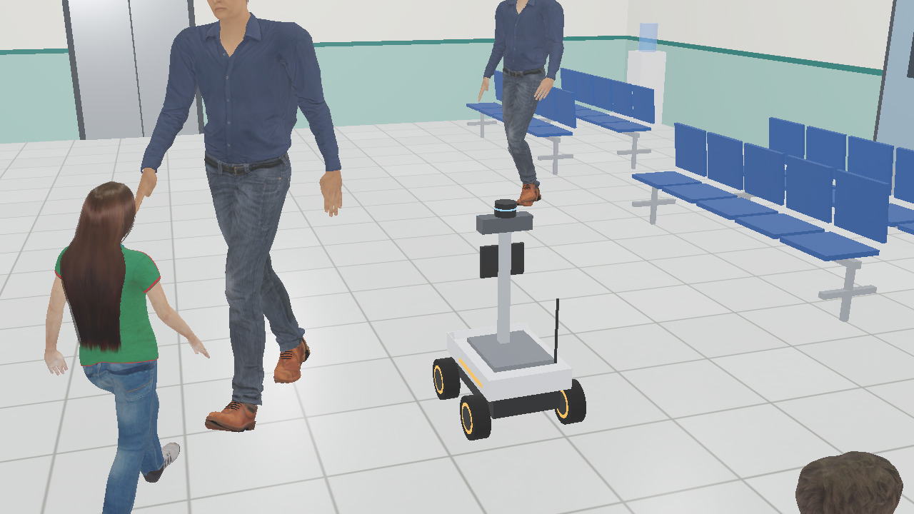
SOLUTION
Saathi is an autonomous guide robot for hospital OPDs. Say “Mujhe X-ray karwana hai” and it walks you to Radiology at your pace, reading the crowd with its camera, and it can explain every move.
KEY FEATURES
Talks like a person
Hindi, Hinglish or English. Asks when unsure: “Kaunsa red shirt?”
Reads the crowd
Predicts where each person will be in 2 s. Never cuts through a conversation; wheelchairs go first.
Side-steps, keeps left
Mecanum wheels slide it aside instead of stopping dead in a busy corridor.
Finds things
“Dustbin dhoondo”: open-vocabulary detection finds it by name, and Saathi drives there.
Watches out
Spots a fall, alerts the nurse station and stays with the patient.
Safe by design
Hard stop under 0.6 m, and a fist gesture stops it. The AI cannot override either.
What Saathi sees: YOLO11s boxes, track IDs and distance from its depth camera
UNIQUE VALUE: EXPLAINABLE, TESTED, BUILT FOR INDIAN CROWDS
A black box records every decision with its camera frame and reason, so “Tum ruke kyun?” gets an answer with proof. In 200 seeded crowds Saathi had 73% fewer near-misses than a normal robot and never cut through a conversation.
Next: Saathi Parivaar. Robots that share one memory of people find a lost child where he is now, not where he was seen.
Moving through the OPD crowd (Webots simulation)

Slide 4
ARCHITECTURE
SENSORS
Stereo RGB camera · depth camera · 360° LiDAR · IMU · ultrasonic
REFLEX BRAIN · 30 Hz
YOLO11 + depth + LiDAR → people with speed; depth finds what the map lacks · A* on a crowd costmap
SAFETY GUARD
Runs on LiDAR, not the AI: stops under 0.6 m. A fist gesture stops it.
MOTOR CONTROL
Body velocity → four mecanum wheel speeds (inverse kinematics)
goals
events
YOU
Voice (Hindi speech-to-text) · typing · hand gesture
THINKING BRAIN · LLM + VLM
LLM talks Hinglish and plans; a small VLM (Qwen3.5-2B) describes scenes and reads signs
BLACK BOX
Every decision: camera frame + reason. Answers “why?”
RUNS ON
Today: an 8 GB M1 MacBook Air. Robot: Jetson Orin Nano (planned)
TECH STACK
• Webots R2025a (physics, mecanum wheels) · Python 3.10
• YOLO11 + YOLOE open-vocabulary · camera + LiDAR tracker
• Qwen3.5-2B vision-language model on Apple MLX
• LLM agent: Claude API, small local model offline
• whisper.cpp (Hindi speech) · Hindi text-to-speech
• MediaPipe Hands for the gesture stop
DATA FLOW
• Camera + depth → people with ID and distance
• Crowd map with each person's next 2 seconds
• Planner picks path and speed (groups, wheelchairs, keep-left)
• Safety guard checks, then the wheels move
• Every decision → black box → the agent can explain it
APIS + MEASURED
• API: Claude for conversation only; offline phrasebook without network
• People placed within 0.10 m (median) by camera + LiDAR
• Planner: about 5 ms a plan, replans twice a second
• YOLO11n 9.5 ms a frame on our 8 GB M1 laptop
• Fall classified 0.3 s after it happened · VLM about 3 s an answer

Slide 5
MARKET RESEARCH/ANALYSIS
TARGET USERS
• Patients: elderly, first-time, low-literacy and non-English-speaking visitors
• Hospitals: government medical colleges, district hospitals, AIIMS-type institutes, large private chains
• Staff: help desks and nurses answer fewer “X-ray kahan hai?” questions
MARKET SIZE
816
medical colleges (2025–26)
714
district hospitals
1,340
sub-divisional hospitals
India medical-robot market: USD 191 M (2024) → 450 M (2029), MarketsandMarkets; USD 1.32 B (2024) → 8.12 B (2033) under IMARC's broader definition. Guide robots are a new slice of it.
POTENTIAL REVENUE MODEL
• Robot-as-a-Service: about ₹15,000 a month per robot, with maintenance and updates
• Sale + annual maintenance contract for large hospitals
• Licence the Saathi brain to robot makers
• Crowd-flow analytics for hospital admins (busy hours, where patients get lost)
• Pilots funded through CSR and the National Health Mission
EXPECTED GROWTH
• Pilot in one OPD → state rollout (NHM / CSR) → private chains
• Beyond hospitals: railway stations, airports, pilgrimage sites
• The medical-robot market is forecast to grow 18.7–20.6% a year (reports above)
• Every robot's black box adds data that makes the next one smarter
Sources: Health Dynamics of India 2022-23 (MoHFW, data as of 31 Mar 2023) · NMC approvals 2025-26 (The Tribune) · MarketsandMarkets and IMARC, India medical robots market

Slide 6
FUTURE SCOPE
BUILT · OCT 2026
Physics rover in a Webots OPD; crowd-aware planner; camera + LiDAR + depth; fall alert; VLM; A/B on 200 crowds
BY 24 OCT 2026
Saathi Parivaar with 2 robots, Hindi voice agent, walks at the patient's pace, gesture stop, demo video
20–21 NOV 2026
Manali finale: Saathi Parivaar with 3 robots and its 200-seed test, live and fully offline on a laptop
2027
Build the real rover: Jetson Orin Nano, team design, face screen, mic, speaker, e-stop. Pilot in one OPD with consent and face blurring
NEXT
More Indian languages (Bhashini, IndicWhisper), token/queue integration, robot fleets, stations and airports
ALSO ON THE ROADMAP
• Staff mobile app: send Saathi, see where it is, read its black box
• Fine-tune YOLO on Indian hospital scenes: wheelchairs, stretchers, crowds at counters
• Crowd heatmaps that tell admins where patients get lost
WHY IT SCALES
• The brain is software: the same code runs in Webots and on the real robot
• Hindi first, then any Indian language with the same agent
• Hospitals, stations, airports and melas share one problem: crowds and lost people

Slide 7
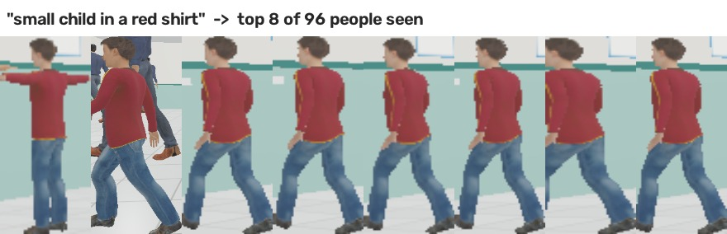
EXTRA · SAATHI PARIVAAR: EK YAAD, KAI AANKHEIN
A mother says “Mera beta kho gaya, laal t-shirt, 6 saal”. Every Saathi in the hospital answers from one shared memory of people. Building now for the finale.
WHAT EXISTS → WHAT SAATHI ADDS
NVIDIA ReMEmbR (2024): a robot recalls where it saw things
→ Where a person is now, from a fresh sighting
HUMEMBR (IROS 2026): finds known people by face and routine
→ Strangers, by clothes only; no face stored
Kumbh 2025 khoya-paya: face recognition on fixed cameras
→ Robots also remember where they looked and saw no one
Lost-child robots (Japan, 2017): share spoken descriptions
→ A team that splits the search; one robot always stays
WHY INDIA
• 98% of 400 older patients at AIIMS Delhi's geriatric OPD usually come alone (preprint, 2026). The robots become the family they didn't bring.
• People rest on OPD floors. Memory tells a fall from rest, so nurses are not paged all day.
1 REMEMBER
Each robot logs who it saw, where, when and which way they walked. Clothes only: no face is stored.
2 ASK
Her words search every robot's memory: “Saathi-2 saw him 3 min ago at the pharmacy, walking to the corridor.” She taps his photo.
3 WHERE NOW?
From his last motion Saathi works out where he can be now, and rules out places the robots checked and found empty.
4 SEARCH AS A TEAM
Robots split the likely places; one stays with the mother. Once they meet, his record is deleted.
TESTED ON SAATHI'S OWN CAMERA
“Small child in a red shirt”: the top 8 of 96 people seen are all him. A woman in green and a man in blue: 24 of 24 right. No look-alikes in this hall yet; the finale test adds them.
ONE MEMORY, FIVE JOBS
Khoya-Paya
finds a lost child
Bichhadne se pehle
spots a child drifting from family
Vaada
fetches you before your token
Doosri raay
fell, or resting on the floor?
Ek ruke, ek bulaye
one stays, one fetches help
Privacy: clothes, not faces · deleted after a reunion · wiped daily · every search logged Plan: 2 robots by 24 Oct · 3 robots and a 200-seed test (1 vs 3 robots, memory on/off) at the finale
Prior work, to our knowledge (our search, Oct 2026): ReMEmbR arXiv 2409.13682 · HUMEMBR arXiv 2606.30404 · Kumbh 2025 Digital Khoya-Paya Kendra · Wada et al., IEICE CNR2017-12 · AIIMS geriatric OPD: Research Square preprint, Aug 2026

Slide 8
EXTRA · PS-01 CHECKLIST: EVERY LINE, WITH PROOF
PS-01 asks for | What Saathi does | Proof from our runs
✓ Understand surroundings with AI vision | YOLO11 + depth camera + 360° LiDAR; people on a floor map | People placed within 0.10 m (median)
✓ Identify relevant people and objects | Tracks people; YOLOE names objects by text | “cardboard box” and “yellow caution sign” named on sight
✓ Navigate autonomously to an objective | A* on a crowd costmap; goals by name or by sight | Found a dustbin by camera, reached it in 12 s
✓ Detect and avoid obstacles | Depth camera finds what the map does not have | Map-only robot hit 2 unmapped objects; Saathi 0
✓ Real-time decision making | 30 Hz reflex loop, replans twice a second | 200 crowds: 73% fewer near-misses than a normal robot
✓ Object detection, image classification | YOLO11 people; YOLOE posture: “person lying on the floor” | Fall classified 0.3 s after it happened
✓ Scene understanding | Conversations and queues from tracks; signs read | Cut through a conversation in 0 of 200 crowds
✓ Vision-language models | Qwen3.5-2B (Apple MLX) describes the scene | Its description goes with the nurse alert
✓ Motor control | Physics mecanum base, speed command per wheel | Forward, sideways and turning within 7% of the command
✓ Real or simulated environment | Realistic Webots OPD hall, Hindi + English signs | Deterministic: every run gives the same numbers

Slide 9
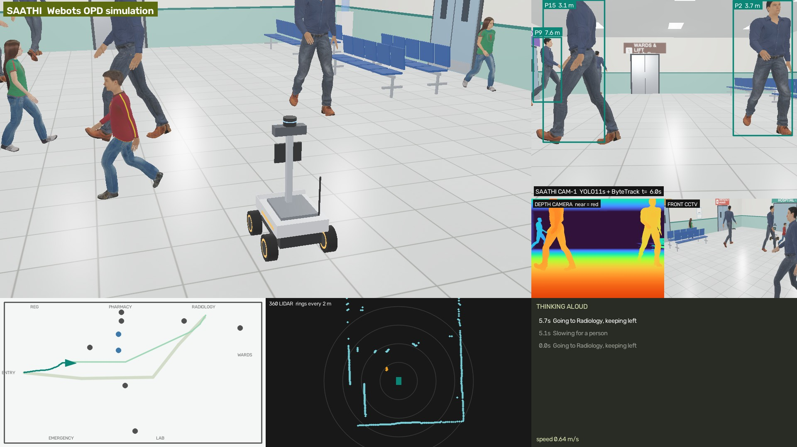
EXTRA · WORKING PROTOTYPE (SIMULATION)
BUILT AND RUNNING
• OPD hall with Hindi + English signs, token display, pharmacy queue, animated people
• Plans its own way to any department (A* on a crowd costmap)
• Sees people with camera + depth + 360° LiDAR, tracks them on the floor
• Slows, waits, slides sideways to let people pass, and thinks aloud
• Sees obstacles that are not on its map, finds things it is asked for, spots falls
• Black box: every decision saved with its camera frame
• Physics mecanum base driven by wheel speed commands
BUILDING NEXT (BY 24 OCT)
• Saathi Parivaar: 2 robots share one memory (Khoya-Paya demo)
• Hindi voice agent: speech in, Hindi voice out
• Walks at the patient's pace; eyes that look at the person
• Gesture stop from a webcam
Demo video and GitHub repo: in the prototype round (18–24 Oct)
One frame of our Webots run: chase camera, Saathi's camera with YOLO boxes and distances, depth camera, front CCTV, map, 360° LiDAR, and its thinking log.

Slide 10
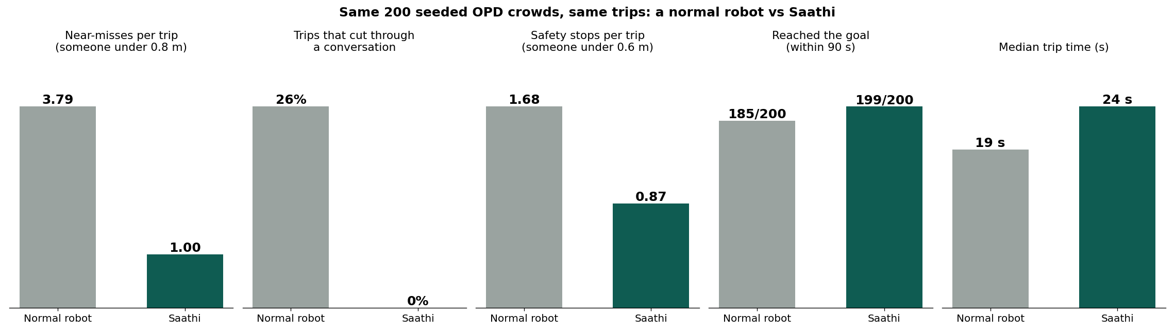
EXTRA · RESULTS: 200 CROWDS, TWO ROBOTS
73% fewer
near-misses: 3.79 → 1.00 per trip
0 of 200
trips cut through a conversation (normal robot: 26%)
199/200
trips reached the goal (normal robot: 185/200)
+5 s
the price: median trip 19 s → 24 s
Method: each seed builds an OPD crowd (8–12 walkers, two talking pairs, a pharmacy queue) and a trip from the entrance to a random department. Both robots get people's true positions. Normal robot = the same A* planner treating people as obstacles where they are now, fixed speed, same 0.6 m stop. The trip Saathi missed: a very crowded crossing where it kept waiting rather than push through.

Slide 11
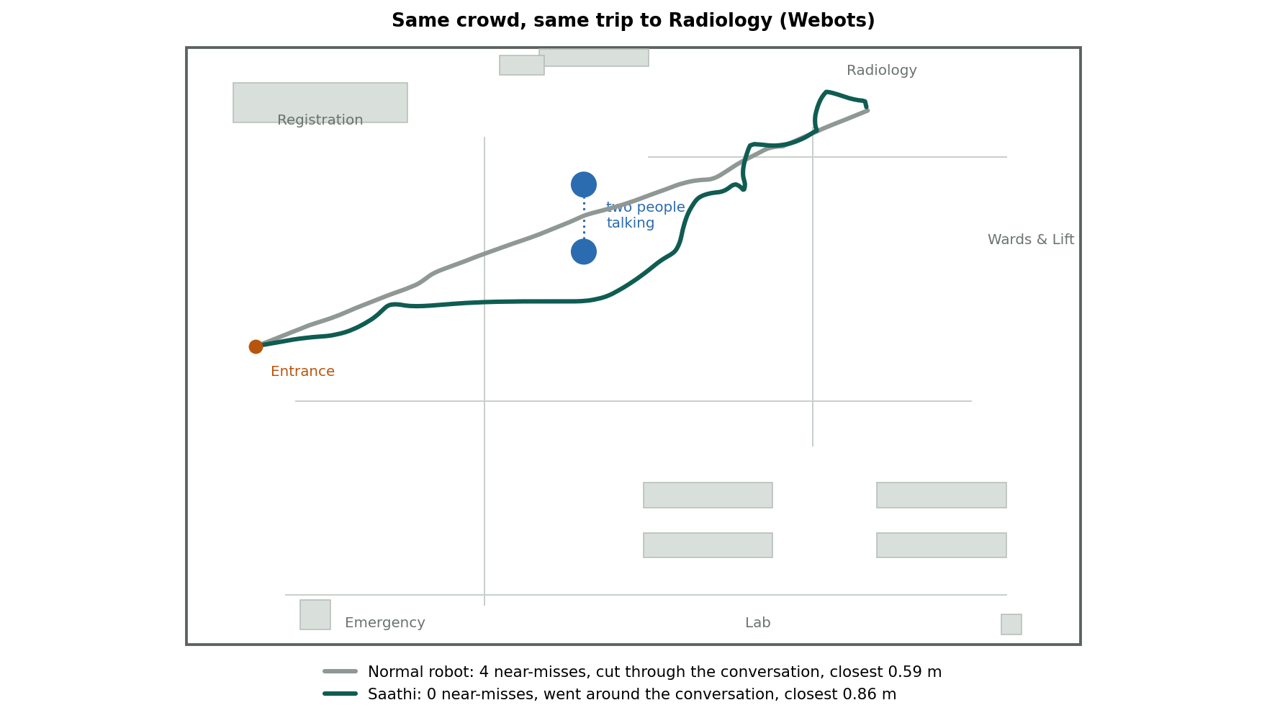
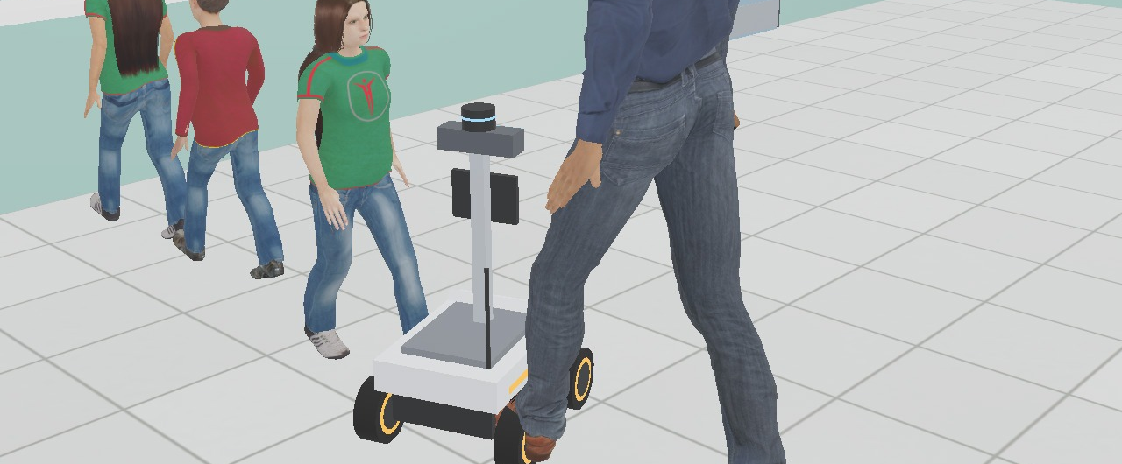
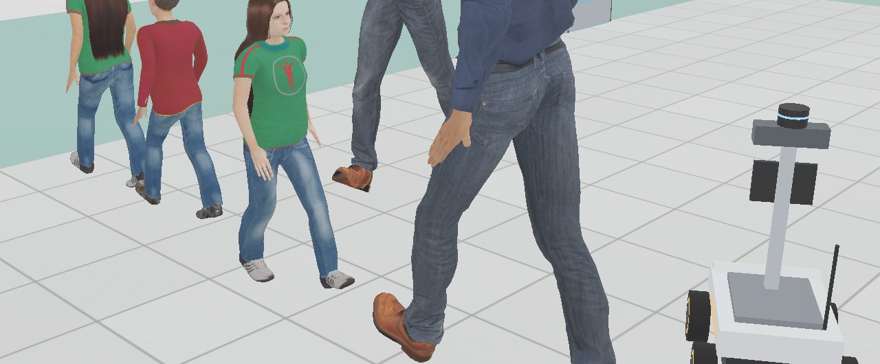
EXTRA · SAME CROWD, TWO ROBOTS (WEBOTS)
NORMAL ROBOT: cuts through the conversation
SAATHI: goes around it
 | Normal robot | Saathi | Saathi, camera + LiDAR only
Near-misses | 4 | 0 | 1
Cut through the conversation | yes | no | no
Time to Radiology | 22 s | 25 s | 29 s

Slide 12
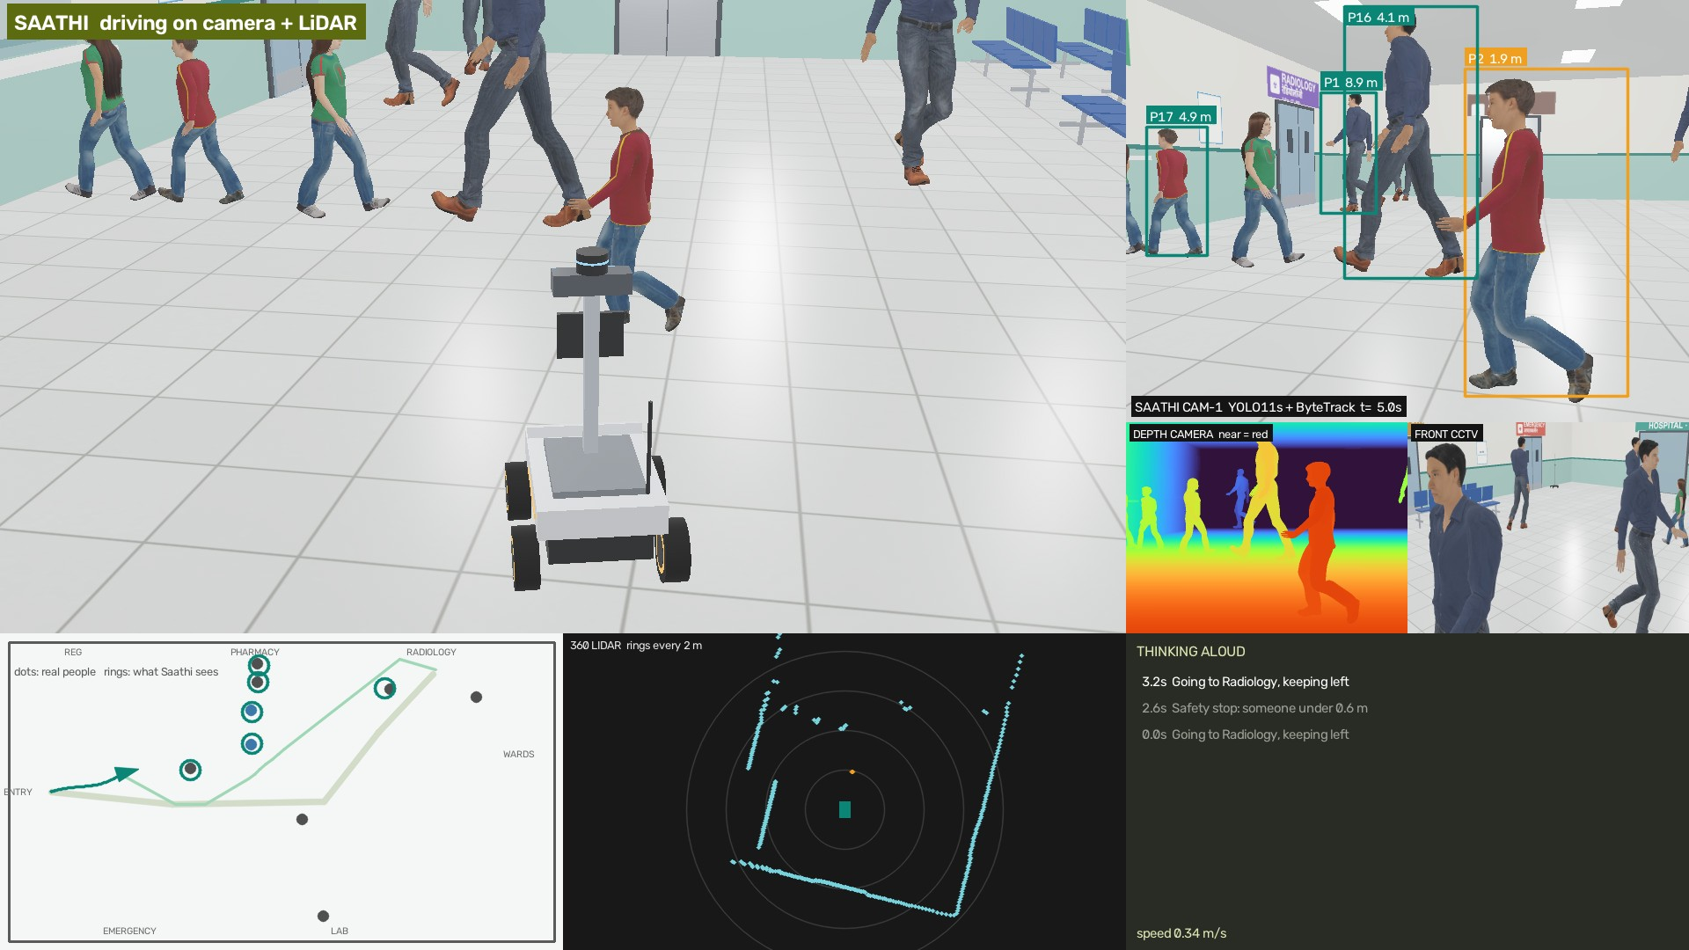
EXTRA · FROM PIXELS TO DECISIONS
HOW IT SEES
• YOLO11 finds people in the camera image
• The depth camera gives each one's distance
• The 360° LiDAR adds people beside and behind
• A floor tracker keeps IDs and walking speeds
• The planner predicts 2 s ahead and picks the path
0.10 m
median error placing people on the floor (0.32 m for 9 in 10)
Drove to Radiology on its own eyes: 1 near-misses, no conversation cut, 29 s (25 s with perfect positions).
Saathi driving on its own sensors. Map: grey dots are where people really are, teal rings are where Saathi thinks they are.

Slide 13
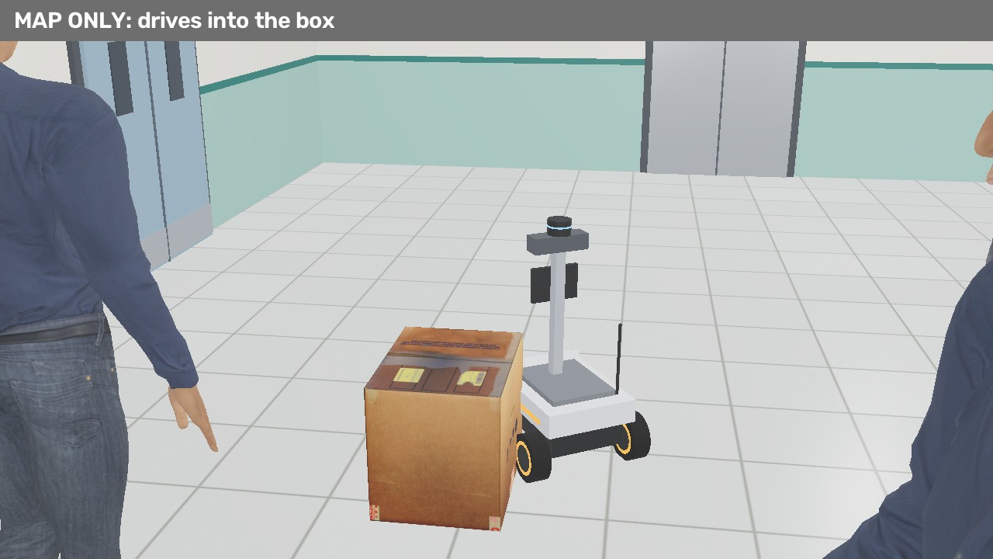
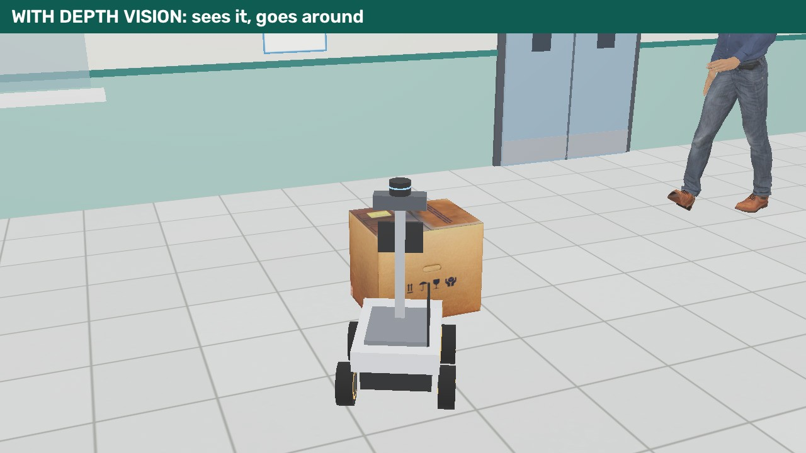
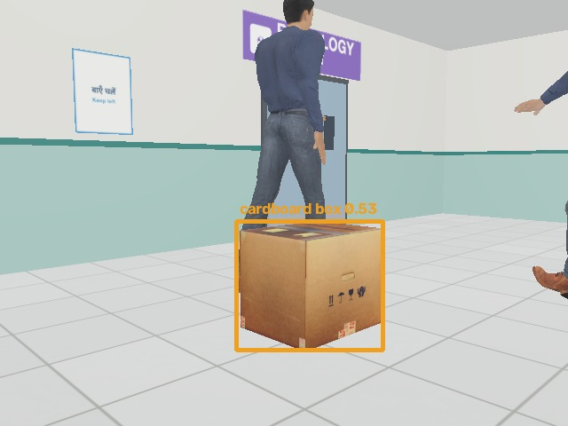
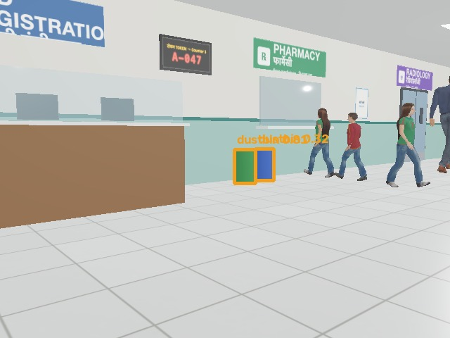
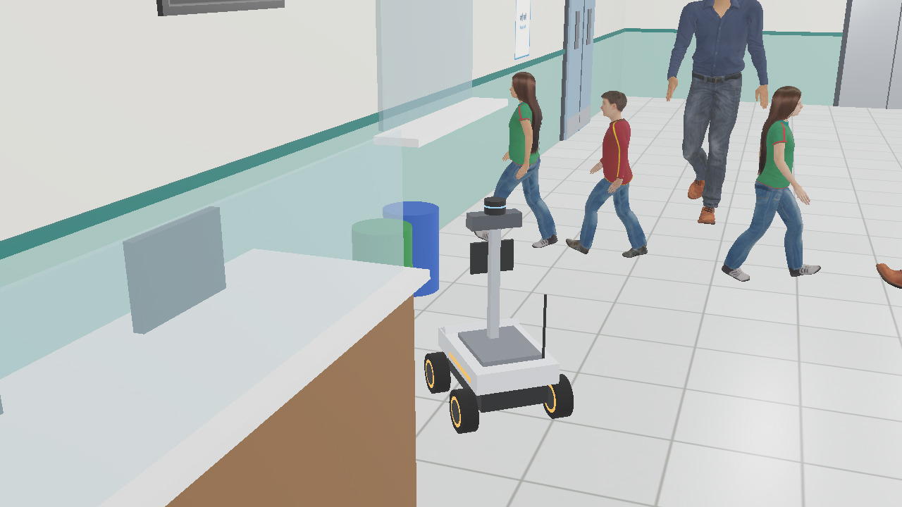
EXTRA · UNKNOWN OBSTACLES, AND FINDING THINGS BY SIGHT
OBSTACLES NOT ON THE MAP: a “wet floor” board and a cardboard box. Map-only: hit 2. With depth vision: hit 0.
At 15 s:
“Found a cardboard box that is not on my map: going around it”
FIND IT BY SIGHT: “dustbin dhoondo”, and the dustbin is not on Saathi's map
• Turns on the spot and asks YOLOE for “dustbin” about 3 times a second
• Sees it 7.5 m away after 1.6 s; the depth camera puts it on the floor map
• Plans there through the crowd and arrives at 12.4 s
• The same works for any word: “water cooler”, “wheelchair”, “sign board”

Slide 14
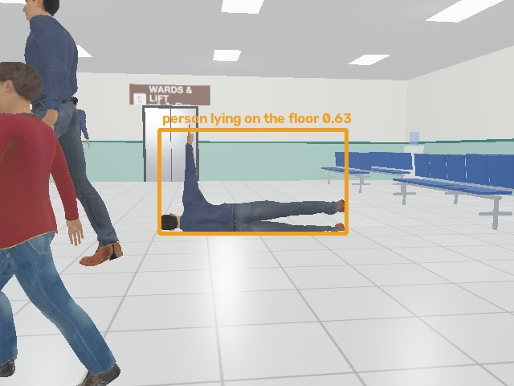
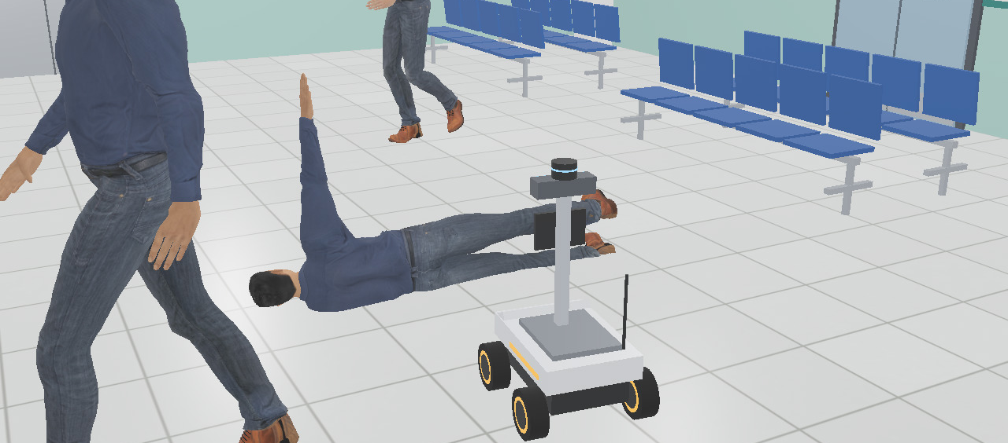
EXTRA · A FALL: CLASSIFY, ALERT, STAY, DESCRIBE
ALERT TO THE NURSE STATION
Patient fallen near the middle of the hall, 5 m from Lab (at 5.4 s)
VLM, in its own process: “In the hospital OPD hall, a man is lying on the floor, possibly injured or unwell, while others walk past or stand nearby.”
Then Saathi goes to them, stays until the nurse takes over, and finishes its trip (42 s).
Saathi's camera 0.3 s after the fall: YOLOE says “person lying on the floor”.

Slide 15
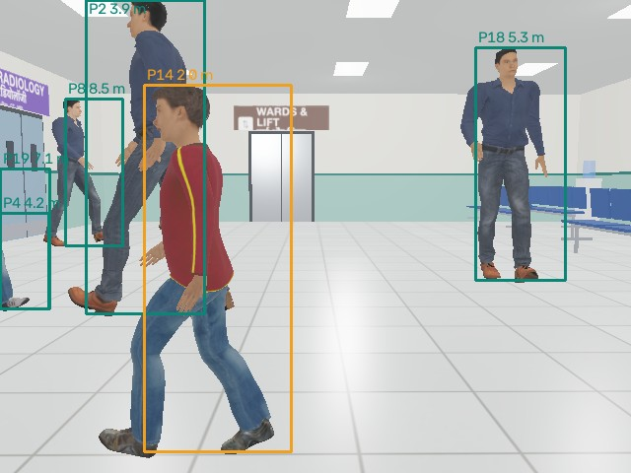
EXTRA · BLACK BOX: “TUM RUKE KYUN?”
You: Saathi, 0:05 pe tum dheeme kyun hue?
Saathi: 0:05 pe P14 mere raaste ki taraf aa rahe the. Main 0.51 m/s pe tha, isliye dheema hua, phir side khisak ke unhe jaane diya. Ye raha us pal ka camera frame.
WHAT THE BLACK BOX KEEPS
• Time 5.28 s · decision: Slowing for P14
• Speed 0.51 m/s · people in view: P8, P2, P18, P14, P4, P19
• The camera frame, with every box and distance
• The answer above is written from this record, so it cannot make things up
Saved by Saathi at 5.3 s: the camera frame of that decision, with what it saw.

Slide 16
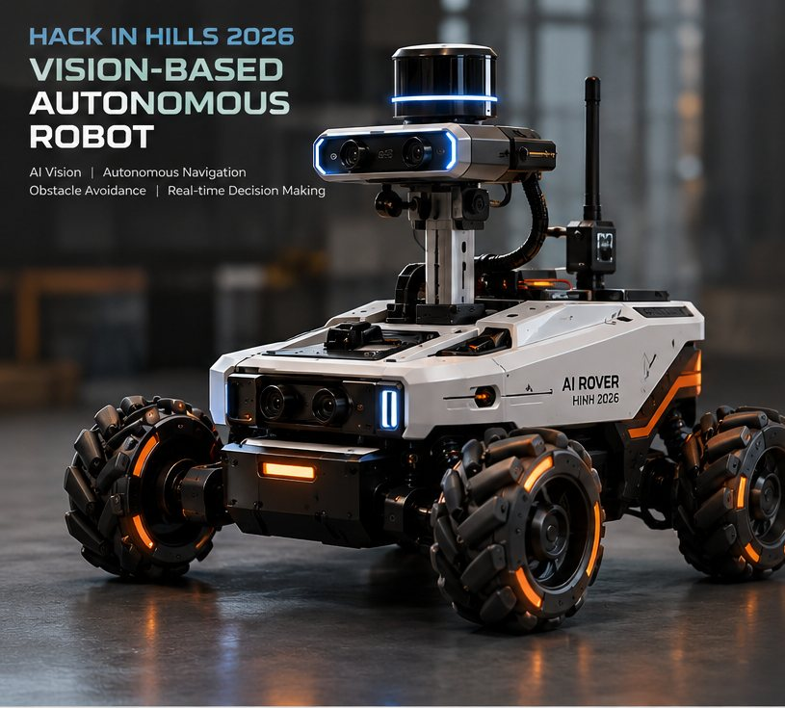
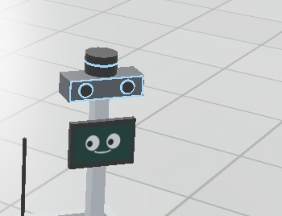
EXTRA · OUR ROVER IS SAATHI'S BODY
Part | What Saathi uses it for
Stereo RGB camera | Find, track and read people's intent
Depth camera | Distance to each person
360° LiDAR | Map, position, blind spots behind
Ultrasonic + IR | Close-range stop
IMU | Speed, heading, gentle braking
Mecanum wheels | Slide sideways in tight crowds
Jetson Orin Nano | Runs the reflex brain on board
+ Face screen, mic, speaker | Talk, listen, show mood (we add)
+ Red e-stop button | A physical stop anyone can press (we add)
SAME SENSORS IN SIMULATION
We built this rover in Webots with the same camera, depth camera, LiDAR and IMU, and gave it the face screen. The brain talks to the sensors through a small interface, so the same code can drive the real rover once its drivers are in.
Team design: AI Rover HiH 2026

Slide 17
SAATHI
Raasta bhi, saath bhi.
The way, and the company.
Team Glitch
Ayush Kumar
Thank
you!

