Slide 1



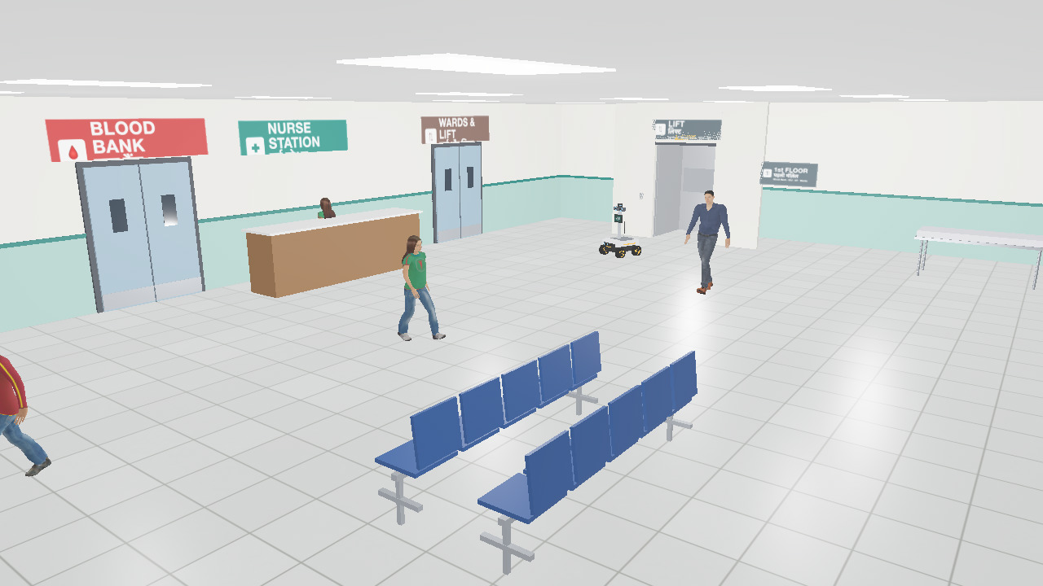
SAATHI
TEAM
A robot guide that reads Indian hospital crowds
PS-01 · Vision-Based Autonomous Robot · Round 2: working prototype in a two-floor Webots hospital
• TEAM NAME: Team Glitch
• MEMBERS & ROLES:
github.com/shaunmortal/saathi
Ayush Kumar
Lead: robot & simulation, vision & AI, shared memory, Hindi voice
Soumya Raghuwanshi
Research: Indian hospital data and sources
Simran Kumari Keshri
Testing and pitch: voice tests, demo video

Slide 2
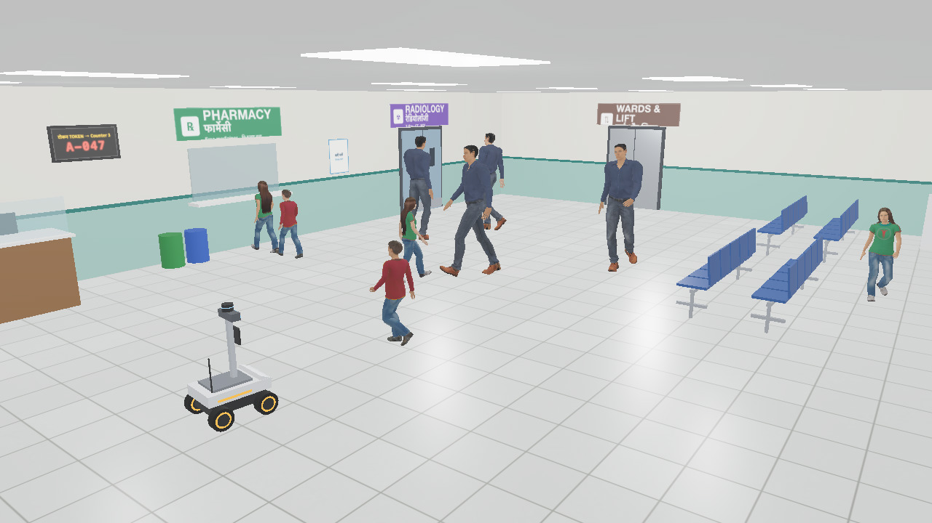
PROBLEM STATEMENT: PATIENTS GET LOST IN INDIAN OPDs
14–15k
OPD patients a day at one hospital (AIIMS Delhi)
69.6%
of first-time OPD visitors needed a person to find their way (GMC Bhopal)
98%
of older patients at AIIMS geriatric OPD come alone (2026 preprint)
3 h+
total wait for 58% of 400 patients (RIMS Ranchi, 2026)
ONE PATIENT, ONE X-RAY: TODAY vs WITH SAATHI
TODAY
Enters alone
signs in English
Asks the guard
“seedha jao”
Wrong corridor
walks back
Asks a nurse
she leaves her patient
Reaches Radiology
after a long detour
Our OPD hall in Webots: Hindi + English signs, token display, pharmacy queue, animated people
WITH SAATHI
“Mujhe X-ray karwana hai”
in Hindi, at the entrance
Saathi walks with them
at their pace, through the crowd
Reaches Radiology
and says so
THE GAP
No wayfinding robot found in any Indian OPD (our 2024–26 search). Guide robots exist at airports abroad; Indian OPD crowds are denser.
WHAT IT COSTS, AND WHY A ROBOT
PS-01 · VISION-BASED AUTONOMOUS ROBOT
Hours lost, appointments missed
patients, mostly first-time, elderly, low-literacy
Help desks and nurses pulled away
every “X-ray kahan hai?” is a nurse off her patient
A fall in a packed hall is noticed late
nobody is watching the floor
Today's robot planners fail in crowds
they freeze, or cut straight through people
AI vision: people + objects
Drives itself to a goal
Real-time decisions
Simulated hospital (allowed)
Sources: AIIMS OPD load, UNI and Free Press Journal, Sep 2026 · GMC Bhopal, IJCMPH 2026 (n=336) · AIIMS geriatric OPD, Research Square preprint, Aug 2026 (n=400) · RIMS Ranchi, Cureus, Sep 2026 (n=400)

Slide 3
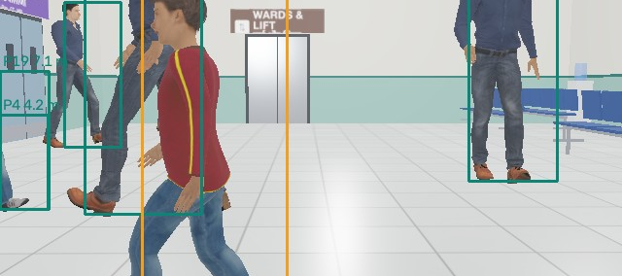
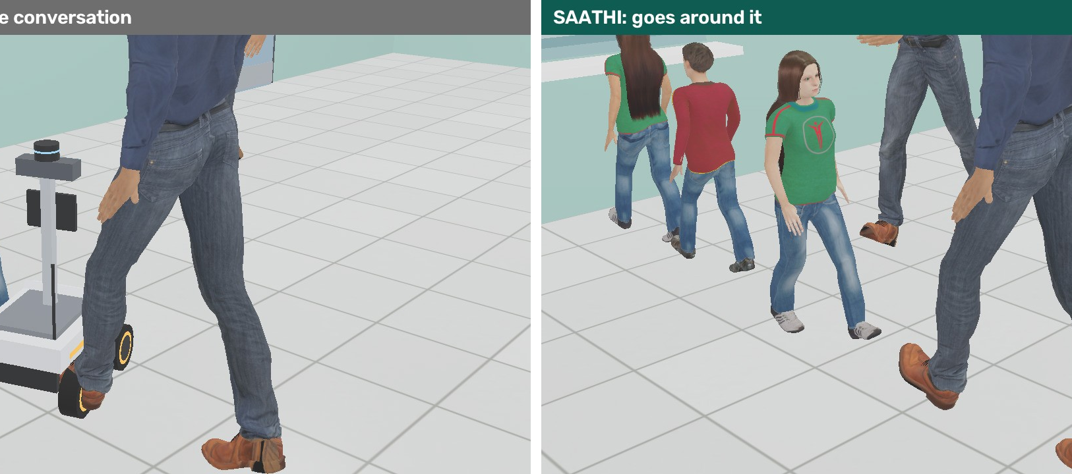
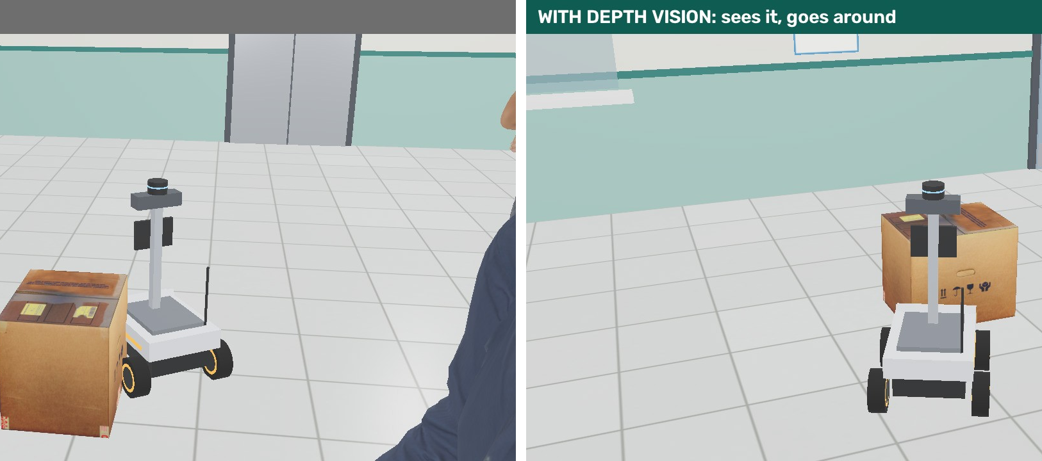
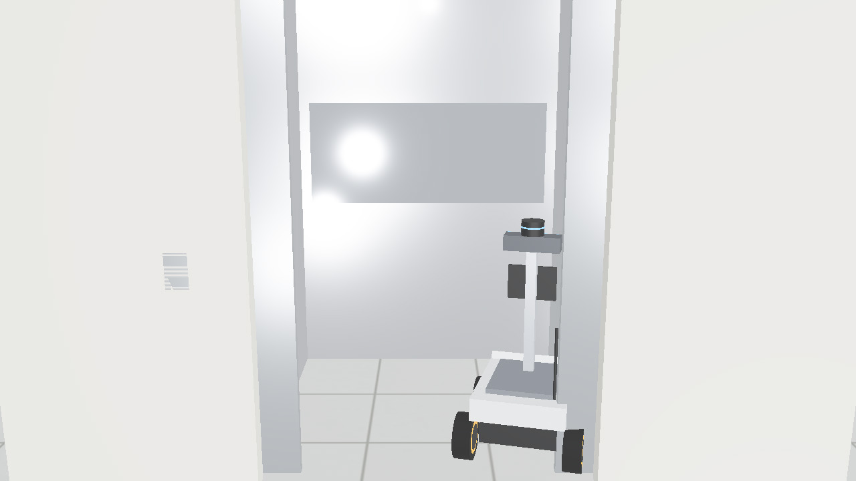
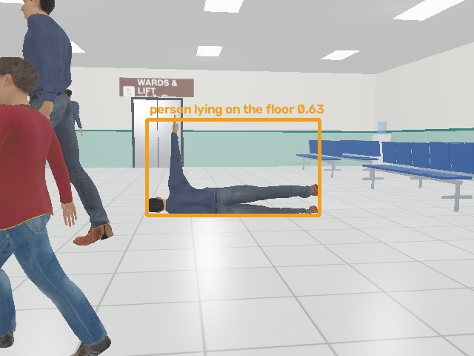
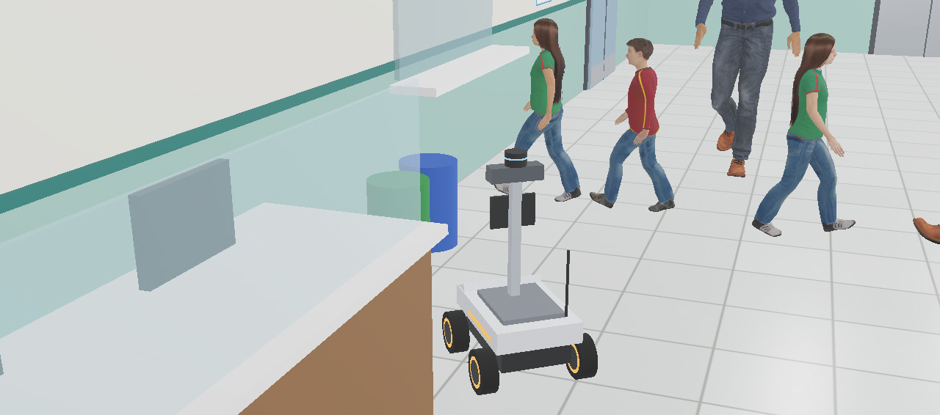
SOLUTION: SAATHI, A GUIDE ROBOT THAT READS THE CROWD
Say “Mujhe X-ray karwana hai”. Saathi walks you there at your pace, talks in Hindi, explains every move, and takes the lift when your department is upstairs. All frames below are from our Webots runs.
Sees every person with an ID and distance
YOLO11 + depth camera + 360° LiDAR
Never cuts through a conversation
left: a normal planner · right: Saathi
Sees what the map does not have
wet-floor board, cardboard box: 0 hits
Takes the lift to the first floor
doors close, cabin travels, doors open
Spots a fall, alerts the nurse, stays
VLM second opinion: resting or fallen?
Arrives, and says so in Hindi
offline Whisper + phrasebook + Lekha voice
🗣 Hindi, fully offline
📼 Black box answers “tum ruke kyun?”
🧠 Robots share one memory of people
📊 Tested on 200 seeded crowds

Slide 4
HOW IT WORKS: TWO BRAINS AND A GUARD NEITHER CAN OVERRIDE
SENSORS
Stereo RGB · depth camera · 360° LiDAR · IMU
REFLEX BRAIN · 30 Hz
YOLO11 + depth + LiDAR → people with speed · A* on a crowd costmap, 2 s ahead
SAFETY GUARD
On LiDAR, below the AI: stop under 0.6 m. Fist = stop.
MOTORS
Body velocity → 4 mecanum wheel speeds (physics)
goals
events
YOU
Hindi voice · typing · hand gesture
THINKING BRAIN
Whisper (Hindi) + phrasebook · Qwen3.5-2B VLM describes scenes · Lekha voice
SHARED MEMORY
Who each robot saw: where, when, clothes, height. Never a face.
BLACK BOX
Every decision + camera frame + reason. Replayable.
ONE REQUEST, END TO END: “BLOOD BANK KAHAN HAI?”
1 Hear
Whisper → “Blood Bank”, first floor
2 Plan
A* to the lift lobby on the crowd costmap
3 Drive
slow, wait, side-step; guard watches 0.6 m
4 Lift
call it, ride up, switch floor map
5 Walk
to Blood Bank, around people and groups
6 Say
“Aa gaye”; every step in the black box
STACK (ALL ON AN 8 GB M1 LAPTOP, NO CLOUD)
Webots physics
Python 3.10
YOLO11
YOLOE open-vocab
ByteTrack
CLIP
Whisper v3-turbo (MLX)
Qwen3.5-2B VLM (MLX)
A* + social costs
MediaPipe Hands
macOS Lekha TTS
0.10 m median error placing people
9.5 ms YOLO11n per frame
~5 ms a plan, replanned twice a second
0.3 s fall classified after it happened

Slide 5
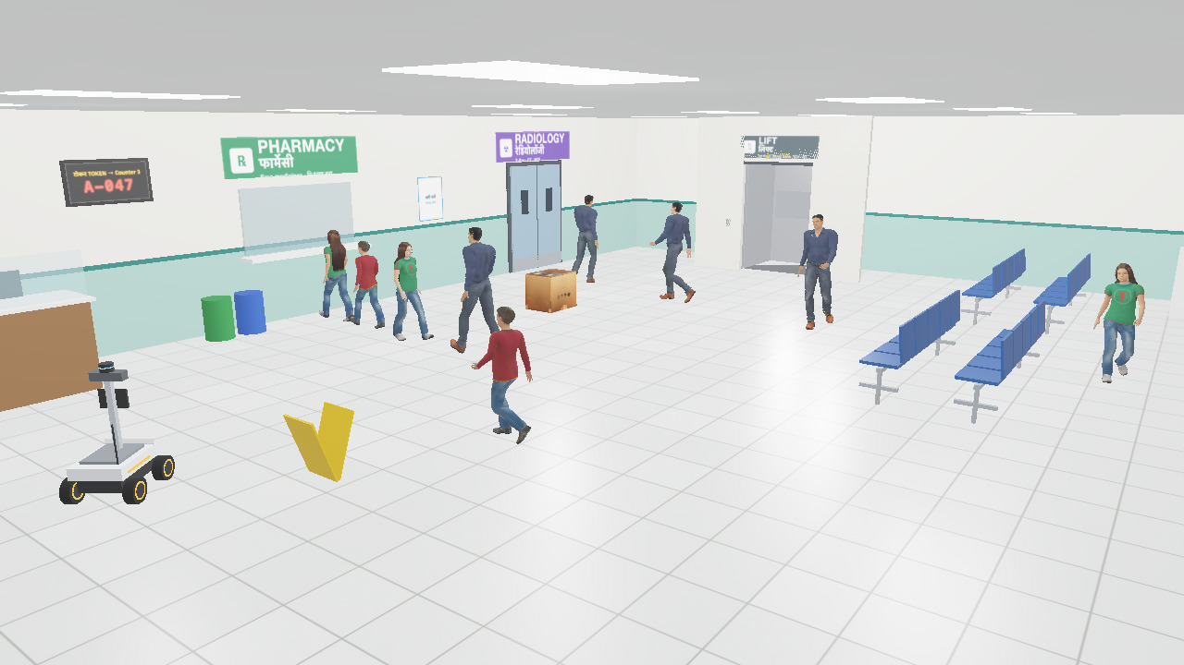
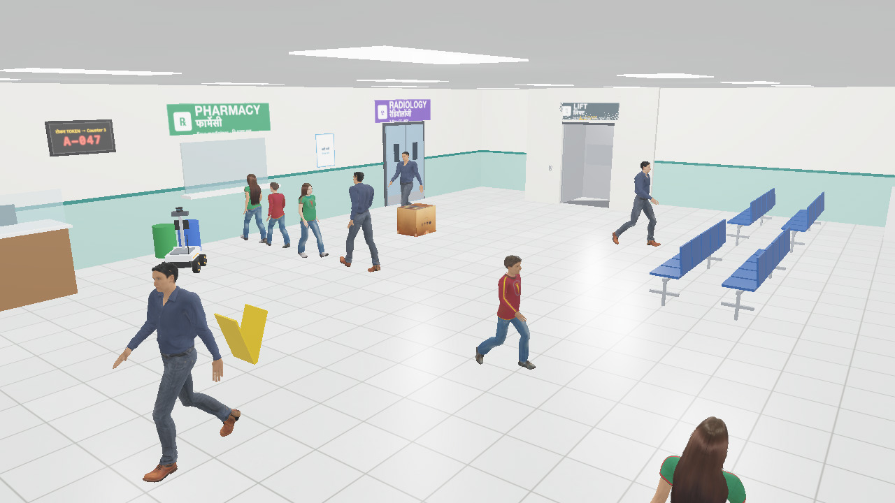
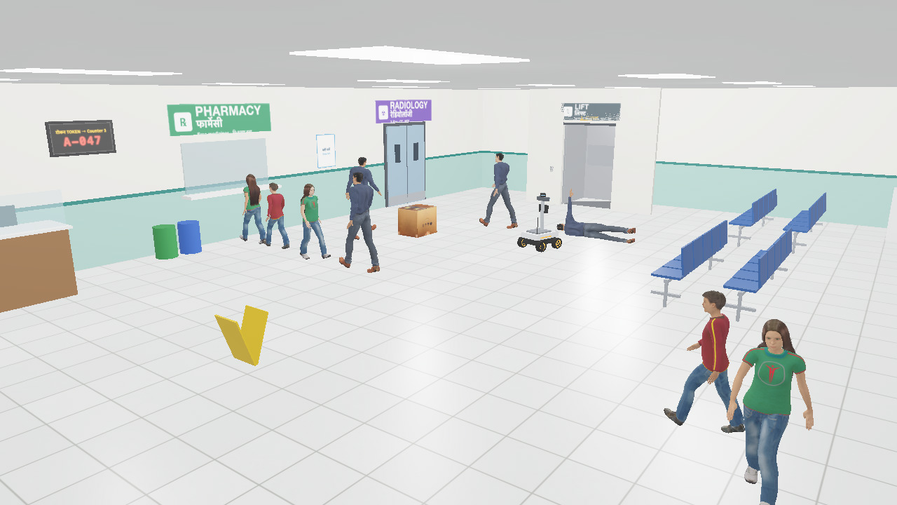
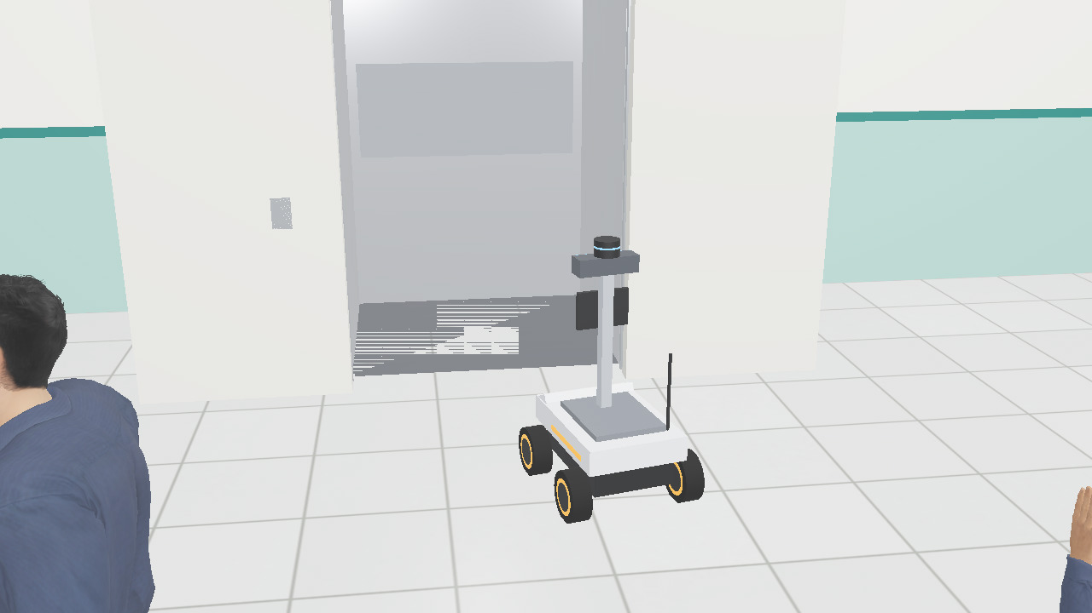
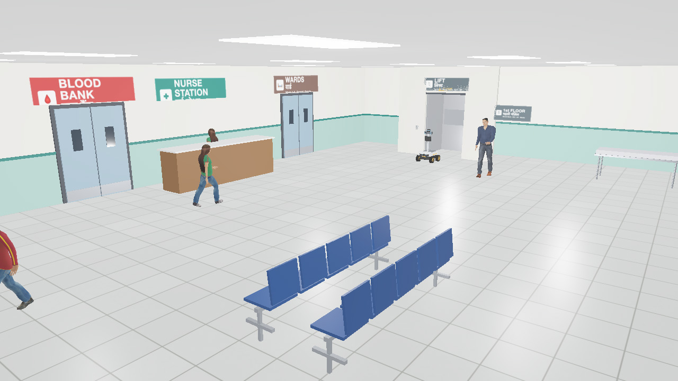
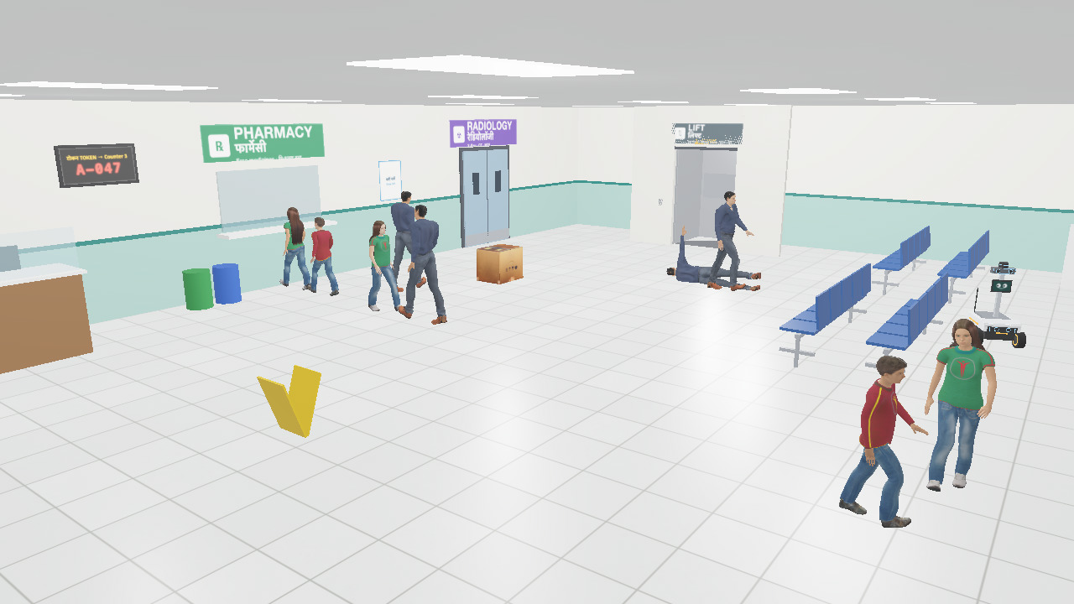
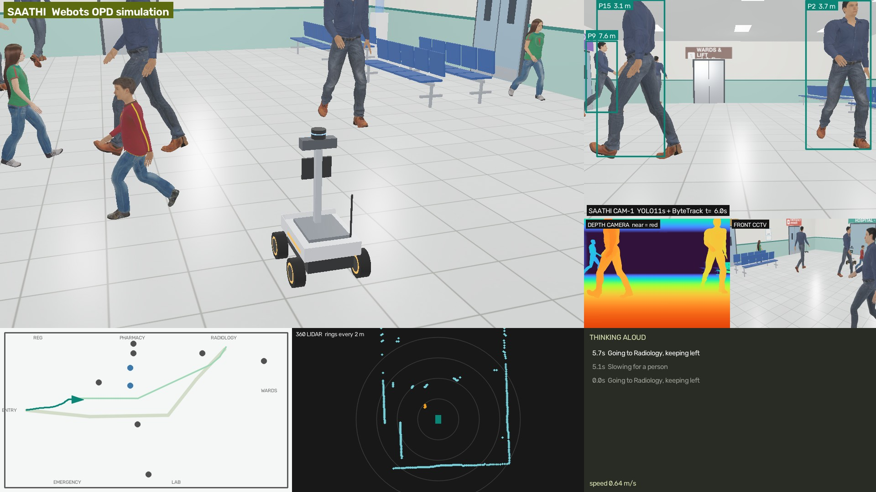
PROTOTYPE: ONE RUN, TWO FLOORS, A LIFT, A FALL · 135 s ON ITS OWN CAMERA
4 s
14 s
35 s
53 s
62 s
135 s
Wet-floor board not on the map: goes around
Arrives at Pharmacy, beside the queue
A man falls: alert sent, Saathi stays
Into the lift; doors close, cabin rises
First floor: Nurse Station, Wards, Blood Bank
Back down by lift: arrives at Lab
THIS RUN, MEASURED
0
near-misses
0
conversations cut
0
unmapped obstacles hit
4
departments on 2 floors
NEW · the lift
doors, cabin, call button; the map switches floors
1
fall handled on the way
135 s
entrance → Lab, all by itself
NEW IN ROUND 2
Lift + first floor
9 departments by voice
What Saathi works from: its camera with YOLO boxes and distances, depth, floor map, 360° LiDAR, its thinking log
Tour of departments
Fall: VLM second opinion
NEW · the first floor
Blood Bank, ICU, OT, Wards, nurse station
2 robots share memory
Open source on GitHub

Slide 6
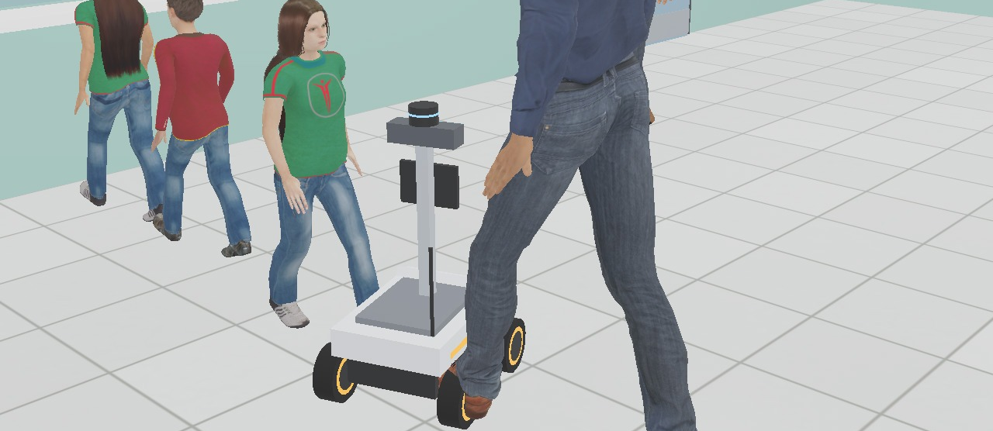
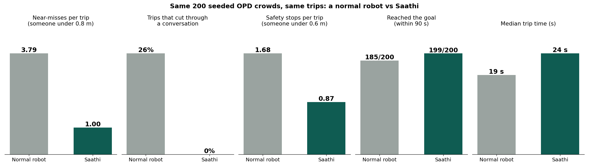
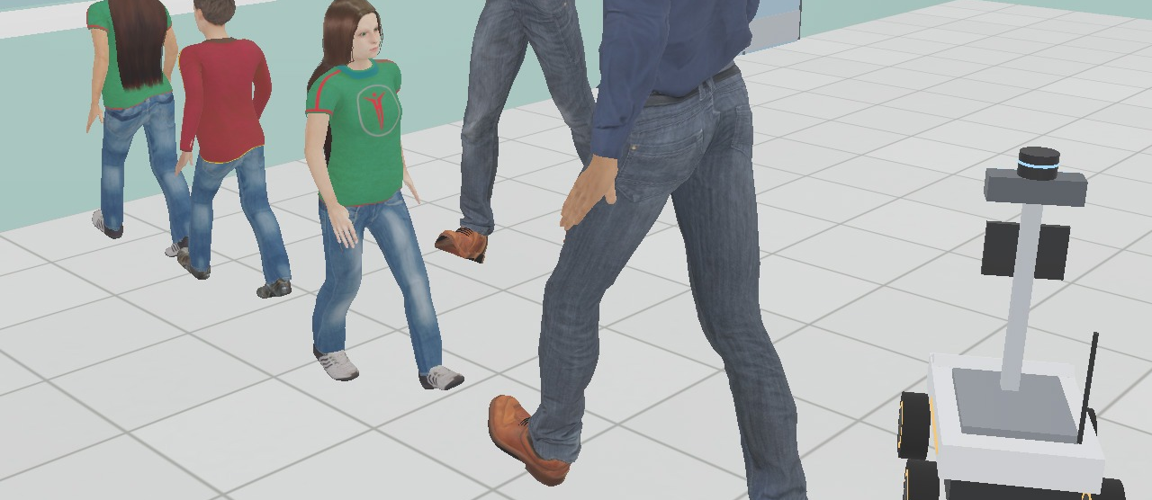
RESULTS: 200 SEEDED CROWDS, SAATHI vs A NORMAL ROBOT
NORMAL ROBOT: cuts through the conversation
SAATHI: goes around it
73% fewer
near-misses: 3.79 → 1.00 per trip
0 of 200
trips cut through a conversation (normal robot: 26%)
199/200
trips reached the goal (normal robot: 185/200)
+5 s
the price: median trip 19 s → 24 s
Each seed: an OPD crowd (8–12 walkers, two talking pairs, a pharmacy queue) and a trip from the entrance to a random department. Normal robot = same A* planner, people as static obstacles, fixed speed, same 0.6 m stop. Deterministic: tools/bench.py 200.
Same crowd, in Webots | Normal | Saathi | Saathi, camera only
Near-misses | 4 | 0 | 1
Cut a conversation | yes | no | no
Time to Radiology | 22 s | 25 s | 29 s

Slide 7
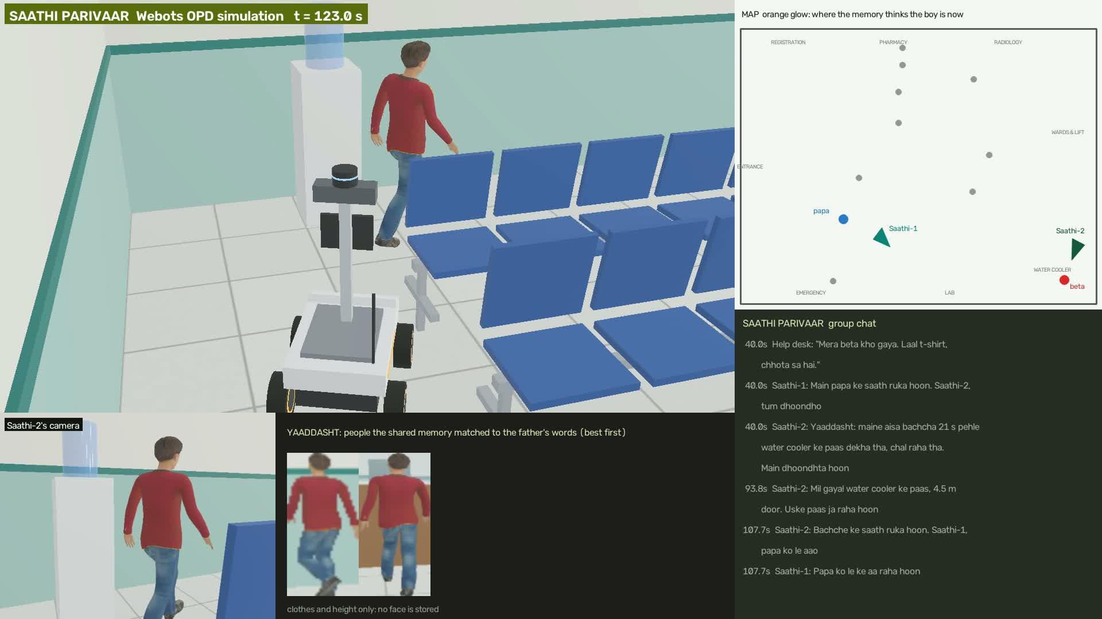
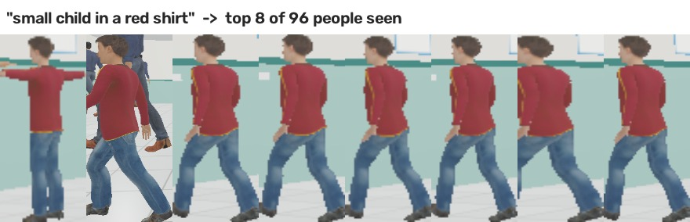
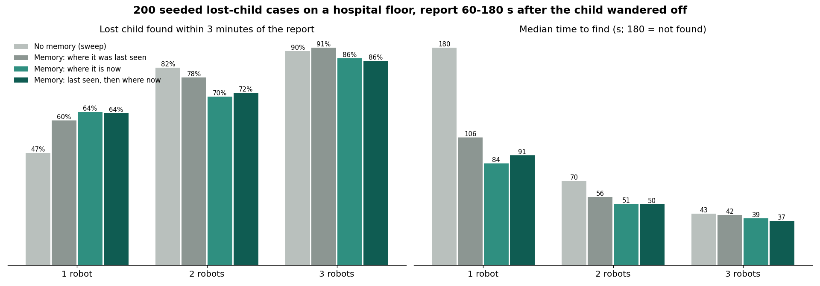
SAATHI PARIVAAR: ROBOTS SHARE ONE MEMORY OF PEOPLE (BUILT, MEASURED)
Search by description on Saathi's own camera: “small child in a red shirt”, top 8 of 96 people seen are all him. 24 of 24 right.
Two Saathis, one run: papa reports “laal t-shirt” at the help desk; Saathi-1 stays with him, Saathi-2 goes where the memory says the boy is now (orange glow).
1 REMEMBER
who each robot saw: where, when, height, clothes. No face.
2 ASK
papa's words search every robot's memory
3 WHERE NOW?
from his last motion; places already checked are ruled out
4 SEARCH AS A TEAM
robots split the places; one stays with papa
2.1×
faster with memory, one robot (180 s → 84 s median)
86%
found within 3 min with three robots
200 lost-child seeds, 3 strategies, 1–3 robots (tools/bench_lost.py). Honest: with a team, team size matters more than strategy.
Privacy: clothes, not faces · record deleted after the reunion · wiped daily

Slide 8
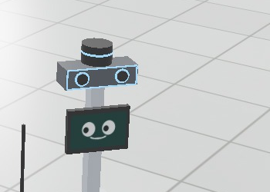
PS-01 CHECKLIST WITH PROOF · WHAT IS REAL AND WHAT IS SIMPLIFIED
PS-01 asks for | What Saathi does | Proof from our runs
✓ Understand surroundings with AI vision | YOLO11 + depth + 360° LiDAR; people on a floor map | People placed within 0.10 m (median)
✓ Identify relevant people and objects | Tracks people; YOLOE names objects by text | “cardboard box”, “yellow caution sign” named on sight
✓ Navigate autonomously to an objective | A* on a crowd costmap; goals by name, by sight, on either floor | Dustbin found by camera in 12 s · Blood Bank via lift
✓ Detect and avoid obstacles | Depth camera finds what the map lacks | Map-only robot hit 2; Saathi 0
✓ Real-time decision making | 30 Hz reflex loop, replans twice a second | 200 crowds: 73% fewer near-misses
✓ Object detection, image classification | YOLOE posture: “person lying on the floor” | Fall classified 0.3 s after it happened
✓ Scene understanding | Conversations and queues from tracks; signs read | 0 of 200 conversations cut
✓ Vision-language models | Qwen3.5-2B (Apple MLX) describes the scene | Its description goes with the nurse alert
✓ Motor control | Physics mecanum base, speed per wheel | Motion within 7% of the command
✓ Real or simulated environment | Two-floor Webots hospital, Hindi + English signs | Deterministic: same seed, same numbers
REAL
• The 3D render; camera, depth and LiDAR data
• YOLO11 / YOLOE / CLIP on the rendered frames
• The planner, the memory, the voice agent
• Physics wheels driven by speed commands; the lift cabin
SIMPLIFIED (WE SAY SO)
• People walk fixed paths and do not react to the robot
• Robot position from the simulator (LiDAR SLAM on the real rover)
• The nurse is simulated (takes over after 6 s)
SAME CODE, REAL ROVER
The brain talks to sensors through one small interface: Webots today, Jetson Orin Nano on our rover next.

Slide 9
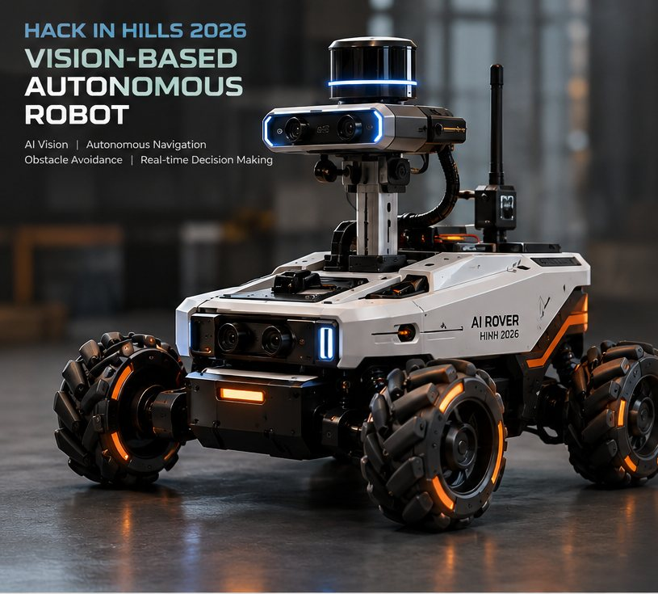
PROGRESS: WHAT WAS BUILT WHEN, AND WHAT COMES NEXT
12 OCT ✓
Webots OPD hall, physics rover, crowd-aware planner, camera + LiDAR + depth, fall alert, VLM, black box, 200-crowd A/B
14 OCT ✓
Shared memory of people, lost-child search, 200-seed benchmark, offline Hindi voice
20 OCT ✓
Whole hospital: lift, first floor (Blood Bank, ICU, OT, Wards), tour of departments, GitHub public
24–27 OCT
Demo video, LinkedIn pitch, Instagram reel, Round 2 submission
20–21 NOV
Manali finale: 3 robots live and fully offline on a laptop, held-out 200-seed test
2027
Real rover (Jetson Orin Nano, face screen, mic, e-stop); OPD pilot with consent and face blurring
OPEN SOURCE, REPRODUCIBLE
github.com/shaunmortal/saathi
README: GIFs of every run, every number with the script that makes it
• tools/demo.sh: the whole-hospital run, live
• tools/bench.py 200: the A/B numbers
• tools/bench_lost.py 200: the lost-child numbers
• tools/voice.py: talk to it in Hindi
Where it goes: 816 medical colleges, 714 district hospitals; Robot-as-a-Service about ₹15,000 a month per robot
The first floor, built this week: Blood Bank, Nurse Station, Wards, ICU, OT, stairs, lift
Our rover design: the body Saathi's brain will drive

Slide 10
SAATHI
Raasta bhi, saath bhi.
The way, and the company.
github.com/shaunmortal/saathi
Team Glitch · Ayush Kumar
Thank
you!

