Slide 1
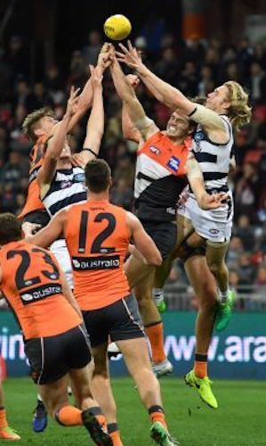
Predicting the Results of AFL Matches

Slide 2
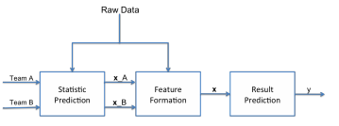
Model Overview

Slide 3
Statistic Prediction
Running average
Home and away average
Decaying running average
Cluster average
PCA = [4,10,15], K = [2,3,5,10]

Slide 4
Results
 | Running Average |  | Home & Away Average
 | Training Error | Testing Error | Training Error | Testing Error
Linear Regression | 0.3096 | 0.3323 | 0.3388 | 0.3715
Logistic Regression | 0.3153 | 0.3222 | 0.3822 | 0.3895
SVM | 0.3149 | 0.3211 | 0.3624 | 0.3724

Slide 5
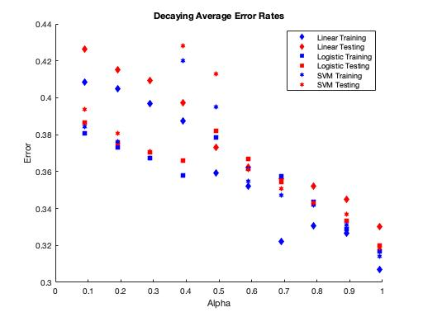

Slide 6
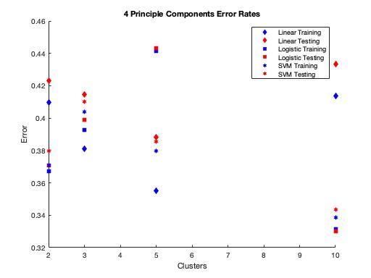

Slide 7
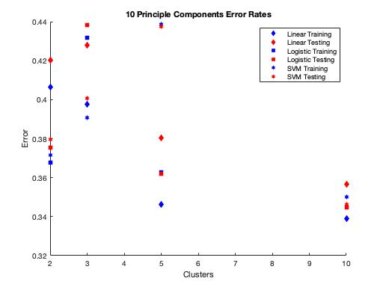

Slide 8
