Slide 1
Shaun McGovern’s
Interactive Portfolio
“Hashbang! Games Business Card Idea One”

Slide 2
Competitive/Similar APPs
http://www.squarespace.com/#alex
A powerful portfolio designer. With eye catching <html> and professional style.
http://ipadportfolioapp.com
Portfolio for iPad, is a blank slate waiting for your personalization. You can customize its appearance to completely fit your needs, showcase your programming skills.

Slide 3
Capabilities
Since my resume starts the conversation with a potential hire. This app, showcasing my programming skills across various languages will increase my chances.
Employers always have the desire to see what a programmer can do.

Slide 4
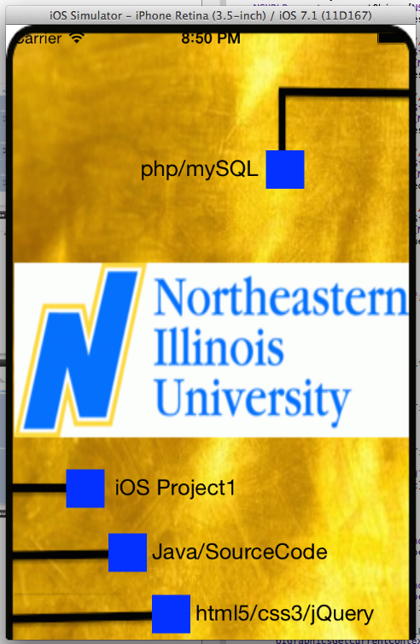
Various blue boxes to click upon, to showcase a variety of programming languages.
Graduated with a B.S. of Computer Science

Slide 5


Php/mySQL && html5,css3,jQuery

Slide 6
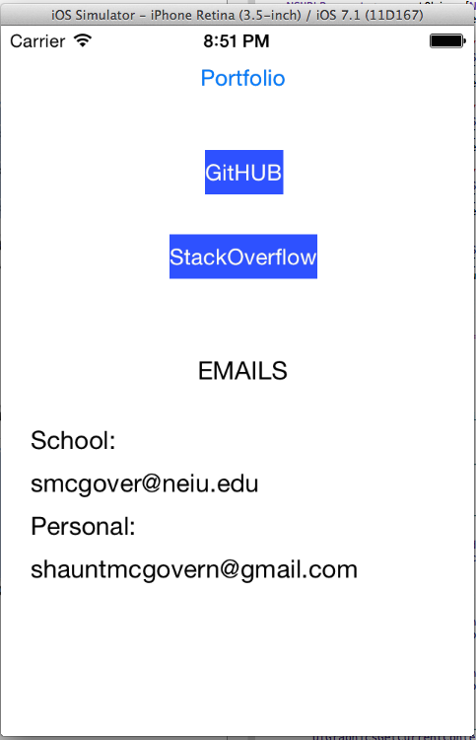
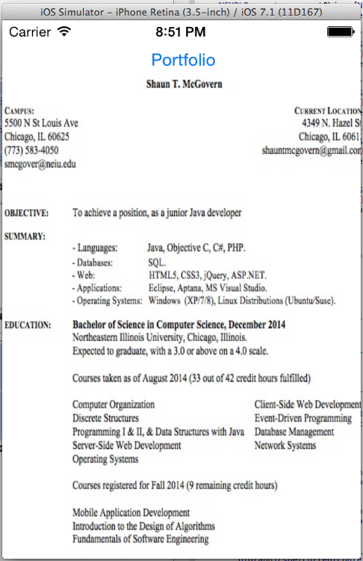
Personal Links && Resume

Slide 7
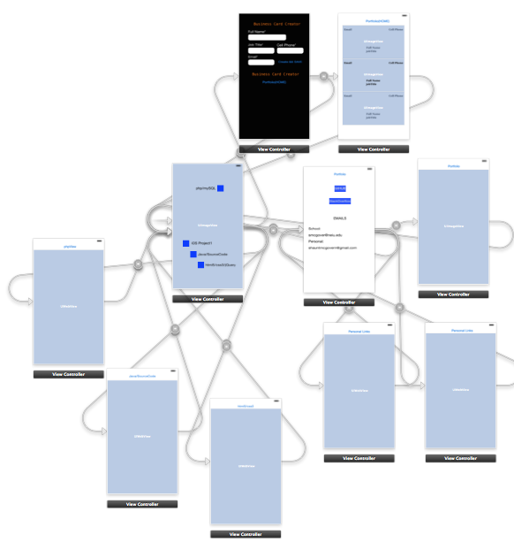
Overall Diagram of View Controllers

