Slide 1
Reclaim
The Operating System for Ownership

Slide 2
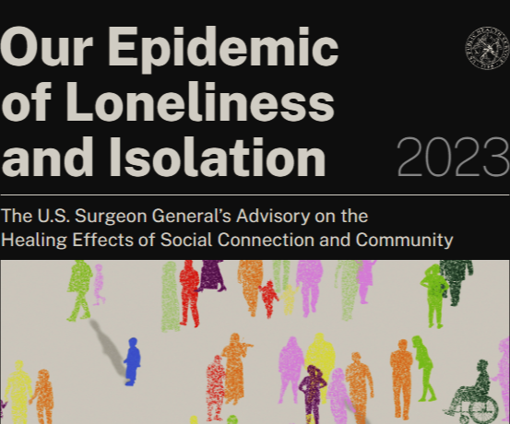

It’s official: We’re in crisis

Slide 3
Has the world has gone mad?
Stress at an all time high
Misinformation and collapse of reality
Societal, economic and political polarization
Widespread loss of faith and trust

Slide 4
The Gap: it’s tools and structure.
Responsibilities - no operating manual
Protections - no practical way to use them.
Help exists - fragmented and expensive.

Slide 5
Today’s reality:
Cost of living
Pay-to-play legal system
Community breakdown
Murphy’s law

Slide 6
Designed
Reclaim is a movement. Sure, it’s the best digital swiss-army knife

Slide 7
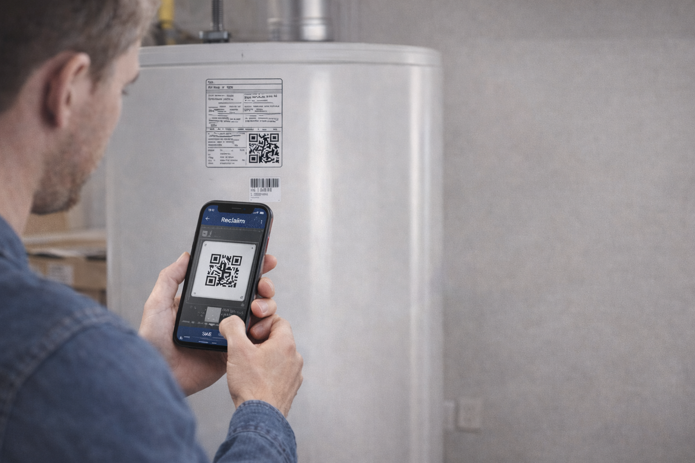
.

Slide 8
The Pivot: Instant Action
We scrapped the dashboard.
We built a weapon.
No data entry. No forms.
Just point, shoot, and solve.

Slide 9
Four modules, one platform.
Home
Money
Community
Rights

Slide 10
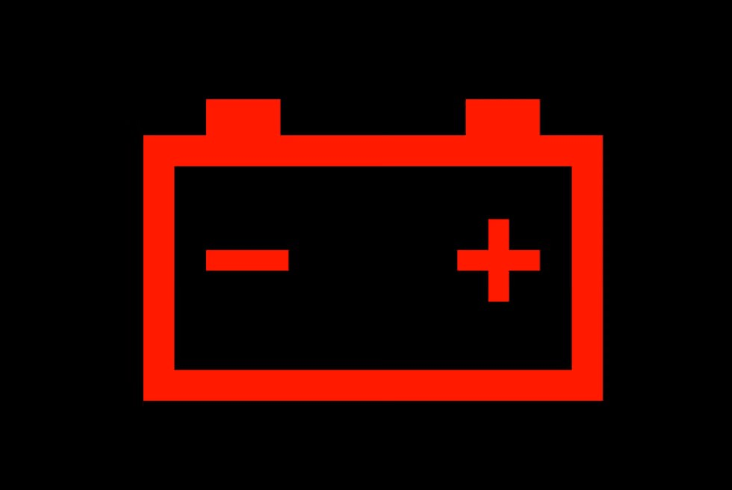




Home – no more emergencies
for your home.
Informed repair or replace

Slide 11
Money: you work hard for it
Stop the energy vampires,
forgotten subscriptions,
unauthorized charges.
It ends now.

Slide 12
Reclaim Rights
Put the legal system to work for you
Timeline builder from messages, documents, photos, and notes.
Evidence vault with tagging and fast retrieval.
Draft support for letters, complaints, declarations, and forms (user review).
Deadlines + workflow checklists to prevent mistakes and missed steps.
Outcome:
Stop getting buried. Operate calmly, correctly, and on your terms.
Tools and workflow only — not a law firm, not representation.

Slide 13
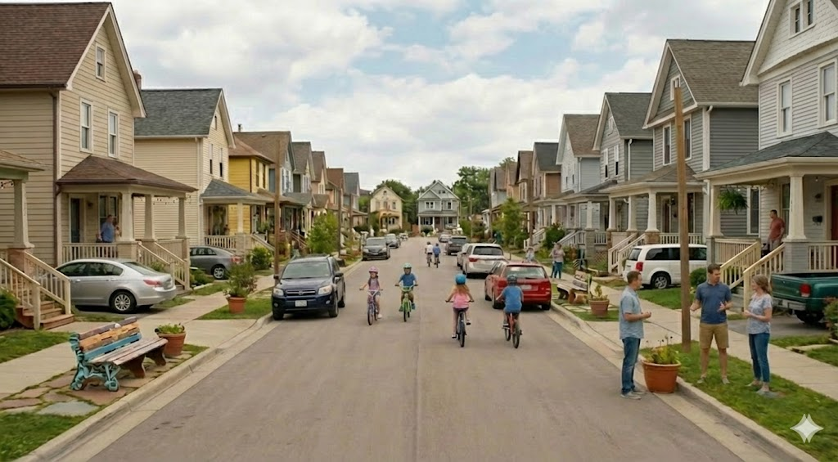
Community: Not Surveillance
User-defined community fabric.
Privacy-first. Opt-in only.
Strength in numbers.
Eliminate loneliness

Slide 14
Four Modules. One OS.
HOME: The Wedge (Free)
MONEY: The Retention (Sub)
RIGHTS: The Shield (Sub)
COMMUNITY: The Moat (Network Effect)
INSERT IMAGE HERE:
IMAGE: 'CC692E95...' (The 4-Phone Lineup). This is the 'Money Shot'.

Slide 15
Fueling the Scale
Ask: $100k Bridge.
I'm not asking to build the MVP.
I'm asking to scale the MVP I'm holding right now.
Unlocks: First 1,000 homeowners.
INSERT IMAGE HERE:
IMAGE: '805E0F42...' (Phone in Hand looking at alerts). Shows readiness.

