Slide 1
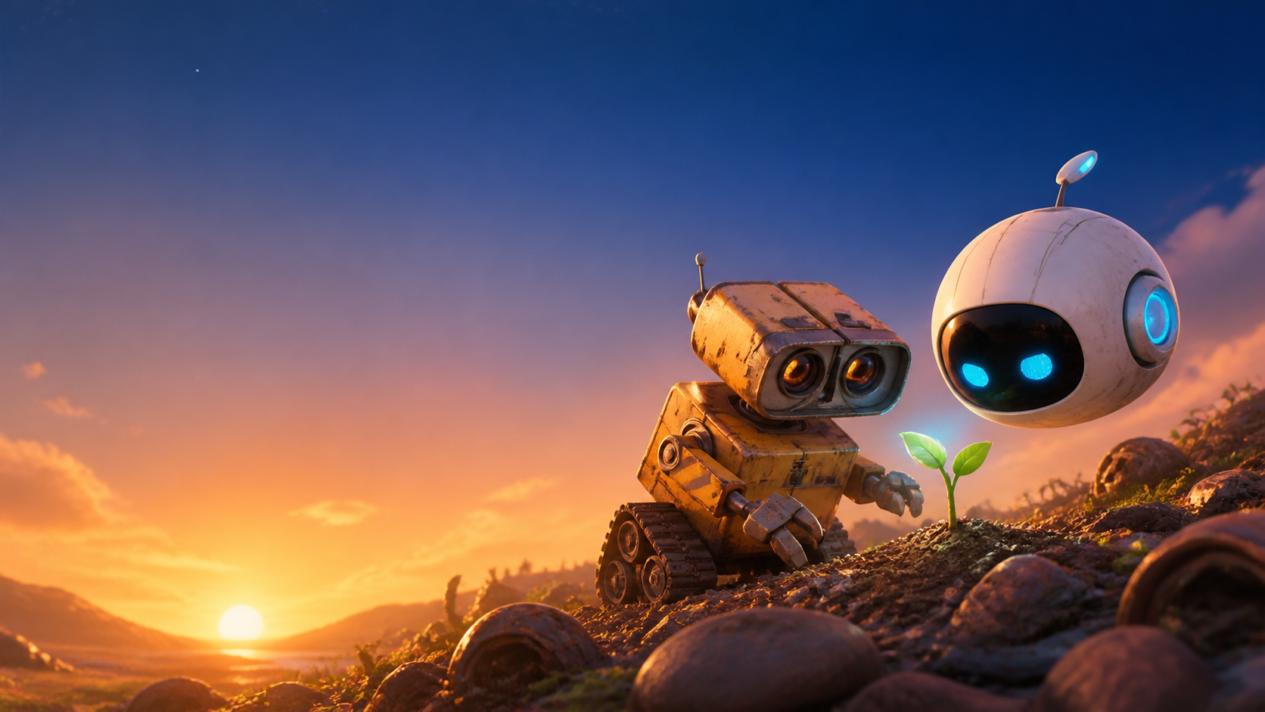
A LITTLE ROBOT
WITH A BIG HEART
A WALL•E + EVE–inspired build story
How imagination becomes a robot that can see, explore, and help.
Made with LEGO + Raspberry Pi + curiosity
Notes:
[Sources]
Original illustration generated with OpenAI image generation, 2026-08-20. The WALL•E + EVE reference is inspiration only; no film images or characters are used.

Slide 2
WHY THIS MOVIE INSPIRES US
It reminds us that even a small robot can notice something important.
BE CURIOUS
BE KIND
WORK TOGETHER
Ask: “What is that?”
Use inventions to help.
Great ideas need a team.
Our robot is not a movie character. It is our own invention with the same hopeful spirit.
2 • OUR ROBOT STORY
Notes:
[Sources]
[Sources]
No external assets. Broad themes are original wording inspired by the user's stated WALL•E movie inspiration.

Slide 3
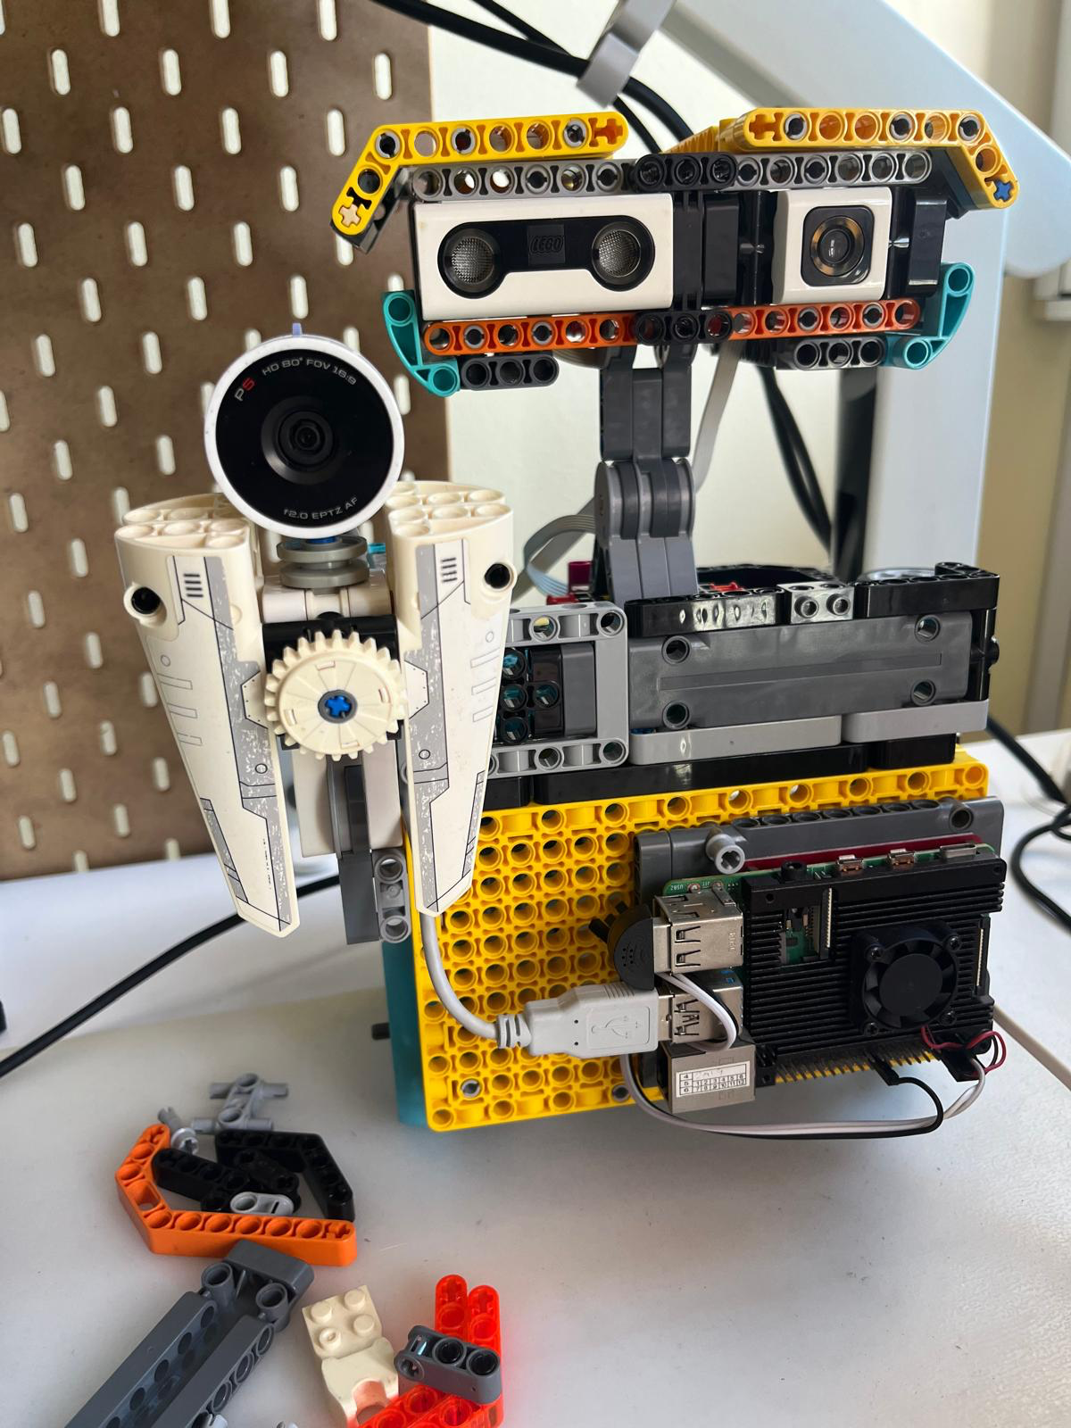
MEET OUR REAL-LIFE ROBOT
We built a playful robot friend with a Raspberry Pi brain and a webcam eye.
It is made from LEGO parts, sensors, motors, wires… and lots of experimenting.
The best inventions begin with: “What if…?”
3 • OUR ROBOT STORY
Notes:
[Sources]
[Sources]
User-provided LEGO robot photograph, supplied in chat on 2026-08-20.

Slide 4
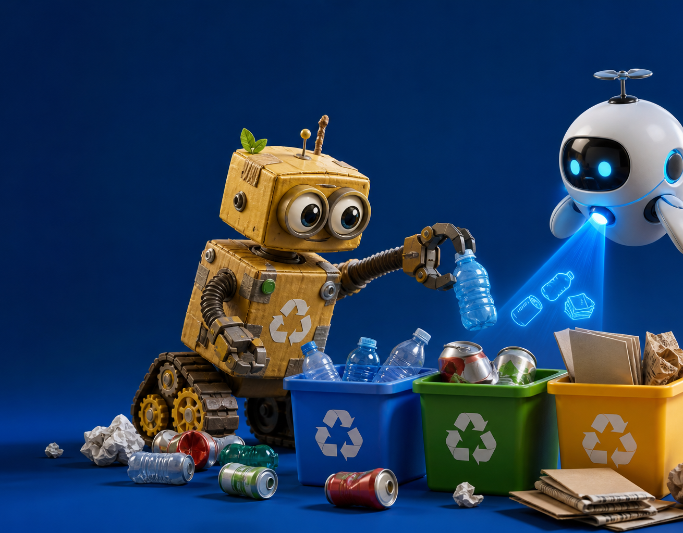
A ROBOT MISSION:
NOTICE • THINK • HELP
1
NOTICE
A camera gives the robot a view of the world.
2
THINK
A tiny AI model helps spot everyday objects.
3
HELP
People choose what the robot does next—safely.
4 • OUR ROBOT STORY
Notes:
[Sources]
[Sources]
Original illustration generated with OpenAI image generation, 2026-08-20. Technical statements describe this project’s webcam and object-detection build.

Slide 5
TWO ROBOT
SUPERPOWERS
THE EXPLORER EYE
It looks around and notices objects.
THE HELPER HEART
It only moves when a person gives a safe command.
5 • OUR ROBOT STORY
Notes:
[Sources]
[Sources]
Original illustration generated with OpenAI image generation, 2026-08-20. Safety wording is based on this project’s stated hub safety controls.

Slide 6
WHAT WILL
YOU BUILD?
A robot that helps recycle?
A robot that explores a garden?
A robot that makes someone smile?
Start with a question.
Then build the answer.
Notes:
[Sources]
[Sources]
Original illustration generated with OpenAI image generation, 2026-08-20.

