Slide 1
Sociophonetics Autocoding
Yunting Gu, Shuangyu Zhao, Wenting Liu

Slide 2
Outline
Background Introduction
Data preprocess and EDA
Model Results
Discussion

Slide 3
Introduction
Language varies; sound variables can have social meanings
Sociophonetics: label the sounds and study their variation
Automate the labeling procedure using classification models in New Zealand English
e.g., in the word water, people may pronounce it with or (water) without the rhotic (wate).
2 datasets:
Dataset 1 /r/: 40,614 rows and 217 columns
4,255 rows absent of /r/;
1,646 rows present of /r/
Dataset 2 /t/: 9,888 rows and 137 columns

Slide 4
Research Questions
Question 1 : autocode the presence or absence of the /r/ sound or rhotacization, which relates to the letter r in words in many cases.
e.g., in the word water, people may pronounce it with or (water) without the rhotic (wate).
Dataset for Q1: 217 columns and 4,255 + 1,646 = 5,901 rows
Question 2: distinguish between /r/ and /t/
Dataset for Q2: 58 columns and 40,614+9,888=50,502 rows

Slide 5
Data preprocess
Dataset for Question1
Encode “absent” into 0 and “present” into 1 as our target.
Keep all the numeric features(according to my understanding about the dataframe, the columns with characteristics are not worth being encoded).
Standardize and centralize the numeric features.
Dataset for Question2
set column names from these two dataframe to the lower case(dataframe about r and dataframe about t)
Merge these two dataframe by the columns with same names
Encode “r” into 1, “t” into 0
Standardize and centralize all the numeric features
Notes:
At first, we have two dataframe, one is for ‘r’ and another one is for ‘t’. Based on the requirement of our two questions, we created two new datasets.

Slide 6
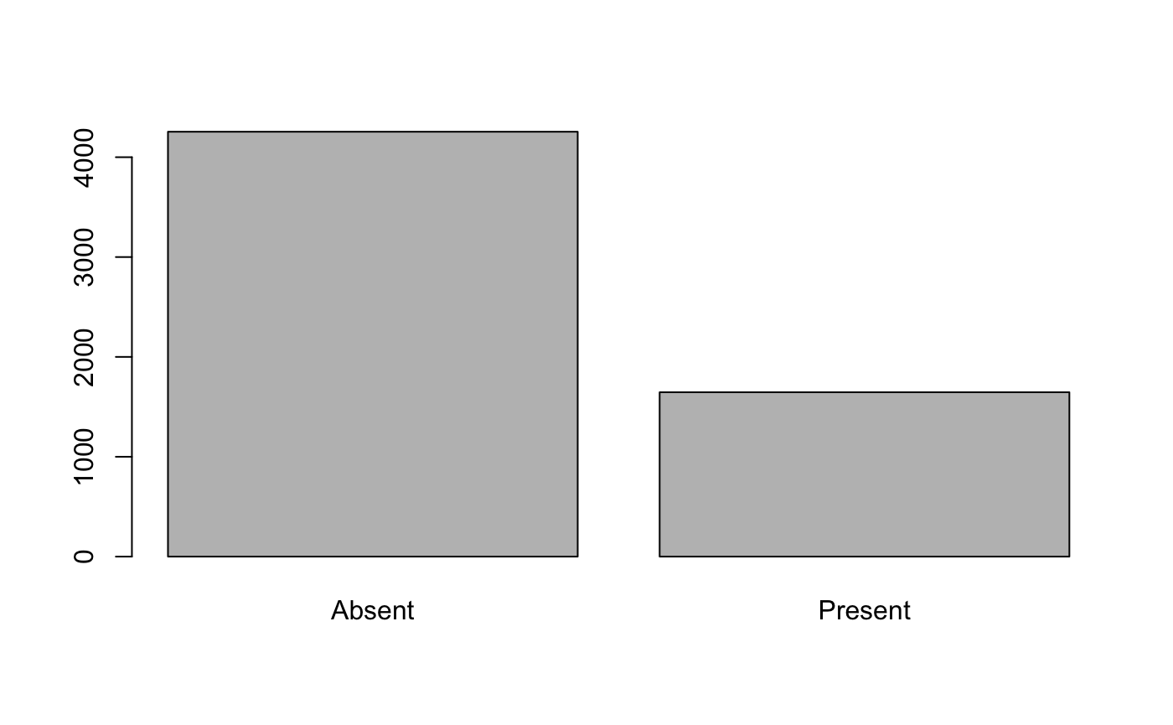
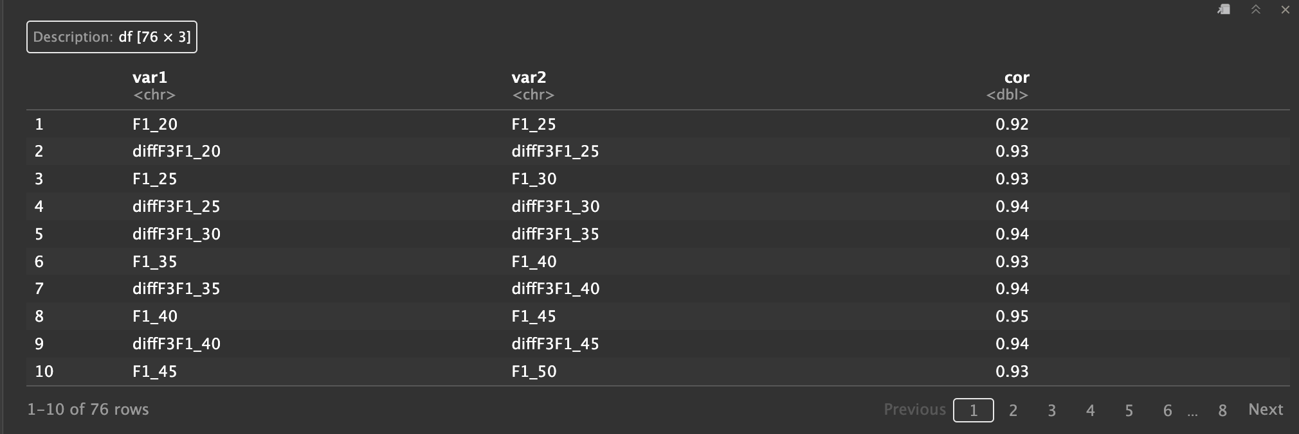
EDA
Question 1
The dataset for question 1 is acceptably balanced
There are 186 columns in the dataset(184 features + 1 target + 1 encoded target)
There are 76 couples of features in the dataset whose correlations are higher than 0.9
the features that have a correlation greater than 0.9
Notes:
About the dataset for question1. The ratio of present to absent is ½.

Slide 7
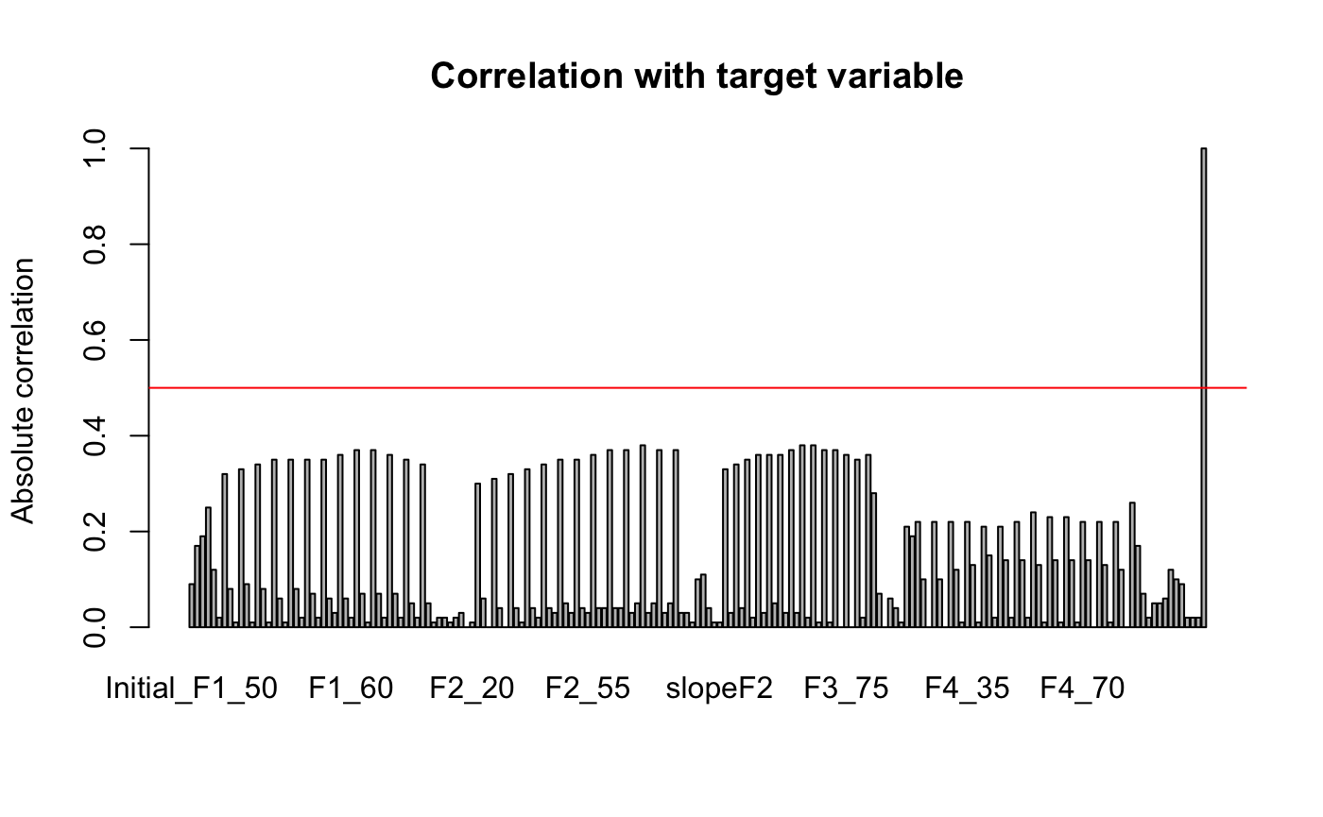
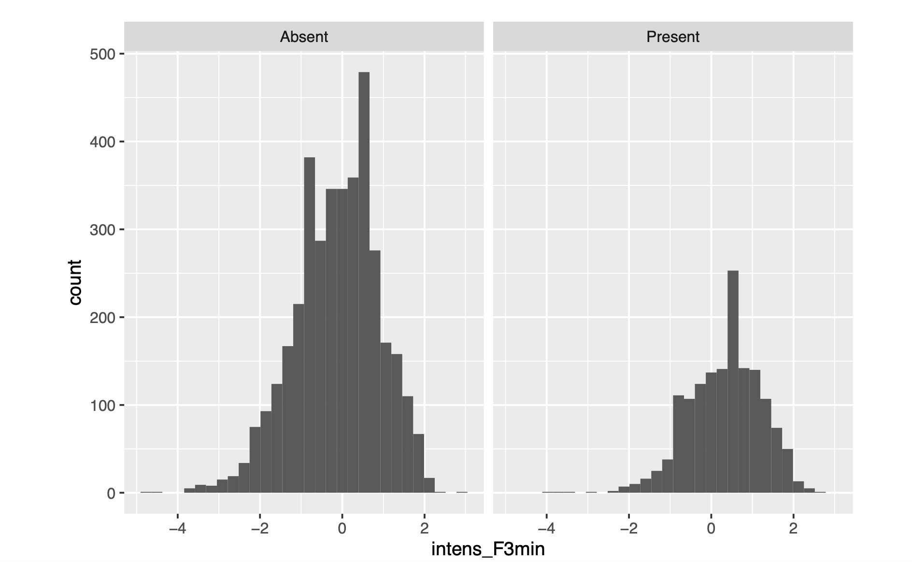
EDA
Question1
The correlation between target and features are all lower than 0.5.
The table in the lower right corner is the distribution graph of feature who has the highest correlation with target.
0.5

Slide 8
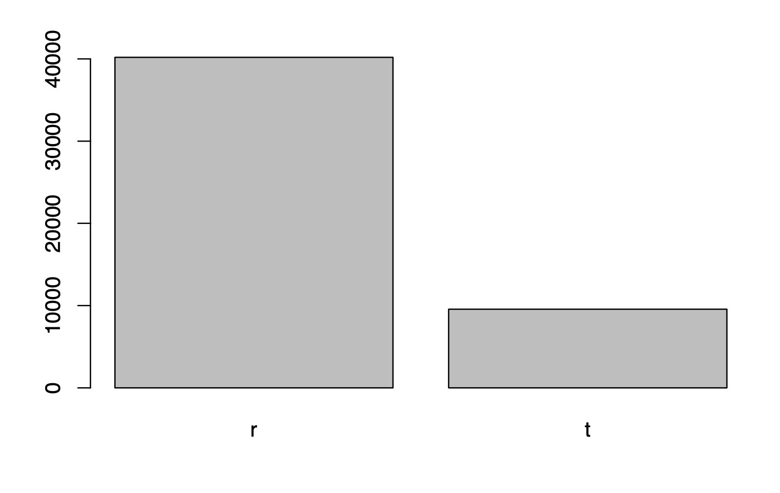
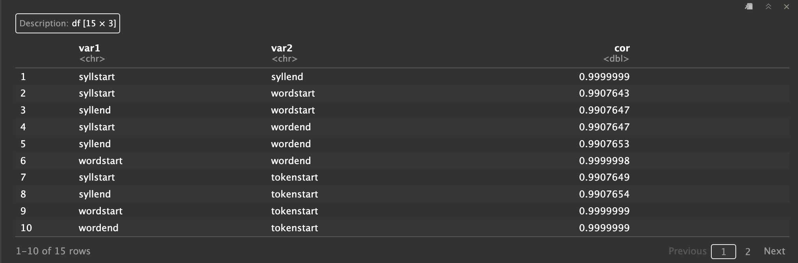
EDA
Question 2
The dataset about distinguishing r and t is also imbalanced.
The dataset has 49 features.
There are 15 couples of features in the dataset whose correlations are higher than 0.9
the features that have a correlation greater than 0.9

Slide 9
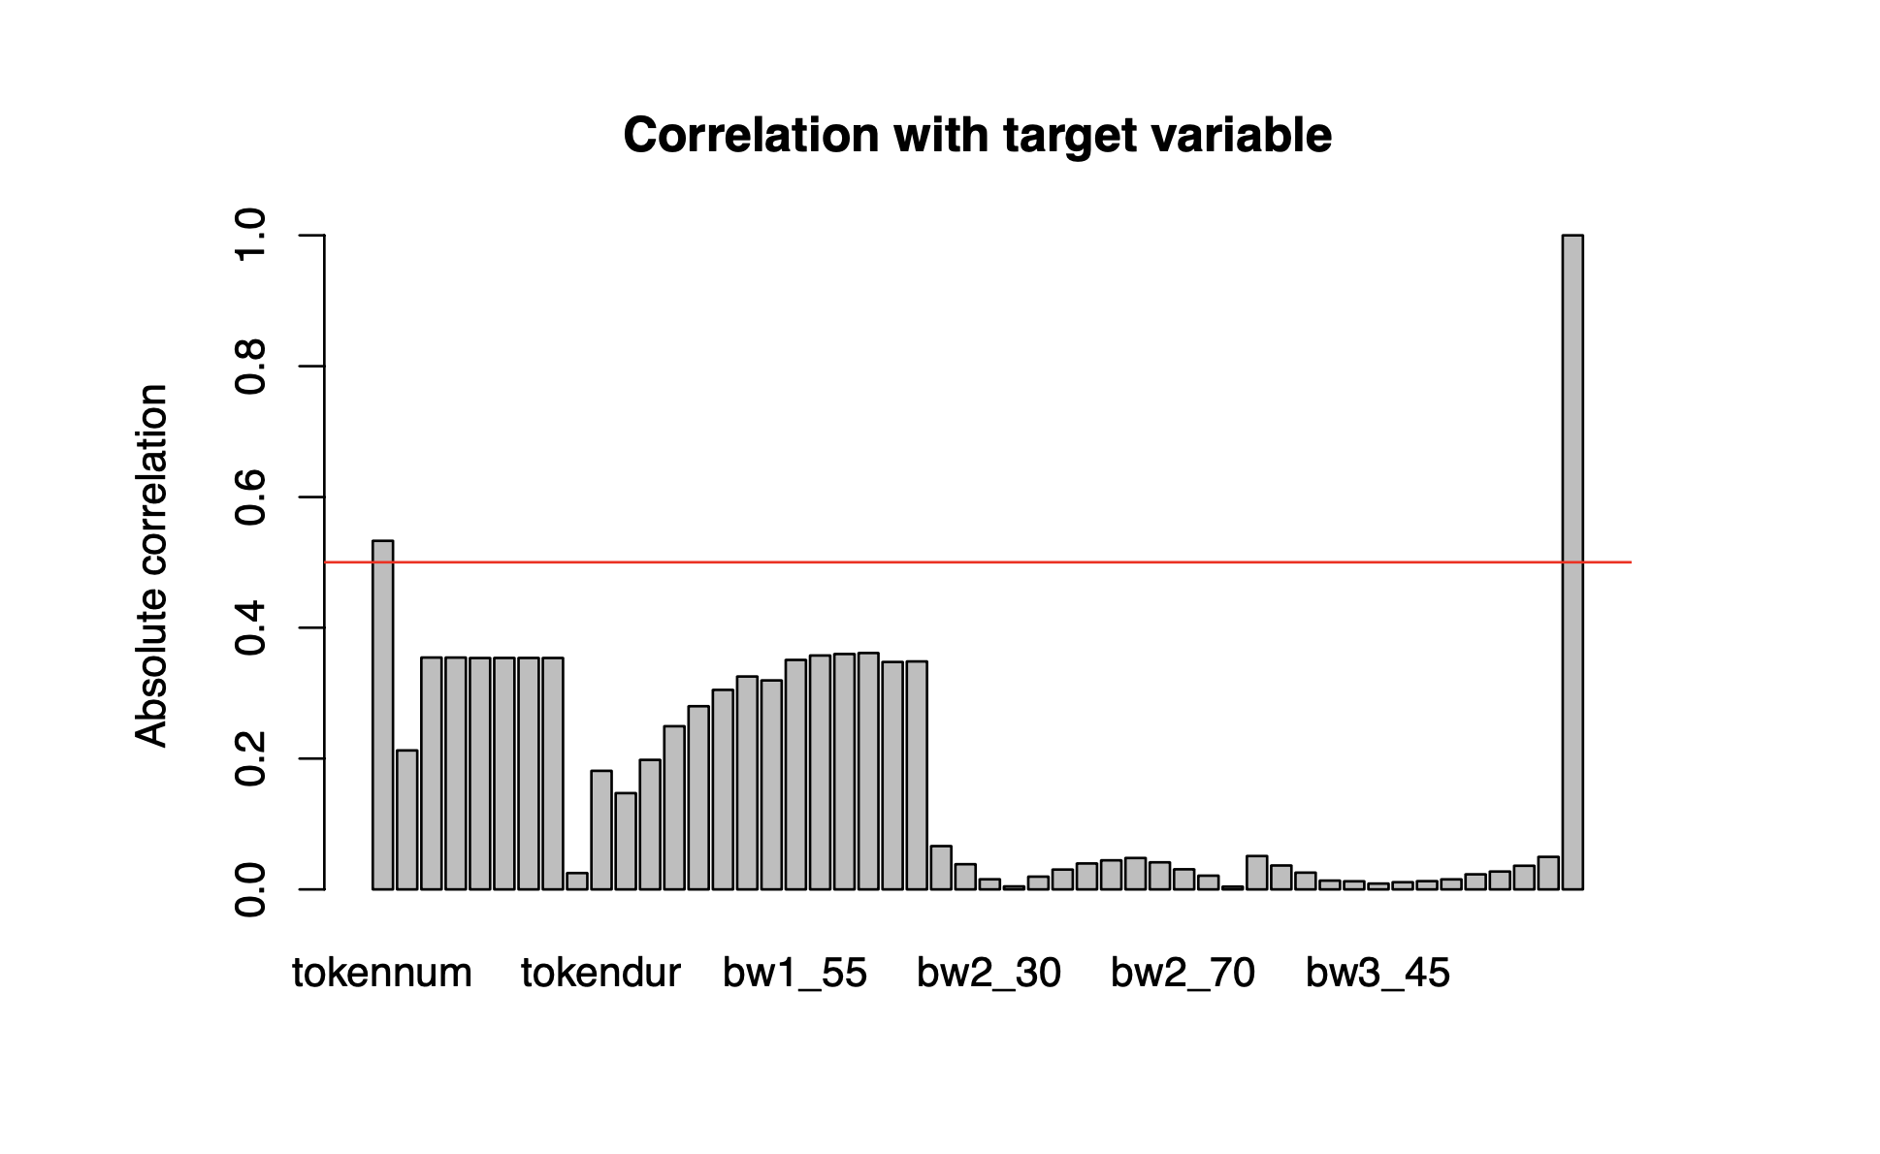
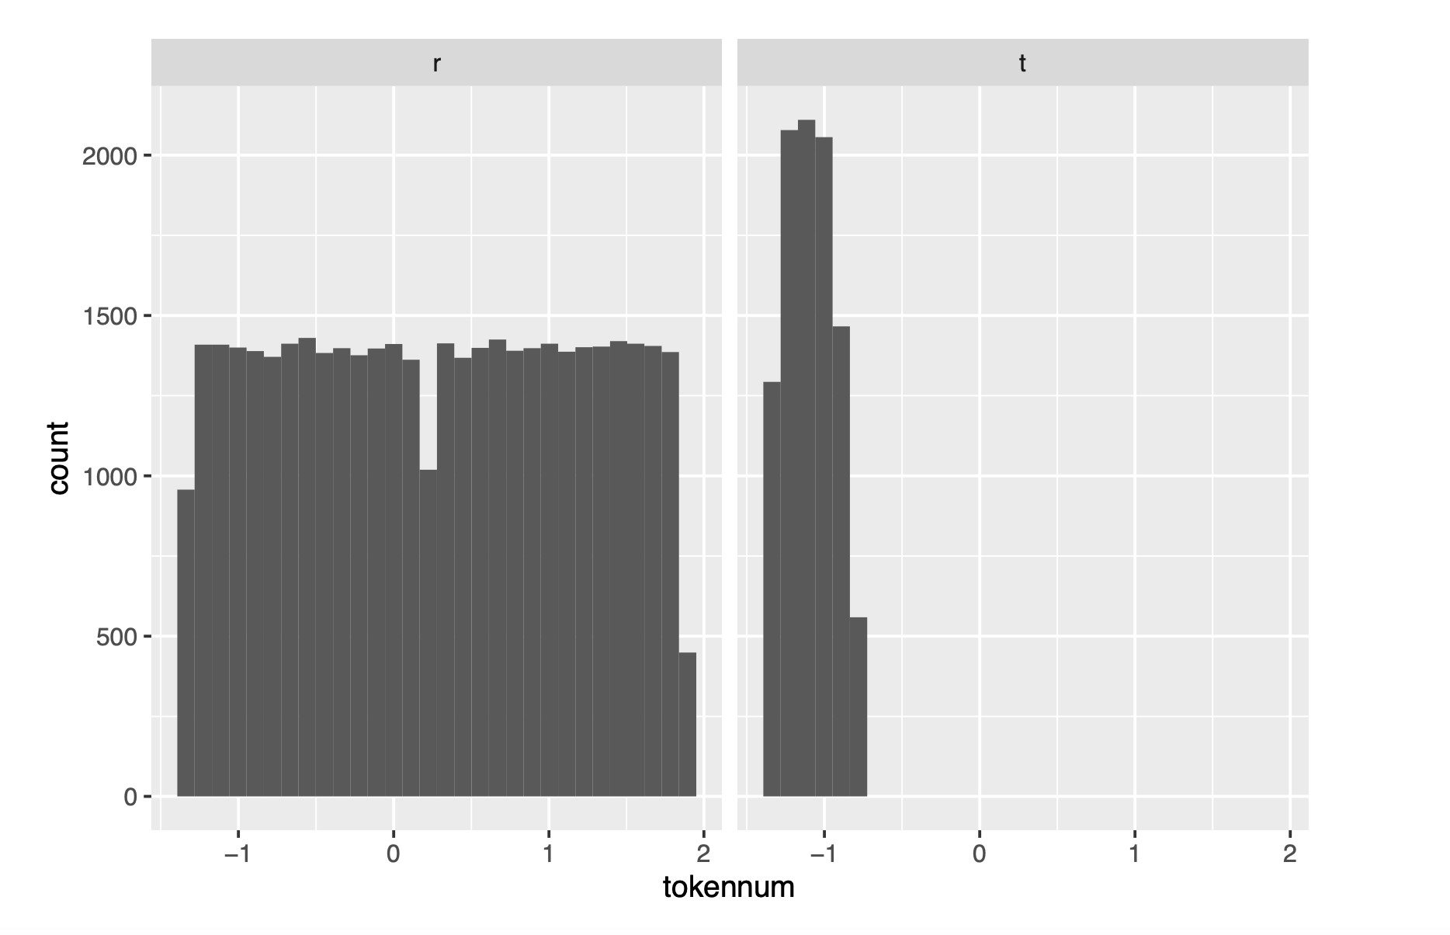
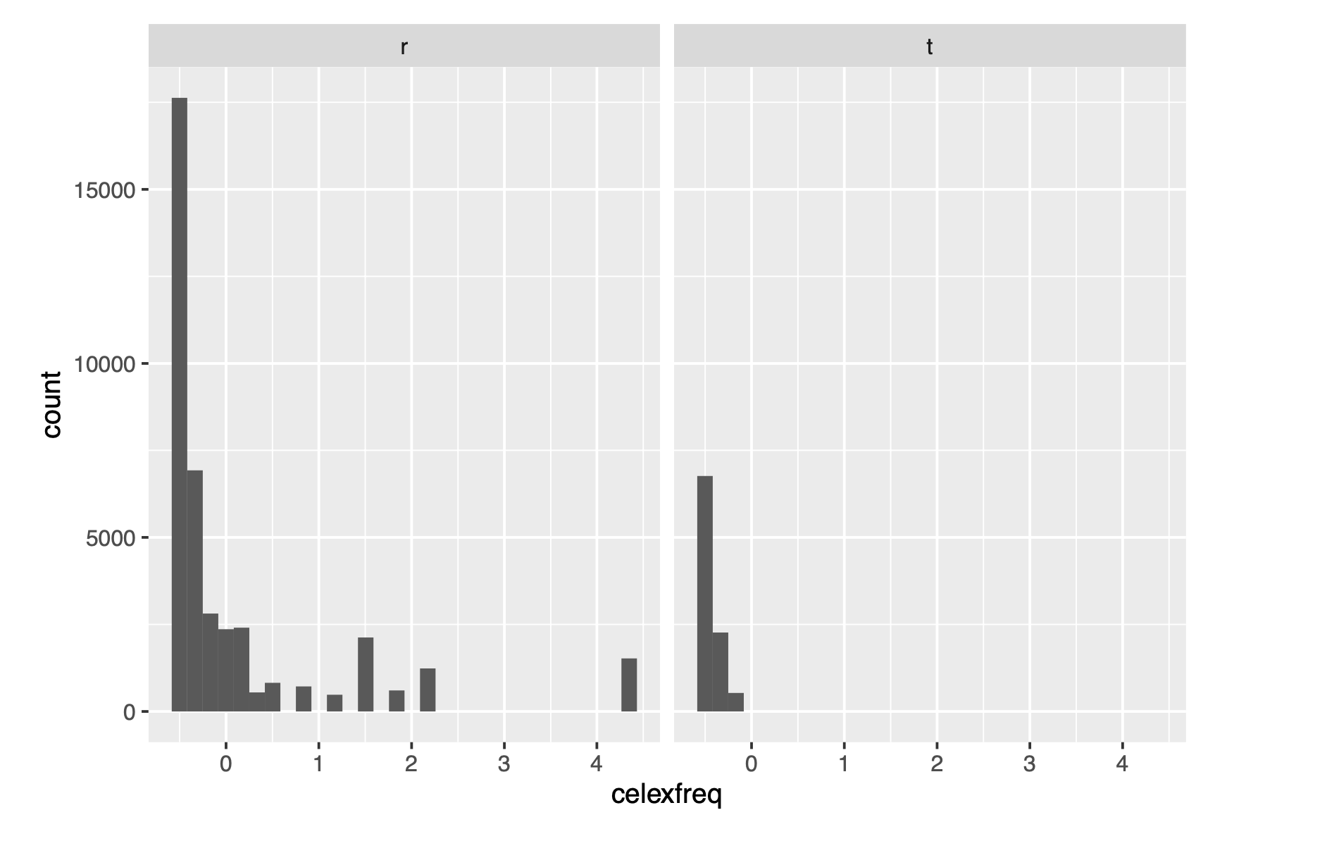
EDA
Question2
There are two features whose correlation with target are higher than 0.5
The lower two graph are their distribution graphs

Slide 10
The reason that so many couples of features have high correlation:
The features are extractions of acoustic signals at each 5% increment point, so adjacent extractions are highly correlated.
Therefore, we decide to keep all features, even most of them have high correlations.
Notes:
As for the reason that so many couples of features in both two dataset have high correlation: ….

Slide 11
Question 1 Model Results
Model Names | Evaluation Methods | (Hyper) Parameters | ACC
Naive Bayes (Baseline) | Confusion Matrix | / | 0.7712
Linear Discriminant Model (LDA) |  | / | 0.7945
Quadratic Discriminant Model (QDA) |  | / | 0.6858
Logistic Regression |  | / | 0.7984
KNN |  | k=9 | 0.8559
Random Forests |  | ntree = 1000, maxnodes = 4 | 0.775
Xgboost |  | nrounds = 100 max_depth = 2 eta = 0.3 objective = "binary:logistic" | 0.8255
SVM with different Kernels |  | type = 'C-classification' cost = 1 gamma = 0.5 | Linear: 0.7965 Polynomial: 0.7124 Radial: 0.8382 Sigmoid: 0.6157
Notes:
With pro-processed data, we applied 8 different models for each question, the 8 models are: ……, and we choose Naive Bayes as baseline model.
We used confusion matrix to do the evaluations.
We did not do the hyperparameter tuning since all the Xs are numerical variables.
For Question 1, we used accuracy to do the comparison. The best performance model is KNN with k = 9. The second one is SVM with Radial Kernel. The third one is Xgboost.

Slide 12
Question 2 Model Results
Dealing with imbalanced data:
0: 9562
1: 40191
Notes:
For question 2, there exits data imbalance issue, the ratio between two labels is around ¼.

Slide 13
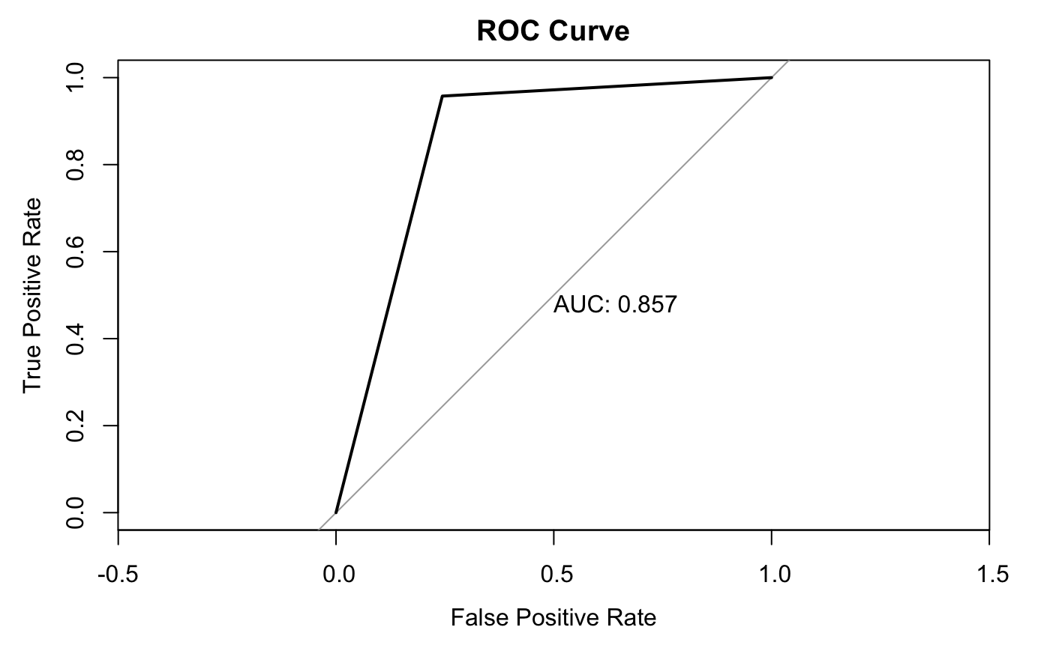
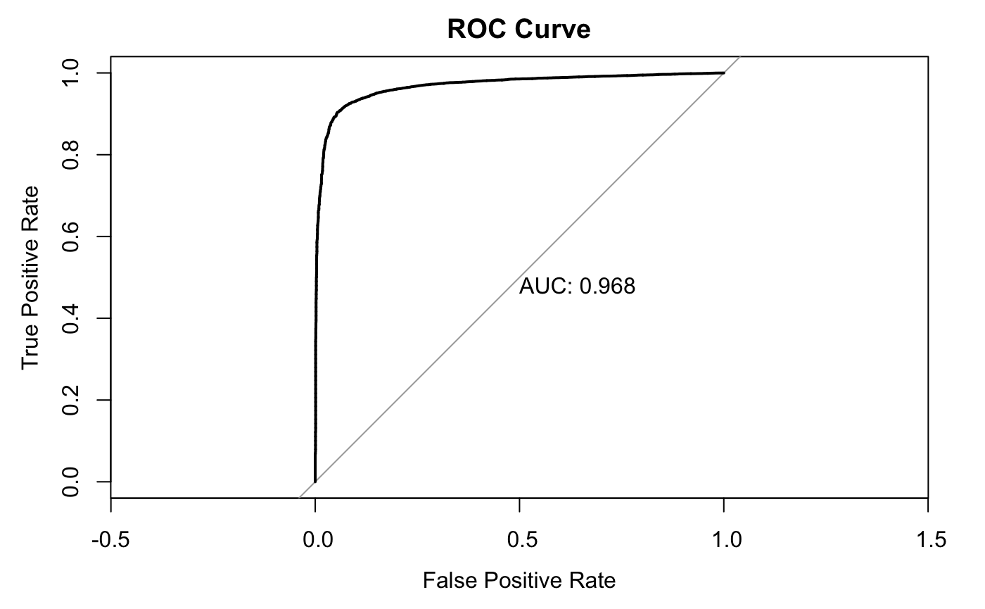
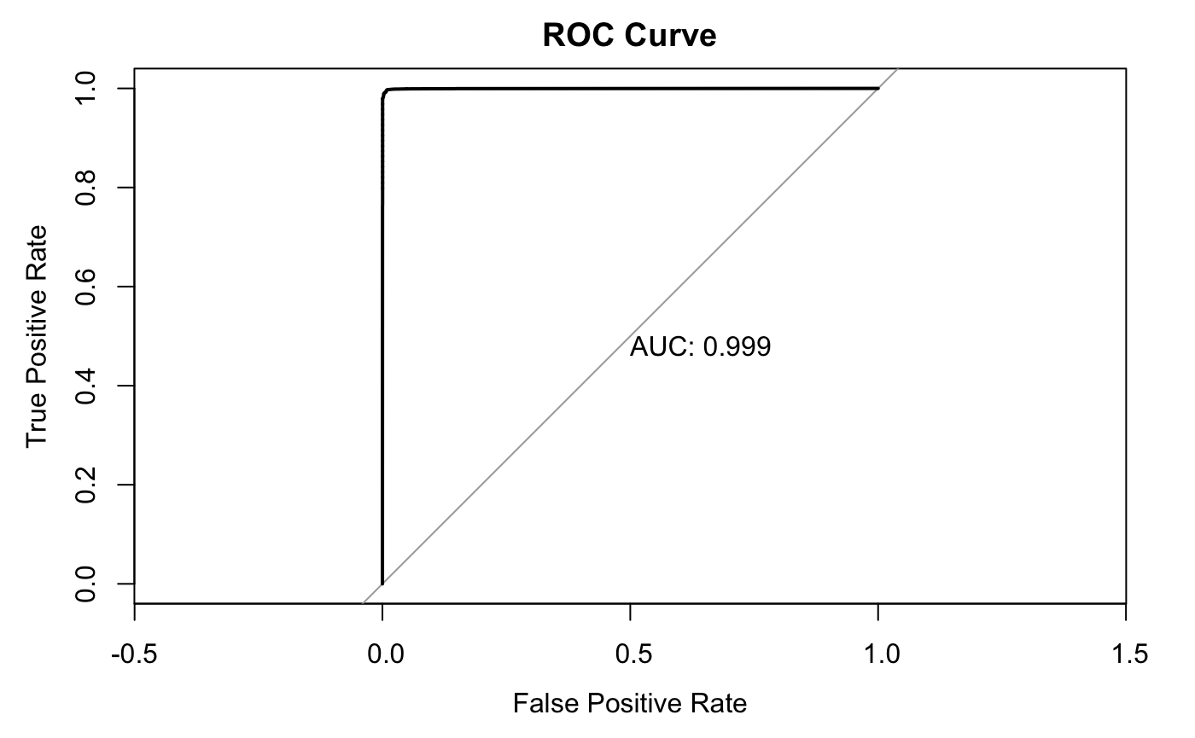

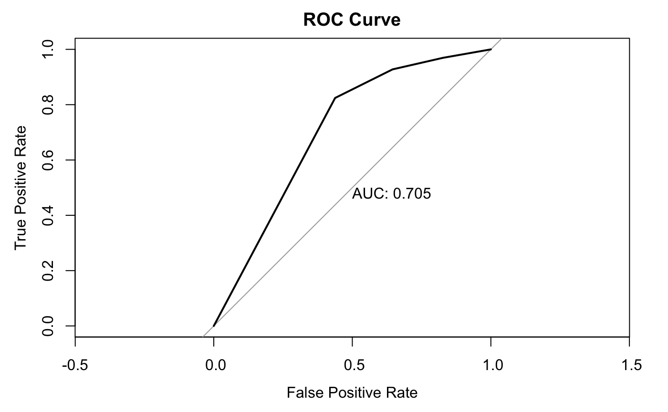
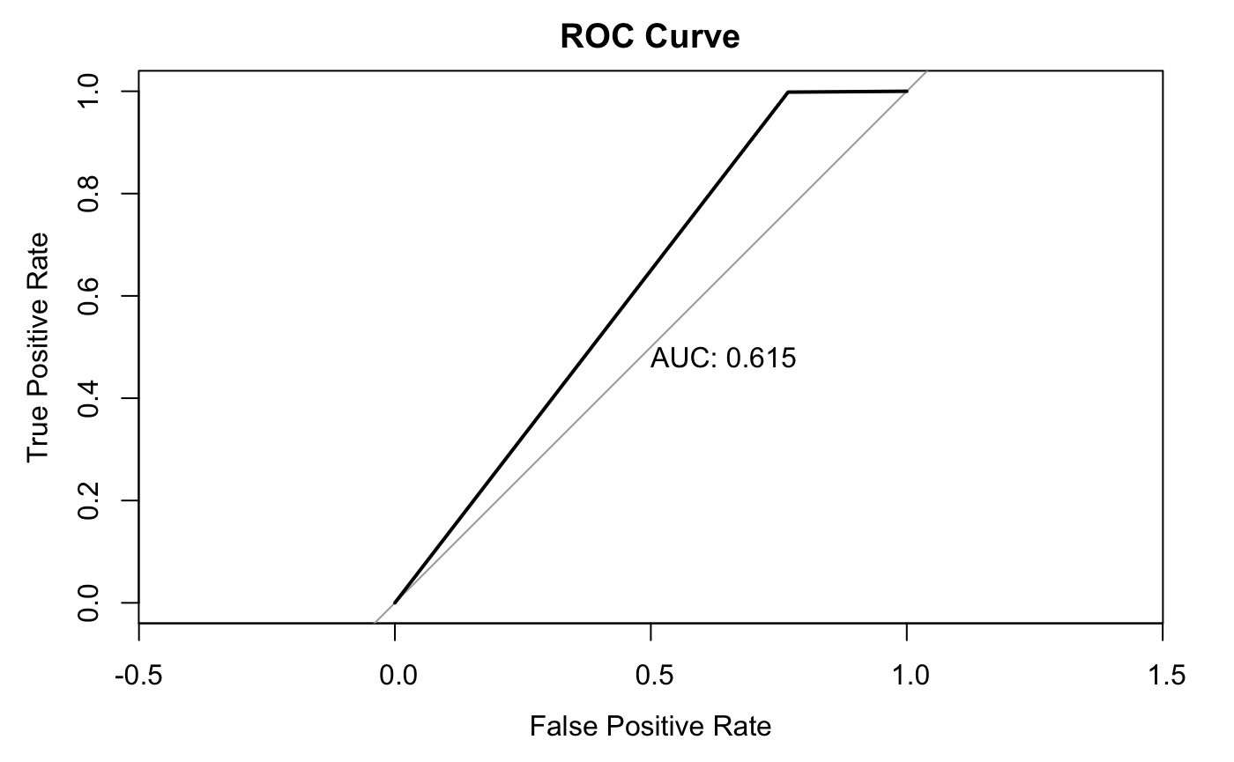

Question 2 Model Results
Model Names | Evaluation Methods | (Hyper) Parameters | F1 Score | ROC Curv | AUC
Naive Bayes (Baseline) | Confusion Matrix |  | 0.7821729 |  | 0.857
Linear Discriminant Model (LDA) |  |  | 1 |  | 0.968
Quadratic Discriminant Model (QDA) |  |  | 0.9991 |  | 0.999
Logistic Regression |  | / | 0.8843 |  | 0.989
KNN |  | k = 7 | 0.8377 |  | 0.705
Random Forests |  | mtry = 2 importance = TRUE ntree = 1000 maxnodes = 4 | 0.3741972 |  | 0.615
Xgboost |  | nrounds = 100 max_depth = 2 eta = 0.3 objective = "binary:logistic" | 0.9911474 |  | 1
SVM with different Kernels
Notes:
So, for question 2, we used F1 Score, ROC curve and AUC to do the performance comparison instead of accuracy.
F1 score is a measure of a classification model's accuracy that combines precision and recall. It is the harmonic mean of precision and recall, with a value ranging from 0 to 1, where 1 indicates perfect precision and recall, while 0 indicates the worst possible performance.
ROC Curve is a plot of the True Positive Rate (TPR) against the False Positive Rate (FPR) at different classification thresholds, ranging from 0 to 1.
The area under the ROC curve (AUC) is a measure of the performance of the classifier, with a value ranging from 0 to 1. AUC of 1 indicates perfect classification, while an AUC of 0.5 indicates the classifier is no better than random guessing.
The best performance model is Xgboost…

Slide 14
Discussion
Ensemble model
Neural Networks
Acoustic features
Autocoding and speech recognition

Slide 15
Thank you for listening

Slide 16
