Slide 1
Knowledge Distillation for Model Compression
Teacher-student CNNs on CIFAR-10
Shaury Sharma | 2430010406 | Section D | Batch F
Manipal University Jaipur | Capstone Project
Notes:
Introduce yourself and the project: compressing a large image classifier into a small one using knowledge distillation.

Slide 2
Big models are heavy
Deep networks reach high accuracy, but they cost memory, compute and power.
9.1x
more parameters
Phones and edge devices have tight budgets. Can a much smaller model keep most of the accuracy?
Teacher
3,249,994 parameters
Student
356,810 parameters
Circle area is proportional to parameter count
Notes:
Set up the motivation. The teacher has about 3.25 million parameters; the student has about 357 thousand, roughly 9 times fewer.

Slide 3
Teaching a small model
Teacher
large CNN, trained first
Student
small CNN, learns from both
Soft predictions (temperature T = 4)
True labels
Loss = α × CrossEntropy(student, labels)
+ (1 − α) × T² × KL(softmax(teacher/T) ‖ softmax(student/T))
T = 4.0
α = 0.5
Temperature softens the teacher's probabilities so the student also learns which wrong classes look similar.
Notes:
The student is trained on a mix of the true labels and the teacher's softened probabilities. Temperature T=4 and alpha=0.5 control the mix.

Slide 4
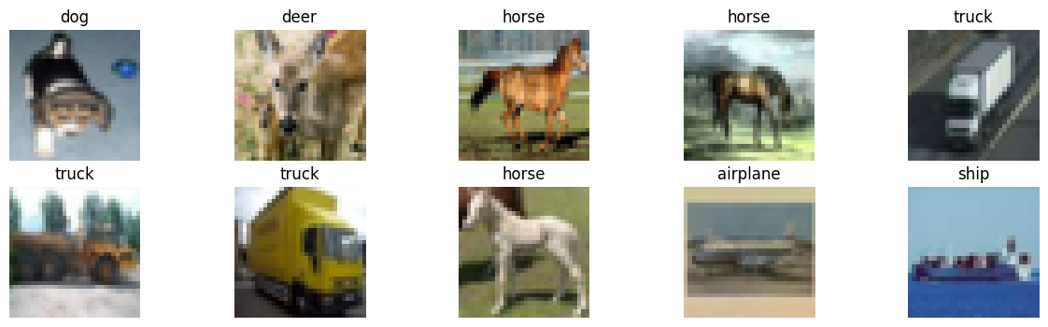
The dataset: CIFAR-10
60,000
10
32 x 32
colour images, 50,000 train and 10,000 test
classes: airplane, bird, cat, ship, truck and more
pixels per image, normalised to [-1, 1]
Notes:
CIFAR-10 is a standard benchmark. Images are tiny, which is why even good models top out around the 80s without augmentation.

Slide 5
Two models, one task
TEACHER
STUDENT
3.25M parameters
357K parameters
6 conv layers with BatchNorm
Dropout 0.5 and a 512-unit dense layer
Adam, lr 0.001, 10 epochs
3 conv layers, no BatchNorm
A single 128-unit dense layer
Same training recipe as the teacher
Notes:
Teacher: deeper, with BatchNorm and dropout. Student: a plain small CNN. Both trained the same way so the comparison is fair.

Slide 6
Results at a glance
+1.21 pts
distilled vs normal student, same 357K-parameter model
9.11x
fewer parameters than the teacher
0.7-1.1 s
student inference vs 1.17 s teacher (20 test batches, one noisy run)
Notes:
Teacher 83.79%, normal student 75.28%, distilled student 76.49%. The gain from distillation is about 1.2 points. Timings come from a single run, so treat them as rough.

Slide 7
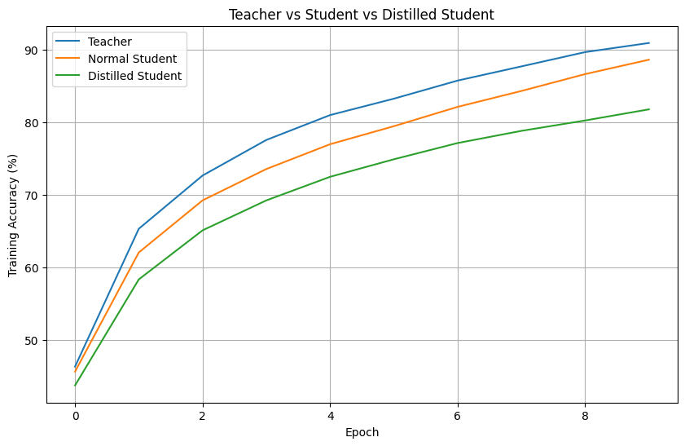
Training behaviour
Final training accuracy
Teacher 90.93%, normal student 88.62%, distilled student 81.77%
Train-to-test gap
Normal student 13.3 points, distilled student 5.3 points
The distilled student fits the training set less tightly but generalises slightly better. This suggests the soft targets act as a regulariser.
Training accuracy per epoch
Notes:
Distilled student has the lowest training accuracy but a higher test accuracy than the normal student. Gaps: 88.62-75.28=13.34 and 81.77-76.49=5.28.

Slide 8

One image, three models
All three are correct
Every model predicts airplane for test image 10.
Confidence differs
The distilled student is the least confident and spreads some probability over other classes such as bird and deer.
One example only, not a statistical result.
Teacher
Normal Student
Distilled Student
98.63%
93.47%
72.72%
confidence: airplane
confidence: airplane
confidence: airplane
Notes:
This is a live-demo slide: run show_prediction in the notebook on test image 10. One image is illustrative, not evidence.

Slide 9
Team and contributions
Workstream | What was done | Owner
Dataset and preprocessing | CIFAR-10 loading, normalisation, data loaders | Add name
Model development | Teacher and student CNNs, distillation loss | Add name
Testing and evaluation | Accuracy, parameter counts, inference timing | Add name
Documentation | README, install guide, results plots | Add name
GitHub workflow | Issues, branches, pull requests, reviews | Add name
Personal repository: MUJ-DS-2430010406
Notes:
Fill in the Owner column with teammate names before presenting, and show the Issues and Pull Requests tabs on GitHub.

Slide 10
Conclusion and next steps
What we found
Next steps
Distillation lifted a 357K-parameter student from 75.28% to 76.49% test accuracy
The student is 9.11x smaller than the 83.79% teacher, at about 7.3 points lower accuracy
The gain is modest and from one run, so repeat it with several seeds
Tune temperature and alpha
Train longer with data augmentation
Try pruning and quantisation, then deploy the student in a small app
Thank you. Questions?
Notes:
Summarise honestly: a small but real gain from distillation, large compression, and clear next steps.

