Slide 1


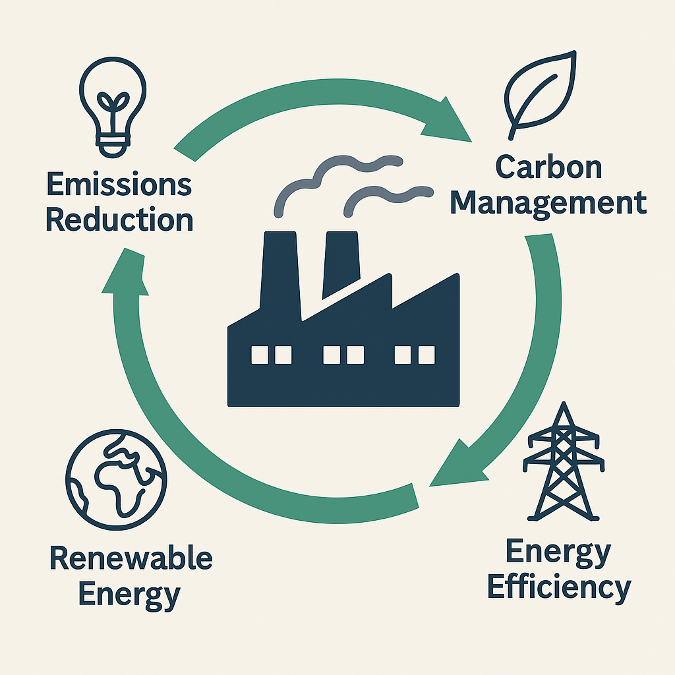

Energy & Carbon Management: Case Studies, Progress & Future Directions (ECM 2025)
Title of Research Article (70 pt., Arial, Bold, Centre)
Author¹, Author² and Corresponding author^{1,2,*} (Kindly provide full names of all authors) (35 pt., Arial, Centre)
¹Author affiliation
²Author affiliation
*e-mail: Corresponding author email id
(30 pt., Arial, Centre)
Section Title - 1 (Eg. Motivation)
Section Title - 2 (Eg. objectives)
Text should be fully justified.
The use of bulleted lists is strongly encouraged.
Section Headings should be in 40 pt., UPPERCASE, Arial, Bold, and Center-aligned.
Section Content should be in 32 pt., Bold, Times New Roman, and Justified.
Apply a 0.2 pt. indentation at the beginning of each paragraph or numbered line.
List objectives here
Objective 1
Objective 2
Objective 3
Section Title - 3 (Eg. Materials and method)
Insert your Methods and Materials content in this text box.
The text box is set to automatically resize based on the length of your content. To disable auto-resizing, right-click inside the text box, choose Format Shape > Text Box > Autofit, and select the “Do Not Autofit” option.
Section Title - 4 (Eg. Result)
To change the font style of this text box, click once on its border to select the entire box. Then, choose your desired font and font size. Please note: The poster size is 4 ft (height) × 3 ft (width).
Set the zoom to 100% to get an accurate preview of how the poster will appear when printed.
Table 1: Table Caption
 | Heading | Heading | Heading
Item 1
Item 2
Item 3
Figure 1: Figure Caption
Section Title - 5 (Eg. Discussion)
Section Title - 6 (Eg. conclusions)
Section Title - 7 (Eg. references)
Click here to insert your Discussion text
Conclusion 1
Conclusion 2
Conclusion 3
Reference 1
Reference 2
Wang J, Li Z, Chen Y. Optimization of energy systems under uncertainty. Applied Energy, 2023;342:120456. https://doi.org/10.1016/j.apenergy.2023.120456
Rao M, Singh A. Energy modeling of hybrid systems. In: Proceedings of the 10th International Conference on Sustainable Energy Technologies; 2022; Kuala Lumpur, Malaysia. Elsevier; p. 215–20.
Bejan A. Advanced Engineering Thermodynamics. 4th ed. Hoboken: Wiley; 2016.
*To Generate QR Code for Your Poster:
Upload poster to Google Drive → get shareable link (set to "Anyone with the link") → paste in Adobe Express QR Generator → download QR code.
To update without changing QR → right-click file in Drive → "Manage versions" → upload new version (or simply drag & drop and click replace) without deleting the old file.
School of Energy Science and Engineering & Department of Chemical Engineering, Indian Institute of Technology Guwahati, Guwahati, Assam, India

