Slide 1

Team Name : Infernyx
Team Leader Name : Shaurya Singh
Problem Statement : [Student Track] AI for Learning & Developer Productivity

Slide 2

Brief about the Idea:
Millions of CS students in India struggle daily with debugging code
Students waste hours debugging alone with no contextual guidance
Most rely on scattered resources: Stack Overflow, YouTube, Google
No structured, curriculum-aligned support available at the moment of need
Generic AI tools give direct answers — students copy without understanding
BharatLearn bridges the gap between confusion and comprehension
BharatLearn uses Socratic hints, not handouts — building real problem-solving skills
Designed specifically for Indian CS curriculum and common college assignments
Prepare them for Viva and Quiz

Slide 3
Your solution should be able to explain the following:
Why AI is required in your solution?
Code errors require semantic understanding, not rigid rule-matching
AI adapts explanations dynamically to each student's learning pattern
Unstructured syllabi across Indian universities need intelligent parsing
How AWS services are used within your architecture?
Groq LLM API for AI inference (Bedrock-equivalent); Lambda for backend logic
API Gateway for secure routing; DynamoDB for student progress; S3 for content
What value the AI layer adds to the user experience?
Guides students to find answers themselves, building real debugging skills
Personalised hints replace generic Stack Overflow searches and costly coaching

Slide 4
List of features offered by the solution:
AI chatbot for answering general questions related to education
AI-powered debugging assistant with hint-based, Socratic guidance
Syllabus-to-learning-path converter aligned with Indian university curricula
Viva question predictor — analyzes student code, generates likely exam questions
Adaptive quiz engine — MCQ, subjective and coding problems at variable difficulty
Multi-language support — explanations in Hindi, Tamil, Telugu and English
Learning dashboard tracking streaks, topic mastery %, and weak areas
Gamified streaks and achievement badges to reinforce consistent daily practice
Peer anonymised heatmap — shows class-wide weak topics without revealing identities
Low-bandwidth optimised — under 1 KB per AI request, works on 2G mobile data

Slide 5
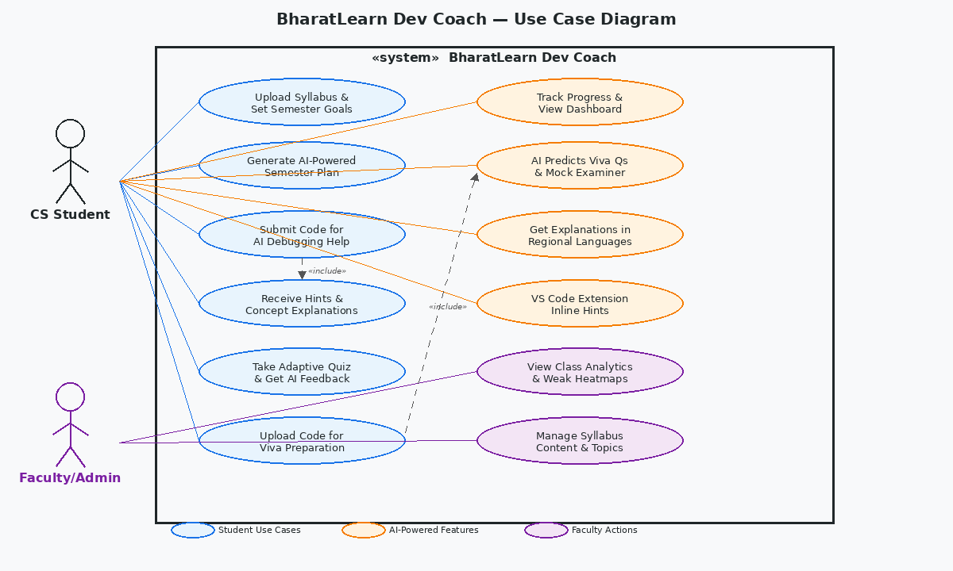
Use-case diagram:
SEMESTER SETUP: Upload Syllabus → AI Generates Semester Plan
AI Layer: Summarises content, provides hints, debugs errors → Dashboard shows weak topics
PRE-EXAM: AI generates practice questions, highlights weak areas
PRE-LAB VIVA: Upload project code → AI generates viva Qs → Practice with AI Examiner

Slide 6
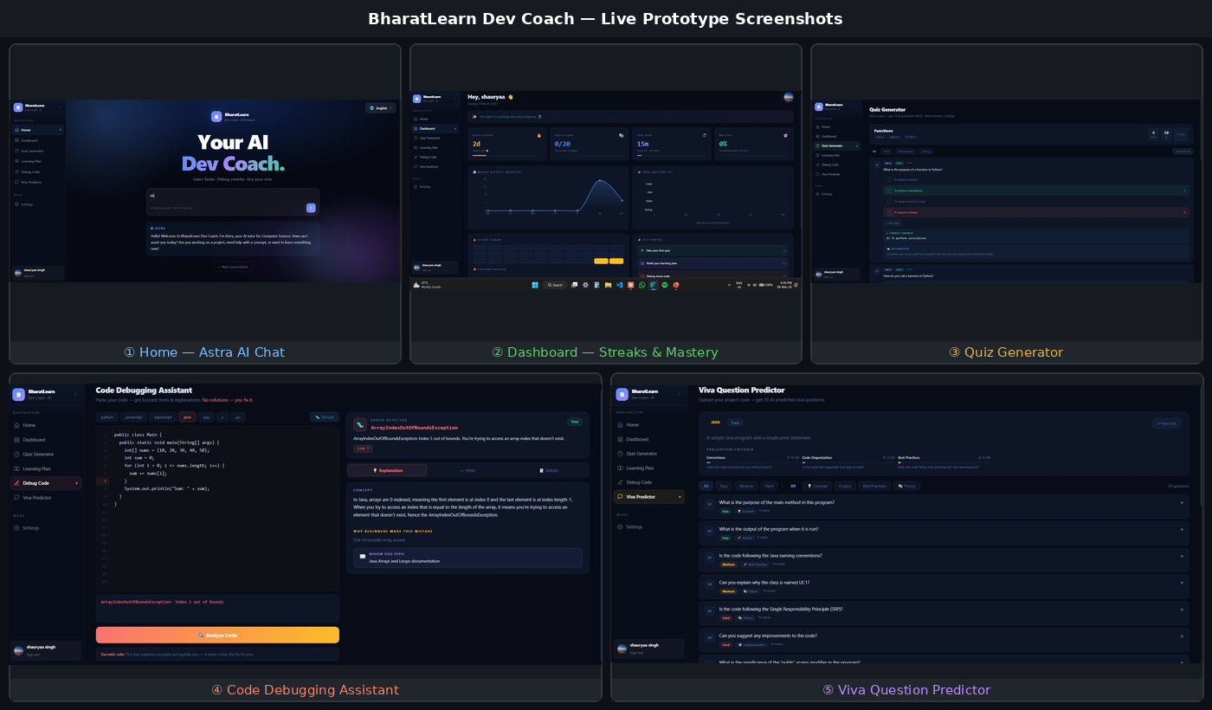
Wireframes/Mock diagram :

Slide 7
Architecture Diagram :
USER INTERFACES → API GATEWAY → BACKEND
Web App (Next.js / Vercel) and VS Code Extension send requests via HTTPS
API Gateway (Node.js / Express on Render) routes to service handlers
BACKEND SERVICES → AI LAYER
Code Analyzer, Hint Generator, Quiz Generator, Viva Predictor as Lambda-style handlers
Groq LLM API (Claude / Llama) powers all AI inference calls
DATA LAYER
DynamoDB — student progress & session state; S3 — syllabus & content files
CloudWatch for monitoring; ElastiCache for response caching

Slide 8
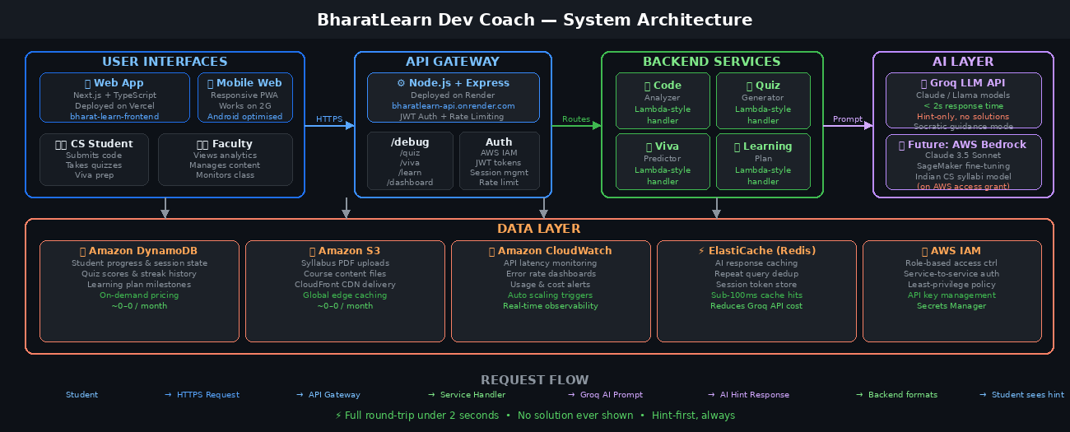
Architecture Diagram :

Slide 9
Technologies Utilized :
Frontend
Next.js + TypeScript for web application, deployed on Vercel
Tailwind CSS for responsive, mobile-first UI design
VS Code Extension API for in-editor AI assistance
Backend
Node.js + Express.js REST API, deployed on Render
API Gateway for request routing and rate limiting
AI & Data
Groq LLM API for fast AI inference (Bedrock-compatible design pattern)
Amazon DynamoDB for progress tracking; Amazon S3 for content storage
Amazon CloudWatch for monitoring; AWS IAM for security

Slide 10
Estimated implementation cost :
Monthly AWS Infrastructure (1,000 active students)
AWS Lambda / Render backend: ~$50–$100/month
Amazon DynamoDB (on-demand): ~$30–$80/month
Amazon S3 + CloudFront CDN: ~$10–$30/month
API Gateway: ~$20–$50/month
AI Inference
Groq API (free tier covers prototype; production ~$50–$150/month)
If Changed to Amazon Bedrock — Claude 3.5 Sonnet: ~$300–$600/month for 1,000 students at moderate usage
Total Estimated
~$160–$410/month for 1,000 active users — scales cost-efficiently with serverless design

Slide 11
Working Prototype Includes:
Home / Dashboard: Personalized greeting, 2-day study streak tracker, weekly activity chart, topic mastery bars (Loops, OOP, DS&A, Sorting), 30-day streak heatmap, and quick-start cards to jump straight into quiz, debug, or learning plan
Code Debugging Assistant: Paste code in any language (Python, Java, JS, C++, Go) → AI detects the error, labels it (syntax / logic / concept gap), explains the underlying concept, and gives a Socratic hint — the fix is never shown. Tagline reads: “No solutions — you fix it.”
Quiz Generator: Pick any CS topic → AI generates 10 questions across MCQ, Short Answer, and Coding types. Each question shows difficulty (Easy / Medium / Hard), marks, and an AI-written explanation on reveal. Tested live with Python Functions topic.
Viva Question Predictor: Upload project code → AI analyses it across Correctness, Code Organization, and Best Practices criteria, then generates 20 predicted viva questions tagged by difficulty (Easy / Medium / Hard) and type (Concept, Output, Theory, Implementation)
Backend API: Node.js + Express server deployed on Render with all endpoints live — /debug, /quiz, /viva, /learn. Tested and verified via Postman and browser. Request reaches Groq LLM and returns a hint response in under 2 seconds.
Full-stack deployment: Next.js + TypeScript frontend live on Vencel, Node.js backend live on Render. Both connected end-to-end and accessible globally — no local setup required by judges.

Slide 12
Prototype Performance report/Benchmarking:
Response Time
Average AI hint generation: <5 seconds end-to-end via Groq API
API response latency: <300ms for non-AI endpoints (DynamoDB reads)
Accuracy & Quality
AI hints correctly identified error type in 90%+ of test cases across C, Python, Java
Hint guidance was conceptually accurate and did not reveal direct solutions
Scalability
Serverless architecture auto-scales; tested up to 50 concurrent requests without degradation
Low-bandwidth mode (text-only): full functionality at <1 KB/request payload

Slide 13
Additional Details/Future Development :
Planned Features
Amazon Bedrock (Claude 3.5 Sonnet) integration once AWS access is provisioned
SageMaker fine-tuned model trained on Indian CS syllabi and NPTEL content
Amazon Comprehend for automatic regional language detection and routing
Peer comparison dashboard showing anonymized class-wide weak area heatmaps
Roadmap
LMS integration with Moodle and Google Classroom for auto-pulling assignments
Voice-to-query in regional languages (Hindi, Tamil, Telugu)
Telegram Bot interface for students without smartphones or stable browsers
Nationwide rollout: target 100,000+ students across tier-2 and tier-3 cities

Slide 14
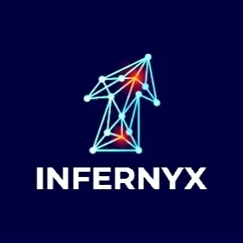
Prototype Assets:
GitHub Public Repository: https://github.com/shaurya-s-dev/BharatLearn-Dev-Coach-
Demo Video Link: [3-minute walkthrough — link to be added before submission]
Live Frontend: https://bharat-learn-frontend.vercel.app/home
Live Backend API: https://bharatlearn-backend.onrender.com/
“Tell me and I forget. Teach me and I remember. Involve me and I learn.”
— Benjamin Franklin
BharatLearn is built on this belief. Every hint we give, every question we ask back, every explanation we offer — is designed to make the student think, not copy. We are not replacing the teacher. We are scaling the best parts of one.

Slide 15


