Slide 1
QuickDrop A File Sharing Hub // IWP PROJECt

Slide 2
TEAM DETAILS
 | NAME | MAIL ID | LAB SLOT
18BCE2113 | Shaurya Choudhary | shaurya.src@gmail.com | L37 + 38

Slide 3
PROJECT OVERVIEW
What are we trying to achieve here?

Slide 4
KEY FEATURES
Strong User Authentication
Backup files on server
Share files with fellow users
Access files from any device after authentication
Add description about files for better management.
Edit profile to create unique identification on the platform.

Slide 5
ROADMAP
Brainstorming and identifiaction of problem statement
Prototype design and user authentication implementation.
Front End enhancement and testing web app integration.
1
3
5
2
4
6
Designing project and module distribution.
Databasae configuration for file sharing.
Final app deployment and documentation.

Slide 6
Front End
STRUCTURE OF WEBSITE

Slide 7
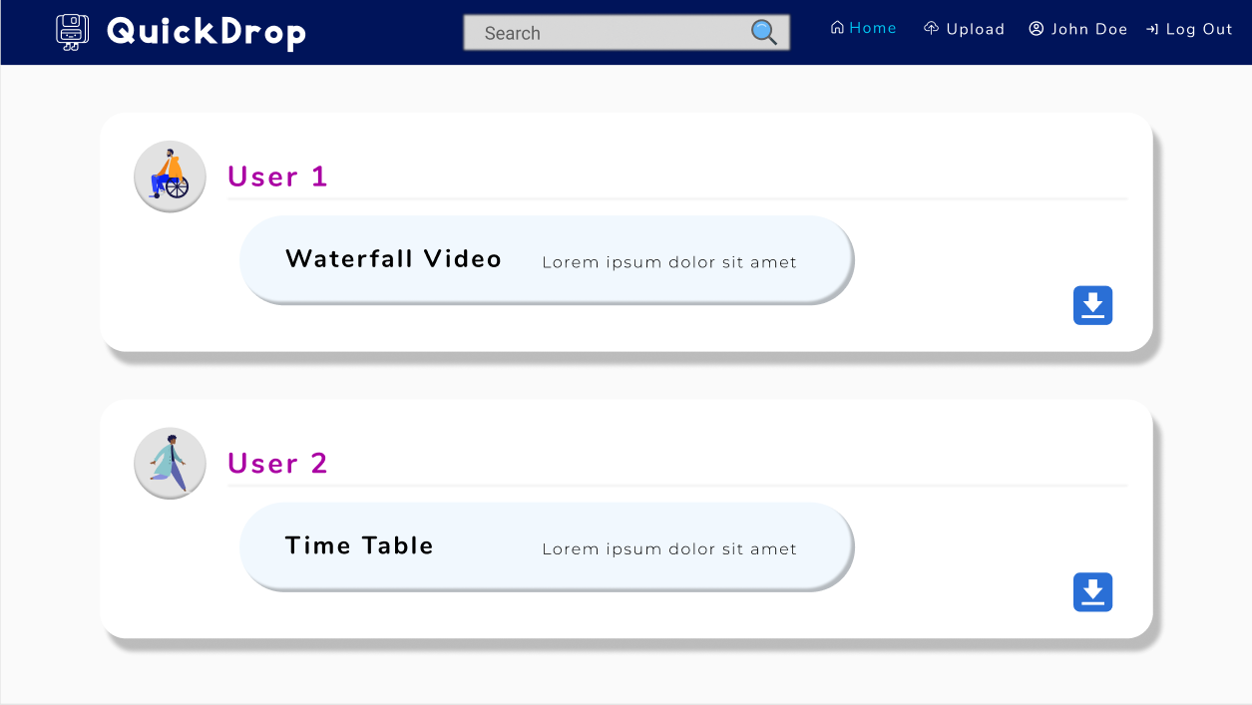
WEB APP
PROTOTYPE
A prototype designed on Figma to visualize final outcome of this project.

Slide 8
WEB PAGES STRCUCTURE
Home Page
User will see the files uploaded by others and can download the same. User will see navigation options to all other pages along with login.
User Login Page
Page will consist of Username and Password field, where users can log in to their account or new users can register through signup option.
My Files Page
After signing in to the account, users will be able to access all the files uploaded by him/her. The user can then view or modify these files.
New Uploads Page
User will be able to upload new files which would be associated with their profiles. The user can add details about the file like title and description.
Edit Profile Page
Users can edit their profile to create a unique identity on the platform, like by adding new profile photo and bio.
Posts Page
On clicking the file upload post from home page, user can see the details about the file including owner, title and description of the file.

Slide 9
Used Languages
HTML
CSS
Django
Framework
Java
Script

Slide 10
Back End
DATABASE DESIGN

Slide 11

NOT REALLY A DATABASE?
Django framework allows to create and maintain databse through models structure.
A model is the single, definitive source of information about the data. It contains the essential fields and behaviors of the data being stored. Generally, each model maps to a single database table.

Slide 12
MVT Design
Model
It is a data access layer which handles the database. Each attribute of the model represents a database field.
View
It is used to define and execute business logic. It interacts with model to carry data and renders a template.
Template
It’s a presentation layer which completely handles User Interface of the web application.

Slide 13
PROJECT MODELS
USERS MODEL
POSTS MODEL
username: Stores the username.
profile_img: Stores the profile picture of respective user.
email: Stores Email ID of the user.
password: Stores user password.
title: Stores title of the post.
file: Stores the uploaded file.
desc: Stores description abot the file.
post_date: Stores Date and Time of the post.
owner: Stores detail about the author of the post.

Slide 14
Module Description
THE PROJECT BREAKDOWN

Slide 15
DJANGO PROJECT APPS (MODULES)
USERS
The module will deal with user registration and authentication. Upon successful log in, user will be allowed to modify his/her details in the profile.
POSTS
This module will allow users to upload and modify their files as well as share with others. The files will be managed in an SQLite serve.

Slide 16
Software Requirements
WHAT IT TAKES TO BUILD THIS?

Slide 17
TECH STACK
PYTHON
DJANGO
JAVASCRIPT
CSS
HTML
SQLITE

Slide 18
PROCESSOR
System Config
i5 9300H
RAM
16 GB
GRAPHICS CARD
GTX 1050
OS / IDE
WIN 10 / PyCharm

Slide 19
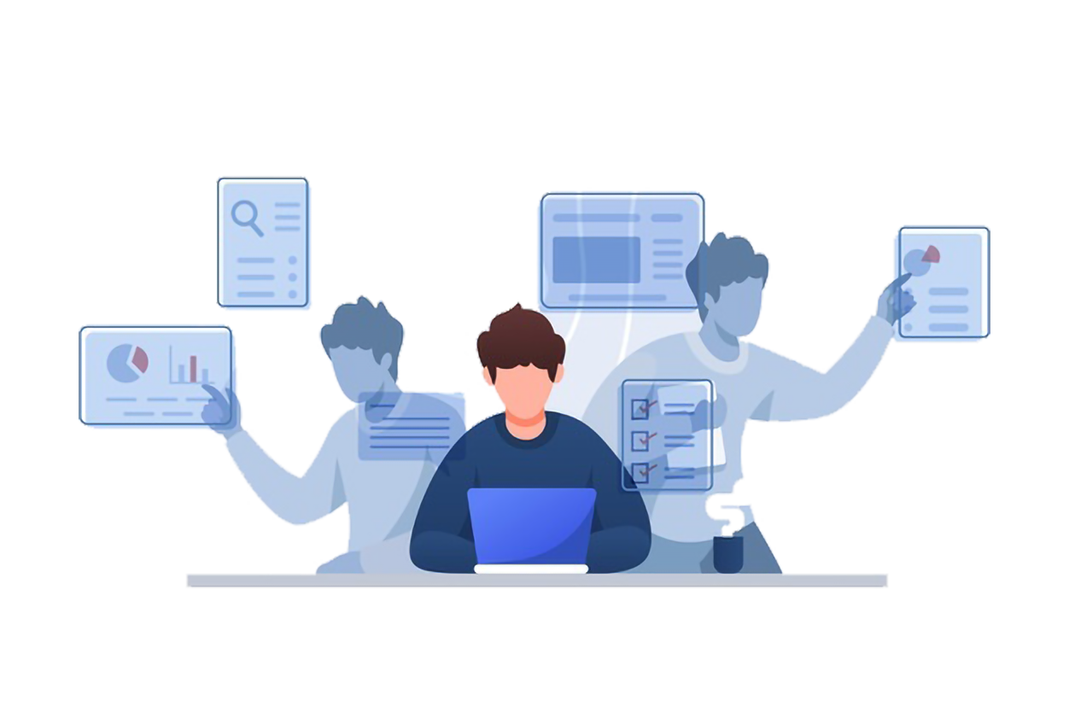
THANK YOU!
Shaurya Choudhary
[18BCE2113]

