Slide 1

Spam detection in social media
A SURVEY

Slide 2

INTRODUCTION
A brief insight

Slide 3
In this technology connected world, every human is connected to the internet all the time, there are a lot of ways people communicate with each other over the internet.
Data has become more costlier than oil in 2018.
Spamming has become one of the major inconveniences faced by every internet user. Despite how many new spam filters and spam detection algorithms are being used the spammers find a way to pass through them.
Few researches say that around fourteen billion spam messages are globally sent per day. Approximately there are 45% of all emails which are spam sent in a day.

Slide 4

Problem Description
Online spamming comes in different forms such as malware dissemination, abusive content, fake news, and generating fake product reviews. This makes it difficult to check the legitimacy of the content being posted.
Thus, spamming makes utilizing data directly from social media platforms untrustworthy and may mislead the analysis to wrong conclusions due to unrepresentative data.
Spamming on twitter is heavily based on the trending hashtags.
Most of the spam detecting methods use behavioural and statistical methods to detect spam, but they all have their limitations.
For instance, a spam account detection model looks for several attributes like follower-followee ratio, tweet frequency, interaction with other users, age of the account, etc. before labelling the account.
One of the major issues faced in classifier models is that the dataset used to train them gets old, so the model fails to detect new spam strategies enforced by spam drift.

Slide 5

Ontology BASED APPROACH

Slide 6
PROBLEM addressed
A report by Nexgate found out that on an average one spam post occurs in every 200 social media posts and a more recent research reports that around 15% of active Twitter users are automated bots for spamming.
The growing volume of spam content and the use of automated bot accounts to publish posts raises many problems about the credibility and representativeness of the data for research.
This study analysis has displayed that common spammers and social media bot spammers behave similarly.
There are many factors that determine whether the account is spam or not. The conventional methods used keyword-based identification to check for spam.
But a real-time spam detection method is used in this paper that performs far more efficient than existing methods and models.
The factors that mainly affect are follower-followee relationship, frequency of tweets, user active time and interaction with the other accounts.

Slide 7
Methodology proposed
The approach proposes an optimised set of features independent of historical tweets, which are only available for a short time on Twitter. We take into account features related to the users of Twitter, their accounts and their pairwise engagement with each other.
We observe that an average automated spam account posted at least 12 tweets per day at well defined periods.
This method is suitable for real-time deployment in a social media data collection pipeline as an initial pre-processing strategy to improve the validity of research data.
Recursive feature elimination has been employed in order to ascertain the robustness and the discriminative power of each feature. In comparison to an earlier study, the proposed features exhibit stronger discriminative power with more consistent performance across the different learning models.

Slide 8
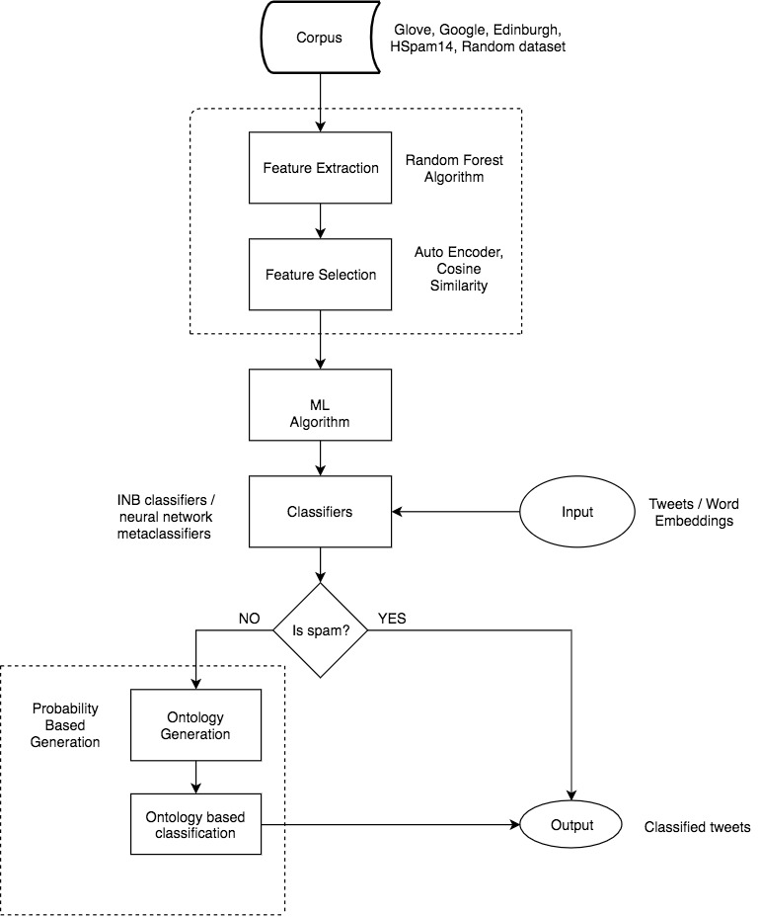
SYSTEM ARCHITECTURE

Slide 9
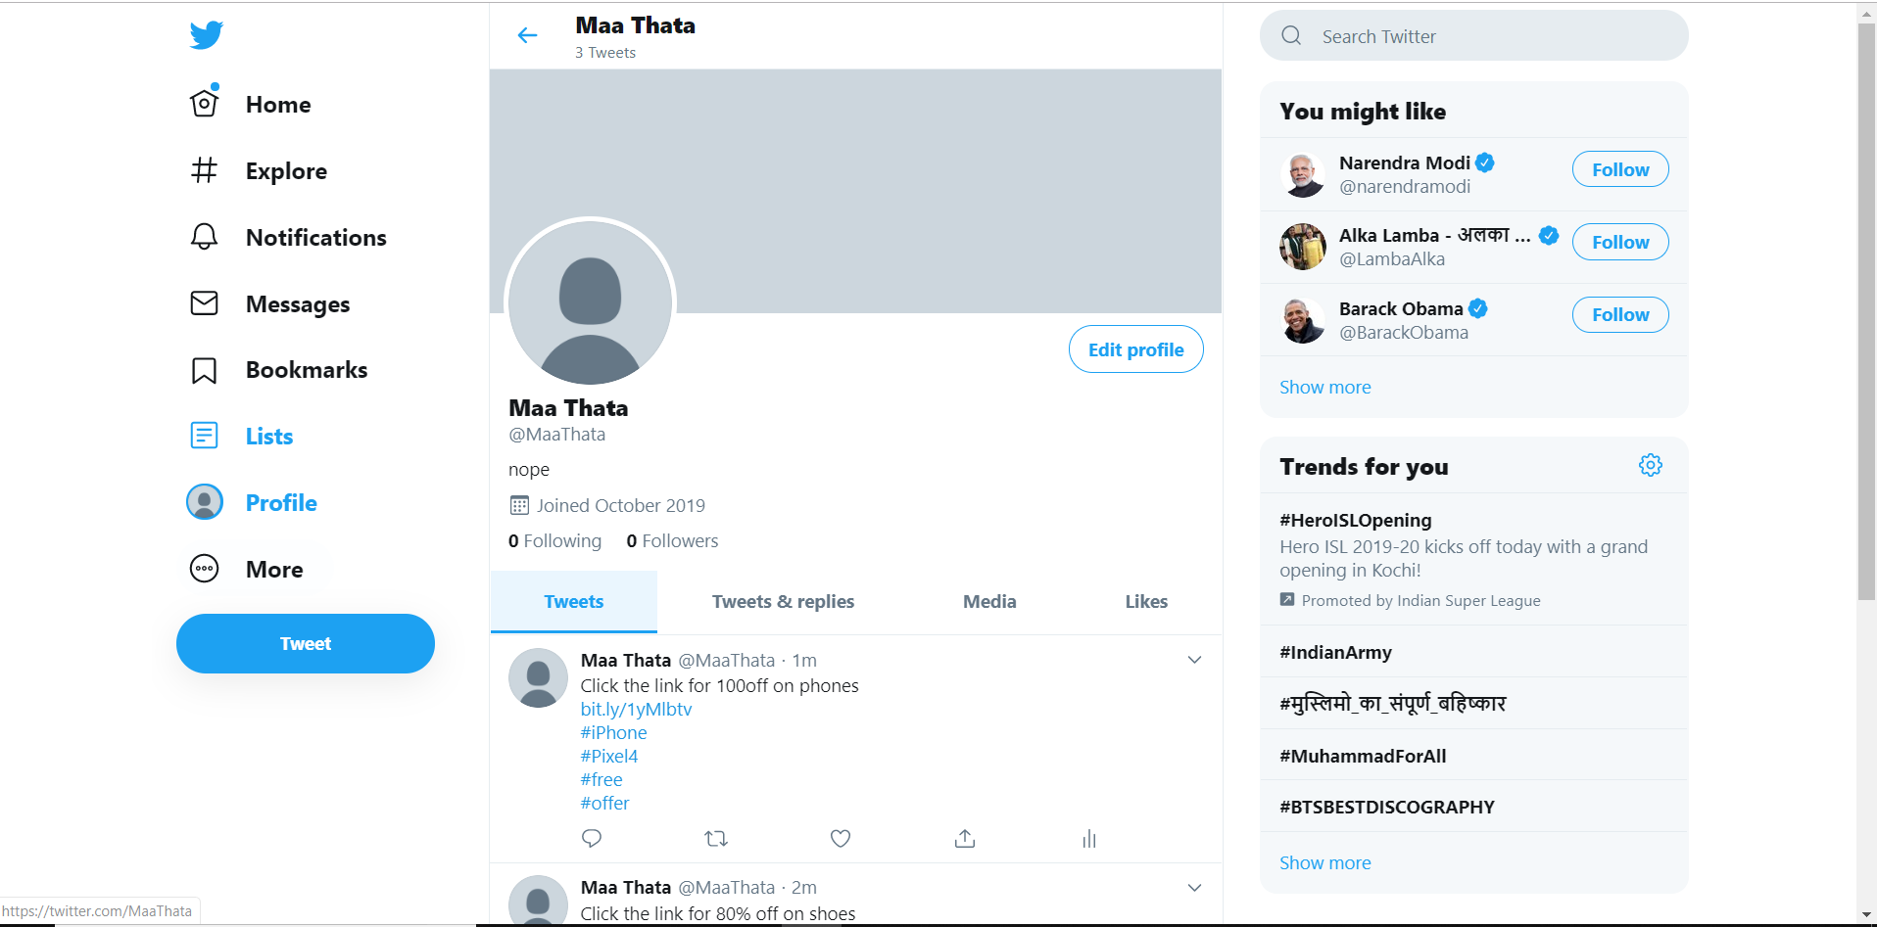

Slide 10
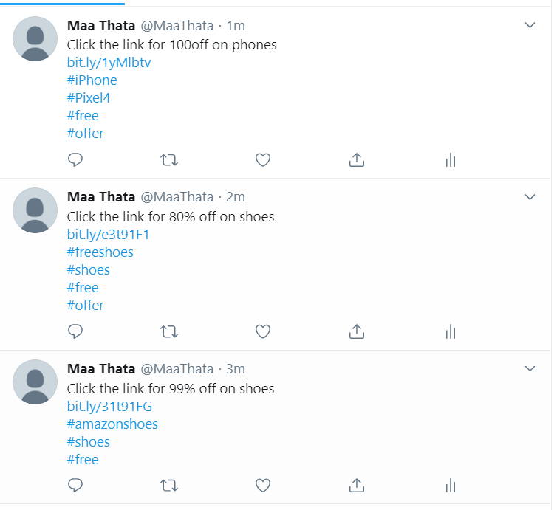
Frequency based

Slide 11

Dynamic retraining spam-detection model
A collective-based Framework

Slide 12
PROBLEM ADDRESSED
Twitter is the most popular real-time microblogging website, making it the main source of information for social-based researches. However, due to enormous amount of spam contents flooding the platform every moment, the Information quality is deteriorating.
SPAM DRIFT: With time, Spammers are also getting smarter. They are adopting new strategies and tricks to exploit social media platforms by changing characteristics of the spammed tweets. This variation in the concept of spamming is known as spam drift.
Properly annotated dataset is required to implement spam detection models, which is very expensive in terms of cost and time.
The model analyses the streamed tweets by 6-tuple attributes <User, #Retweets, #Replies, #Favorites, Text, Time>.
Here, the user attribute is again represented by attributes like Username, Screenname, and User account Age.

Slide 13

Methodology PROPOSED
TWO MODULES
CORE
REAL-TIME TWEET
FILTERING
PERIODIC CLASSIFICATION
MODEL LEARNING
Stores all the streamed tweets in a storage component.
When enough database is stored, it uses unsupervised ML to create newly labelled training dataset.
New feature space is prepared using the obtained annotated tweets.
Supervised Learning method (ex. Random Forest) is applied to the feature space to build new classifier.
This new classifier replaces the classification model of first module.
Prepares feature vector for streamed tweets by extracting pre-defined feature set.
The vector is passed to the classification model (learned), and it predicts the class label.

Slide 14
LIST OF FEATURES
User features exploited in spam-detection
Number of hashtags
Number of URLs
Number of Words
Number of characters
Number of mentions
Number of Retweets
Number of spam words
Number of trending topics
Number of replies
Number of favorites
Number of followings
Number of followers
Count of tweets
Account age
etc. ...

Slide 15
DATASET USED
Ground-truth dataset is used which is directly observed through manual inspection and clustering.
WHY?
It is obtained from direct observation.
Dataset provided by other publishers mostly contain target ID’s which have already been suspended by twitter.
To obtain a large reliable dataset, clustering is used.

Slide 16

USERS SET EXTRACTION
USER-AGE BASED CLUSTERING
COMMUNITY DETECTION
COMMUNITY-BASED FEATURE EXTRACTION
COMMUNITY CLASSIFICATION FUNCTION
FLOW CHART

Slide 17
USERS SET EXTRACTION: From the streamed tweets, information is extracted to obtain the unique set of Users.
USER-AGE BASED CLUSTERING: The age of account is determined by extracting the User Age feature attribute. It can’t be altered by the user and thus paly a crucial role.
Cumulative Distribution Function (CDF) of all the features are mapped into graph for verification. Social spammers take all the measures to behave and present themselves exactly as legitimate users. The CDF of AccountAge Feature shows most robust and distinctive results as compared to other features as it is non-editable.
On the basis of account-age, the user accounts are grouped to form clusters which may have possible co-relation among them.
HOW IT WORKS?

Slide 18
3. COMMUNITY DETECTION: Non-negative Matrix Factorization(NMF) is used as an unsupervised method to establish differences between real user and spam accounts.
Several new accounts are made every moment, both spam and non-spam. And further more plethora of spam accounts are made for different campaigns at the same time.
To distinguish already formed clusters as community, this stage establishes correlation among the cluster by taking into account of tweet content, posting behavior, etc.
4. COMMUNITY-BASED FEATURE EXTRACTION: Following features are further extracted from communities:
UNPS – Username Patterns Similarity
SNPS – Screenname Patterns Similarity
TWSS – Tweets Writing Style Similarity
TPBS – Tweets Posting Behavior Similarity
5. COMMUNITY CLASSIFICATION FUNCTION: Using the above extracted features, the community is marked as Spam or non-spam.
HOW IT WORKS?

Slide 19
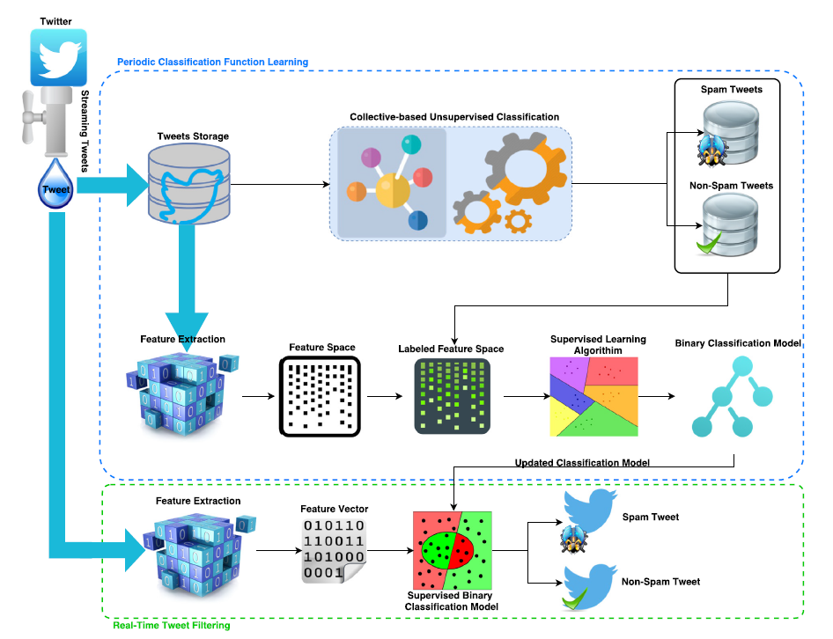
Framework diagram

Slide 20
ANALYSIS
PROS
CONS
High recall values.
(What proportion of actual positives was identified correctly)
It works in real time.
Tackles the recent spamming techniques (spam drift) efficiently.
Doesn’t require human intervention for preparing annotated dataset.
Low precision values.
(What proportion of positive identifications was actually correct)
The model doesn’t address the growth of collected training dataset.
Old non-spam dataset serves no purposes, and only causes loss of resource.
Requires more time for training.

Slide 21

A Novel Stream Clustering Framework

Slide 22
PROBLEM addressed
The conventional clustering methods consider the micro-clusters to be smaller in size and having symmetric distribution.
But in reality there are more number of big micro-clusters and most of them don’t have symmetric distribution. There is also a less consideration towards the boundary of these clusters. In such a case, we get inaccurate results of spam filtering during the online phase.

Slide 23
Methodology proposed
They propose that all the conventional methods replace the Euclidean distance they use with a set of Incremental Naïve Bayes (INB) classifiers. This modified method was called by them as ‘INB-DenStream Clustering’. The datasets they have used on was from a research paper that collected over 600 million tweets using JSON format.
The data when first enters, acts according to the DenStream clustering and is calculated with Euclidean distance. So the neighbouring data becomes a microcluster.
From the second window of data, the population is compared with “MinC” value and when exceeded an INB classifier is assigned to it. These INB classifiers take the mean and variance of that microcluster.
If these outputs exceed “SimThreshold” then the incoming data is assigned to those INB with maximum probability using the Euclidean distance.

Slide 24
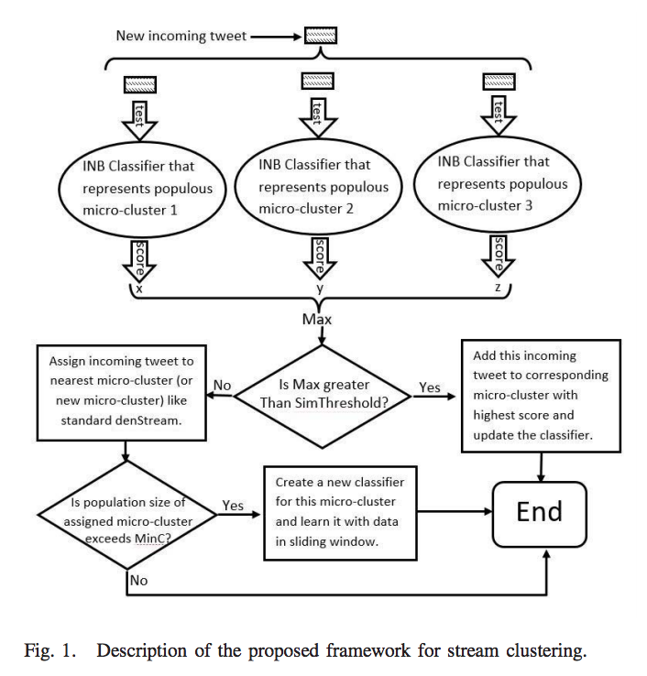
System architecture

Slide 25
Analysis
Advantages
Disadvantages
Saves memory space - Each microclusters are only labeled with mean, variance, population, and the timestamps. The sample data is completely eliminated.
Low computational complexity - INBs are only updated with new incoming data. The other INBs are left untouched. This gives lesser complexity than the DenStream clustering method.
Undesirable results - For smaller clusters, the standard clustering method seems more accurate than the proposed method. This method is only useful for bigger microclusters with un-symmetric distribution.

Slide 26

Comparison

Slide 27
COMPARISON TABLES
Method | Accuracy | Precision | Recall | F-measure
CNN+Glove 200d ns CNN+GOOGLE300D ns CNN+Edinburgh 400d ns CNN+HSpam 200d ns CNN+Random | 0.912 0.952 0.936 0.939 0.922 | 0.711 0.869 0.782 0.796 0.785 | 0.945 0.895 0.943 0.938 0.839 | 0.812 0.822 0.855 0.861 0.811
Proposed Method (5 CNN+ 1 Feature based) | 0.957 | 0.880 | 0.909 | 0.894
Evaluation Parameter | Datasets and their respective results
F1- Measure | Dataset I (63.7), Dataset II (60.6), Dataset III(51.3), Dataset IV(49.9)
Purity | Dataset III(98.31), Dataset IV(78.15)
Table 2: The evaluation parameters used in INB-Denstream clustering model.
Table 1: The evaluation parameters used in 5CNN1FB model.

Slide 28
Dataset used
Data Sets | Method
1. Hspam14 Data Set, 1ks10kn | Neural Network-Based Ensemble Approach
1. raw and unstructured data | An Ontology-Based Tweet Spam Detection
1. Ground-Truth | Collective Approach Of Unsupervised And Supervised Model
1. Spamassassin 2. Lingspam 3. Csdmc2010 Corpus | Identification Of The Most Relevant Features With Random Weight Networks
1. Dataset -I , -II , -III and -IV [11] | Stream Clustering Framework
1. Enron Data 2. Imdb Data 3. Trec07 | Unsupervised Feature Learning
1. Csmining Spam Emails Datasets 2. Concept Drift In E-Mail Datasets | Semantic-Based Feature Selection
1. Spam-Posts Detection Dataset Automated 2. Honeypot 3. Spam-Posts Detection Dataset Manual | Based On User Activity And Behaviour

Slide 29
Evaluation parameters
Algorithms | Feature extraction model (unsupervised) |  |  | Feature extraction model (Semantic based)-using Topic Guessing |  |  | Ontology based
 | Precision (%) | Recall (%) | F-measure (%) | Accuracy | FN | FP | Accuray (%) | Precision (%) (0,1) | Recall (%)(0,1) | F-measure %(0,1)
SVM | 97.80 | 98.80 | 97.80 | 90.8 | 7.4 | 1.8 | 88.13 | 90,86 | 86,90 | 88,88
RF | 97.60 | 97.10 | 97.10 | 99.2 | 0.6 | 0.2 | 94.70 | 93,91 | 92,93 | 93,92
C4.5 | 95.00 | 94.20 | 94.20 | 97.6 | 1.2 | 1.2 | - | - | - | -

Slide 30

CONCLUSION

Slide 31
After surveying the different algorithms and methods used, it was evident that:
SVM is more efficient and accurate when we use it for feature based methods which take the content into account but Random Forest algorithm seemed to be more efficient for the feature extraction model which is semantic based.
The 5CNN1FB neural network ensemble model seemed to take more execution time compared to the other methods but had better or similar performances with the baselines for both balanced and unbalance datasets.
The DenStream Clustering method outperformed all other Clustering methods present today. The accuracy of this method is more in case of the bigger datasets. In case of smaller datasets, DenStream method seemed more accurate.
For Ontology based methods, it was seen that Random forest algorithm had better accuracy than the SVM algorithm.

Slide 32

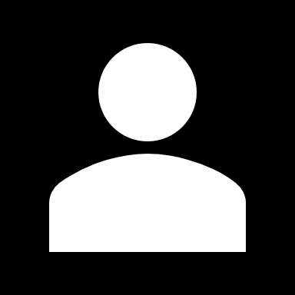
THANK YOU
VARSHITHA CHENNAMSETTI
C BHARATH SAI REDDY
SHAURYA CHOUDHARY

