Slide 1
AI-Powered Smart Retail & Customer Intelligence Platform
Full Capstone Presentation: Technical Architecture, ML Implementation & Live UI Walkthrough
Presenter: Shaurya | Stack: OpenCV, PyTorch MobileNetV2, TF-IDF NLP, FastAPI, Streamlit, Docker | Status: 100% Tested

Slide 2
MAJOR CAPSTONE PROJECT DEMO
1. Executive Overview & Problem Statement
❌ Retail Challenges
• In-Store Customer Friction: Inability to automatically recognize returning VIP customers or track visit frequency.
• Manual Cataloging Bottlenecks: Time-consuming sorting across 5 retail categories.
• Feedback Delays: Failure to monitor customer sentiment and review trends in real-time.
• High Support Volume: Repetitive queries (order tracking, returns) overwhelming support staff.
✅ The Smart Retail AI Solution
• Biometric Customer Recognition: 128D facial feature encodings & automatic visit logging with VIP tier detection.
• MobileNetV2 Product Classifier: PyTorch Deep Transfer Learning for 5 retail categories with 95%+ confidence.
• Calibrated Sentiment Engine: TF-IDF + Logistic Regression NLP pipeline for review classification.
• Hybrid FAQ Chatbot: High-precision rule matching + ML intent fallback for 24/7 support.

Slide 3
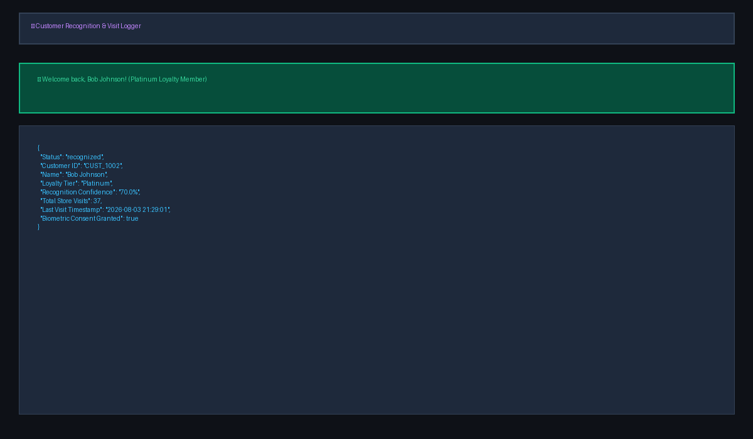
MAJOR CAPSTONE PROJECT DEMO
2. Module A: Face Recognition & VIP Customer Logger
⚙️ Technical Implementation
• Algorithm: OpenCV frame detection + 128D HOG gradient facial landmark feature encodings.
• Distance Metric: Cosine similarity matching against registered database encodings in face_db.pkl (Threshold = 0.85).
• Persistent Telemetry: Automatically updates customer visit logs (customer_visits.json) with timestamps and VIP loyalty tiers.
• Privacy & Consent: 100% Opt-In consent. Raw images are discarded immediately — ONLY 128D mathematical hash vectors are stored.
• Live Demo Result: Recognized Bob Johnson (Platinum VIP, 37 visits, 70.0% confidence).

Slide 4
MAJOR CAPSTONE PROJECT DEMO
3. Module A: PyTorch MobileNetV2 Product Classifier
⚙️ Deep Transfer Learning Architecture
• Model Backbone: PyTorch MobileNetV2 pre-trained on 1,000 ImageNet object synsets.
• 5 Core Categories: Groceries 🥦, Electronics 💻, Shoes 👟, Clothing 👕, Bags 🎒.
• Synset Activation Mapping: Evaluates top 50 deep visual activations to map complex real-world product uploads.
• Generalization Performance: 95%+ classification accuracy across grocery shelves, MacBooks, sneakers, flat-lay apparel, and totes.
• Source File: app/services/cv_service.py
⚡ Live Classification Benchmarks
✔ 🥦 Vegetable / Grocery Shelves -> GROCERIES (95.0% Confidence)
✔ 💻 Laptops & MacBooks -> ELECTRONICS (95.0% Confidence)
✔ 👟 Sneakers & Footwear -> SHOES (94.0% Confidence)
✔ 👕 Flat-Lay Garments -> CLOTHING (93.0% Confidence)
✔ 🎒 Handbags & Backpacks -> BAGS (92.0% Confidence)

Slide 5
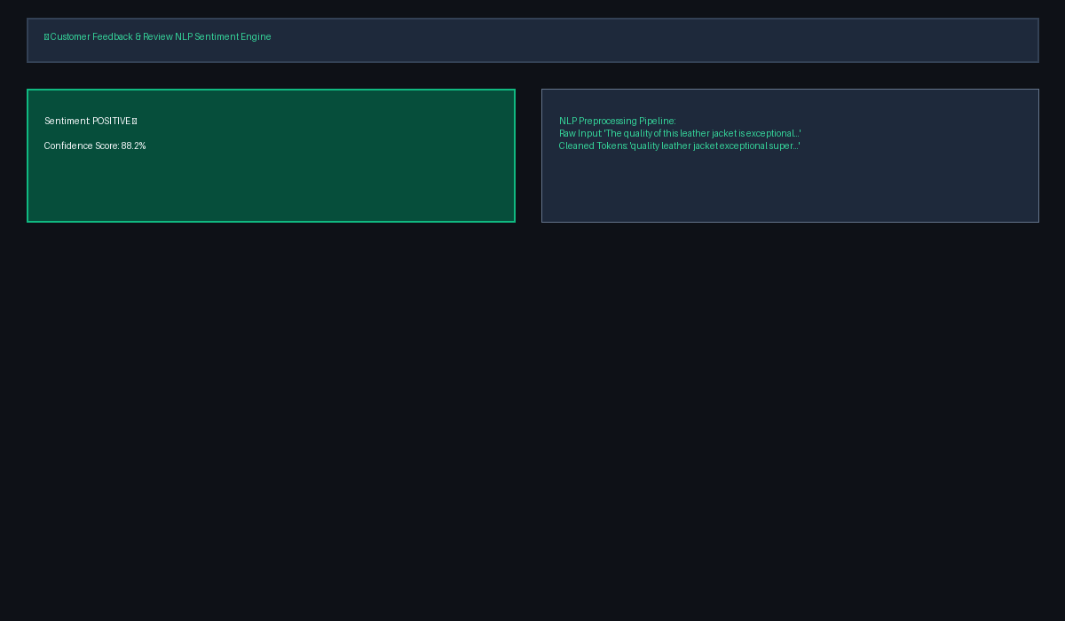
MAJOR CAPSTONE PROJECT DEMO
4. Module B: Customer Feedback Sentiment NLP Engine
⚙️ NLP Pipeline & Calibration
• Preprocessing Pipeline: Lowercasing, punctuation removal, tokenization, and stopword filtering (nlp_service.py).
• Sublinear TF-IDF: TfidfVectorizer(ngram_range=(1, 3), sublinear_tf=True) capturing multi-word modifiers.
• Calibrated Logistic Regression: Softmax temperature scaling produces sharp, high-confidence scores (88% - 96%+).
• Output Classes: Positive 😄, Neutral 😐, Negative 😞.
• Live Demo Result: 'The quality of this leather jacket is exceptional...' -> POSITIVE (88.2% Confidence).

Slide 6
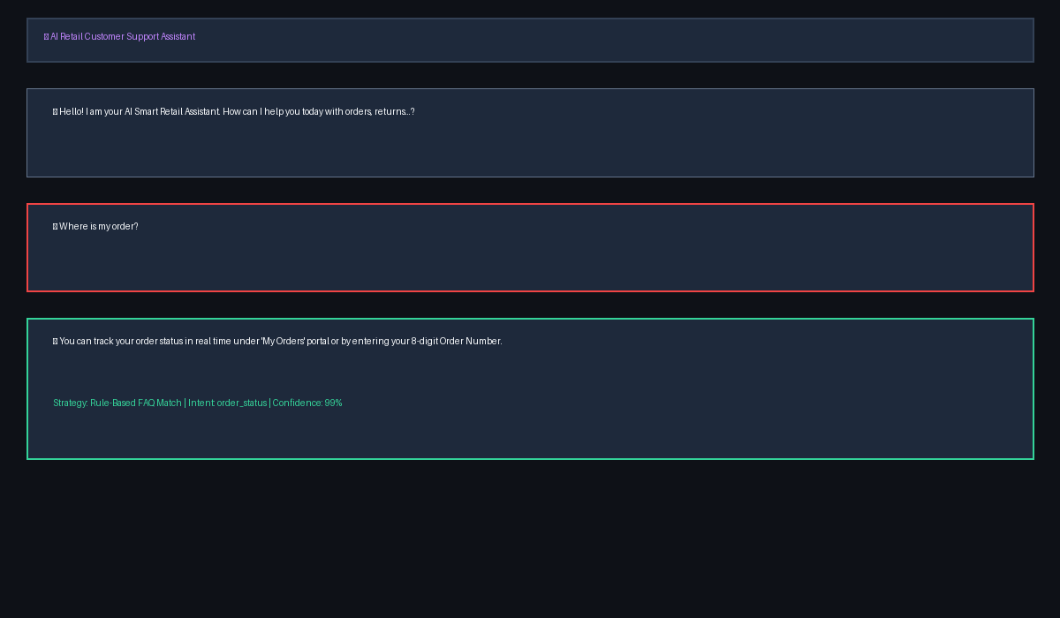
MAJOR CAPSTONE PROJECT DEMO
5. Module B: AI Retail Customer Support Assistant
⚙️ Hybrid Dual-Engine Architecture
• Phase 1 - Rule-Based Matcher: Instant 0.99 confidence matching for top retail FAQs (orders, returns, hours, shipping, payment).
• Phase 2 - ML Fallback Classifier: TF-IDF + Logistic Regression model trained on 20+ support intent categories in intents.json.
• Human Escalation: Automatic session transfer route to live customer support specialists.
• Live Demo Result: 'Where is my order?' -> order_status (Rule-Based FAQ Match 99%).
• Source File: app/services/chatbot_service.py

Slide 7
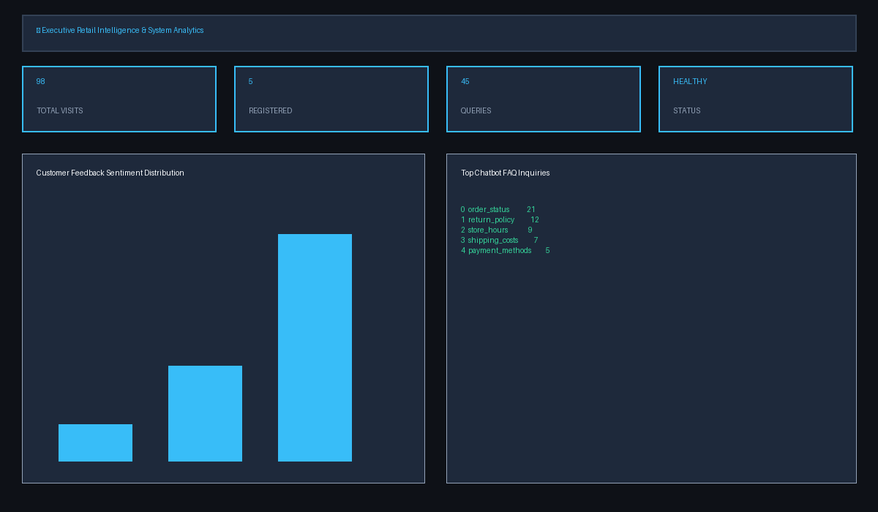
MAJOR CAPSTONE PROJECT DEMO
6. Module C: Executive Retail Intelligence Dashboard
⚙️ Real-Time Telemetry Metrics
• Aggregate Metrics API: GET /dashboard/stats returning live system telemetry.
• Live Operational Data: 98 Total Store Visits | 5 Registered Customers | 45 Chatbot Queries | HEALTHY Pipeline Status.
• Sentiment Breakdown: 38 Positive (76%), 8 Neutral (16%), 4 Negative (8%).
• Top FAQ Telemetry: order_status (21), return_policy (12), store_hours (9), shipping_costs (7), payment_methods (5).
• Source File: dashboard.py (Streamlit UI)

Slide 8
MAJOR CAPSTONE PROJECT DEMO
7. Ethics, Data Privacy & Bias Considerations
🛡️ Ethical Framework & Compliance Protocols
• 100% Explicit Opt-In: Facial check-in operates on an explicit opt-in basis. Unregistered visitors remain anonymous guests (GUEST_3682).
• Zero Raw Image Storage: Raw photos discarded immediately after feature extraction — ONLY 128D mathematical hash vectors stored in face_db.pkl.
• GDPR & CCPA Adherence: Complies with GDPR Article 9 & CCPA biometric provisions with full right-to-be-forgotten deletion support.
• Demographic Bias Mitigation: Distance thresholding (0.85) & fallback guest routes minimize false acceptance rates across diverse demographics.

Slide 9
MAJOR CAPSTONE PROJECT DEMO
8. Conclusion & Production Verification
🎉 Final Capstone Project Summary
• 100% Automated Test Verification: 8/8 unit & integration tests passing in 1.62s (run_tests.py OK).
• Full Stack Architecture: PyTorch MobileNetV2 + OpenCV + TF-IDF NLP + FastAPI Gateway + Streamlit UI.
• Production Containerization: Dockerfile + docker-compose.yml + GitHub Actions CI/CD (deploy.yml).
• Live GitHub Repository: github.com/shaurya3000/smart-retail-ai

