Slide 1

Notes:
EarlyDrop · PBL-III · Speaker (suggested): Shaurya Ojha
PBL-III covers Unit 5, combining models. Same cohort, same target, same folds as PBL-I. The question for this review: does a committee of models flag at-risk students better than the best single model, and why or why not?

Slide 2
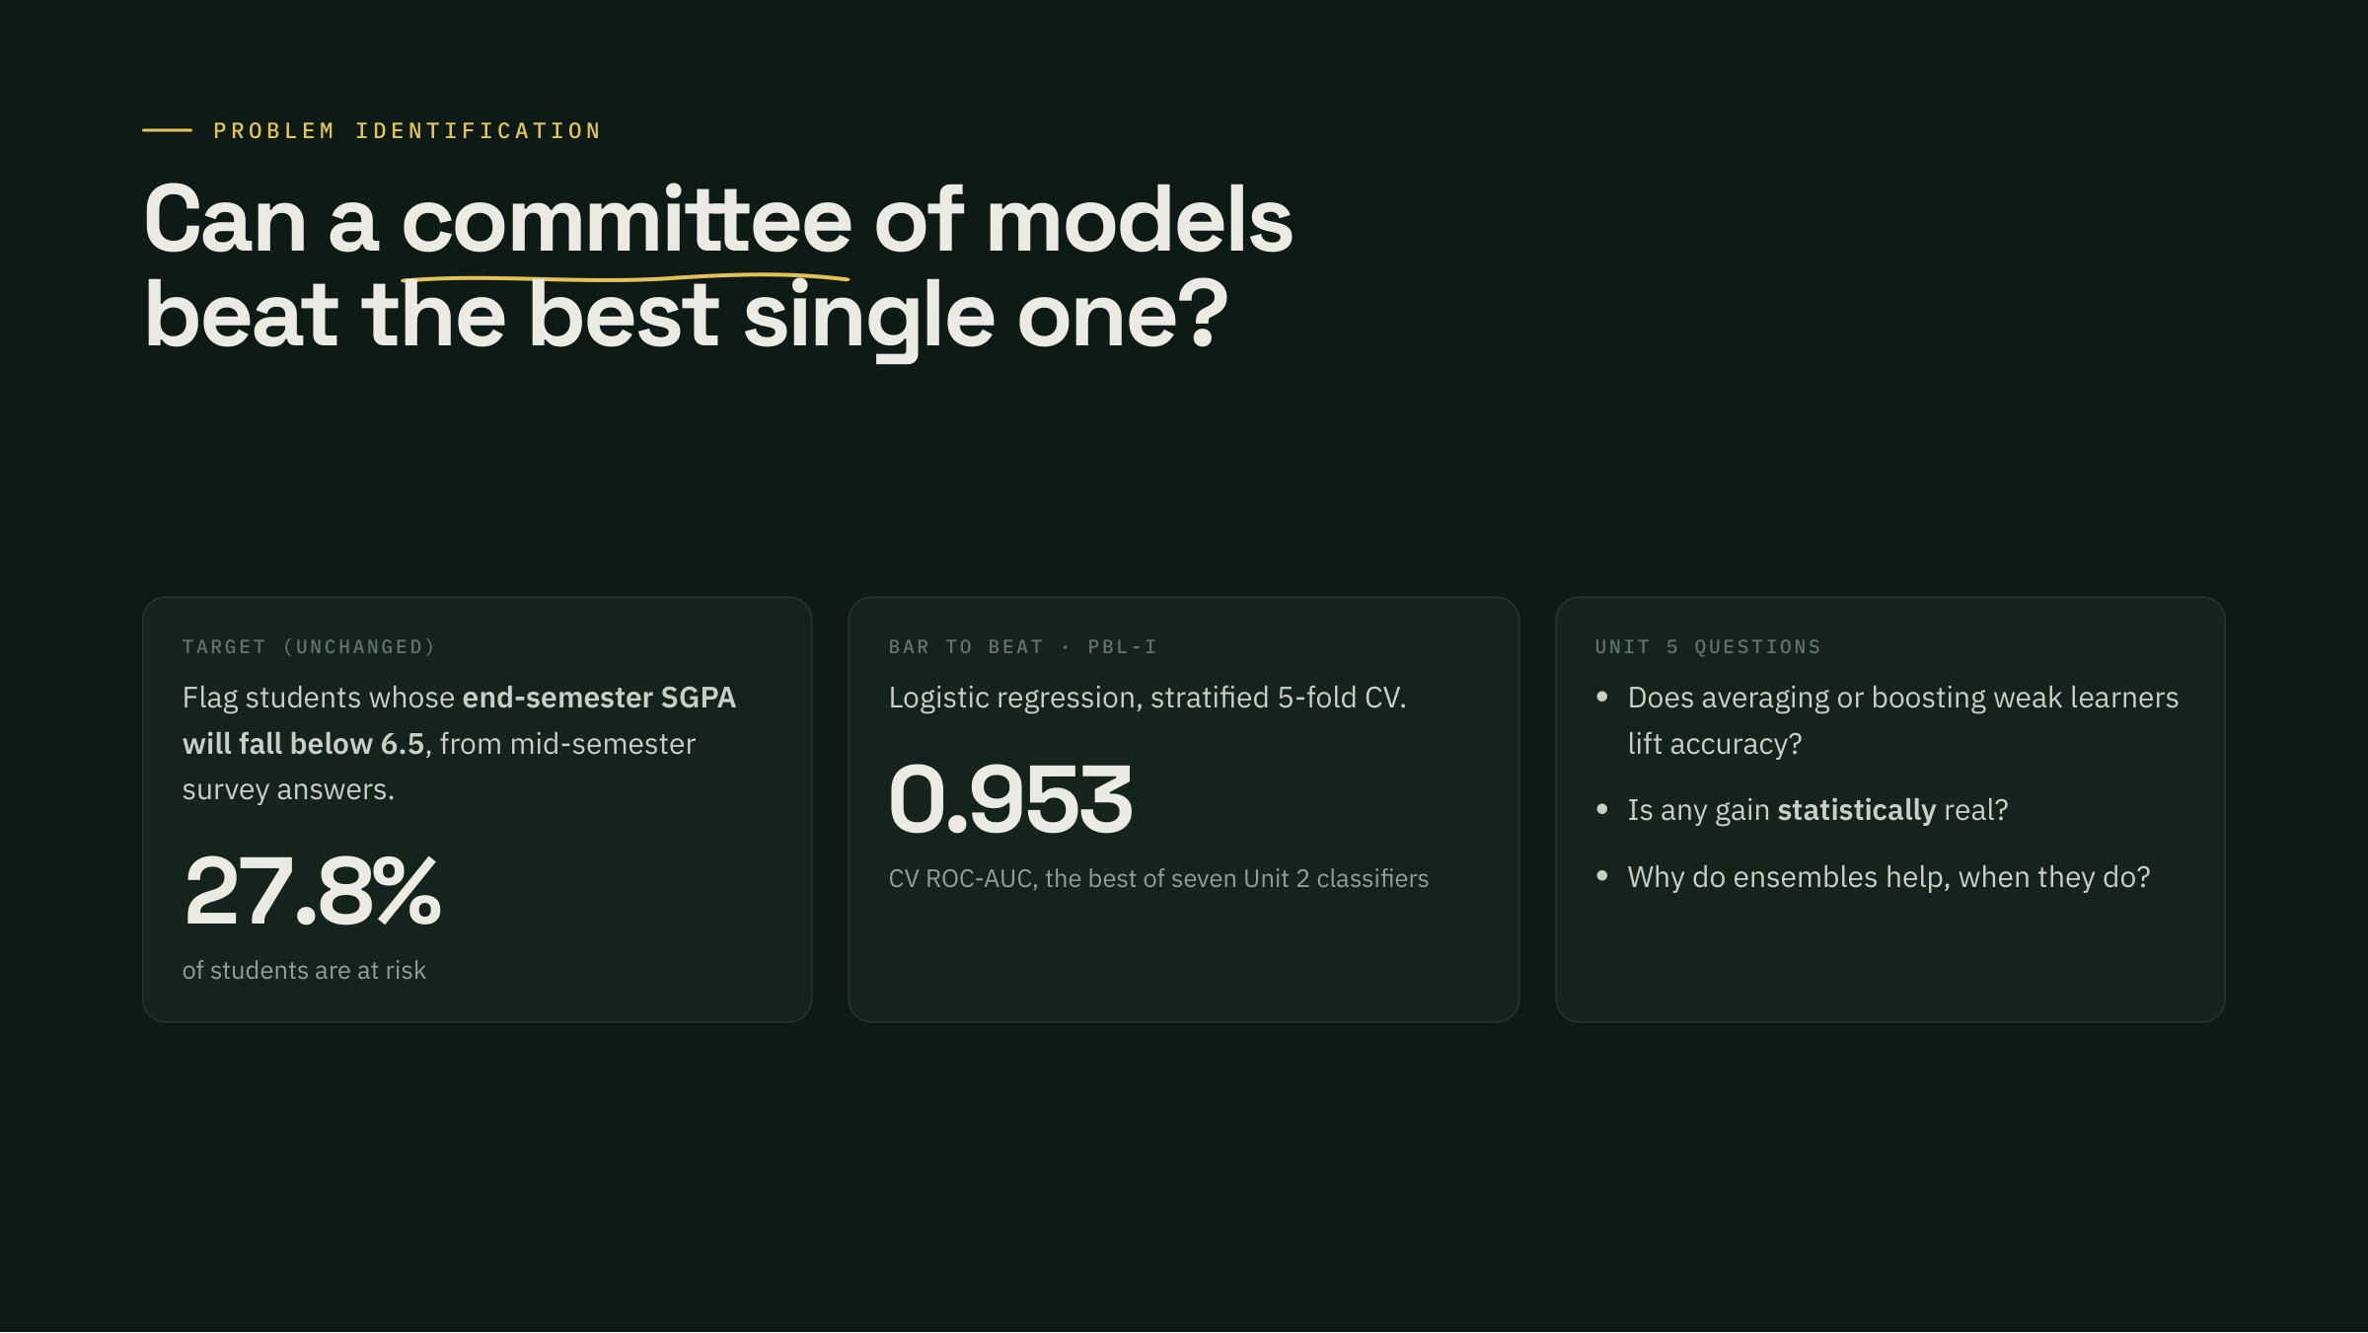
Notes:
The question · Speaker (suggested): Yash Arun Mulajkar
Recap: EarlyDrop flags students whose end-semester SGPA will fall below 6.5, from a mid-semester survey. PBL-I found logistic regression at about 0.95 CV AUC. Unit 5 asks a sharper question: can combining models beat that, and when does combining help at all?

Slide 3
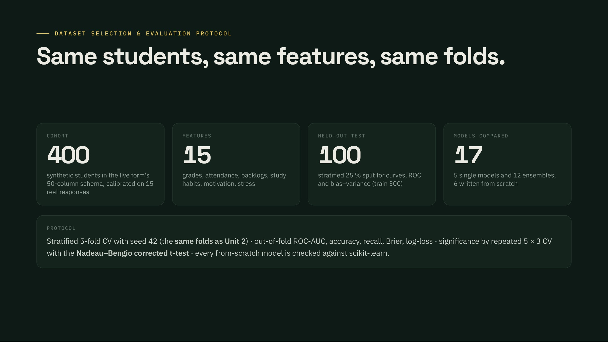
Notes:
Dataset & protocol · Speaker (suggested): Yash Arun Mulajkar
Same cleaned cohort as PBL-I and II: 400 synthetic students in the live form's schema, calibrated on the 15 real responses, 15 selected features. Every model sees the identical 5 folds used in Unit 2, so numbers are directly comparable, plus a stratified 25% held-out test set for curves and ROC. Significance uses repeated 5-fold CV three times with the Nadeau–Bengio correction.

Slide 4

Notes:
Unit 5 map · Speaker (suggested): Bignesh Sahu
The six Unit 5 topics from the course plan and where each one lives in our pipeline. CART, bagging, random forests, AdaBoost, gradient boosting and Bayesian model averaging are implemented from scratch.

Slide 5
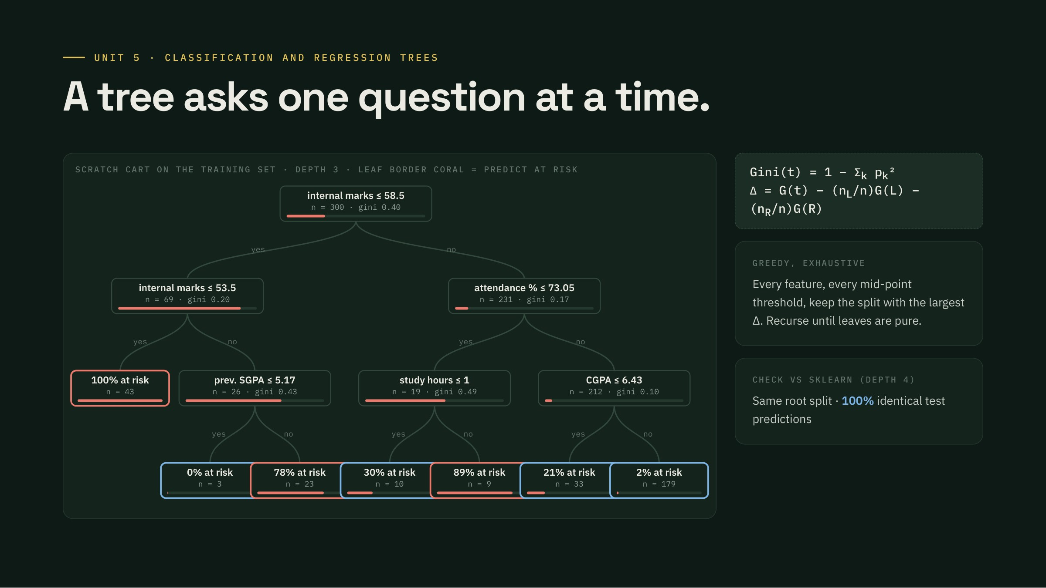
Notes:
CART · Speaker (suggested): Bignesh Sahu
Our from-scratch CART, cut at depth 3 for display. Each split is the one that lowers weighted Gini impurity the most. The root splits on internal marks at 58.5, exactly as sklearn does. On the right branch, the next question is attendance below 73 percent, next to SRM's 75 percent rule. Leaves show the share at risk.

Slide 6
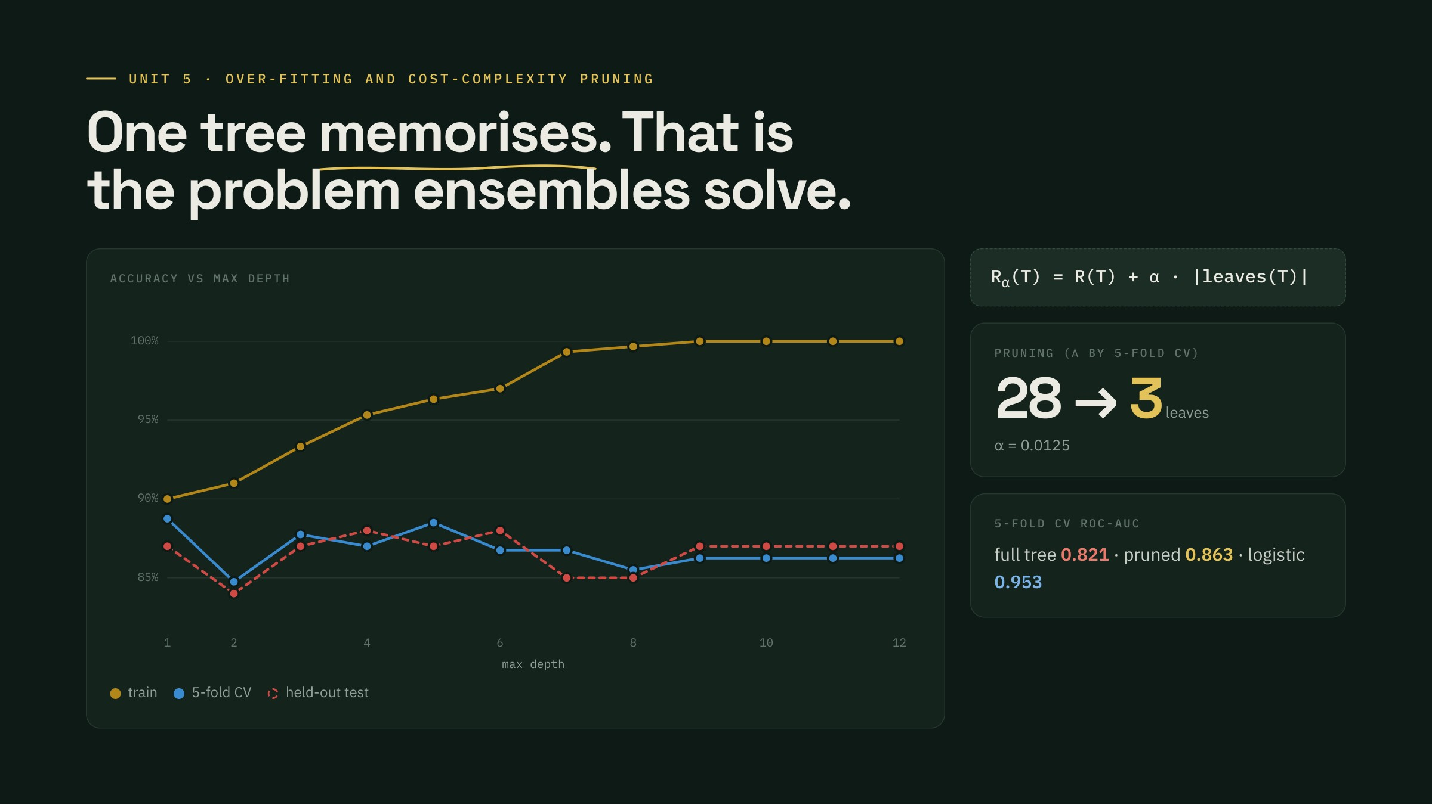
Notes:
Tree depth & pruning · Speaker (suggested): Bignesh Sahu
Grow the tree deeper and training accuracy climbs to 100 percent while cross-validated accuracy stalls and falls: a single tree is a high-variance learner. Cost-complexity pruning chooses alpha by CV and collapses the tree to a few leaves; that helps AUC but a single tree still trails linear models. This variance is exactly what ensembles attack.

Slide 7
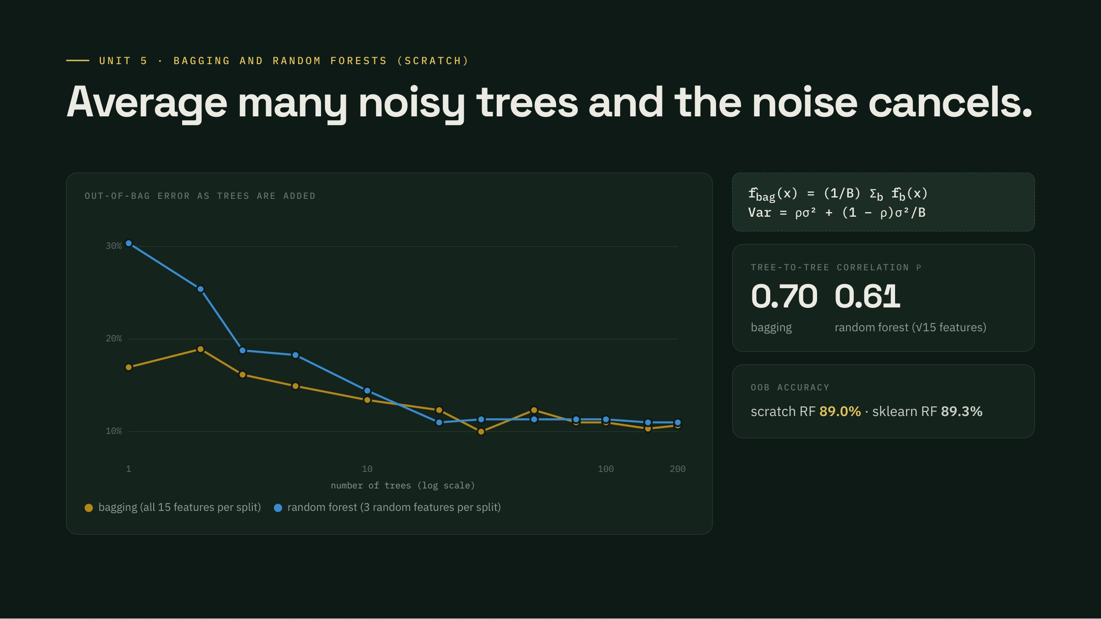
Notes:
Bagging & random forest · Speaker (suggested): Bignesh Sahu
Bagging trains each tree on a bootstrap sample and averages. About 37 percent of students are left out of each sample, which gives a free out-of-bag error estimate. A random forest also restricts each split to a random 3 of the 15 features, which decorrelates the trees: average pairwise correlation drops, and the average of less correlated trees has lower variance.

Slide 8
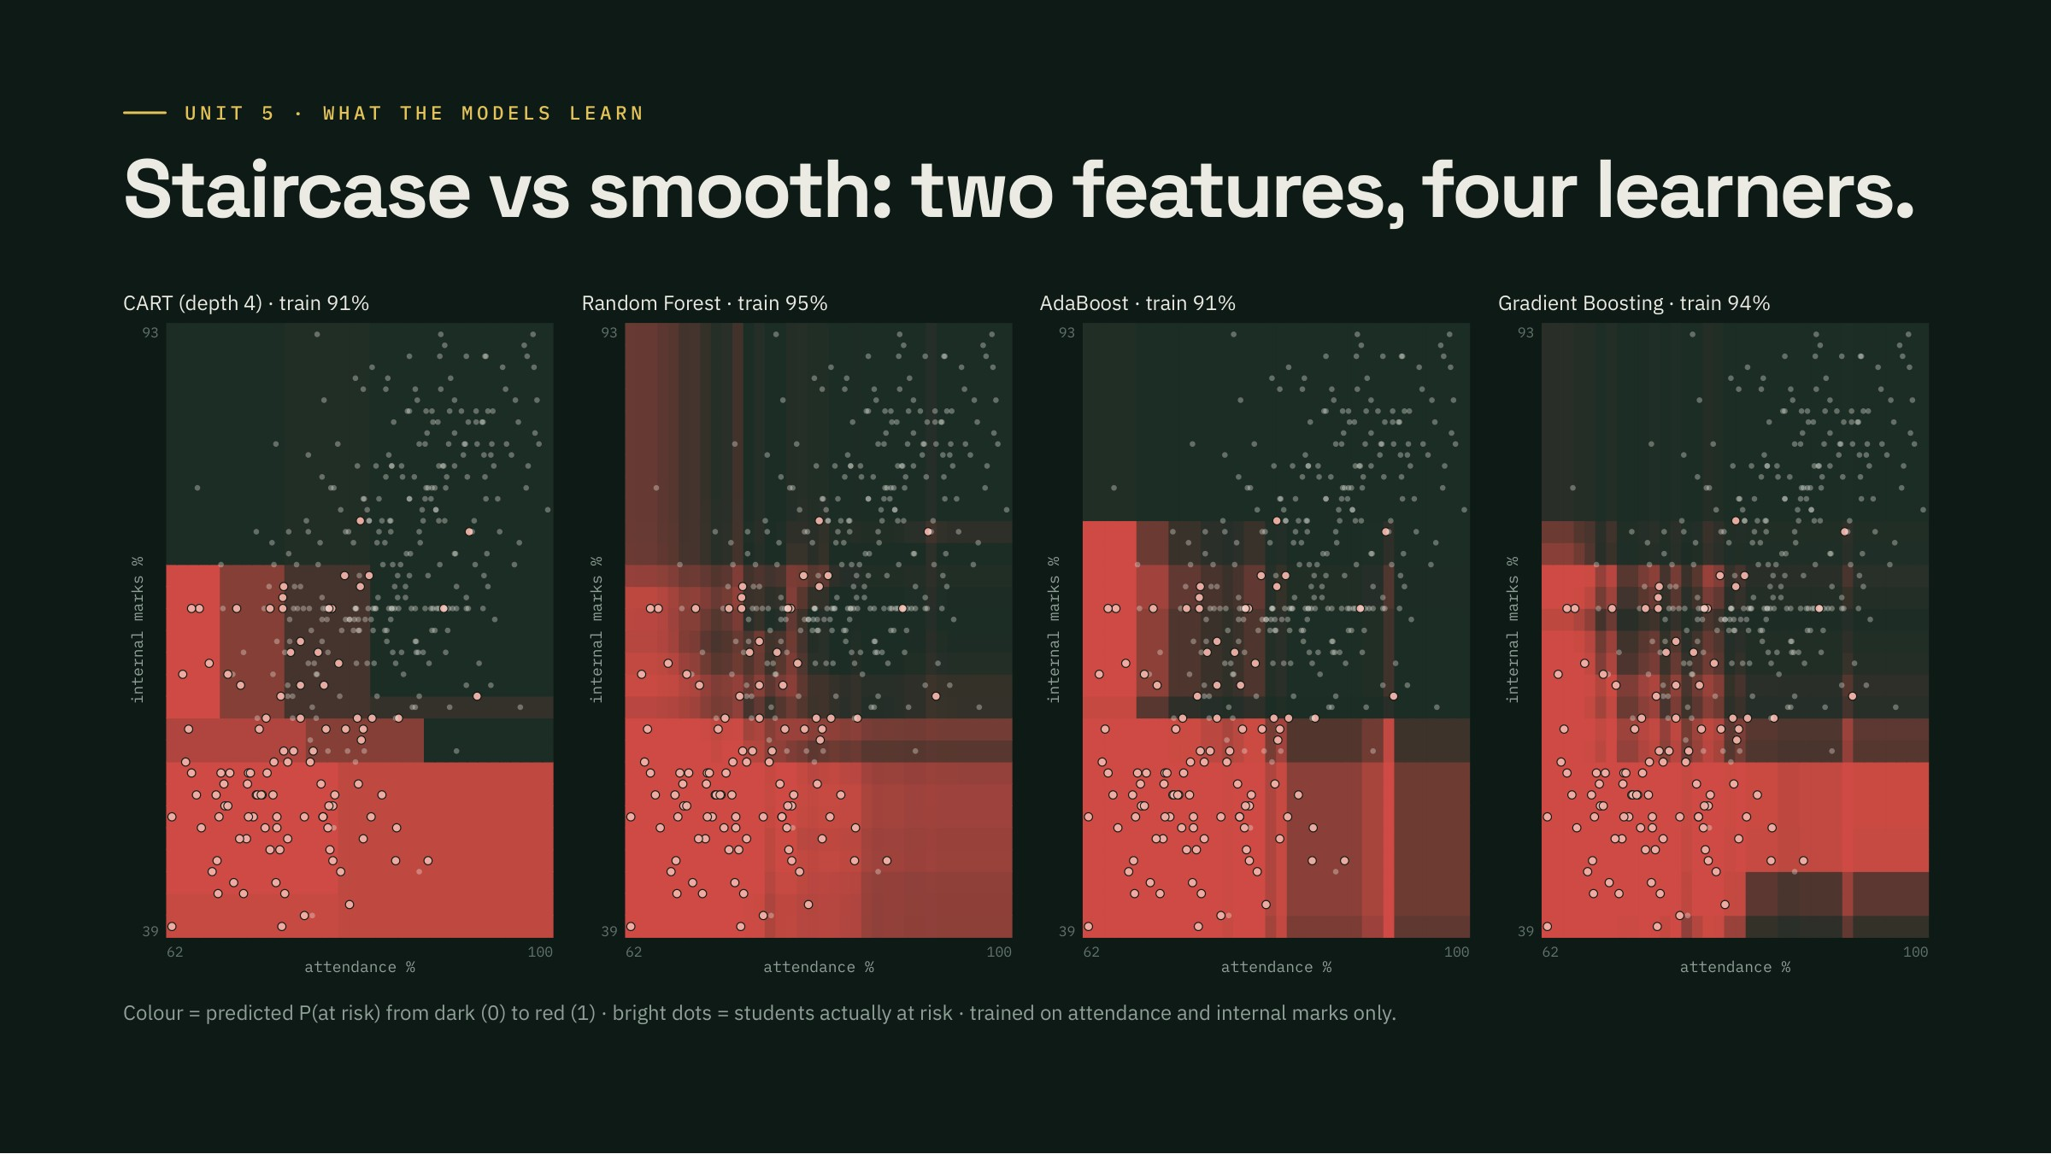
Notes:
Decision surfaces · Speaker (suggested): Bignesh Sahu
Four models trained on just two features, attendance and internal marks, so we can see the risk surface. Brighter red means higher predicted risk; light dots are at-risk students. One tree gives a blocky staircase. The forest and gradient boosting give smoother, graded surfaces. AdaBoost is a sum of axis-aligned stumps.

Slide 9
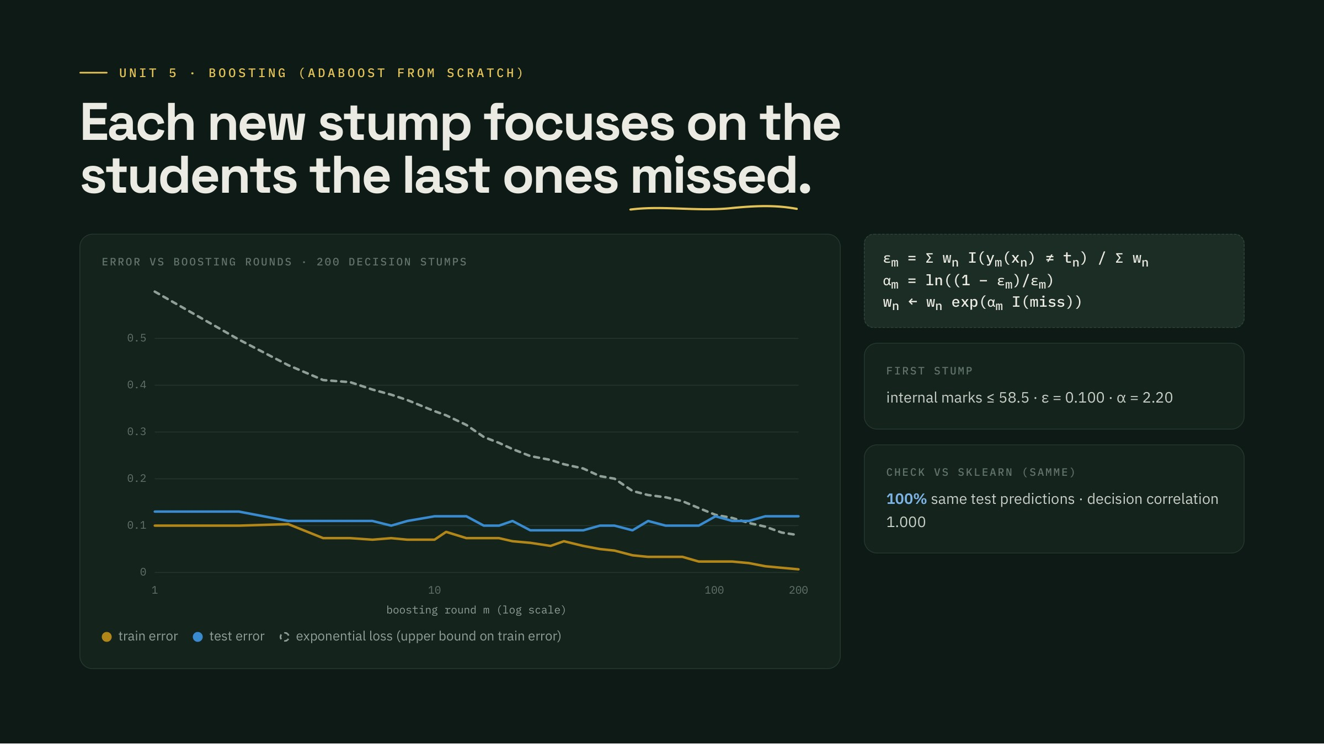
Notes:
AdaBoost · Speaker (suggested): Shaurya Ojha
Boosting builds models in sequence. AdaBoost re-weights students the previous stumps got wrong. The first stump is internal marks at 58.5 with a weighted error of 0.10, so its vote is alpha = ln(0.9/0.1) = 2.2. Training error falls under the exponential-loss bound; test error flattens after a few dozen rounds. Our implementation makes the same predictions as sklearn on every test student.

Slide 10
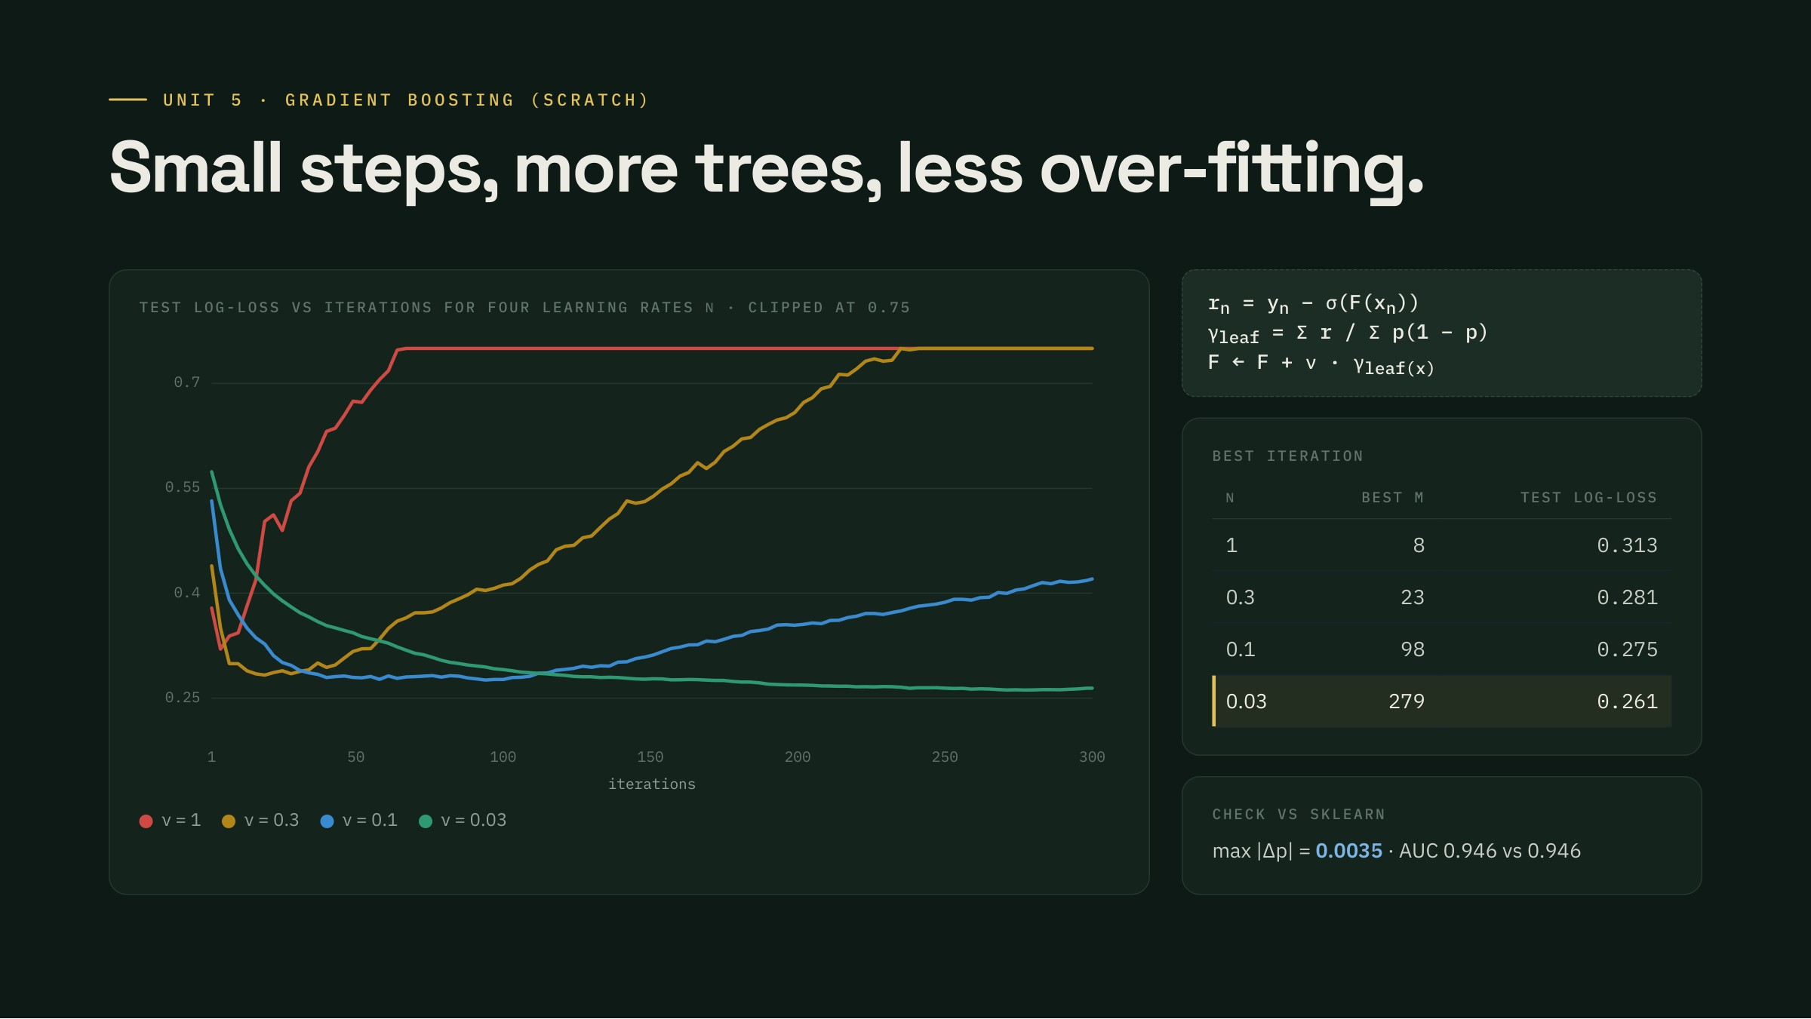
Notes:
Gradient boosting · Speaker (suggested): Shaurya Ojha
Gradient boosting fits each new tree to the negative gradient of the log-loss, the residual y minus p, then sets each leaf with one Newton step. The learning rate nu shrinks every step. With nu = 1 the test loss bottoms out after a handful of trees and then climbs: over-fitting. Small nu needs more trees but reaches a lower test loss. Our version matches sklearn to within 0.004 in probability.

Slide 11
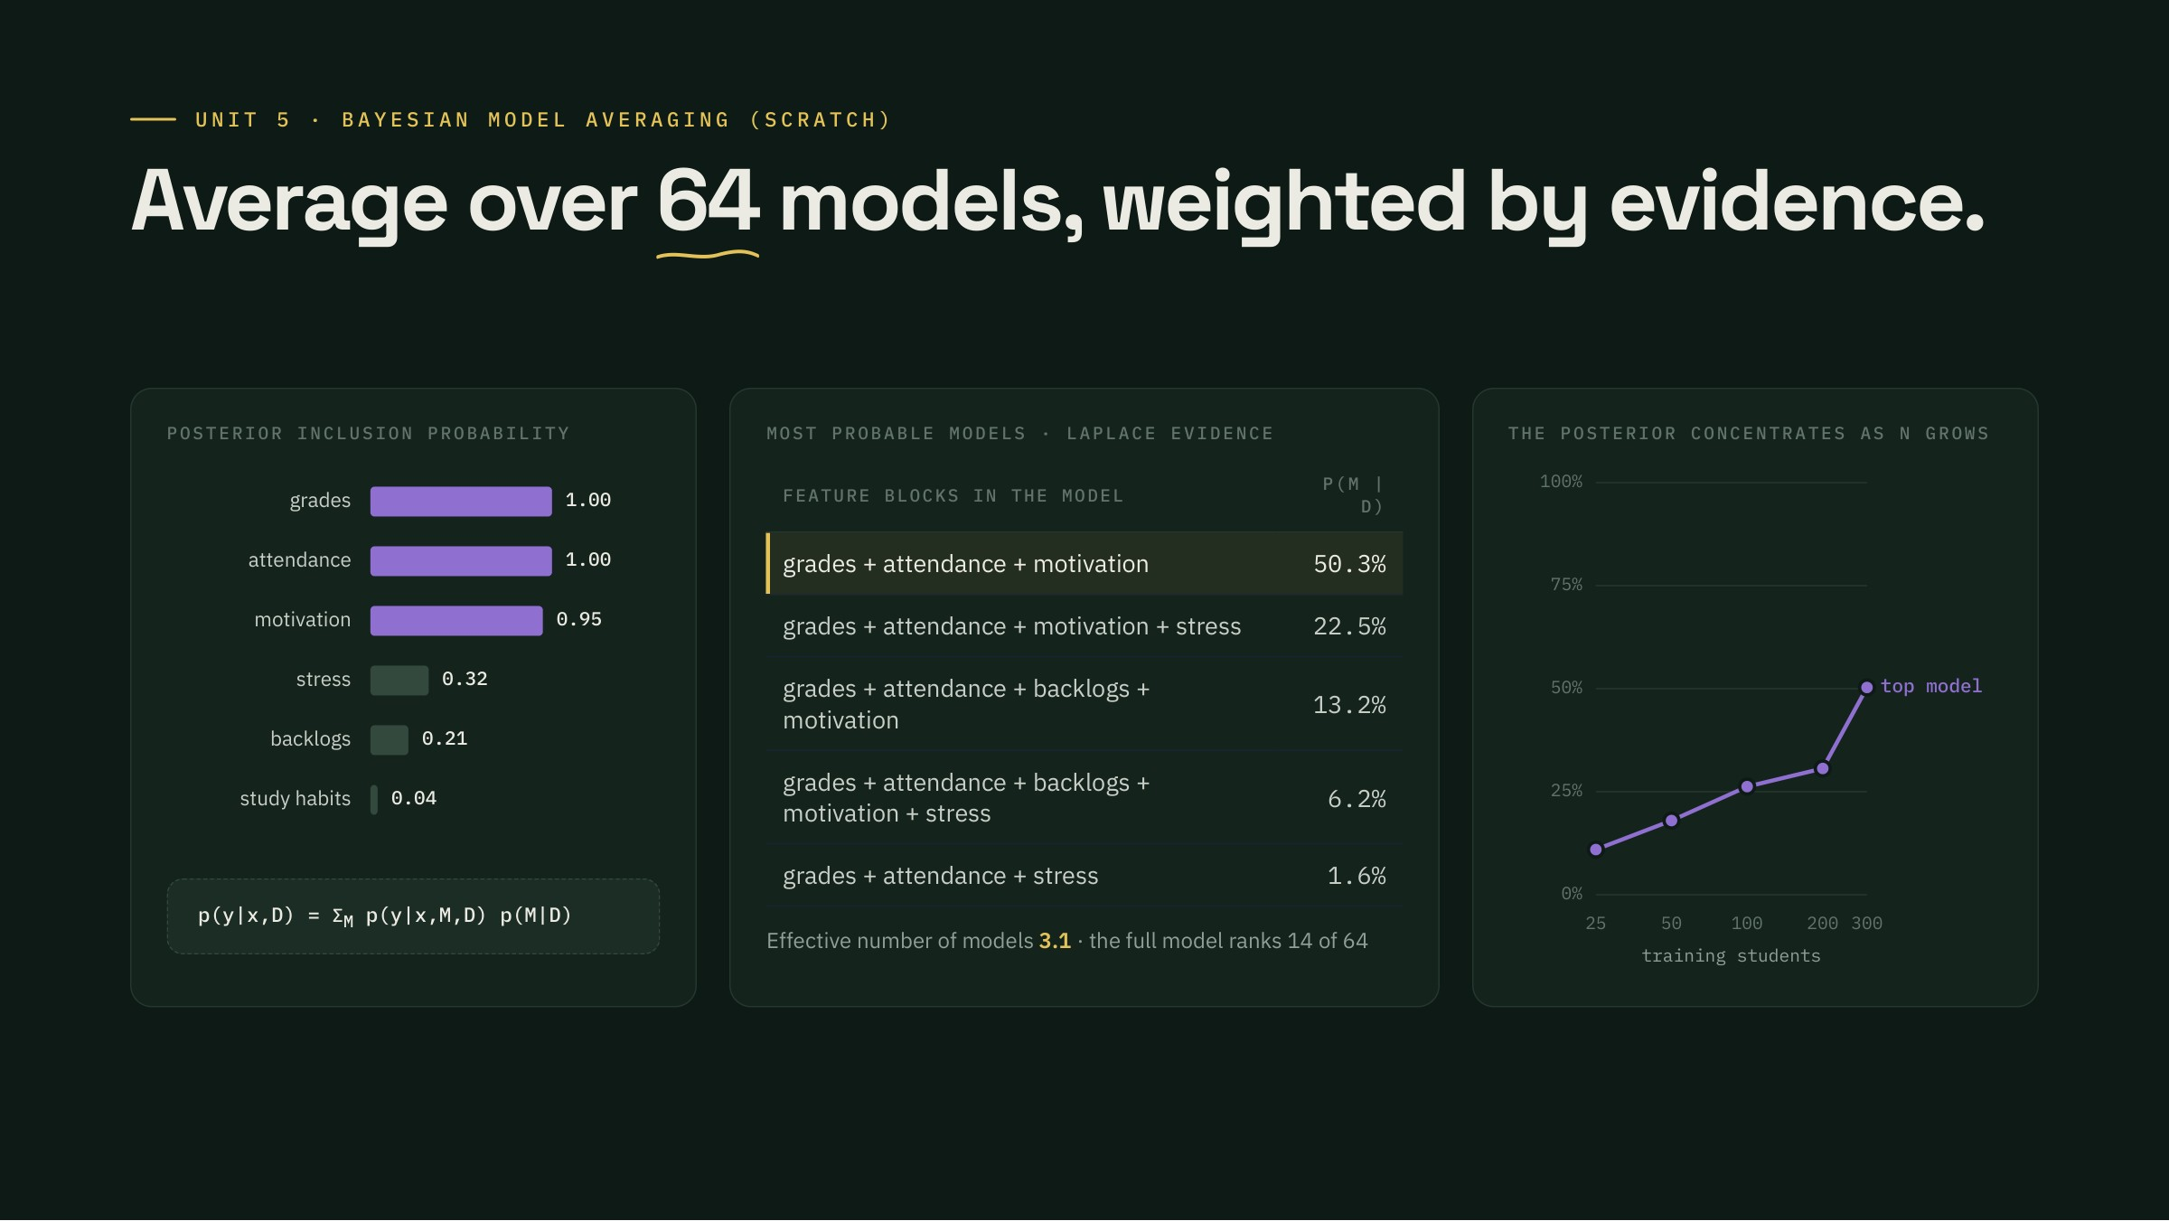
Notes:
Bayesian model averaging · Speaker (suggested): Shaurya Ojha
BMA treats the model itself as unknown. We enumerate all 64 subsets of six feature blocks, fit a Bayesian logistic regression to each (our Unit 2 code), and weight each by its Laplace-approximated evidence. Grades and attendance are in essentially every probable model; study habits almost never. Bishop's point in 14.1: BMA is not model combination; as data grows the posterior concentrates on one model, and the right chart shows exactly that.

Slide 12
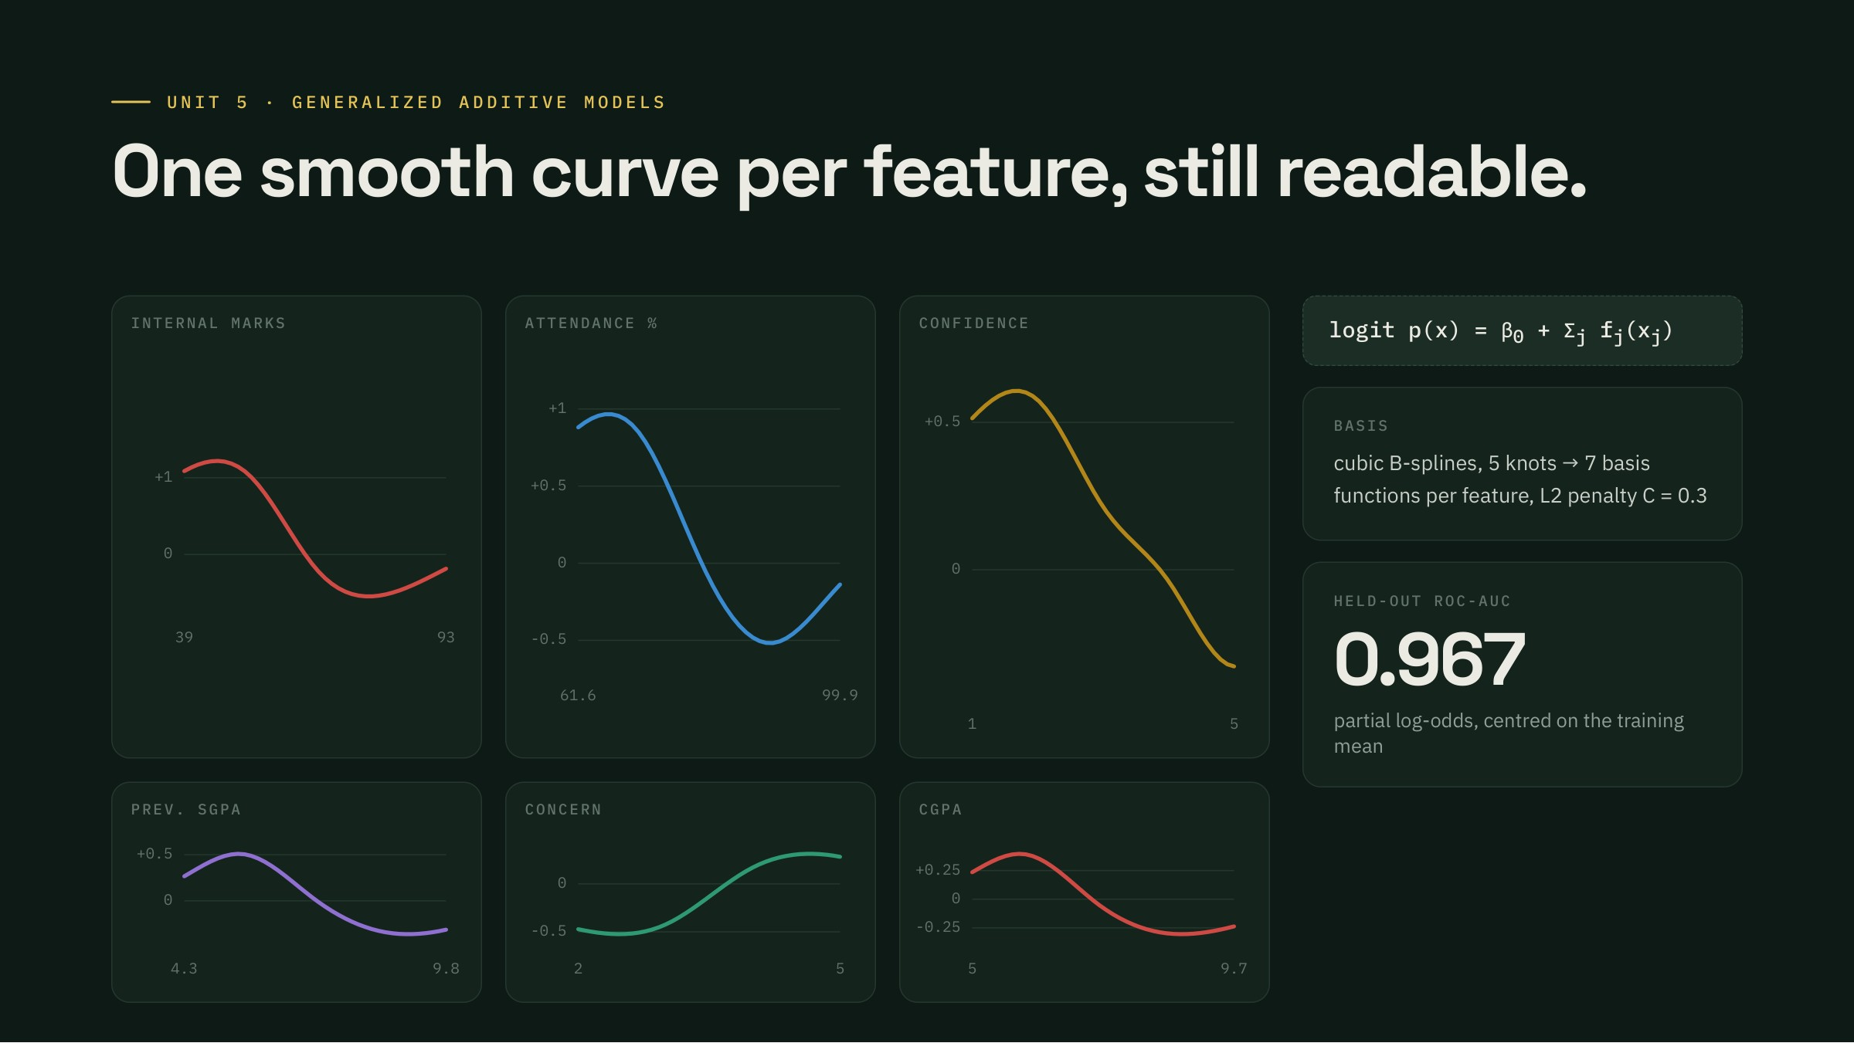
Notes:
GAM · Speaker (suggested): Shaurya Ojha
A generalized additive model keeps the logistic link but replaces each linear term with a smooth curve, here a cubic B-spline with five knots, fitted with an L2 penalty. The curves are readable. For internal marks and attendance, risk is high and flat at the bottom, falls steeply through the middle range and levels off at the top: a threshold shape, which is why the tree splits near 58 percent marks and 73 percent attendance. The GAM is still an additive model, so it stays as easy to explain as logistic regression.

Slide 13
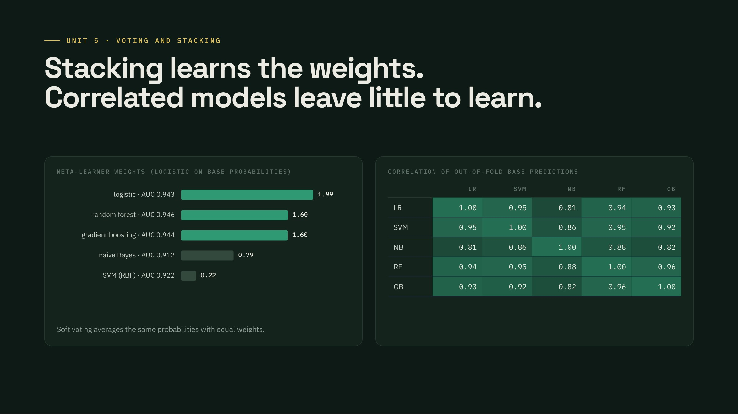
Notes:
Stacking · Speaker (suggested): Shaurya Ojha
Stacking learns how to combine. Five base models produce out-of-fold probabilities, and a logistic regression learns weights on top. It leans on logistic regression, the forest and boosting. The base predictions are highly correlated, 0.81 to 0.96, which limits how much any combination can add: you can only average away errors that differ.

Slide 14
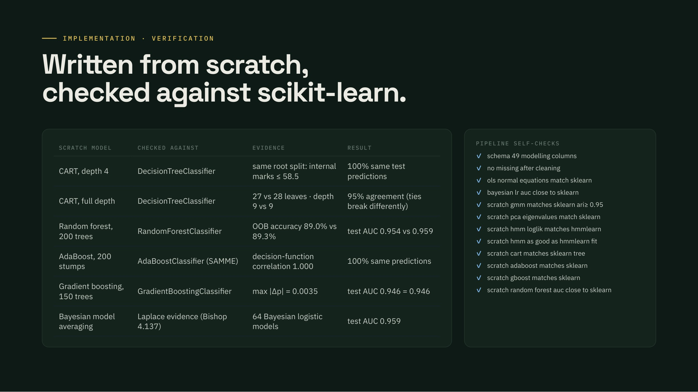
Notes:
Scratch vs library · Speaker (suggested): Aditya Bhutada
Every from-scratch model is checked against its library counterpart. CART picks the same splits; full-depth trees differ slightly only where two splits tie exactly. AdaBoost is identical to sklearn's SAMME. Gradient boosting matches to four decimals. Four new self-checks in run_all.py fail loudly if any of this breaks.

Slide 15
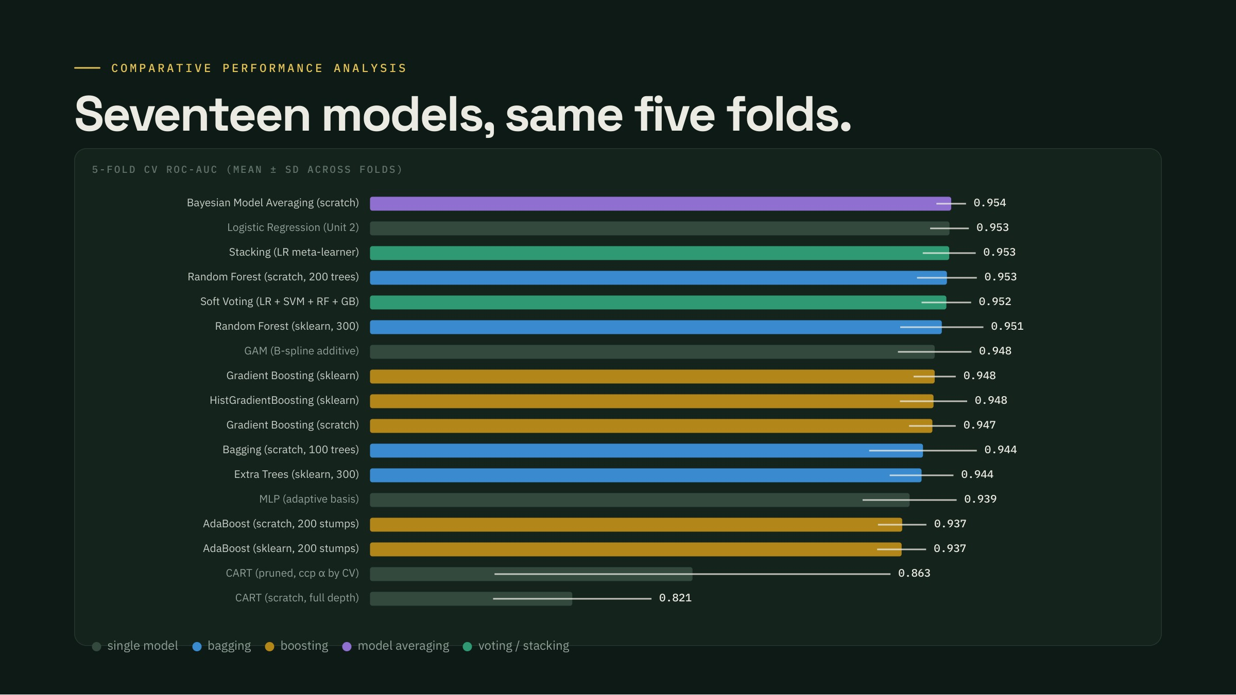
Notes:
Comparison · Speaker (suggested): Aditya Bhutada
All 17 models on the same five folds, sorted by mean ROC-AUC. Two clear tiers. Single trees sit far below at 0.82 to 0.86. Everything that averages or boosts trees jumps to about 0.94 to 0.95. But the top of the table is a tight cluster: BMA, logistic regression, stacking and the random forest are within the fold-to-fold noise of each other.

Slide 16
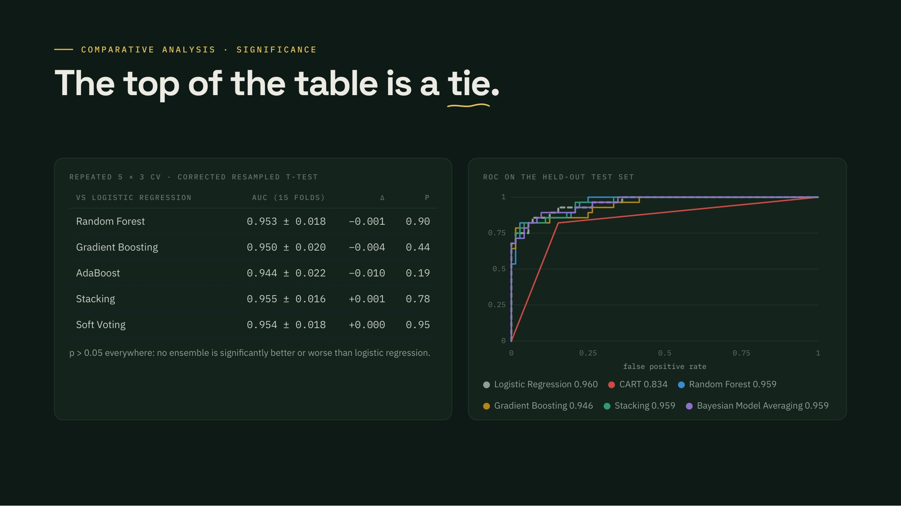
Notes:
Is it real? · Speaker (suggested): Aditya Bhutada
Is any ensemble's edge real? Repeated 5-fold CV three times, and the Nadeau–Bengio corrected t-test, which accounts for overlapping training sets. No ensemble differs significantly from logistic regression; the differences are a few thousandths of AUC. The ROC curves on the held-out test set overlap, except the single tree.

Slide 17
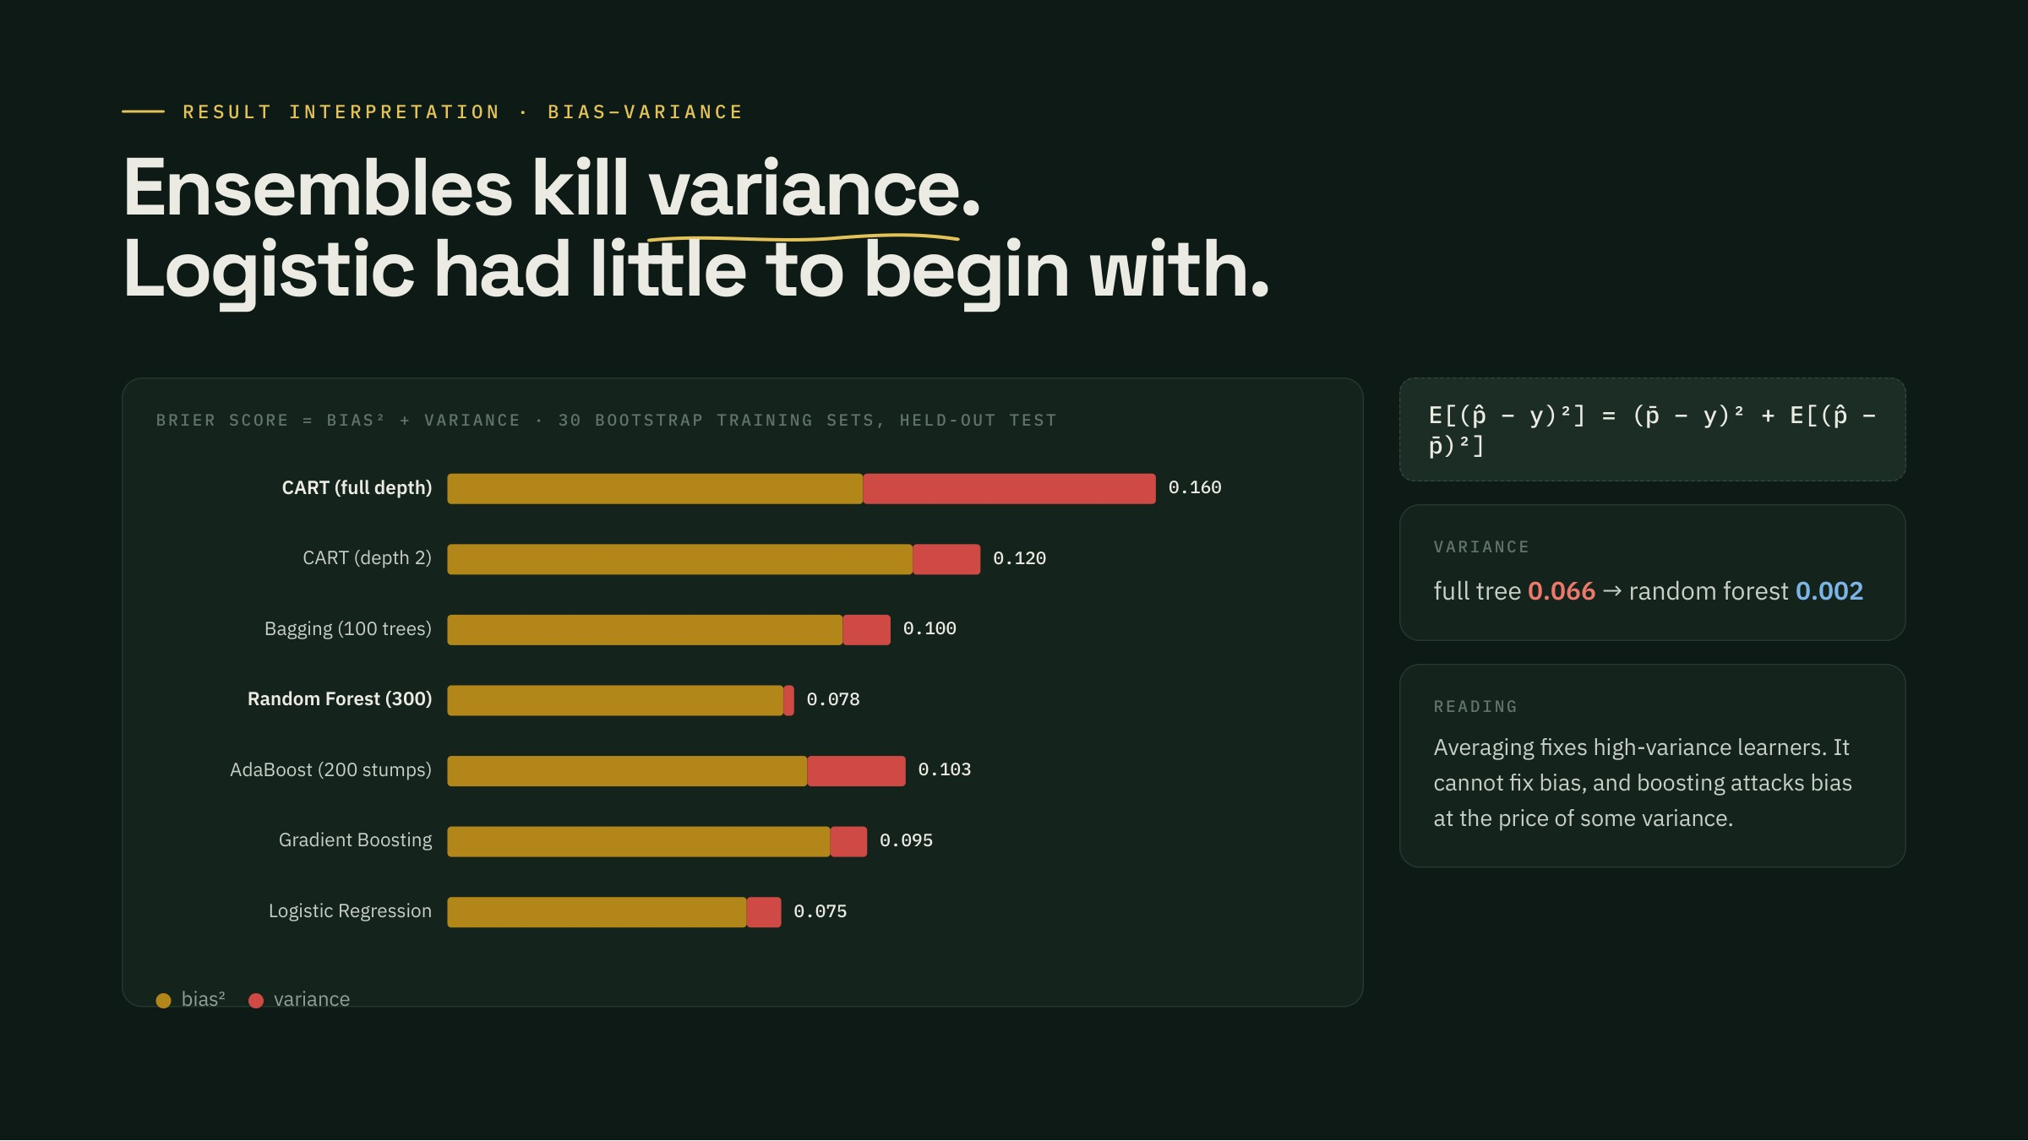
Notes:
Why ensembles work · Speaker (suggested): Aditya Bhutada
Why the two tiers? Train each model on 30 bootstrap copies of the training set and split its test Brier score exactly into bias squared plus variance. A full-depth tree has large variance; bagging cuts it and the random forest removes almost all of it. Logistic regression already has both low bias and low variance on this data, so there is little left for an ensemble to fix.

Slide 18
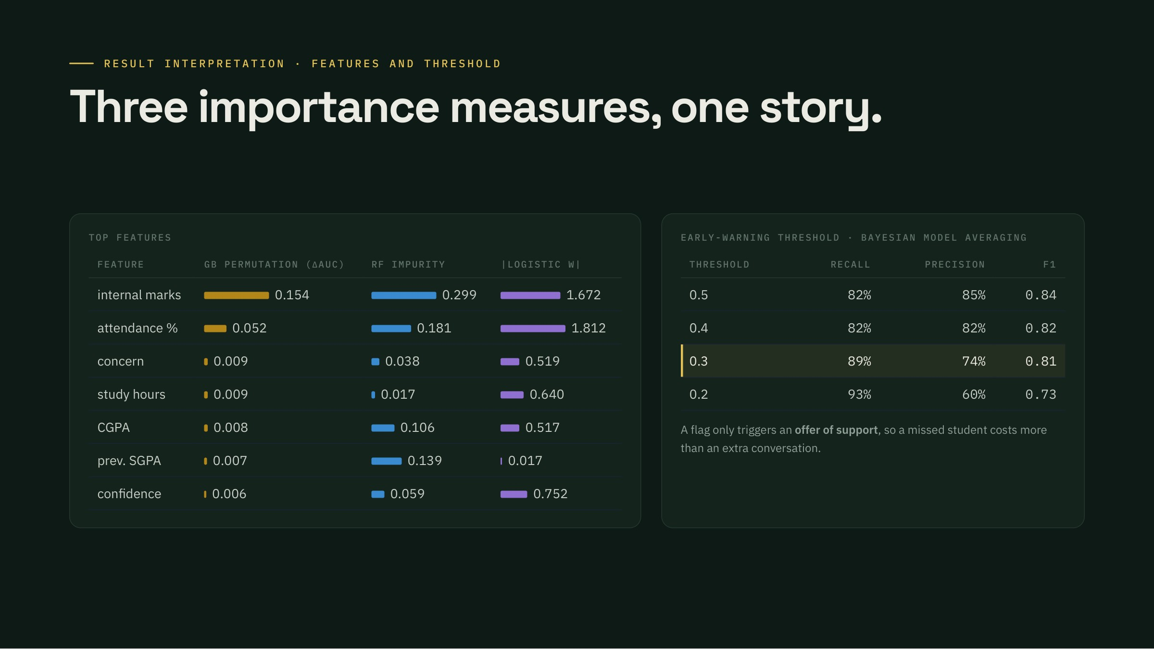
Notes:
What drives risk · Speaker (suggested): Aditya Bhutada
Three different importance measures agree: internal marks and attendance dominate, the same two signals PBL-I found by correlation and BMA found by evidence. For deployment, early warning prefers recall, so lower the threshold of the best model: at 0.3 it catches about nine in ten at-risk students.

Slide 19
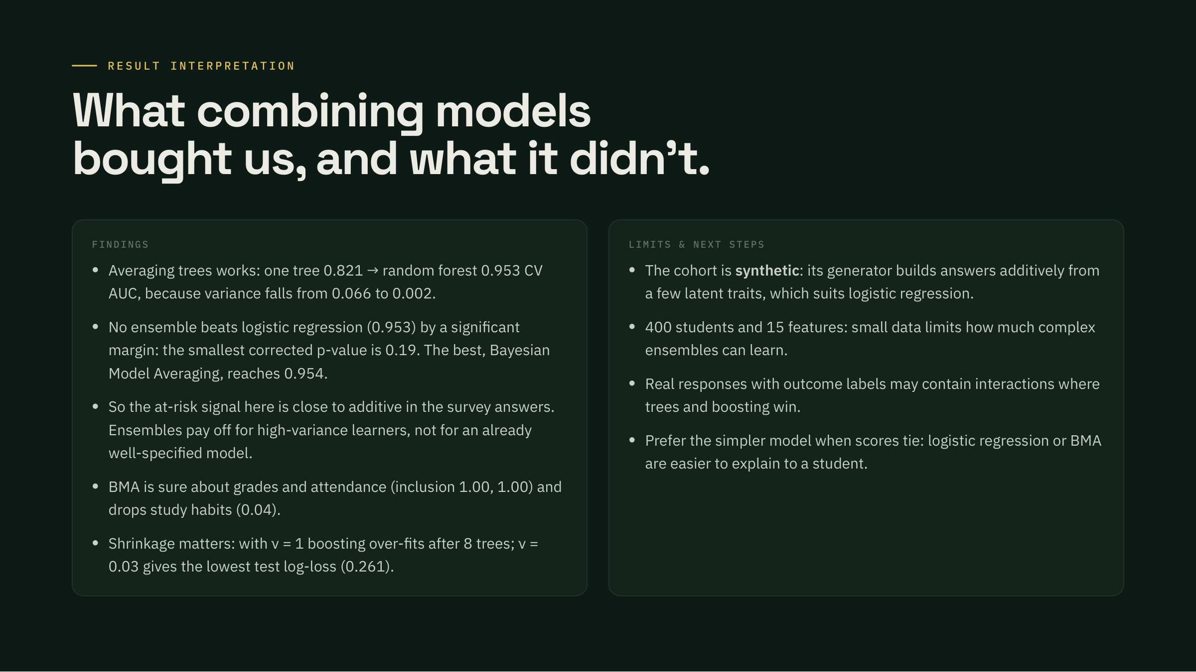
Notes:
Findings & limits · Speaker (suggested): Aditya Bhutada
Key findings, then limits. The headline is honest: ensembles turn weak trees into strong models, but on this cohort they tie a well-specified logistic regression. The data is synthetic, and its generator builds the survey answers additively from a few latent traits; real data with interactions may favour trees and boosting more.

Slide 20

Notes:
Demo & Q&A · Speaker (suggested): Shaurya Ojha
Switch to the dashboard, Unit 5 page (localhost:8501/unit-5): the comparison table, then the live tab, change the number of trees and depth and watch CV AUC move. Then questions.

