Slide 1
SCHNEIDER ELECTRIC · HMI HACKATHON · PROBLEM STATEMENT 3
HMI Copilot
“Build the whole plant: an overview plus a screen for each area, with pump status, flows, levels and alarms”
11
560
232
1,248
0
screens
objects
alarms
tags bound
by hand
And the file opens in EcoStruxure Operator Terminal Expert 4.4.
It was never saved by the product.
Notes:
0:00–0:20 · HOOK. Read the sentence, then the numbers, then the last line slowly. Two seconds of silence. Do not explain yet.

Slide 2
01 · THE PROBLEM
Today this is done by hand, every time
The cost the brief names | What it looks like on a real project
Manual screen development | Hand-place every lamp, bargraph and trend. Then repeat it for 40 near-identical equipment screens.
Expert-driven configuration | Only senior engineers know which object, animation and colour standard applies. Juniors block on them.
Complex tag integration | Hundreds of PLC symbols mapped by hand onto object properties, one property sheet at a time.
Inconsistency | Two engineers on one project produce two differently-named, differently-coloured HMIs.
A wrong binding is not a drawing error. It is pump 2’s flow under pump 1’s label, found during an upset.
Notes:
0:20–0:50 · Do not read the table. Land the black bar: this is a safety problem, not only a productivity one.

Slide 3
02 · THE SOLUTION
A tag export and a sentence become a finished project
PLC tag export (.csv / .xlsx / symbol file) ---+
|
"Two pump station with running lamps, ---+---> HMI COPILOT ---> project.eote
a flow display and a high-level alarm" | | validation report
| |
Company standards (naming, colours, layout) ----+ v
LIVE CANVAS + BINDING MAP
(the engineer sees it and steers it)
One file. File ▸ Open Project, and the HMI is there — screens drawn, tags declared, alarms configured, bindings wired. Nothing to import, nothing to assemble.
The engineer stays in control throughout: the AI proposes, the canvas makes the proposal legible, and a human accepts, edits or redirects. It never deploys anything itself.
Notes:
0:50–1:15 · The product in one diagram. Stress the last line — the human is in the loop by design, not by limitation.

Slide 4
03 · THE PROJECT FILE
Why this is possible at all
<project>.eote ZIP (nested entries use BACKSLASH separators)
|-- Project.dat, Target.dat JSON project identity, panel model, resolution
|-- Variables.db SQLite the tags
|-- Alarm.db SQLite alarm groups and alarms
|-- Recipe.db, Security.db ... SQLite other subsystems, passed through untouched
|-- Bindings.dat JSON Sources[] -> Bindings[] -> Targets[] graph
|-- Screens\Hierarchy.dat JSON screen order
+-- Screens\<guid>\Screen.dat JSON the object tree
Plain JSON and plain SQLite. No signature. No encryption. Nothing to defeat.
Bindings are declarative — wiring a tag to a display is one JSON object. And the geometry is absolute Location, Width and Height inside a ViewBox, which maps one-to-one onto SVG. That last property is what lets one model drive both the preview and the file.
So the first thing we did was not design a UI. It was to prove a project could be written from scratch.
Notes:
1:15–1:40 · The enabling insight. Say: we asked the one question that kills this category of idea, and we asked it first.

Slide 5
04 · SYSTEM ARCHITECTURE
Eight stages, one streaming contract
+---------------------------------------------------------------------------+
| WEB CLIENT Conversation . Live HMI canvas . Binding map . Validation |
+-------------------------------+-------------------------------------------+
| SSE - one finished object at a time
+-------------------------------v-------------------------------------------+
| ORCHESTRATOR |
| Tag Ingestion --> Equipment Inference --> Layout Planner |
| | | | |
| | v v |
| | Part Selector -------> Screen Generator |
| | (50 real part shapes) (schema-grounded JSON) |
| +------------> Binding Resolver <--------+ |
| | |
| Validation Engine --> Project Packager |
| (7 rules) (.eote: screens, Variables.db, |
| Alarm.db, Bindings.dat) |
+---------------------------------------------------------------------------+
One model, two renderers — so the preview cannot lie.
The same Screen.dat JSON drives the SVG canvas and the packager. There is no second model of the screen to drift from the first, and the compiler enforces it: the canvas switches exhaustively over the part union, so it cannot draw a part the packager cannot write.
Notes:
1:40–2:15 · The longest non-demo slide. Trace the flow left to right once, then land the green line — that is the credibility claim.

Slide 6
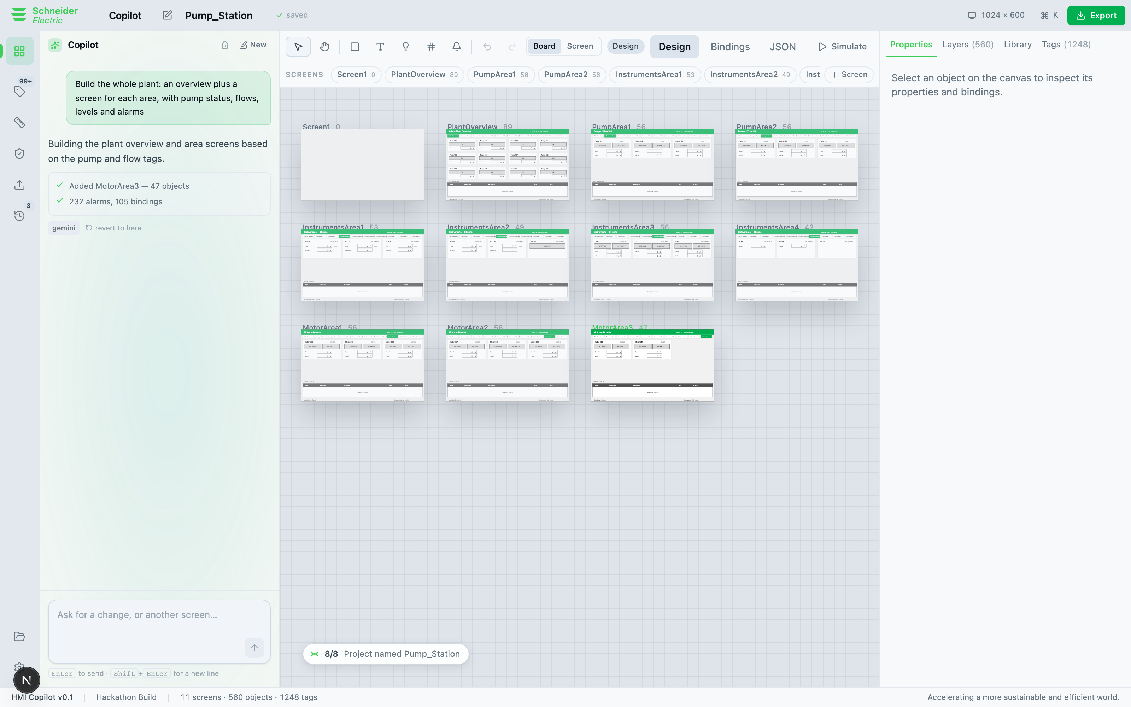
05 · DEMO
One sentence becomes a plant
DEMO · 1 · THE RESULT
Eleven screens on a board. An overview, then a screen per area, with navigation between them.
A 1,248-tag plant is not one screen — it is a hierarchy, and inferring that hierarchy from tag names is the actual problem. Every unit gets a screen.
Notes:
2:15–2:40 · Switch to the live app here if it is up. Otherwise this slide is the fallback.

Slide 7
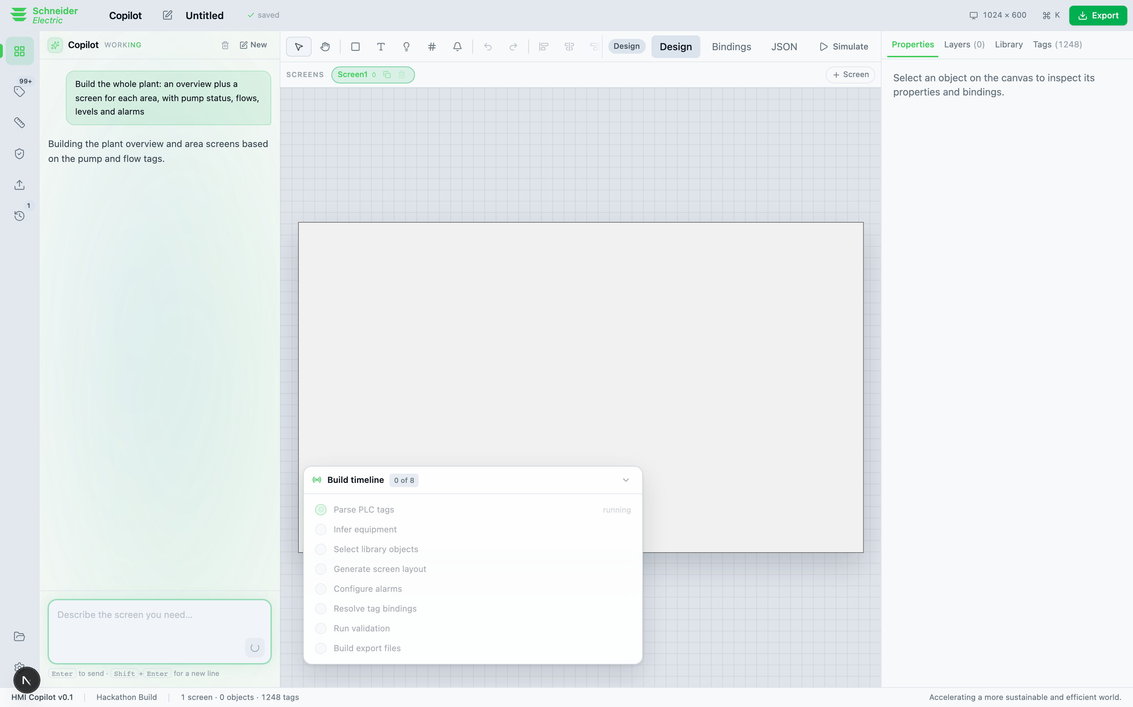
05 · DEMO
You watch it work, in engineering language
DEMO · 2 · THE PIPELINE, RUNNING
Eight steps, each reporting what it produced, each clickable to select the objects it created.
Not “Thinking…”. Parsed 1,248 tags. Inferred pumps, instruments, motors. Configured 232 alarms. An engineer will not accept a screen they did not see being built.
Notes:
2:40–3:02 · Point at the step details. This is the difference between a black box and a tool.

Slide 8
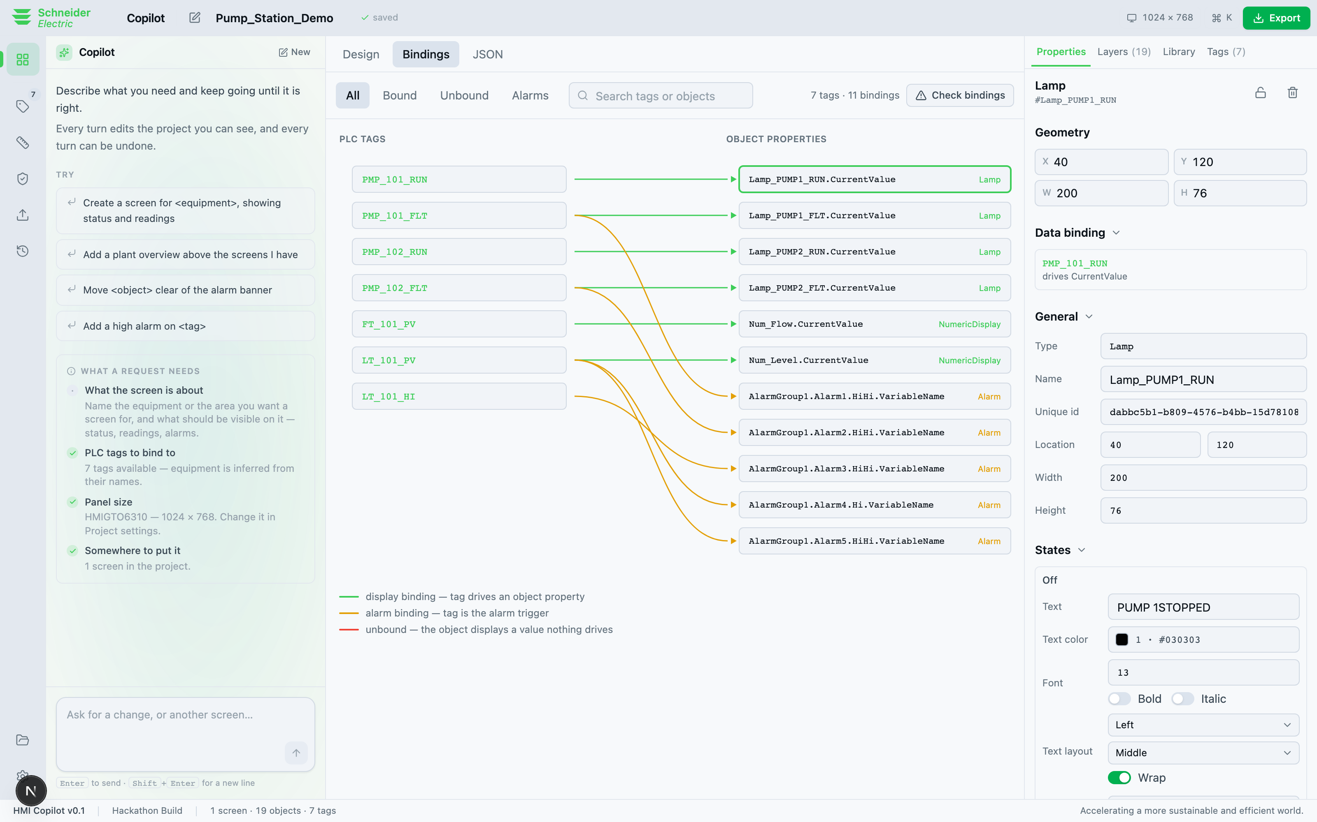
05 · DEMO
Every tag, wired and visible
DEMO · 3 · THE PAIN POINT, SOLVED
The binding map, drawn from the real Sources / Targets graph inside the .eote.
Tag integration is the pain point the brief names, and today it is invisible until commissioning. Here you can check it before you export.
Notes:
3:02–3:24 · The highest-value view. Say: this is the stated problem, and this is it solved.

Slide 9
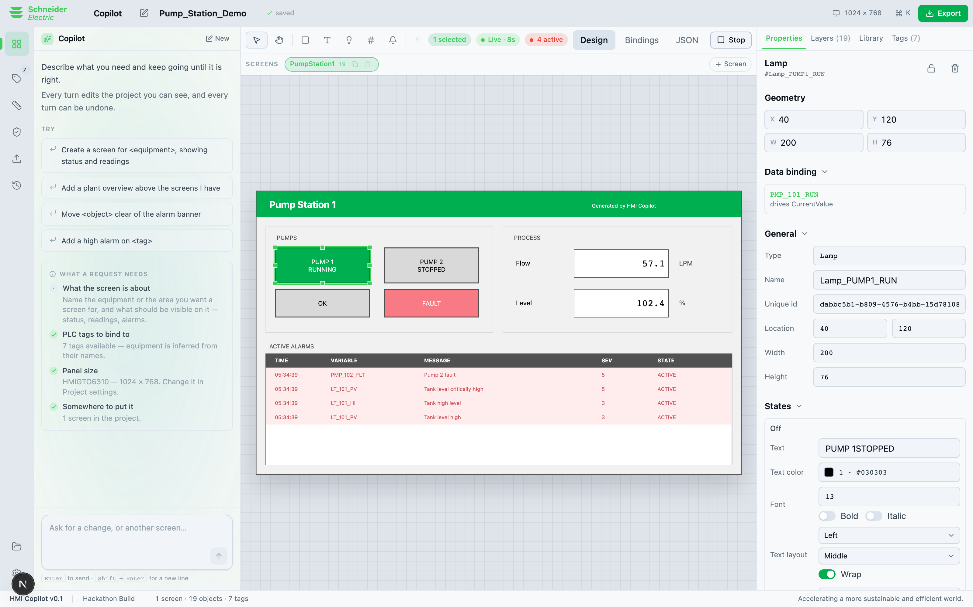
05 · DEMO
Behaviour, before any hardware exists
DEMO · 4 · VALIDATION WITHOUT HARDWARE
Press Simulate and a process model drives the screen: lamps change state, numbers move, alarms raise.
Values are driven through the project’s own alarm setpoints, so every alarm it configured actually fires. Lead and standby pumps behave differently.
Notes:
3:24–3:46 · Let it run in silence for a few seconds. The alarms firing is the moment.

Slide 10
06 · PROOF
Built, not proposed
Two .eote files written from scratch, both open in EcoStruxure Operator Terminal Expert 4.4. Neither was ever saved by the product.
19
7
5
11
0
parts placed
typed tags
alarms
bindings
placed by hand
467
474
50
2
tests
shipped symbols indexed
real part types extracted
independent packagers that agree
A Python reference and a TypeScript packager, structurally diffed against each other. Two implementations agreeing is a stronger claim than either passing its own tests.
Notes:
3:46–4:10 · If a judge takes one thing away, it is this slide. Offer to open the file on their machine.

Slide 11
07 · BUSINESS PROPOSAL
Who pays, and what it costs them
 | Who | Why they buy | Price
The wedge | System integrators and panel builders | Fixed-price work. Time saved is margin on hours they already quoted, and they decide fast. | ₹3,499 / seat / month
Expand | Plants, utilities, OEMs | They own the house style. Standards packs make every contractor produce their HMI. | from ₹25,00,000 / year
Scale | Schneider Electric | A generative front end for the format they already ship, with no change to the product. | OEM
# BREAK-EVEN Indian automation engineer, fully loaded INR 700-1,200 / hour
Team seat INR 41,988 / year
Hours it must give back 41,988 / 950 = ~44 h = 5.5 days
Does generating your first draft and resolving your bindings save you five days a year? That is the whole question — and it needs no savings claim we have not measured.
Notes:
4:10–4:45 · Integrators already have the licensed OTE install the tool needs. Customer and technical precondition are the same people.

Slide 12
The AI does not replace the HMI engineer.
It encodes the senior engineer’s judgement — which part to use, which alarm every pump needs, which naming standard applies — and gives it to everyone on the team, every time.
It works today, at the file boundary, with no change to Schneider’s product.
Ask us to open the generated project on your machine.
github.com/shauryaaojha/HMI_Copilot_EcoStruxure
HMI Copilot · From Intent to HMI — Faster. Smarter. Safer.
Notes:
4:45–5:00 · Close on the invitation. Stop talking.

