Slide 1
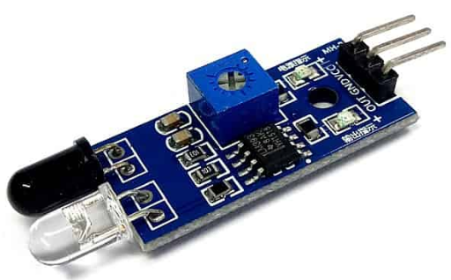
ECE 570 - Computer Networks Final Project
By Shaurya Doger

Slide 2
Intro
This project aims to describe Internet-of-Things communications from (Sensor node) (Collector Node) (Python Wi-Fi Server) (Figure Display).
The sensor utilized here is the infrared obstacle sensor.
The purpose of all this is to ensure that all the sensor data gets sent to Python for both displaying the information as well as Machine Learning Analysis to test for accuracy via Random Forest Classifier.

Slide 3
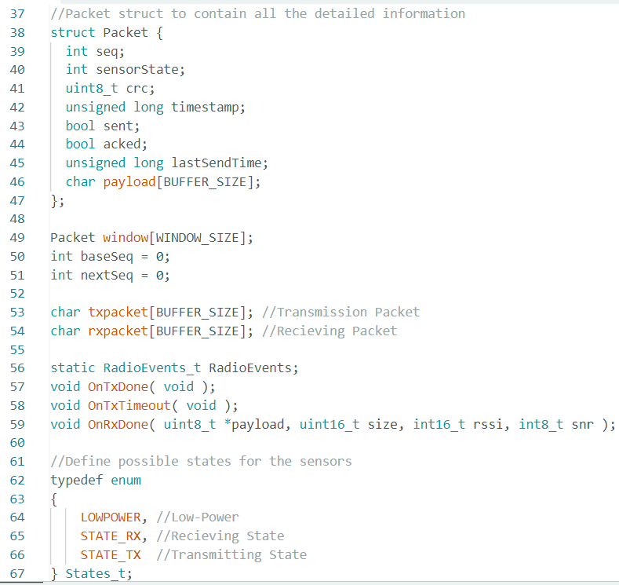
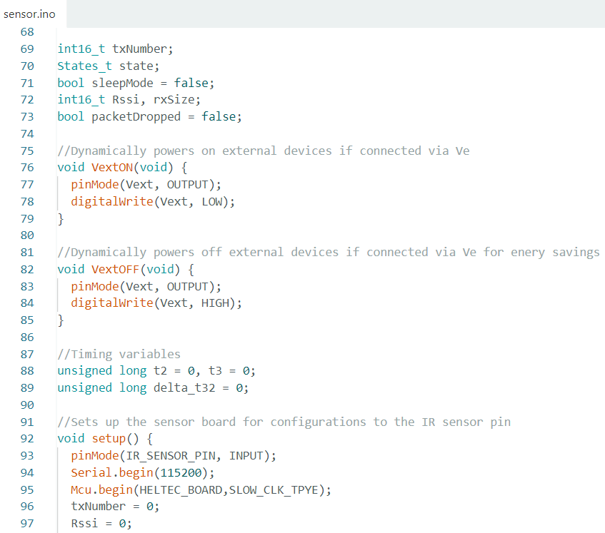
Lora Wan Sensor Code Samples
Above code demonstrates Packet’s struct on all the data sent from the Sensor node to the Collector node., as well as the states and setup.
Note: For the entire Sensor code, see the attached file submitted (sensor.ino) along with this presentation

Slide 4
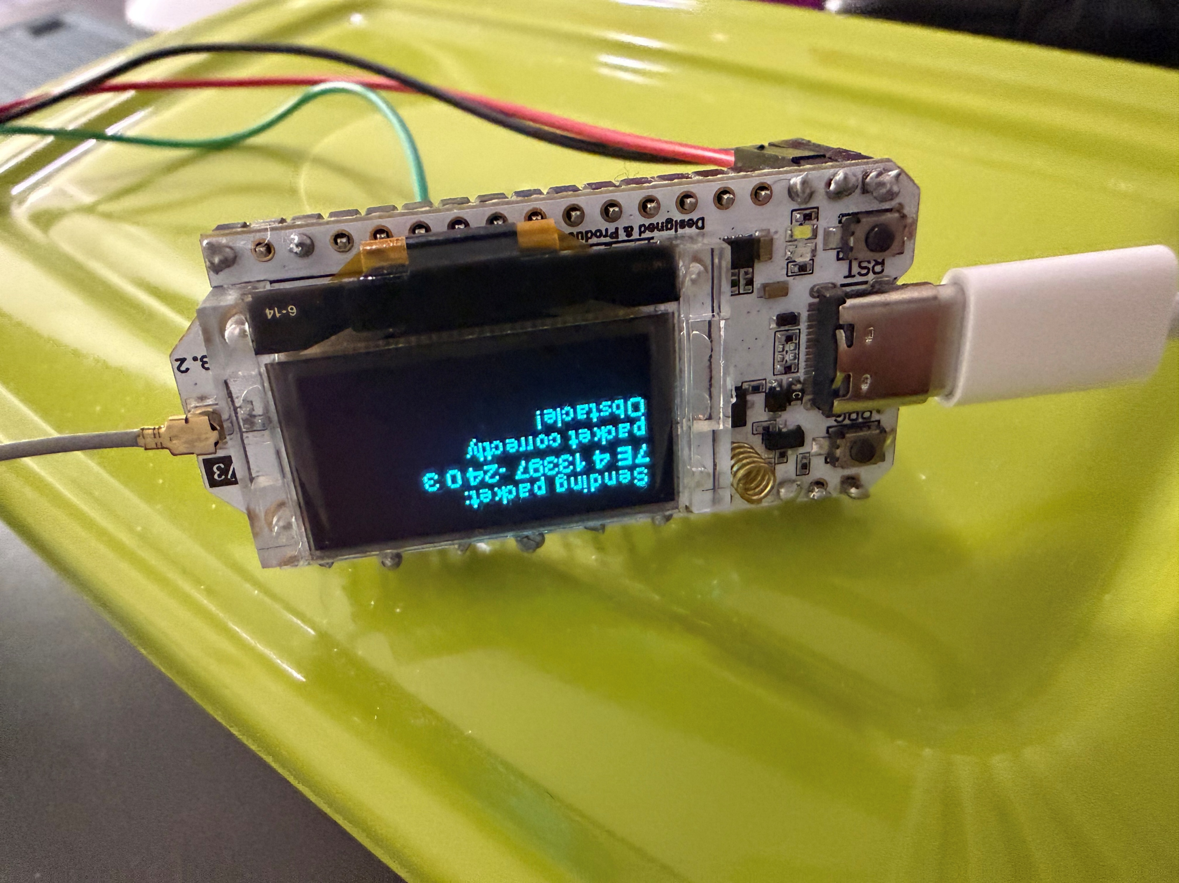
Sensor Node Display

Slide 5
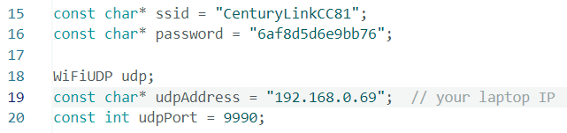

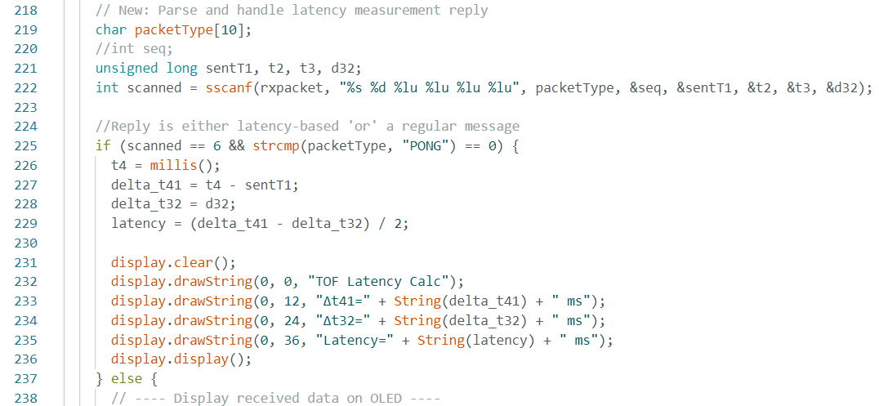
Lora Wan Collector Code Samples
This code demonstrates how collector connects to my home Wi-Fi. It is very essential for Python Wi-Fi server to even open its display.
Code shown below demonstrates the concept of Latency as per part B of the project. Despite so many trials and debugging, unfortunately this information could not be displayed on the OLEDs!
Note: For the entire Collector code, please see submission file for this project (collector.ino)!!!

Slide 6
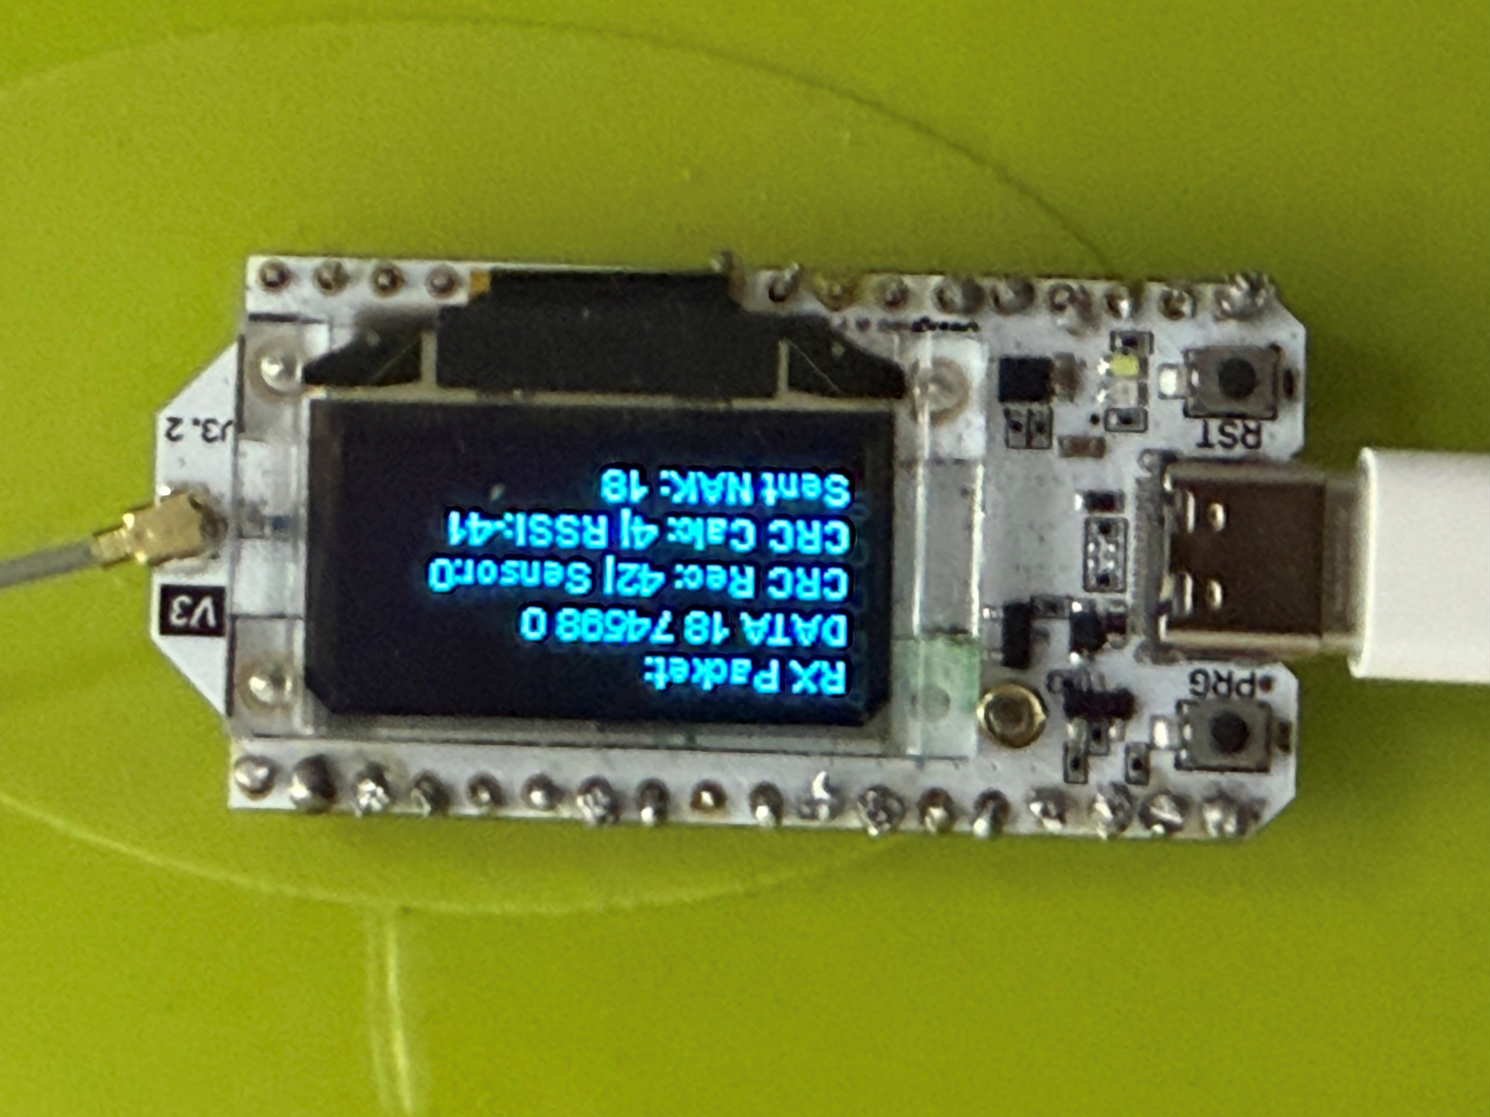
Collector Node Display

Slide 7
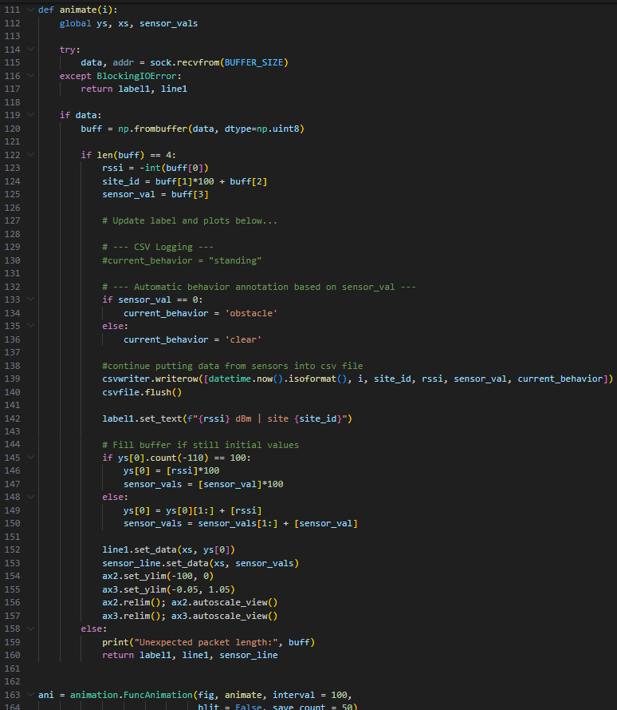
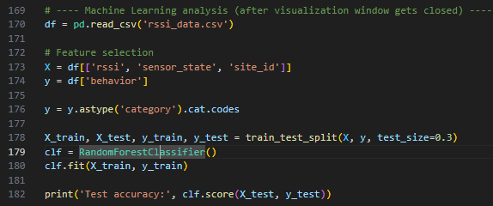
Python Server Code Samples
For the full Python Wi-Fi Server implementation, see the attached submitted file (UDPSever2.py) within canvas.

Slide 8
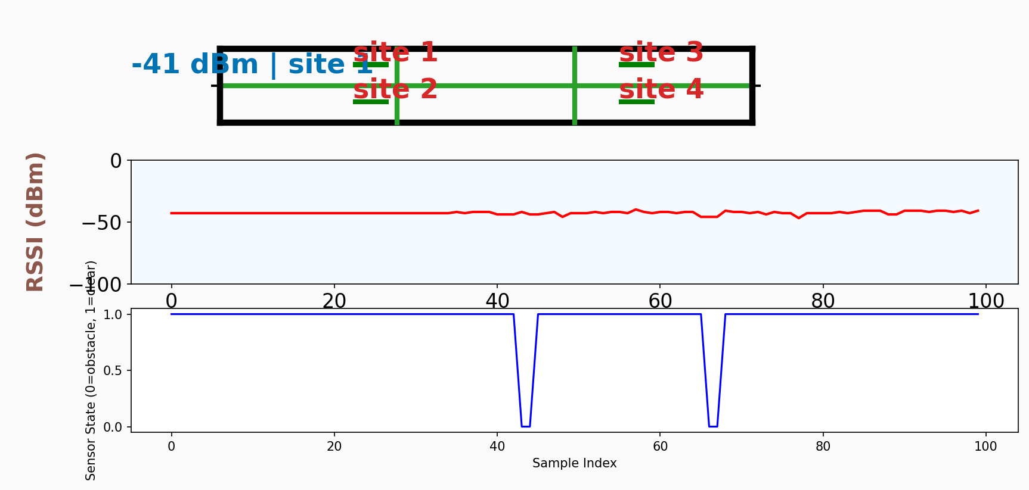
Python Sensor Output Displays (1)
Output shown below is obtained on two different forms of live data:
RSSI (dBM) as the signal strength that travels from Sensor to Collector Lora Wan node.
Second plot on the bottom shows the Sensor state value that indicates presence of obstacles.
Sample Index refers to the instance of time at which data gets collected

Slide 9
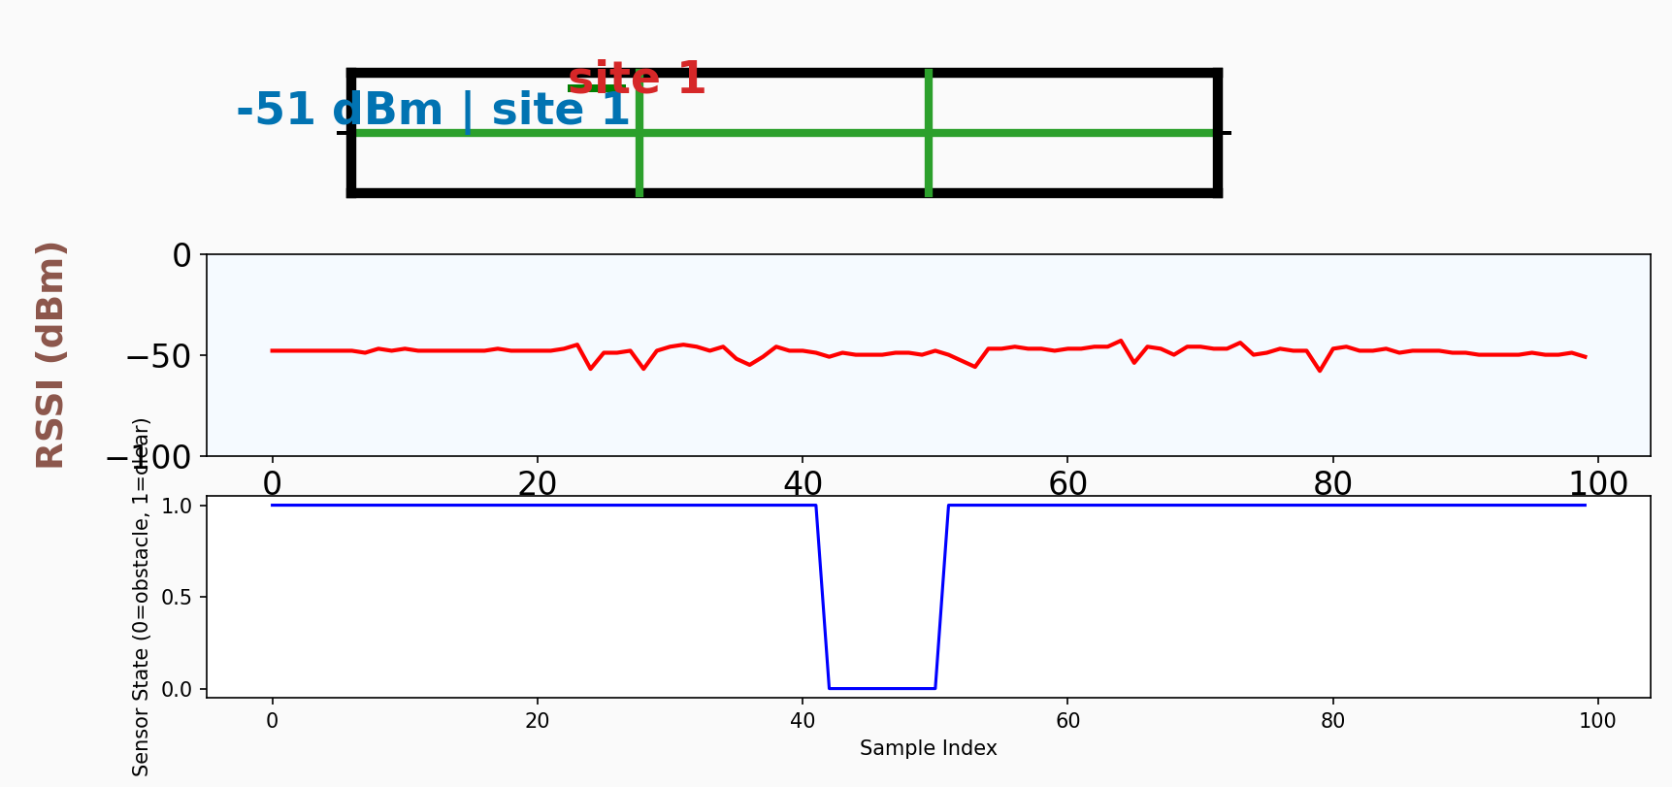
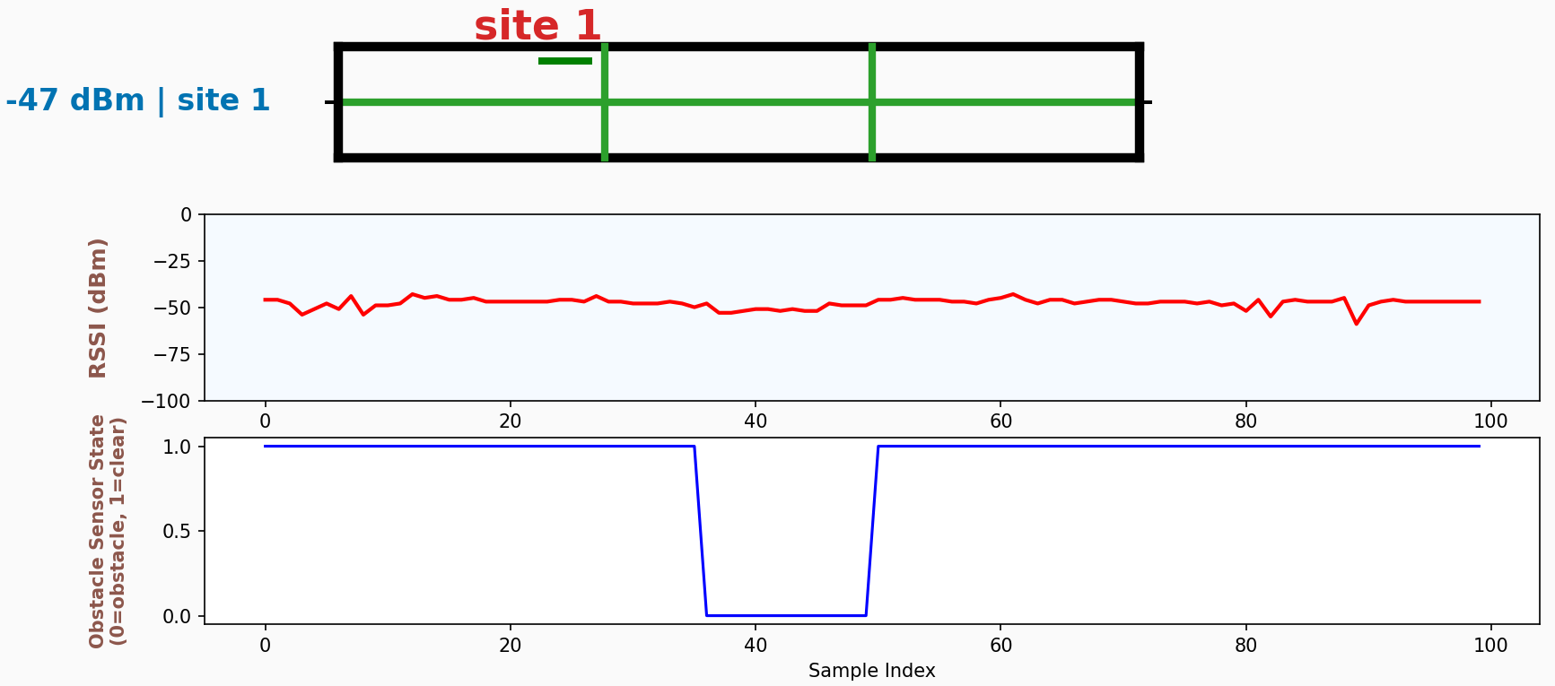
Python Sensor Output Displays (2)
Trial 2 of the sensor and RSSI (dBM) data display
Trial 3

Slide 10
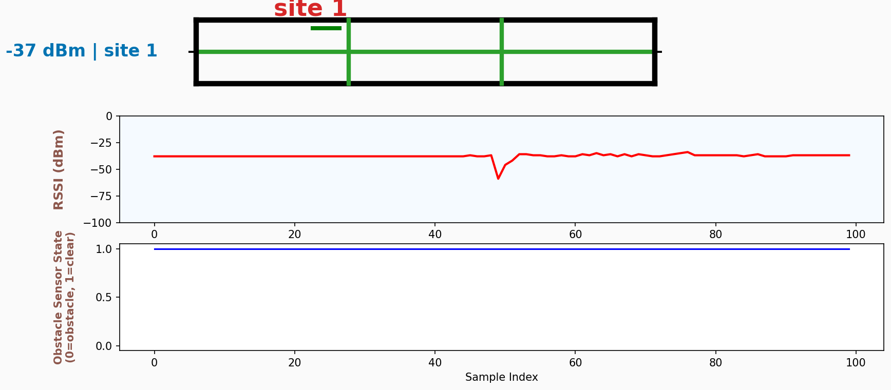
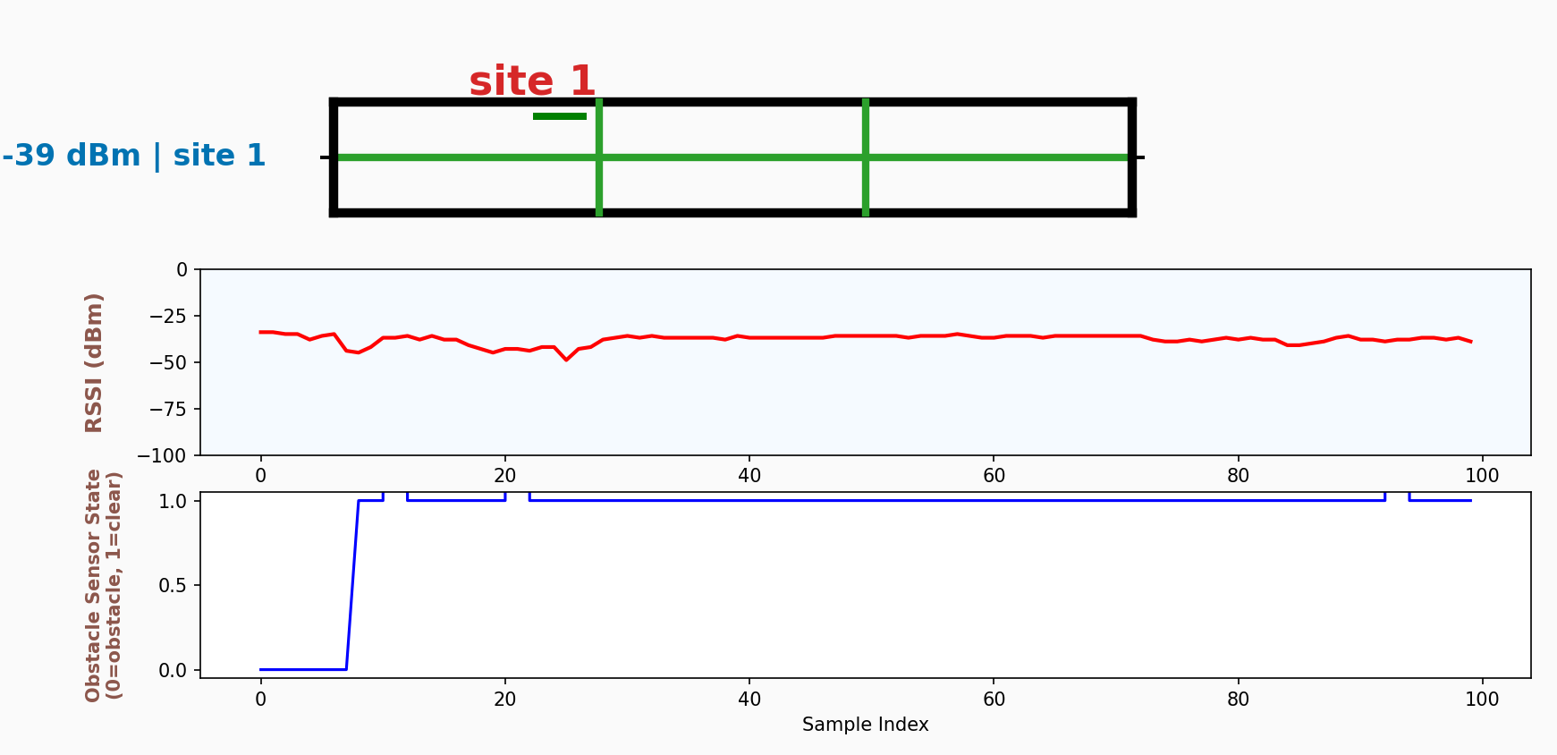
Python Sensor Output Displays (3)
Trial 4
Trial 5

Slide 11
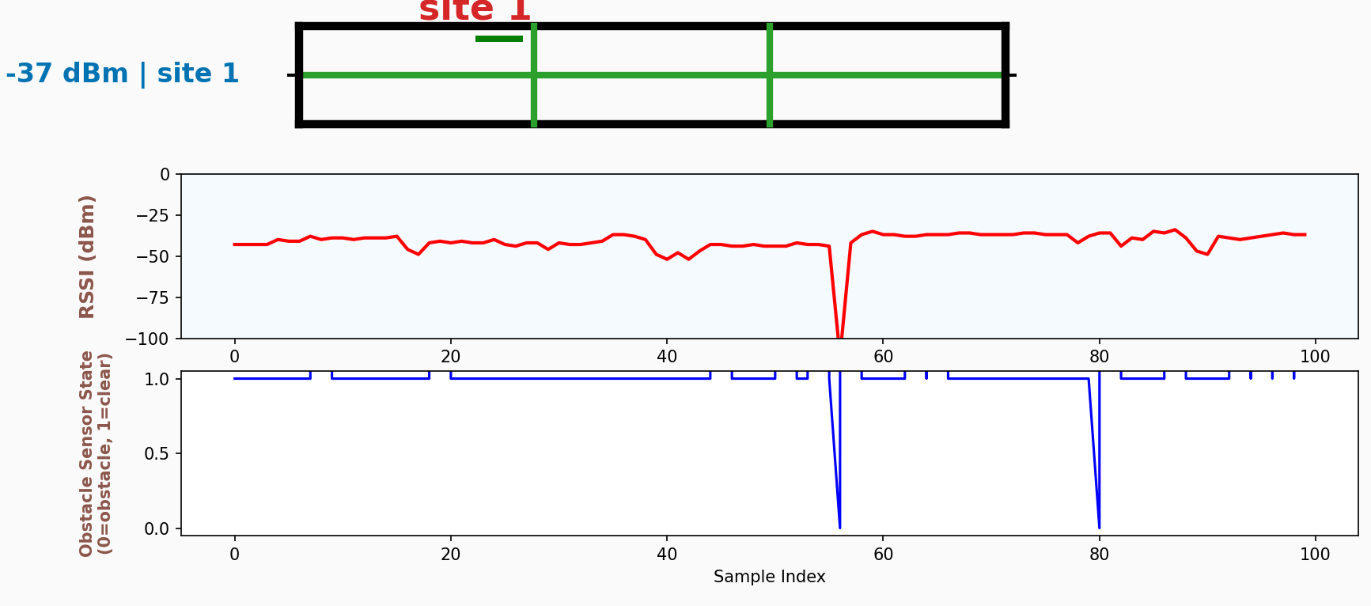
Python Sensor Output Displays (4)
This is trial 6 when I added further components to collector and sensor nodes (e.g. ARQ, Latency, etc.)

Slide 12
Python Accuracy Output from ML Analysis
The image shown above demonstrates Accuracy Analysis through ML methodology of Random Forest Classifier as the code is demonstrated within slide 5.
Overall logic is that during runtime and within the loop, Sensor Data continuously gets grabbed, then inputted within CSV files until the user closes out Window.
Then, all that CSV data gets fed within Random Forest Classifier algorithm to determine Accuracy of the Tests.
For further details, please watch one of the videos submitted in Canvas along with this ppt file.

Slide 13
Obstacles
When adding ARQ protocol Arduino code to Sensor and Collector nodes, my OLED was blinking at extremely high rate for any user to read.
To resolve this, I added “delay(…)” function to allow sufficient time for users read the OLED display contents.
Although my sensor node functions, often sensor readings had gotten choppy after approximately 60 seconds of operations from the plug-in time slightly impacting my sensor output accuracy.
I debugged to check portions causing delays to correct the order on which operations occur to ensure long-time and continuous data operations.
Despite my addition of Latency calculation Arduino codes, that data was never able to get displayed potentially due to lack of Ping Pong requests.

Slide 14
Enhanced Skills
Improved my soldering skills and to also only solder those pins as necessary for prevention of power/signaling conflicts, especially those pins directly with each other.
Gained stronger understanding networking protocols (ARQ, CRC, servers, addresses, sensors, etc.)
Got better with utilization of GPT tools on assisting me with code understanding and techniques to add newer software (and potentially hardware) capabilities to sensor and collector nodes, along with Python server visual display enhancements.
Can visually investigate actual occurrences of errors and ways packages get sent and resent.

Slide 15
Conclusion
Overall, this project helped me learn new material as my understanding of Computer Networking protocols has increased significantly.
Even with the obstacles, I could get a functional version of this project in terms of both hardware and software display capabilities and enhancements.

Slide 16
Future
Would further diagnose root cause of sensor issues and why they sometimes get defective or biased data.
Make more enhanced ML algorithms that can generate inferences about physical behaviors:
Ideally, my project would aim to utilize multiple sensors via Internet-of-Things for more enhanced behavior diagnosis across multiple rooms

Slide 17
Demo Videos
The following videos were uploaded to Canvas for this project along with this ppt file and the codes:
Sensor Node Readings (2)
Spreading Factor Distance Tests
Full Demo with Animation

