Slide 1
Wildfire Detection Using CNN
CNN baselines and a fine-tuned ViT-B/16 on the Kaggle FIRE dataset
Shaurya Gupta · 2430010320 · Data Science · Batch D
Notes:
Introduce the project: binary fire / no-fire image classification, comparing a pre-trained Vision Transformer with CNN baselines, plus an SE-attention innovation.

Slide 2
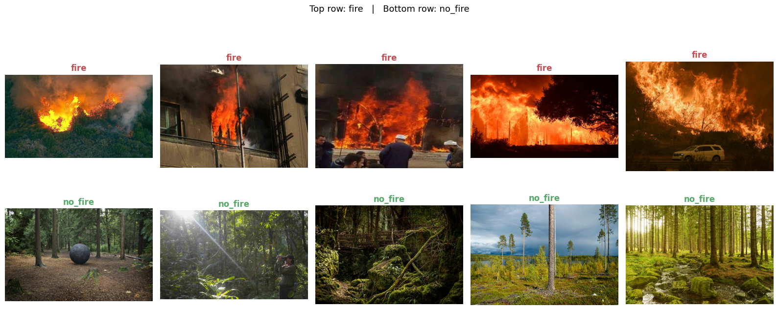
A missed fire costs far more than a false alarm
Fire minutes old can be contained; an hour later it may not be.
Goal: a classifier for camera towers, drones and phones that flags fire in a single image.
Recall on the fire class is the metric that matters most.
Top: fire. Bottom: no-fire. Samples from the dataset.
999
3.09 : 1
75.6%
images in the Kaggle FIRE dataset
fire to no-fire imbalance
accuracy from always predicting "fire"
Notes:
The imbalance means accuracy alone is misleading: a model that always says fire scores 75.6%. That is why macro-F1 and missed fires are the headline metrics.

Slide 3
A stratified 70/15/15 split with the test set held out
Same fire share (75%) in every split
Test split never used for training or early stopping
Class weights: no-fire 2.06, fire 0.66
Augmentation on training images only: flip, rotation, zoom, brightness, contrast
All images resized to 224 × 224
Notes:
Stratification keeps the class ratio identical, so differences between splits are not caused by class mix.

Slide 4
Pipeline: frozen ViT features first, then partial fine-tuning
1
2
3
4
5
Image
Patches
ViT-B/16
Head
Output
224 × 224 RGB, augmented in training
196 patches of 16 × 16 + [CLS] token
12 encoder blocks, ImageNet-21k pre-trained
Dense 128 (GELU) → Dropout 0.4 → sigmoid
P(fire), threshold 0.5
Phase 1 — feature extraction
Backbone frozen; 98.6 K trainable; LR 1e-3
Phase 2 — fine-tuning
Last 4 blocks unfrozen; 28.45 M trainable; LR 1e-5
Notes:
Both phases use early stopping on validation loss with best weights restored.

Slide 5
Regularisation experiments map the bias–variance trade-off
Model A underfits: 67% test, below the 75.6% "always fire" baseline
Model B: 4.8-point train–test gap
L1 has the smallest gap (0.7 points)
ViT-B/16 is best on both
Notes:
Bias = 100 minus train accuracy; variance = train minus test accuracy. Model C underperformed on this split but scored 94.8% ± 2.4 under 5-fold cross-validation.

Slide 6
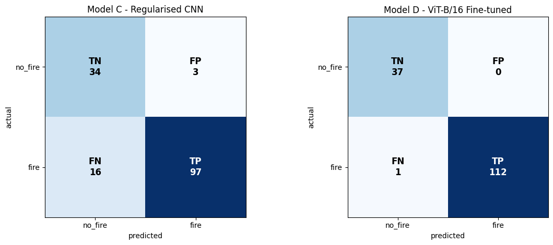
ViT-B/16 reaches 99.33% test accuracy with one missed fire
99.33%
0.991
test accuracy (149 / 150)
macro-F1
1 / 113
0 / 37
Left: regularised CNN (Model C). Right: ViT-B/16. ROC-AUC for the ViT is 1.000.
fires missed
false alarms
With 150 test images, one error = 0.67 points; the 95% CI on accuracy is about 96.3–99.9%.
Notes:
Phase 1 already peaked at epoch 1; fine-tuning did not improve validation loss. The single error disappears at any threshold from 0.1 to 0.4.

Slide 7
CO4: the ViT ties a frozen ResNet50 on the same test split
ViT = ResNet50 (identical scores)
vs MobileNetV2 and L1/L2: not significant (McNemar)
vs every other CNN: significant, p < 0.05
ViT is 35× larger than MobileNetV2
Notes:
McNemar p-values are upper bounds because image-level predictions were not saved. Pre-training, not the transformer architecture, explains the gap to the from-scratch CNNs.

Slide 8
CO4: matches the best published result on this dataset
99.33%
99.2%
85–94%
This work: ViT-B/16
Lilhore et al., Sci. Rep. 2026
Their ResNet50 / VGG16 baselines
Single image; test split of 150 untouched originals
ViT + 3D-CNN + video clips; augmented before the split
Same dataset; our frozen ResNet50 scores 99.33%
On harder data, transformers drop sharply: a Swin model fell from 0.945 to 0.612 F1 on an unseen dataset (Hamdan et al., 2026). Our results are in-domain only.
Notes:
The 0.13-point difference with Lilhore et al. is well inside our confidence interval, so the honest reading is "similar", with a cleaner protocol on our side.

Slide 9
CO5: SE attention helps; focal loss, as configured, does not
No focal loss
Focal loss (α = 0.75)
Baseline
0.458
Focal only
0.744
No SE
macro-F1
macro-F1
AUC 0.975 · 36 false alarms
AUC 0.922 · 21 false alarms
SE only
0.897
SE + Focal (proposed)
0.816
With SE
macro-F1
macro-F1
AUC 0.974 · 8 false alarms
AUC 0.926 · 17 false alarms
SE adds 5.1% parameters. Focal α was applied to the majority class (fire); the fix is α = 0.25 on fire.
Notes:
SE leaves AUC unchanged, so its gain is mainly a better-placed decision boundary. Focal loss lowered AUC by about 5 points in both pairings.

Slide 10
Limitations and next steps
Limitations
Only 150 test images; one seed per model
No external dataset tested
Grad-CAM cell failed: no heatmaps yet
Threshold tuned on the test split
Next steps
Test on FlameVision or DeepFire
Repeat runs over 5 seeds; report mean ± SD
Rerun ablation with corrected focal loss
Fix Grad-CAM; measure inference latency
Bottom line: the 99.33% result is credible in-domain, but an external test is needed before claiming real-world readiness.

Slide 11
Pre-training, not architecture, drives the result
ViT-B/16 and a frozen ResNet50 both reach 99.33%; SE attention is the CNN improvement that holds up.
Questions? · github.com/shauryagupta575/MUJ-DS-2430010320

