Slide 1
Machine Learning in R
A Primer on stats::glm and glmnet packages | Logistic Regression
Shaurya Jauhari, Mora Lab.

Slide 2
Agenda
A word about Docker
Background: Machine Learning
Characterization: Machine Learning
Linear Regression
Logistic Regression
Theory
Stats::glm()
glmnet package
General Concepts
Dataset Description
Hands-on session

Slide 3
Docker
Provides for operating-system level virtualization
Repository name: shauryajauhari/lab_workshop_logistic_regression
Containers hold the runtime binaries
Instances of an Image
3 essential components
Program script
Dockerfile ~ DESCRIPTION file in an R package
Base Image
FROM rocker/r-base:latest
FROM rocker/verse:3.5.1
USER rstudio
WORKDIR /Users/mei/Desktop/Machine_Learning_Logistic_Regression/Logistic_Regression_Lab
RUN export PATH=$PATH:/Applications/RStudio.app/Contents/MacOS/pandoc
COPY ./glmnet_stats_glm_demo.Rmd glmnet_stats_glm_demo.Rmd
RUN R -e "rmarkdown::render('glmnet_stats_glm_demo.Rmd')"

Slide 4
Background
Under the umbrella of Artificial Intelligence
Inducing intelligence in the systems in a manner to perform, just like any human would
Broadly for classification and clustering tasks
Fake emails, fraudulent bank transactions, weather prediction, etc.
Classification : mapping to Known labels
Clustering: Exploratory analysis; finding patterns on the fly.

Slide 5
Characterizing Machine Learning
Machine Learning Algorithms
Classification
Clustering
Descriptive Models
Predictive Models
Regression
SUPERVISED
UNSUPERVISED

Slide 6
Postulates
Genesis
Core Idea
Available Data
Computational Power
Statistical Methods
Data Collection
Abstraction
Generalization
Template
TRAIN
TEST
Scaling; Adaptation

Slide 7
Why Machine Learning?
Relationships
Quantification and Mechanization
Highlighting variables that best describe the relationships within data
Normalization
Dimensionality reduction
Aids inference
Inference is the basis of statistics
Population -> Sample

Slide 8

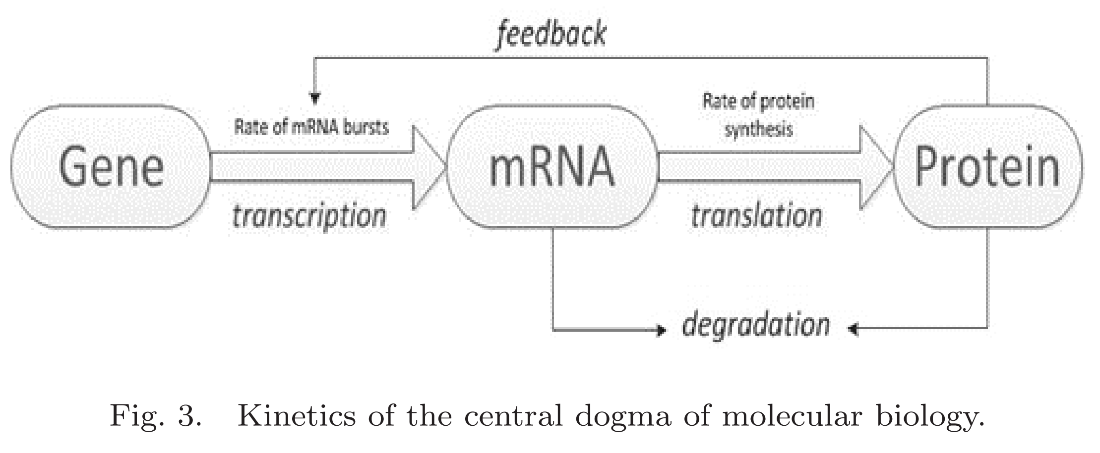
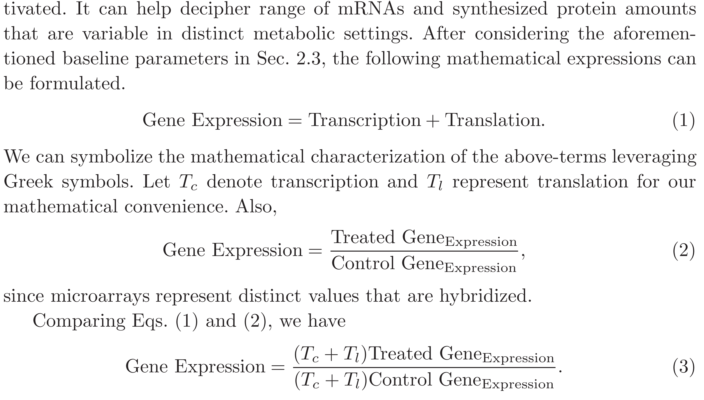

Slide 9
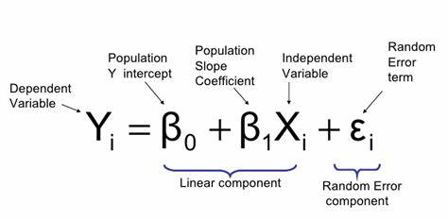
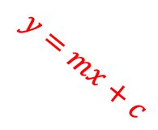
Linear Regression
In its simplest form, regression helps ascertain the value for dependent/response variable, given predictor(s) variables.
Correlation can only quantify the scale of relationship
-1 (negative),0 (no correlation),1 (positive correlation)
Simple Linear Regression (one predictor variable); Multiple Linear Regression (two or more predictor variables)
No direct Machine Learning linkage.
Y
Error
$$y=mx+c$$
X

Slide 10
Logistic Regression
Classification Technique | Categorical, response variable
Discrete Dependent Variable
dummy variable coded as “yes” or “no”, “0” or “1”, “true” or “false”, etc.
Logistic regression is a methodology used for ascertaining binary outputs.
Rain or not
Head or tails
Binomial Models
Two dimensional data (two predictive variables)
Multinomial Models
Multidimensional data (many predictive variables)

Slide 11
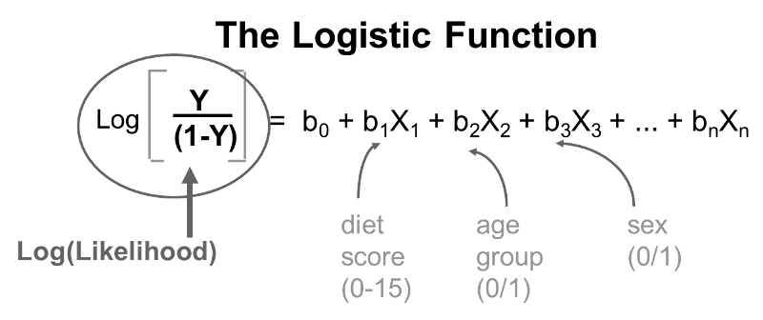

Mathematics of Logistic Function
$\ln\left(\frac{p}{1−p}\right)$=$β_{0}$+ $β_{1}$ $x_{1}$+ $β_{2}$ $x_{2}$+$…$+ $β_{n}$ $x_{n}$, where n is the number of variables/ features, $p$ is the probability of acceptance/ success and (1- $p$) is the probability of rejection/ failure.
Let $\ln\left(\frac{p}{1−p}\right)$=y, then $p$=$\frac{e^{y}}{1+e^{y}}$ .

Slide 12
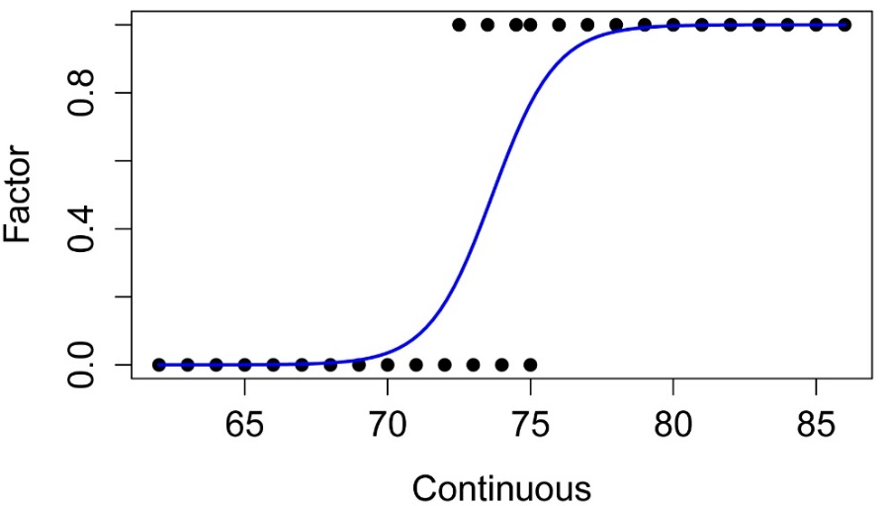
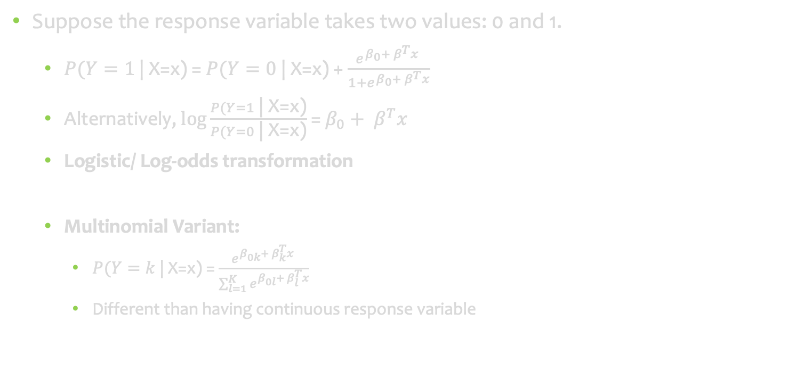
Model
Suppose the response variable takes two values: 0 and 1.
$P(Y=1$ | X=x) = $P(Y=0$ | X=x) + $\frac{e^{β_{0}+ β^{T}x} }{1+e^{β_{0}+ β^{T}x}}$
Alternatively, $\log{\frac{P(Y=1\text{ | }\text{X}\text{=}\text{x}\text{)}}{P(Y=0\text{ | }\text{X}\text{=}\text{x}\text{)}}}$ = $β_{0}+ β^{T}x$
Logistic/ Log-odds transformation
Multinomial Variant:
$P(Y=k$ | X=x) = $\frac{e^{β_{0k}+ β_{k}^{T}x} }{\sum_{l=1}^{K}{e^{β_{0l}+ β_{l}^{T}x}}}$
Different than having continuous response variable
0.5
Class I
Class II

Slide 13
Penalized Logistic Regression: Mitigating high-dimensionality evil
Also termed Regularization of Bias-Variance Trade-Off Problem
(Multi)Collinearity Problem:
Overfitting
Unstable Estimates
Inaccurate Prediction Model
Imposing penalty due to large number of variables
Results in shrinking coefficients of less contributive variables
Three methods adopted:
Ridge (coefficients pushed closer to zero)
Lasso (coefficients reduced to zero)
Elastic Net (hybrid approach)

Slide 14
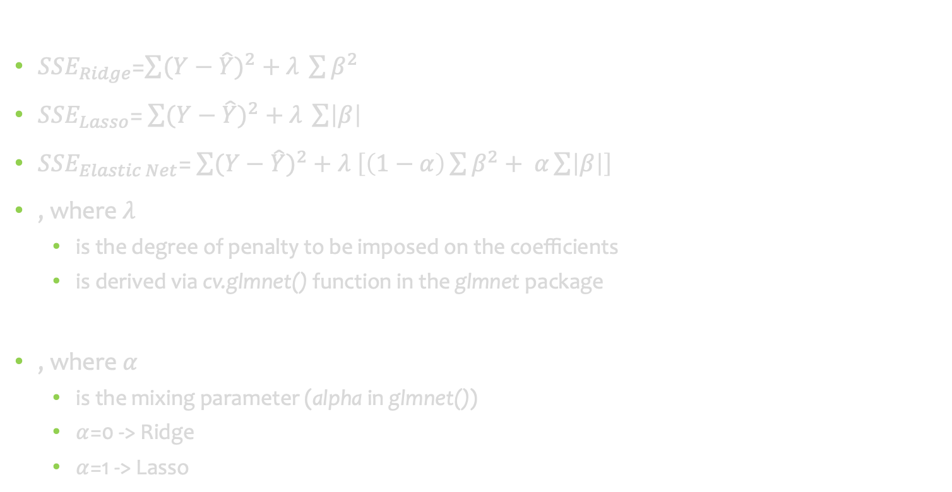
Sum of Squared Errors
${SSE}_{Ridge}$=$\sum{{(Y−\hat{Y})}^{2}}+λ \sum{β^{2}}$
${SSE}_{Lasso}$= $\sum{{(Y−\hat{Y})}^{2}}+λ \sum{\left|β\right|}$
${SSE}_{Elastic Net}$= $\sum{{(Y−\hat{Y})}^{2}}+λ \left[\left(1−α\right)\sum{β^{2}}+ α\sum{\left|β\right|}\right]$
, where $λ$
is the degree of penalty to be imposed on the coefficients
is derived via cv.glmnet() function in the glmnet package
, where $α$
is the mixing parameter (alpha in glmnet())
$α$=0 -> Ridge
$α$=1 -> Lasso

Slide 15
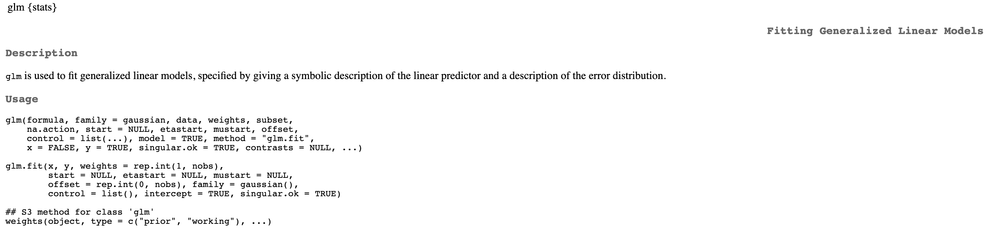
stats::glm
“binomial”

Slide 16
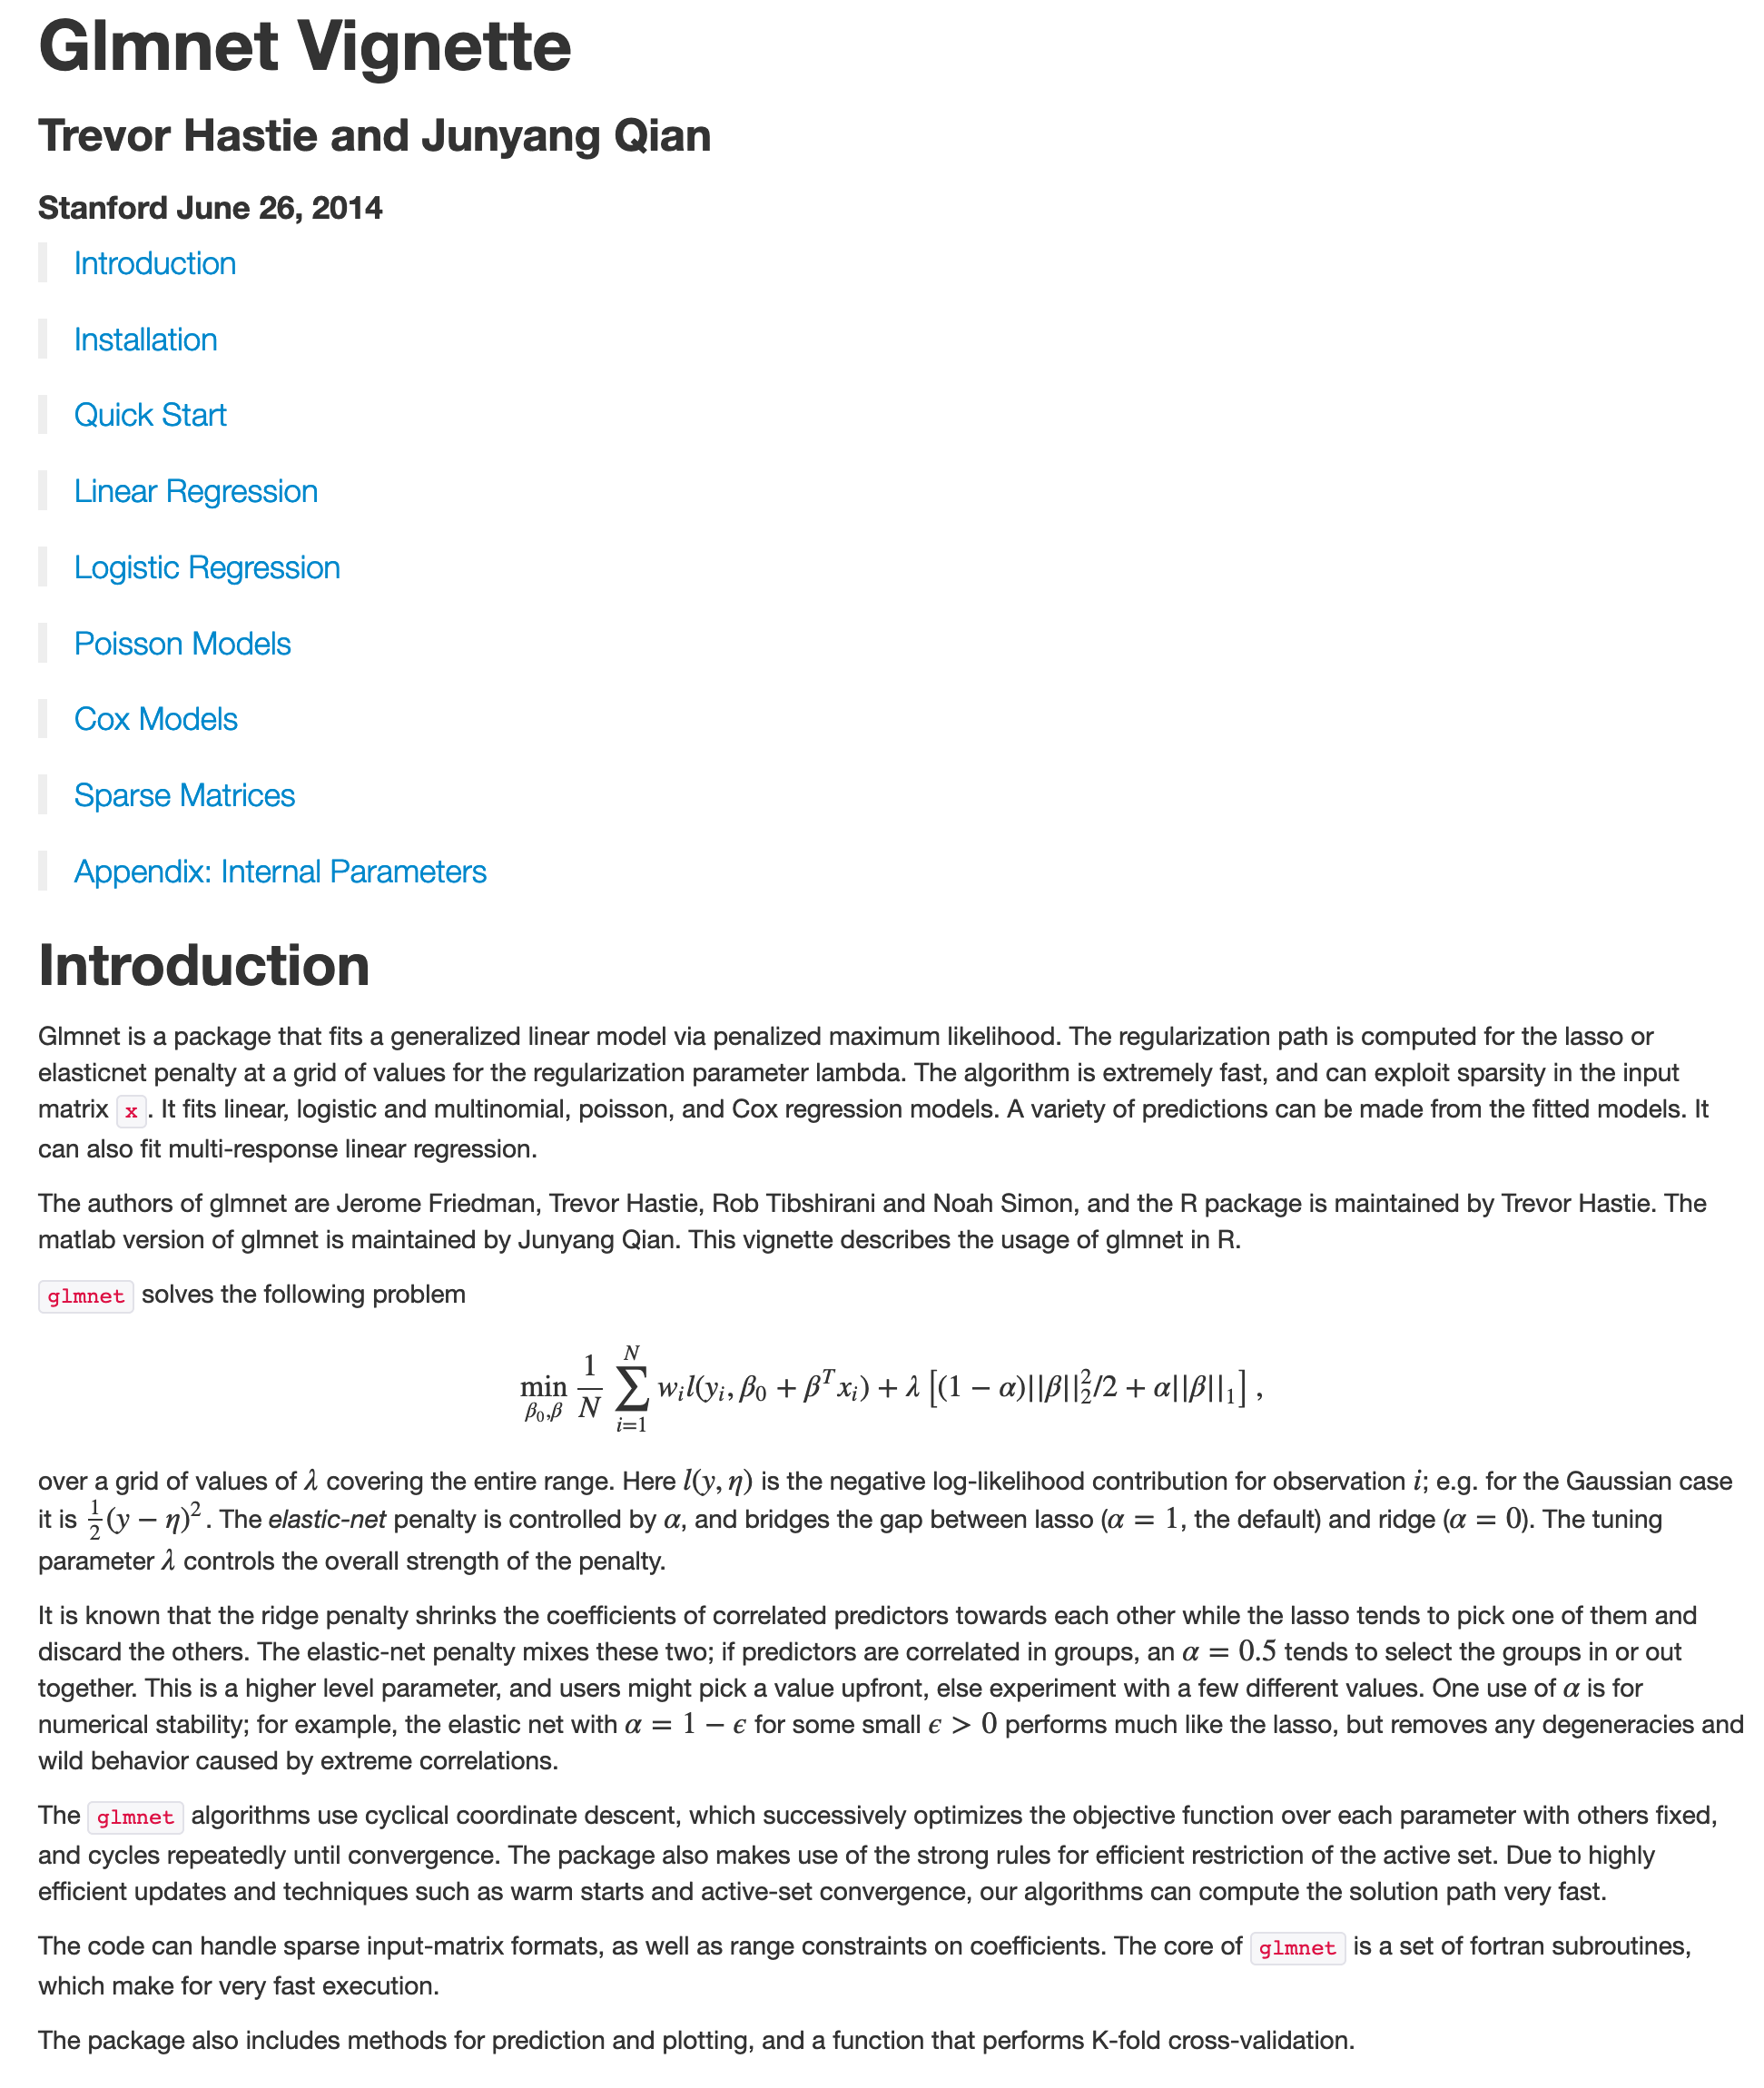
glmnet

Slide 17
General Concepts
Mis-classification Error
An example/row is mapped to inaccurate class.
misclassfication_error <- 1- sum(diag(confusion_matrix))/sum(confusion_matrix)
K-fold Cross Validation
Divide dataset into k groups (of examples/rows)
Use kth group for testing and (k-1) groups for training; repeat process for each group and average out the results.
Multicollinearity
When two or more variables exhibit high correlation
Bias-Variance Tradeoff
Bias is the difference between estimated and actual values
Variance is deviation of the estimates
Inversely proportional
(TN+TP)

Slide 18

Dataset Description
Ronald Fischer, 1936
Iris family of flowers
Setosa
Versicolor
Virginica
Numerical characterizations of sepals and petals
150 observations
E. Coli. of datasets!
Petal
Sepal
http://en.wikipedia.org

Slide 19
Thank You
Over to hands-on now!

