Slide 1
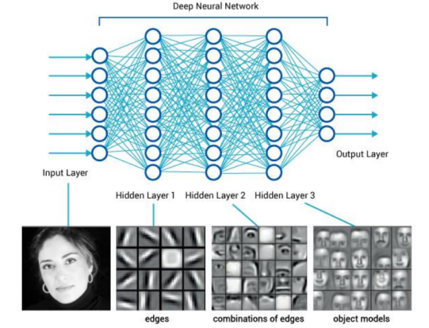
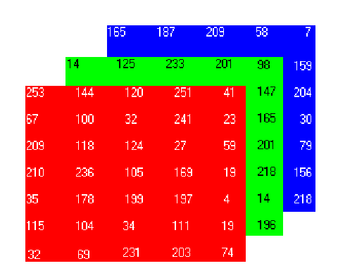





Feature vector
Image, we see
Image, computer sees
$$\begin{matrix}165 \\ 187 \\ ⋮\end{matrix}$$
$$\begin{matrix}14 \\ 125 \\ ⋮\end{matrix}$$
$$\begin{matrix}253 \\ 144 \\ 120\end{matrix}$$
$$\begin{matrix}251 \\ 41 \\ ⋮\end{matrix}$$
Image credit: https://leonardoaraujosantos.gitbooks.io/

