Slide 1
Dataset Preparation for Enhancer Prediction via Deep Learning
Shaurya Jauhari, Mora Lab.

Slide 2
DataSet
ENCODE (https://www.encodeproject.org/)
H1 Cell Line
Pull ChIP-Seq data (BAM files) for H3K27ac, H3K4me1, HeK4me2, H3K4me3.
Index the BAM files using samtools
Calibrate bin level peak-enrichment using bamCoverage (deeptools)

Slide 3


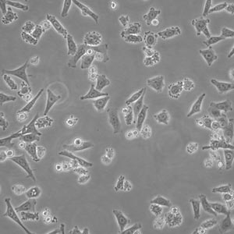


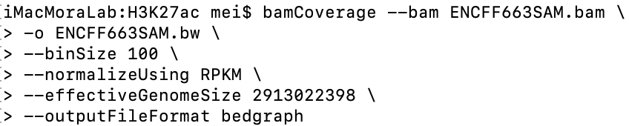
H3K27ac
ChIP-Seq Data
(BAM file)
H3K4me1
Protein-binding
assay
H3K4me2
H1 Cell Line
H3K4me3
2000

Slide 4
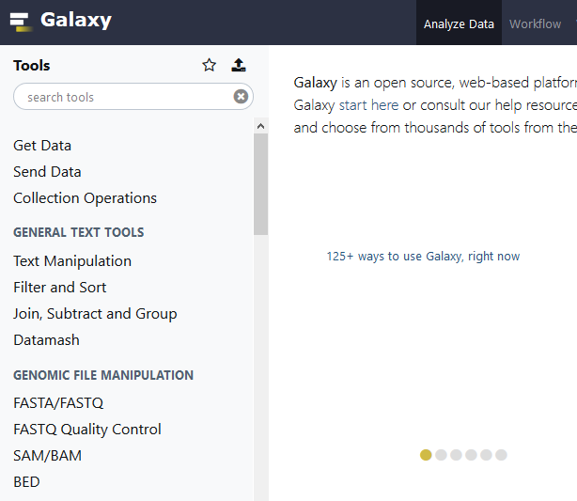

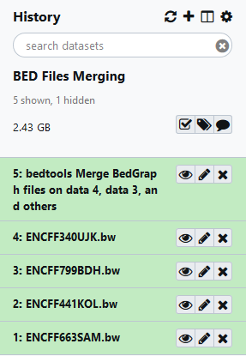
ENCFF340UJK.bw (H3K4me3)
ENCFF799BDH.bw (H3K4me2)
ENCFF441KOL.bw (H3K4me1)
ENCFF663SAM.bw (H3K27ac)

Slide 5
Positive Training Set: Class Labels
(Enhancer -> 1)
Dnase Hypersensitivity Sites (Open Chromatin Regions) (DHSs/ BED file)
P300 binding sites (ChIP-Seq/BED file)
bedtools Merge
Spread out at same bin-size

Slide 6
Negative Training Set: Class Labels
(Non-Enhancer -> 0)
Dnase Hypersensitivity Sites (Open Chromatin Regions) (DHSs/ BED file)
TSS sites (ChIP-Seq/BED file)
Random sites distal to TSS and p300 binding sites (ChIP-Seq/BED file)
Spread out at same bin-size

Slide 7
Web Resources
Github Page
https://github.com/shauryajauhari/Machine_Learning/Machine_Learning_Deep_Learning
Email
shauryajauhari@gzhmu.edu.cn
R Markdown
https://rpubs.com/shauryajauhari/

Slide 8
Positive Training Set
(Enhancer -> 1)
Dnase Hypersensitivity Sites (Open Chromatin Regions) (DHSs/ BED file)
P300 binding sites (ChIP-Seq/BED file)
H3K27ac (Histone Modification) (ChIP-Seq/BED file)
H1 Cell Line RNA-Seq Data (Peak Enrichment/ Counts)
Choose any range from the resultant dataset after H3K27ac filter and divide into 20, 100 bp bins (-1 kbp to +1 kbp around center)
Curate a 20 dimensional vector (20x1 matrix) with enrichment values

Slide 9
Negative Training Set
(Non-Enhancer -> 0)
Dnase Hypersensitivity Sites (Open Chromatin Regions) (DHSs/ BED file)
TSS sites (ChIP-Seq/BED file)
Random sites distal to TSS and p300 binding sites (ChIP-Seq/BED file)
H1 Cell Line RNA-Seq Data (Peak Enrichment/ Counts)
Choose any range from the resultant dataset and divide into 20, 100 bp bins (-1 kbp to +1 kbp around center)
Curate a 20 dimensional vector (20x1 matrix) with enrichment values

Slide 10
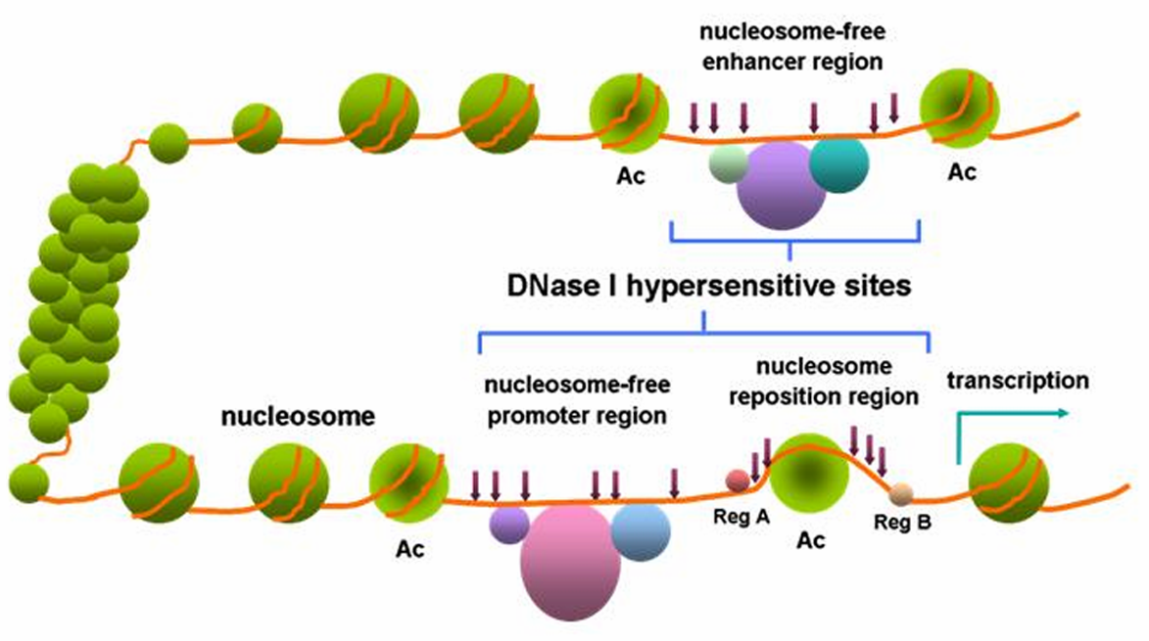
Hypersensitive site (http://en.wikipedia.org)

Slide 11

Potential Enhancer Markers |
Illustration for positive training set
DNase Hypersensitivity Site
P300 Binding Site
H3K27ac Modification Site
Target Range
100 bp
-600 bp
0 bp
200 bp
400 bp
500 bp
600 bp
800 bp
900 bp
1000 bp
-900 bp
-500 bp
-100 bp
300 bp
700 bp
-800 bp
-400 bp
-200 bp
-1000 bp
-700 bp
-300 bp

Slide 12
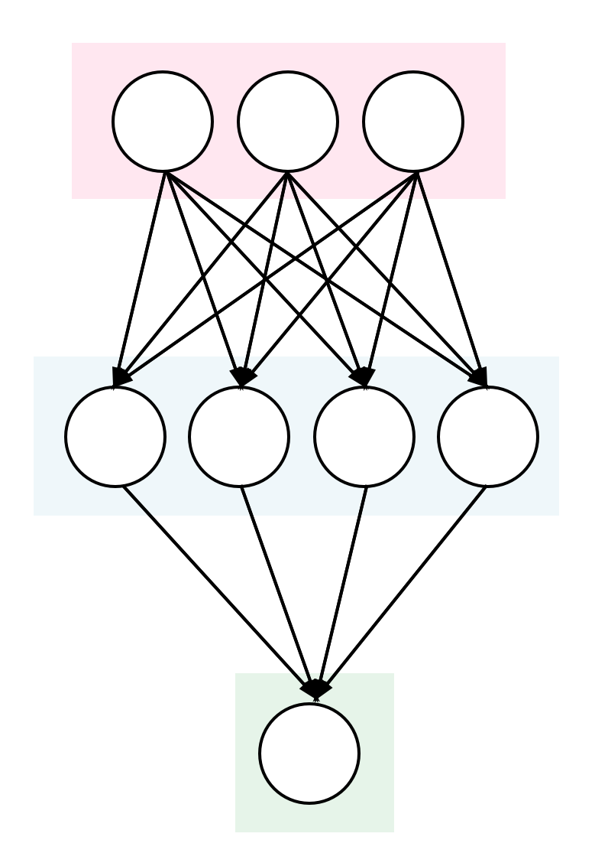
1 | 2 | 3 | 4 | 5 | 6 | 7 | 8 | 9 | 10 | 11 | 12 | 13 | 14 | 15 | 16 | 17 | 18 | 19 | 20
Input Layer
Hidden Layers
(Confounding Variables)
Enhancer (1) / Non-Enhancer (0)
Output Layer

Slide 13
Take home
Dataset structure
2 columns
Enrichment Value, Class
Enrichment Value ~ numeric
Class ~ binary
Histone modifications flank protein binding sites.

