Slide 1
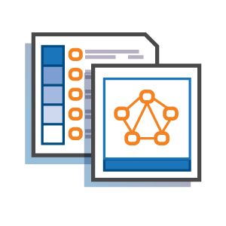


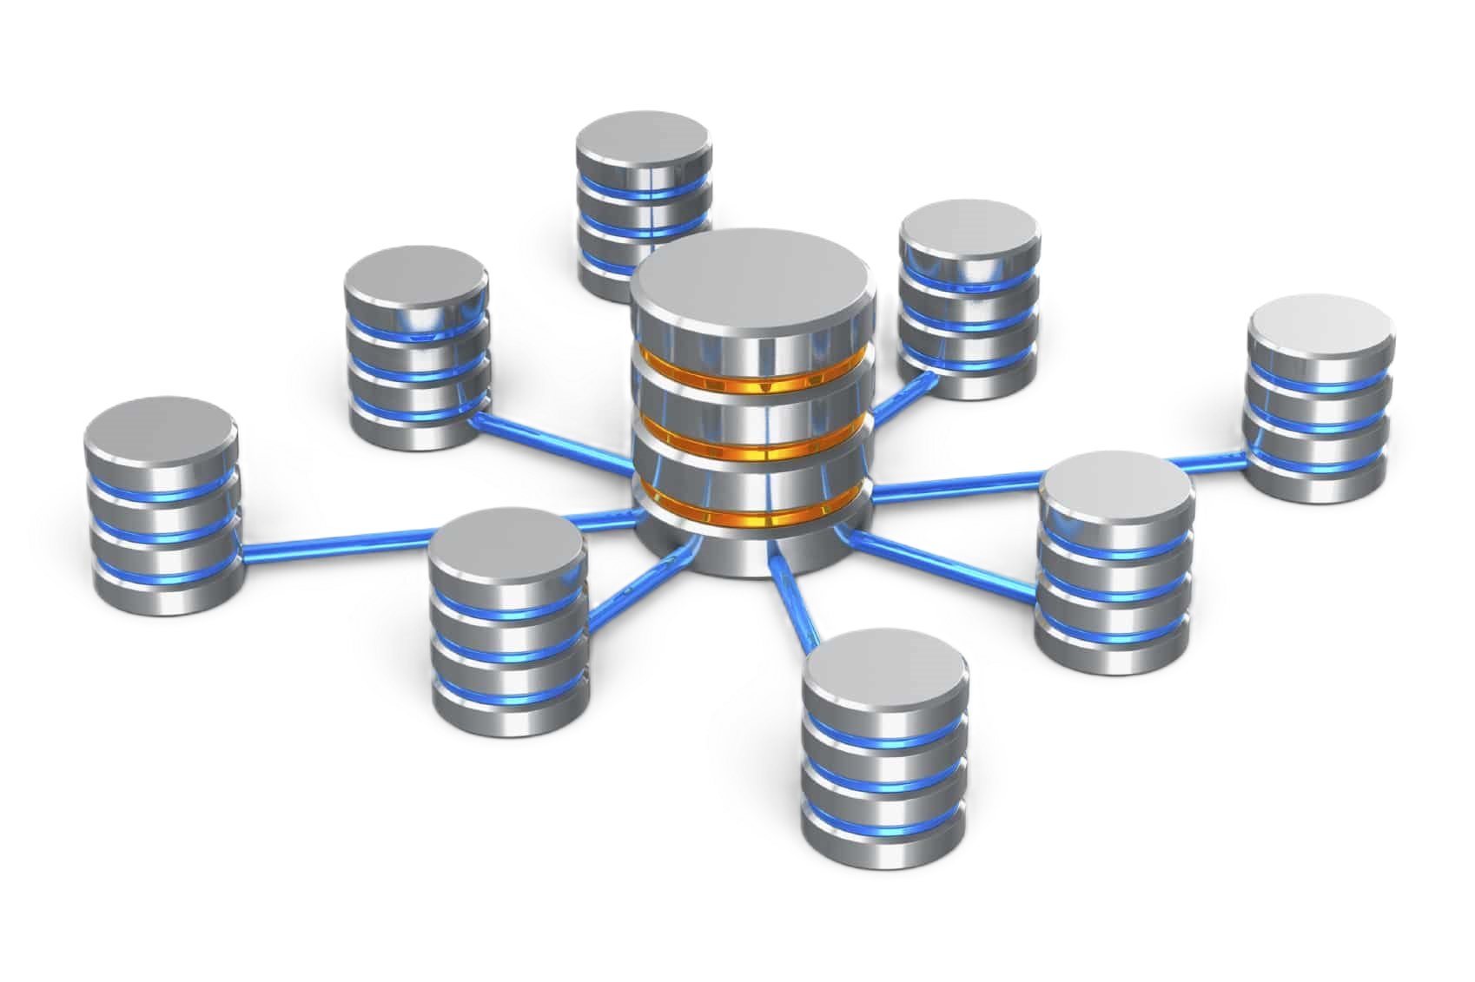



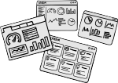



Knowledge Graphs overlaid by AI algorithms
Employing public APIs to garner data from noted social media platforms.
Normalize data, impute missing values, standardize dimensions
Load the resultant data to a secure warehouse.
Now this becomes the data store for downstream analysis.
Create interactive dashboards for real-time data reflection.
Dash (Python), Shiny (R)
Extract
Transform
Load
Visualize

