Slide 1
COALINDIA
Coal India Limited
PRICE (NSE)
INR 466
NSE · Energy / Mining · Large Cap · INR 2,874B
INVESTMENT DEEP DIVE
P/E: 9.2x
Yield: 5.7%
Prepared: May 12, 2026
World's Largest Coal Producer · Maharatna PSU · Ministry of Coal, Government of India
For Long-Term Investment Purposes Only · Not Financial Advice

Slide 2
INVESTMENT VERDICT
WATCH
Coal India is the world's largest coal miner — a government monopoly with 35% ROCE, zero debt, and a 5.7% dividend yield at just 9x earnings. The valuation is cheap. But India's energy transition from coal to renewables is real and accelerating. This is an income vehicle with a 5–7 year runway, not a 15-year compounder. Buy at INR 380–430 for income; hold with a clear exit plan.
Current Price
Fair Value (Base)
Entry Range
Dividend Yield
INR 466
INR 685
INR 380–430
5.7%
2

Slide 3
BUSINESS OVERVIEW — COALINDIA: Coal India Limited
What They Do
Revenue (FY2026)
Gross Margin
Coal India Limited (CIL) is the world's largest coal producer, a Government of India Maharatna PSU producing ~700MT annually across 83 mines in 8 subsidiaries. ~80% of offtake goes to thermal power plants at regulated prices; the balance via e-auction at market rates. Revenue is INR 1,68,400 crore (FY2026). No private competitor can displace it — but India's renewable energy ambitions are the structural long-term risk.
INR 1,684B
89.0%
Flat YoY
FY2026
Operating Margin
ROCE
18.5%
35.3%
FY2026 (down from 32.5%)
Exceptional
Dividend Yield
Production Target
5.7%
810 MT
COMPETITIVE MOAT
Type: Government Monopoly + Irreplaceable Infrastructure
Strength:
Wide — but structurally time-limited
INR 15.5/share FY2026
by FY2028 (5% CAGR)
3

Slide 4
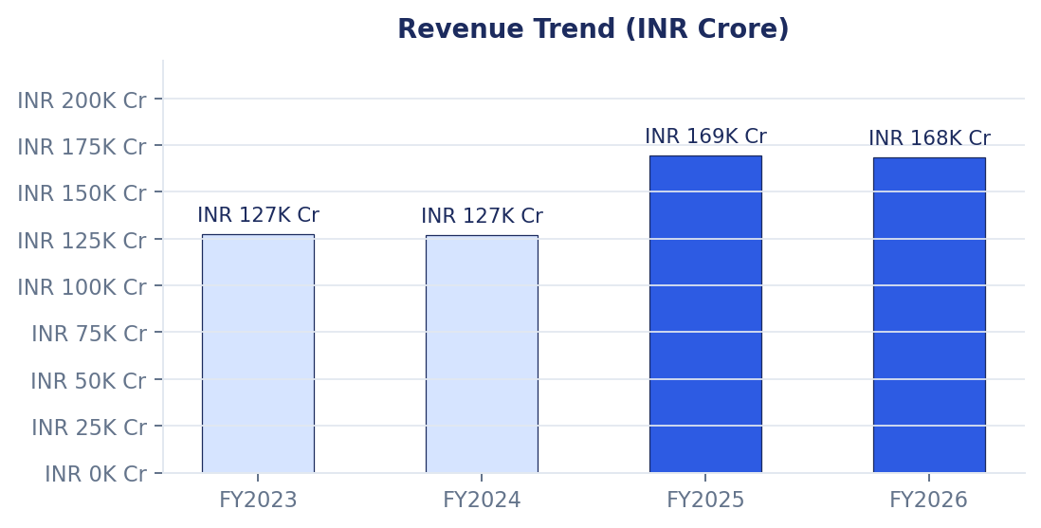
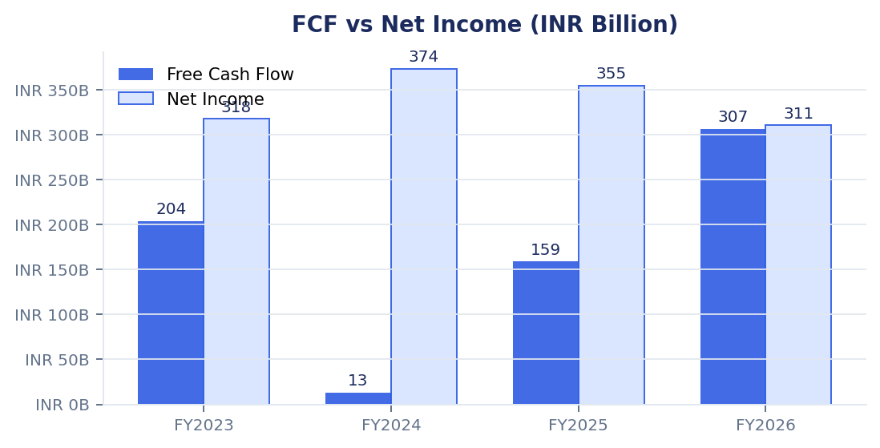
EARNINGS QUALITY — Are the numbers real and repeatable?
FY2023
FY2024
FY2025
FY2026
FCF/NI: 0.64x
FCF/NI: 0.03x
FCF/NI: 0.45x
FCF/NI: 0.99x
FCF/NI >0.9x = High Quality · 0.6–0.9x = Moderate · <0.6x = Red Flag
⚠️ FY2026 one-time item: INR 1,458Cr court-mandated executive wage provision (arrears Aug 2023–Dec 2025) — depressed reported PAT. Underlying earnings are higher.
4

Slide 5
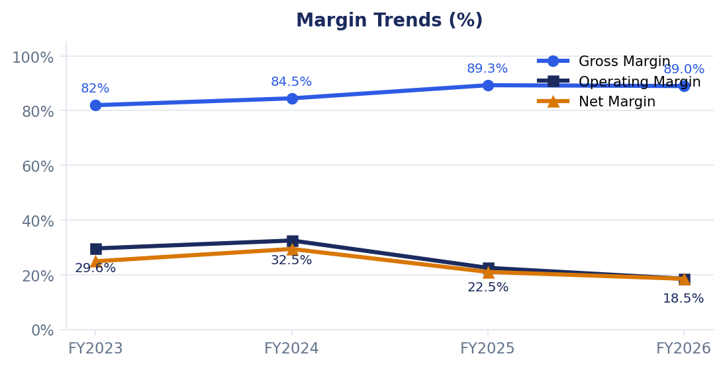
MARGINS & MANAGEMENT — Profitability trend and stewardship quality
Promoter (Govt)
Dividend Payout
63.1%
45.1%
0% pledged — no stress
INR 15.5/sh FY2026
Govt Divestment
ROCE
INR 8,800Cr
35.3%
Planned — supply overhang
Exceptional for mining
CAPITAL ALLOCATION
Consistent high dividends every year. 45.1% payout. Self-funds all capex from OCF. Zero M&A risk. Pure income compounder.
Net Debt/EBITDA
Interest Cover
Goodwill/Assets
0.1x
35.5x
~0%
Safe <2x ✅
Safe >5x ✅
No M&A risk ✅
5

Slide 6
KEY RISKS — The energy transition is the existential question
1. Energy Transition — Renewable Displacement
HIGH
India's renewables scaling 15%+ annually. New coal power already costlier than firm renewables. By FY2031, coal tariffs ~25% more expensive than solar+wind. This is the 10-year existential risk.
2. Government Divestment / PSU Discount
HIGH
INR 8,800Cr planned stake sale creates supply overhang. PSU governance discount (no independent management, ministry directives) depresses valuation permanently vs. private peers.
3. E-Auction Price Compression
MEDIUM
E-auction premiums compressing as global coal prices soften. Operating margin fell from 32.5% (FY2024) to 18.5% (FY2026) — this trend could continue if global prices stay soft.
4. Wage & Cost Inflation
MEDIUM
240,000+ employees. Court-mandated FY2026 pay hike added INR 1,458Cr. Structural wage inflation partially outside management control — erodes fixed-cost leverage.
5. Production Volume Shortfalls
LOW
CIL has historically missed production targets. 810MT FY2028 guidance requires sustained 5% volume CAGR. If power demand disappoints or renewables scale faster, this risks a miss.
6

Slide 7
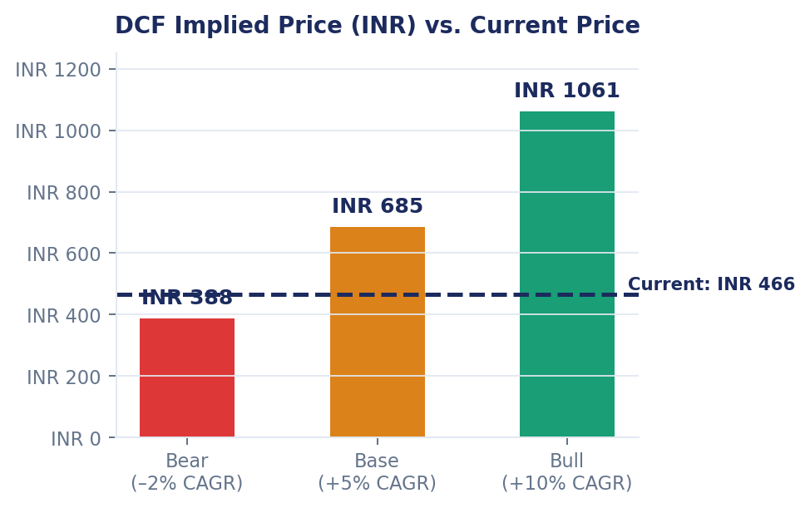
VALUATION — Cheap for a reason, but asymmetric risk/reward
Bear
Base
Bull
FCF CAGR
FCF CAGR
FCF CAGR
–2% CAGR
+5% CAGR
+10% CAGR
FAIR VALUE
FAIR VALUE
FAIR VALUE
INR 388
INR 685
INR 1,061
UPSIDE
UPSIDE
UPSIDE
–17%
+47%
+127%
Metric | Current | 5-Yr Avg | PSU Avg
Trailing P/E | 9.2x | 10x | 11x
Forward P/E | 8.1x | — | —
EV/EBITDA | 6.0x | 7x | 8x
FCF Yield | 10.7% | ~5% | —
Dividend Yield | 5.7% | ~5% | ~4%
7

Slide 8
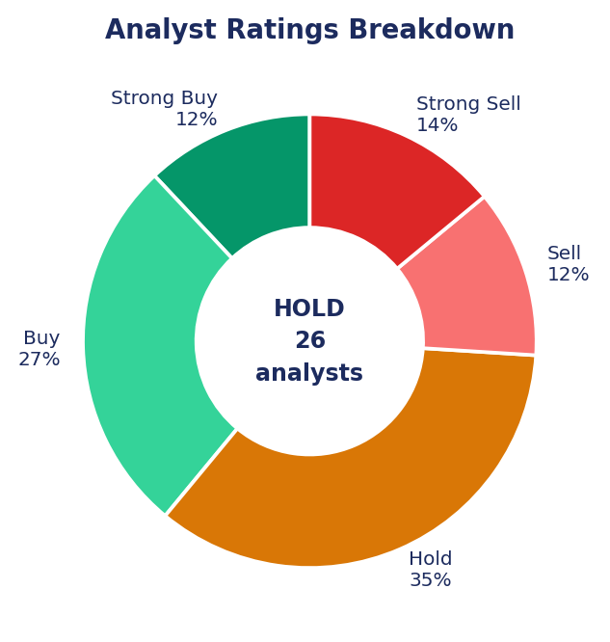
ANALYST CONSENSUS & FINAL VERDICT
CONSENSUS: HOLD
26 analysts · 39% Bullish · 35% Hold · 24% Bearish
Mean target: INR 452 · Range: INR 290 – INR 550
FINAL VERDICT — WATCH ⚠️
✅ 0.1x ND/EBITDA — pristine balance sheet, no financial risk
✅ 35.3% ROCE + 5.7% dividend yield — exceptional income asset
✅ 9x P/E — market pricing in decline too aggressively near-term
⚠️ Energy transition risk is real — India renewables scaling fast
⚠️ Buy INR 380–430 · Collect yield · Hold 5–7 yrs · Exit plan needed
Coal India is a fantastic income vehicle for the next 5–7 years. Not a 15-year compounder. Buy below INR 430 · Collect the 5.7% annual yield · Exit as India's renewable mix approaches 60% of power generation.
8

