Slide 1
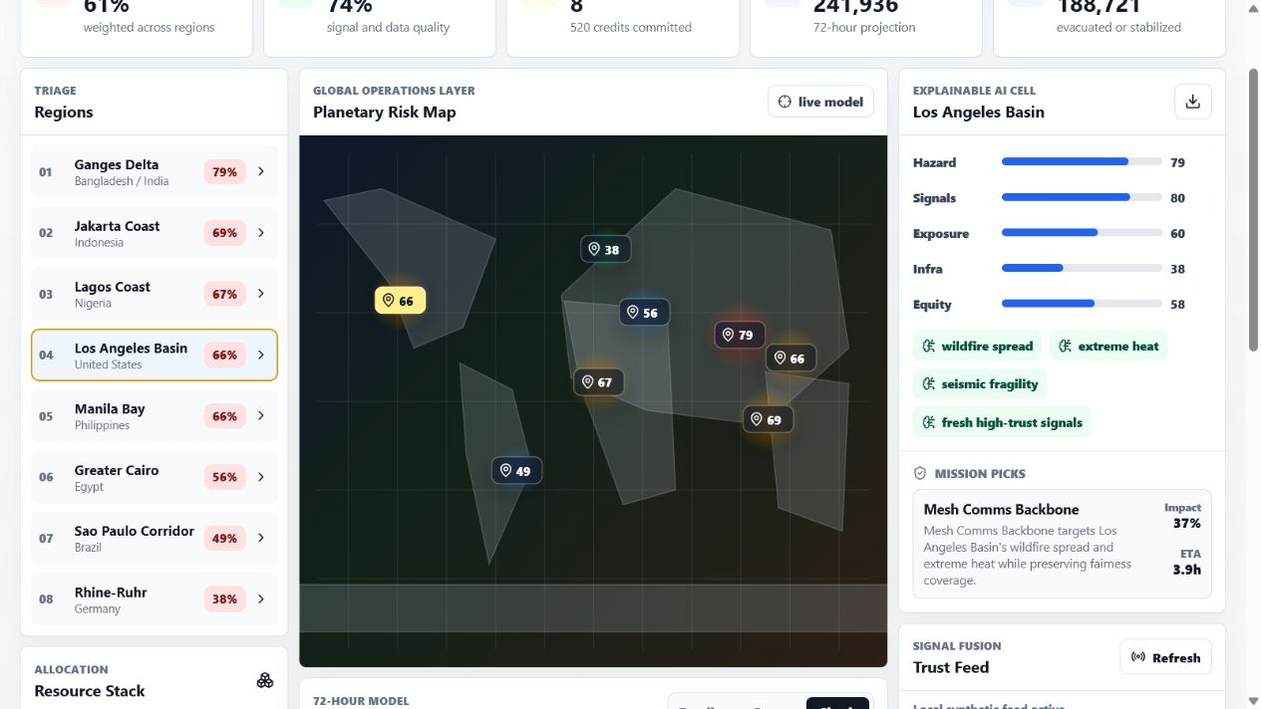
Aegis Earth
Disaster response should explain what to do first.
The thesis
The product
Most dashboards show events. Aegis Earth recommends defensible action.
Explainable AI command center for crisis triage, resource allocation, and 72-hour simulation.
1

Slide 2
The bottleneck is not data. It is deciding fast enough.
Emergency teams already have satellites, weather feeds, hospital status, road reports, shelters, and field updates. The missing layer is an explainable decision engine that connects those signals to action.
Where is risk highest?
Which action protects people fastest?
Can the plan be defended ethically?
What changes when conditions worsen?
2

Slide 3
The working product is a live-feeling crisis room.
Real interactions
Clickable regions, scenario modes, live alert refresh, and exportable executive brief.
3

Slide 4
The engine explains its decisions before it asks for trust.
Risk scoring
Signal trust
Hazard, exposure, signals, fragility, equity need, and cascade risk become a ranked regional triage list.
Reports are weighted by source channel, confidence, recency, and corroboration before affecting decisions.
Optimizer
Scenario lab
Resources are selected under budget, team, speed, scarcity, and duplicate-mission constraints.
The simulator projects lives protected, sheltered population, systems restored, and unmet need over 72 hours.
4

Slide 5
The demo ships with numbers that move when assumptions change.
Default surge scenario, synthetic data, verified in-browser.
61%
8
213k
0
Global risk across the synthetic scenario.
Missions selected under budget and team constraints.
Projected lives protected over 72 hours.
Known dependency vulnerabilities after audit.
The point is not that the demo predicts the future. The point is that every decision is inspectable, tunable, and testable.
5

Slide 6
Triage is computed, not curated.
Risk evidence
The highest-risk region is not simply the region with the loudest signal. The score combines exposure, infrastructure fragility, equity need, and multi-hazard pressure.
79%
74%
Top regional risk
Decision confidence
6

Slide 7
The project is built to be inspected, tested, and challenged.
Proof point
What it proves
Engine tests
Risk, signal pressure, optimizer constraints, scenario output, and sanitization.
UI tests
Command center render, region selection, scenario mode, and live-feed fallback.
Build
TypeScript production build passes with Vite 8.
Audit
npm audit reports zero known vulnerabilities at moderate level and above.
Safety
Synthetic data by default, optional public alert feed, no secrets, documented limitations.
Research anchors: NWS API, NOAA/NCEI, NASA FIRMS, Harvard Data-Smart. The app labels emergency data as synthetic unless a public alert feed is explicitly refreshed.
7

Slide 8
Aegis Earth is a decision engine for moments when delay is the risk.
Open it
Stress it
Inspect it
Run the command center and select a region. The model explains the ranking immediately.
Change scenario mode, budget, climate stress, and public trust. The projection moves.
Read the engine, tests, security note, and architecture. The demo is meant to survive questions.
8

