Slide 1
SE SW Competency Task Force(SSCTF)
SSC Task Force
Anju Bala
Arabinda Verma
Chetan Sai Kumar T
Prathap HS
Vikas Agrawal
Veeraj S Khokale
Sasikumar Sathasivam
Class - 4

Slide 2
Toll Gate Problem - (Similar to Mar’16 Adv Test) - Brainstorming session and approach to resolve Class-4
Compiled by Sasikumar

Slide 3

Practice: Advance Test –TollGate–Mar’16
Please find the minimum cost to travel from Source to Destination location with multiple toll gates across
There are challenges at each toll gate to minimize the cost.
One can either choose to pay the toll or
One can battle at the toll gate to avoid paying by having his own set of men's they travel with them (initially zero) or
One can pay double the toll cost and hire all the men at the each tolls for the next toll to battle and avoid toll cost,
If you choose to battle at particular toll only if you can have no.of.. hired men is more than the count hired men at respective toll gate.
Note: Each hired men can battle for 3 times only
For each battle you will lose equal no.of.men with you as well as available in the toll gate . Rest of them will lose 1 round of battle irrespective of they are alive or not. After 3 battle they will not survive. If you have 10 men with you and toll no. of. Toll men is 8, then you lose 8 men in battle and remaining 2 men lost 1 round of battle and hence they can be available for 2 more rounds only.
Ex:
7 //toll no.of.tolls
10 100 //toll hire men and toll cost
70 5
80 15
20 60
50 90
30 80
10 10
Min cost: 150
$100
$5
$15
$60
$90
$80
$10
S
T1
T2
T3
T4
T5
T6
T7
D
10 men
70 men
80 men
20 men
50 men
30 men
10 men
Practice

Slide 4
TollGate – Approach
Approach: At each toll, we have 3 options. Hence we need to explore all 3 paths. This can be done with traversal of tree in preorder or dfs.
Both Pay and Hire, can move forward as we traverse, but we can proceed battle traversal only if it succeeds.
S
P
T1
H
B
P
H
T2
B
Time complexity for 1 test case is 3^{N}
if N is 20, then time complexity is 34,867,84410
How to reduce the computing cycle?
All battle will not happen as we may not have enough men with us to fight at all tolls.
Also there is no point in traversing all the path if already computed cost is minimum than newly computed cost and hence it can be abandon mid way
P
H
B
T3
P
H
B
P
H
B
T4
P
H
P
H
B
P
H
B
B
T5
P
H
B
P
H
B
P
H
B
T6
T1 - Toll gate1
P
H
P
H
B
P
H
B
B
P
Pay toll
P
H
B
T7
P
H
B
H
Hire and pay double toll
At each toll, we have 3 options and hence the tree will be 3^N. due to picture congested, it was not drawn
B
D
Battle , do not pay toll

Slide 5
TollGate – Problem solving approach
int N, t_cost [22], t_hire[22], min_cost = 1000000;
void dfs (int tp, int cc)
{
if (tp == N-1) //base condition to check last toll gate
{
cc += tc[tp];
if ( cc < min_cost) min_cost = cc;
return;
}
dfs(tp+1, cc+tc[tp]); //toll pay option
}
Let us assume this is code that will help to traverse toll pay option only.
void dfs (int tp, int bp3, int bp2, int bp1, int cc)
{
if (tp == N-1) //base condition to check last toll gate
{
cc += tc[tp];
if ( cc < min_cost) min_cost = cc;
return;
}
dfs(tp+1, bp3+th[tp], bp2, bp1 , cc+2*tc[tp]); //toll hire option
}
Similarly this will be the code that will help to traverse toll hire and double toll pay option only.
tp- toll position, cc- current cost, tc-toll cost, th-toll hire, bp1-bp2-bp3 – battle pool

Slide 6
TollGate – Problem solving approach
int N, t_cost [22], t_hire[22], min_cost = 1000000;
void dfs(int tp, int bp3, int bp2, int bp1, int cc)
{
int tot_bp = bp3 + bp2 + bp1;
if (tp == N-1) //base condition to check last toll gate
{
if ( tot_bp < th[tp]) cc += tc[tp];
if ( cc < min_cost) min_cost = cc;
return;
}
if ( tot_bp >= th[tp] ) //toll battle option
{
if ( th[tp] > bp2 + bp1 )
{
bp3 = tot_bp - th[tp];
bp1 = bp2 = 0;
}
else if ( th[tp] > bp1 )
{
bp2 = (bp1+bp2) - th[tp];
bp1 = 0;
}
dfs(tp+1, 0, bp3 , bp2, cc); //note: pool3 is zero, pool3 becomes pool2 and pool2 as pool1
}
}
This piece of code for toll battle option only.
tp- toll position, cc- current cost, tc-toll cost, th-toll hire, bp1-bp2-bp3 – battle pool

Slide 7
TollGate – Problem solving approach
int N, t_cost [22], t_hire[22], min_cost = 1000000;
void dfs(int tp, int bp3, int bp2, int bp1, int cc)
{
int tot_bp = bp3 + bp2 + bp1;
if (cc > min_cost) return; // condition important to avoid unnecessary cpu cycle
if (tp == N-1) //base condition to check last toll gate
{
if ( tot_bp < th[tp]) cc += tc[tp];
if ( cc < min_cost) min_cost = cc;
return;
}
dfs(tp+1, bp3 , bp2, bp1 , cc+tc[tp]); //toll pay option
dfs(tp+1, bp3+th[tp], bp2, bp1 , cc+2*tc[tp]); //toll hire option
if ( tot_bp >= th[tp] ) //toll battle option
{
if ( th[tp] > bp2 + bp1 )
{
bp3 = tot_bp - th[tp];
bp1 = bp2 = 0;
}
else if ( th[tp] > bp1 )
{
bp2 = (bp1+bp2) - th[tp];
bp1 = 0;
}
dfs(tp+1, 0, bp3 , bp2, cc); // note: pool3 is zero, pool3 becomes pool2 and pool2 as pool1
}
}
Merge all 3 codes.
Is this efficient?
Time complexity for N=20 is 3^N
tp- toll position, cc- current cost, tc-toll cost, th-toll hire, bp1-bp2-bp3 – battle pool

Slide 8
TollGate – Problem solving approach
int N, t_cost [22], t_hire[22], min_cost = 1000000;
void dfs(int tp, int bp3, int bp2, int bp1, int cc)
{
int tot_bp = bp3 + bp2 + bp1;
if (cc > min_cost) return; // condition important to avoid unnecessary cpu cycle
if (tp == N-1) //base condition to check last toll gate
{
if ( tot_bp < th[tp] ) cc += tc[tp];
if ( cc < min_cost) min_cost = cc;
return;
}
dfs(tp+1, bp3 , bp2, bp1 , cc+tc[tp]); //toll pay option
dfs(tp+1, bp3+th[tp], bp2, bp1 , cc+2*tc[tp]); //toll hire option
if ( tot_bp >= th[tp] ) //toll battle option
{
if (th[tp] > bp2 + bp1 )
{
bp3 = tot_bp - th[tp];
bp1 = bp2 = 0;
}
else if (th[tp] > bp1 )
{
bp2 = (bp1+bp2) - th[tp];
bp1 = 0;
}
dfs(tp+1, 0, bp3 , bp2, cc); // note: pool3 is zero, pool3 becomes pool2 and pool2 as pool1
}
}
This condition will avoid unnecessary traversal if the cost is going more than already computed min cost.
Rotating Battle pool members 3 to 2 and 2 to 1 pool
tp- toll position, cc- current cost, tc-toll cost, th-toll hire, bp1-bp2-bp3 – battle pool

Slide 9
TollGate – Main function
#include <stdio.h>
#include<time.h>
// no.of.toll gate(between 5 and 20, cost at toll gate, total hire available at tollgate, minimum cost
int N, tc [22], th[22], min_cost = 1000000;
void dfs(int tp, int bp3, int bp2, int bp1, int cc);
int main()
{
int i, TC;
clock_t start, end;
double cpu_time_used;
printf("No.of.TC? "); scanf("%d", &TC);
start = clock();
while( TC-- )
{
scanf("%d", &N);
for ( i = 0; i < N; ++i)
scanf("%d %d", &th[i], & tc [i]);
dfs(0, 0, 0, 0, 0);
printf("\nMinCost= %d\n\n", min_cost );
min_cost = 1000000; //some large number
}
end = clock();
cpu_time_used = ((double) (end - start)) / CLOCKS_PER_SEC;
printf("fun() took %f seconds to execute \n", cpu_time_used);
getch();
return 0;
}
tp- toll position, cc- current cost, tc-toll cost, th-toll hire, bp1-bp2-bp3 – battle pool

Slide 10
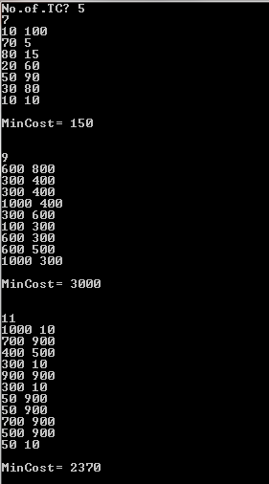
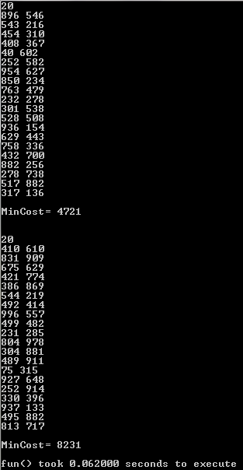
TollGate – Output

Slide 11
TollGate – cpp
#include <iostream>
int N, cc[25], t[25], min_cost = 10000007;
void dfs(int p, int a, int b, int c, int cost)
{
int asum = a+b+c;
if (cost > min_cost) return;
if (p == N-1)
{
if (asum < t[p]) cost += cc[p];
if (cost < min_cost) min_cost = cost;
return;
}
dfs(p+1, a, b, c, cost+cc[p]);
dfs(p+1, a+t[p], b, c, cost+2*cc[p]);
if (asum >= t[p])
{
if (t[p] > b+c) a = asum-t[p];
if (t[p] > c) b = t[p]-c>=b ? 0 : b-t[p]+c;
dfs(p+1, 0, a, b, cost);
}
}
int main()
{
std::cin >> N;
for (int i = 0; i < N; ++i)
std::cin >> t[i] >> cc[i];
dfs(0, 0, 0, 0, 0);
std::cout << min_cost << std::endl;
return 0;
}

Slide 12
Thank You

Slide 13
NEXT SESSION
Next Session
Shortest Path Algo – Dijkstra’s & Bellman Ford & Floyds Warshall
VIDEO:
Shortest Path (3 Algo - Dijstras, Bellman Ford, Floyds Warshall) http://stackoverflow.com/questions/11704643/am-i-right-about-the-differences-between-floyd-warshall-dijkstras-and-bellman

