Slide 1
#Stand_for_Wildlife
Presented by
Team: Hack O’ Holics

Slide 2
Motivation
Summers are harsh for both human and animals
Drought and Forest Fires are major issues in summers
This is the main cause of Global Warming and Pollution
Animals are getting endangered / becoming extinct
Government spend a lot of money to resolve this and revive the beauty of nature

Slide 3
Objective
Monitoring the forest ecosystem / zoo / wildlife sanctuary using IoT Sensors
Predicting the upcoming drought / forest fires using Machine learning

Slide 4
Proposed Solution
Collect data of forest with the help of sensors
Air Quality
Soil Dryness
Temperature
Animal Movement
Flame Detection
Smoke Detection
In case of drought-like condition, sprinklers are automatically switched on

Slide 5
IoT along with Machine Learning
Determine present scenario
Predict future environmental conditions that cause disastrous situations
Forest Fire
Drought
Classification algorithm for supervised data

Slide 6
Dashboard
Monitor the conditions on the basis of Temperature, Moisture, Motion, Fire on an hourly basis
Graphs generated
Map which shows the coordinated of disaster prone areas
Shows the predictive value of Drought or Forest fire and send an alert to authorities

Slide 7
Notifications
In case of Uneasy Activities in Forest, immediate alert system provided
SMS / Call - Twillio
E-Mail – Gmail
Notify government authority, zoo-keepers, care-takers, etc in case of mis-happenings
Fire alert with location information

Slide 8
Competitors in Market
No such solution in India, have implementation in Japan, Russia, Austraila, etc
Government initiatives by Indian Forest Fire Response and Assessment System (IFFRAS)
Limited to only one geographical area

Slide 9
Why our solution is better?
Our system can be used to monitor the wildlife
On a large scale (over district / state / country)
Cost efficient (within INR 1000)
Low maintenance
Portable
Can be used by anyone
(general public can use to predict weather conditions)

Slide 10
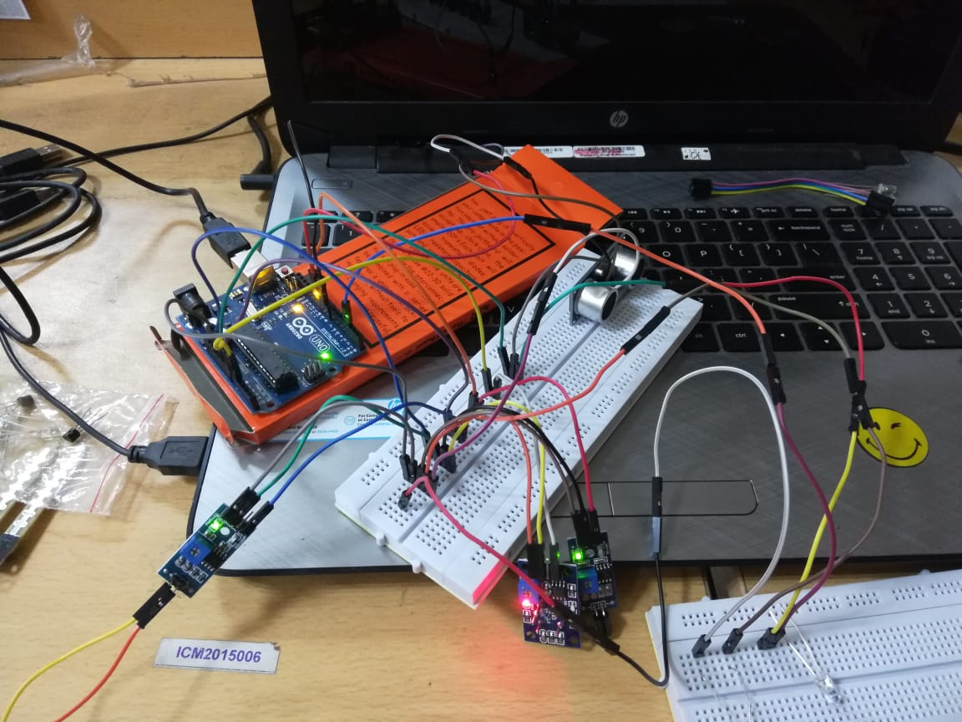

Slide 11
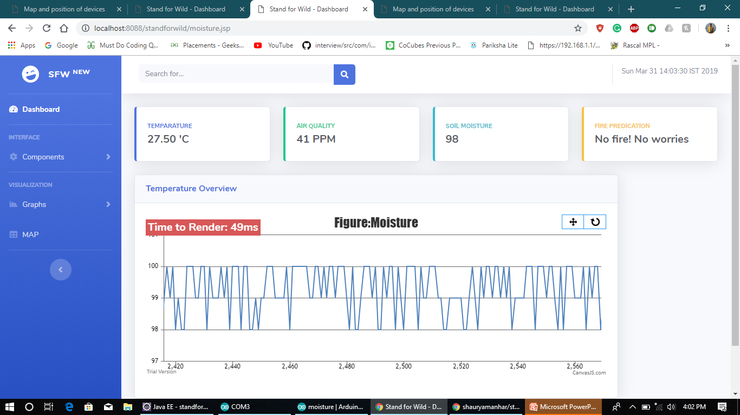

Slide 12
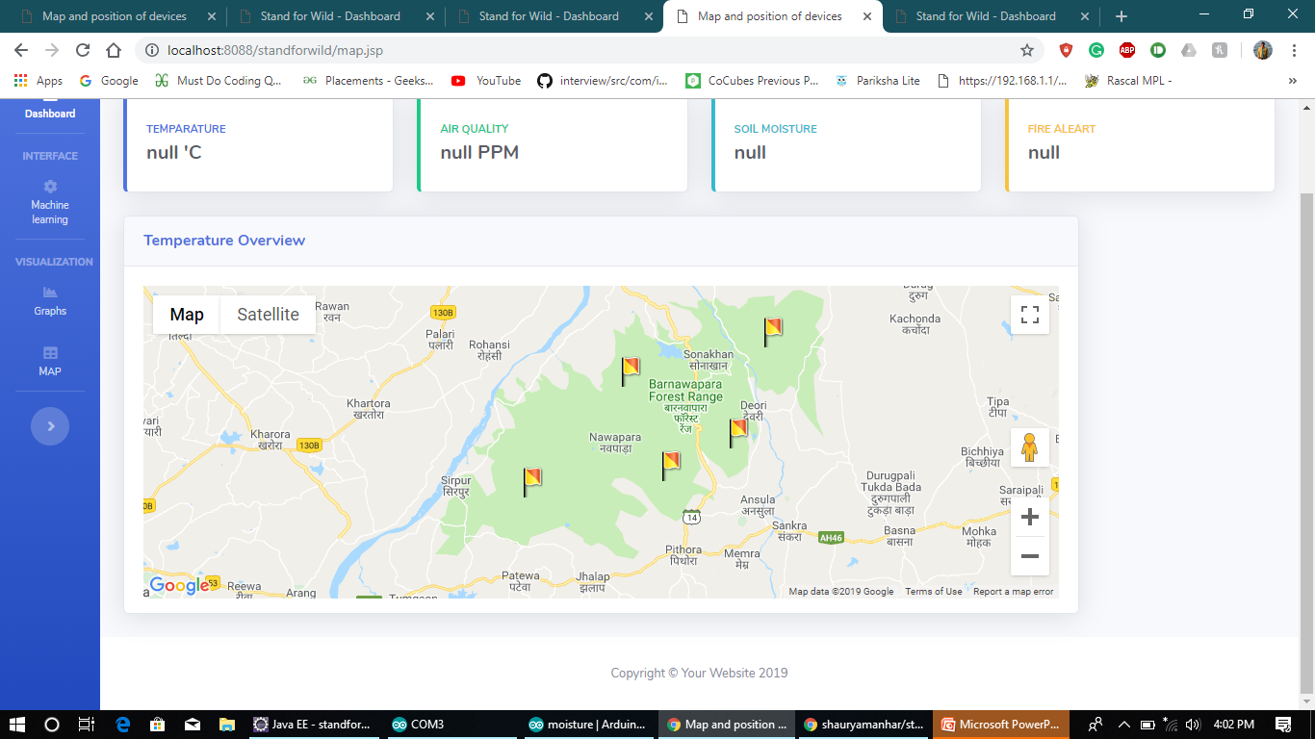

Slide 13
Future Work
Training ML model with more devices and collect data from different time of years
Detecting types of harmful gases
Weather proof enclosed box
Deployment of more number of such units in various parts of forest
Integrating with satellite

Slide 14
THANKYOU

