Slide 1
Neuro-Symbolic Reasoning over Patient-Specific Knowledge Graphs for Breast Cancer Progression Prediction
Shaurya Pratap Singh (20233262) Surya Pratap Singh (20233283)
Vishesh Vigh (20233583) Sehar Majid Abdi (20233561)
Supervisor: Dr. Shashwati Banerjea
Department of Computer Science and Engineering, MNNIT Allahabad
Notes:
Good morning, respected panel members. We are presenting our BTech project on neuro-symbolic reasoning for breast cancer progression, carried out under the supervision of Dr. Shashwati Banerjea. Four of us will each take one part. The full mathematics is in our report, so today we will focus on the ideas and the results.

Slide 2




What we will cover
Part 1
Part 2
Part 3
Part 4
The problem, the data, and the graphs
Neural models and what we ruled out
Symbolic reasoning and our novelty
From model to patient
The clinical question, the data, and how each patient becomes a graph
Graph neural networks, what we dropped, and why accuracy saturates
Learned logic in place of IF-THEN rules, and our novelty
The final model, explanations, patient reports, and a live demo
Sehar Majid Abdi
Surya Pratap Singh
Shaurya Pratap Singh
Vishesh Vigh
Notes:
Here is the plan. I will set up the clinical problem and the data. Surya will cover the neural models and what we ruled out. Shaurya will explain the logic reasoning, which is where our novelty lies. Vishesh will bring it together, show the patient reports, and run the live demo.

Slide 3



The question: will it progress, and when?
Our system must
Common
About 2.3 million new breast cancer cases in 2020
1
Estimate the risk of progression
2
Estimate the month it may happen
Unpredictable
Some never relapse, some progress in months, some after a decade
3
Explain why, in checkable steps
4
Write a clinical report for each patient
Needs reasons
Doctors can only act on a prediction they can check
Two firm rules: no outcome data in the inputs, and no patient is predicted by a model that saw them.
Notes:
Breast cancer is the most commonly diagnosed cancer worldwide, and its course after treatment is hard to predict. Doctors want to know whether it will progress and when, and a score alone is not enough: they need reasons they can check. So our system has four jobs: estimate risk, estimate the month, explain why, and write a report. We held two rules throughout. No outcome data enters the inputs, and no patient is ever predicted by a model that saw them.

Slide 4



What a tumour record tells a clinician
Stage: how far it has spread
Subtype: how it behaves
Alterations: what changed in the DNA
T: size of the tumour
N: spread to lymph nodes
M: spread to distant organs
Stage I to IV sums these up
Luminal A: slower growing
Luminal B: faster growing
HER2-enriched: too much ERBB2
Basal-like: aggressive
Mutation: a small change
Amplification: extra gene copies
Deletion: lost gene copies
Notes:
A quick piece of background. Stage tells us how far the cancer has spread, using the T, N, and M codes. Subtype tells us how the tumour tends to behave. Alterations tell us what changed in the tumour's DNA. Our patient graphs are built from these three kinds of information.

Slide 5
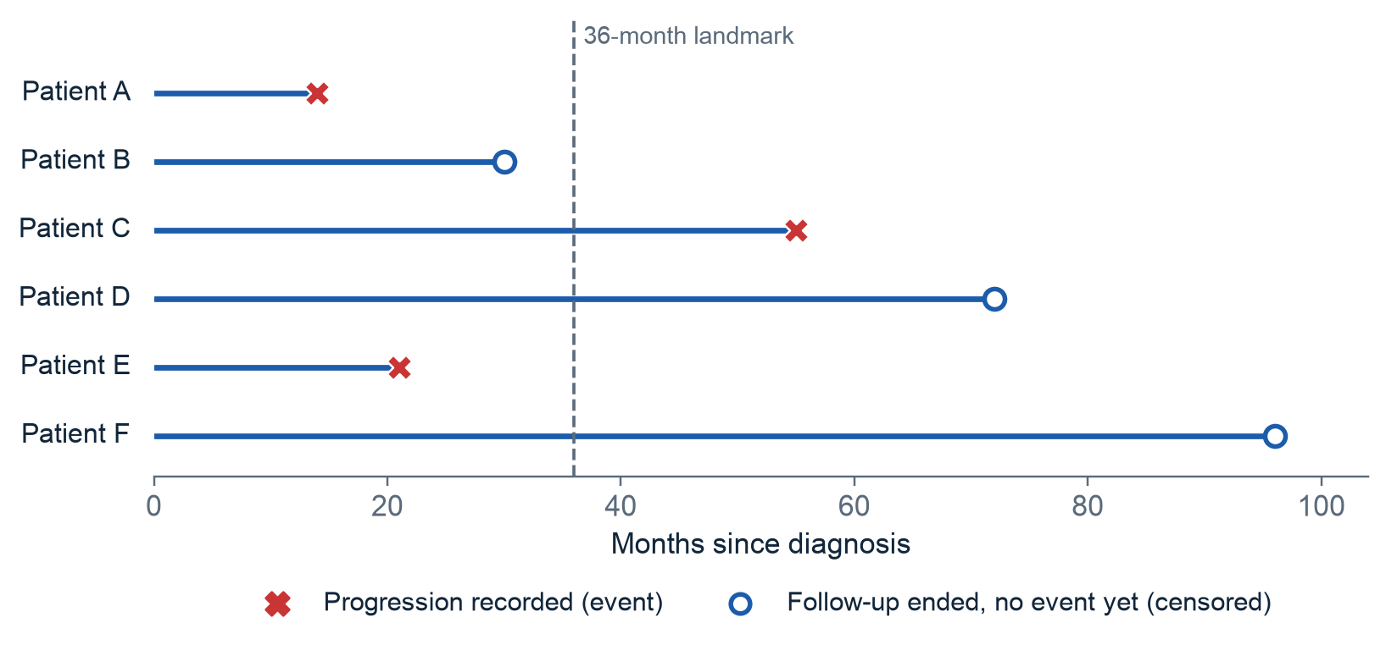
The hard part: most patients have no final answer
145
patients progressed
938
left follow-up with no event
This is called censoring. No event yet does not mean cured.
Notes:
This idea drives most of our design decisions. 145 patients have a recorded progression. The other 938 simply left follow-up with nothing recorded. Patient B here left at month 30, and we do not know what happened next. This is called censoring. It is like checking who has finished a book after one week: still reading does not mean never finishing.

Slide 6
Data: real patients and a public knowledge graph
1,083
145
500
breast cancer patients from TCGA
recorded progressions
genes in our panel, including 27 known drivers
8.1M
4,570
3
connections in PrimeKG
PrimeKG connections kept for our genes
kinds of patient data: clinical, mutation, copy number
Notes:
Our patient data is the public TCGA breast cancer study. We use clinical records, mutations, and copy-number changes. To keep graphs manageable we use a panel of 500 genes, including 27 known drivers. PrimeKG is a public map of biomedical knowledge linking genes to pathways, drugs, and diseases. We keep the 4,570 connections that touch our genes.

Slide 7
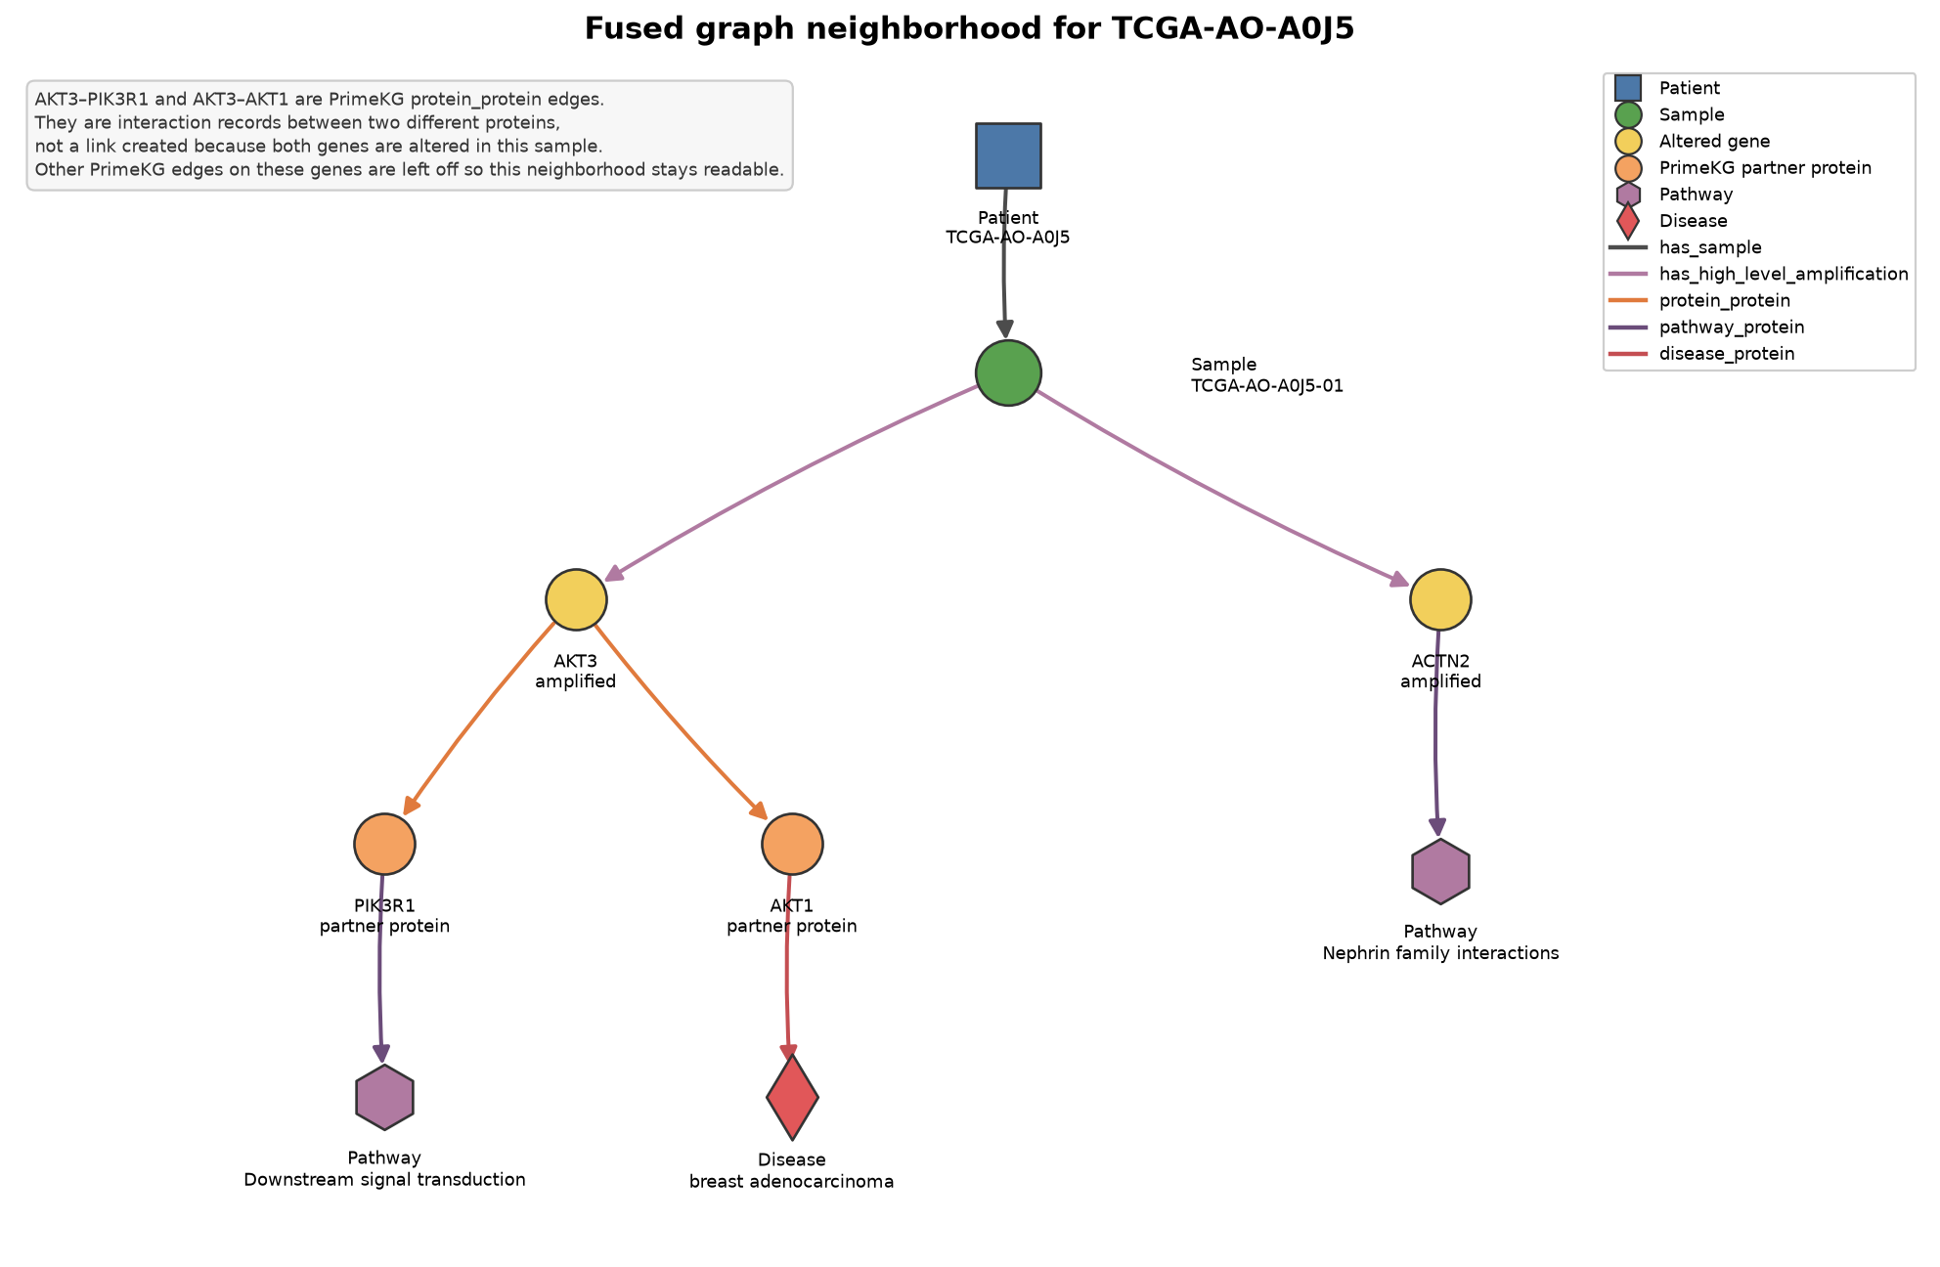
Each patient becomes a knowledge graph
How it is built
Patient connects to the tumour sample
Sample connects to the altered genes
Genes connect to PrimeKG pathways, drugs, and diseases
Why it helps: two patients with different genes can meet at the same pathway.
Notes:
Each patient becomes a small graph: the patient connects to the tumour sample, which connects to the altered genes. We then connect those genes to PrimeKG pathways, drugs, and breast diseases. The benefit is simple: two patients with different genes can meet at the same pathway, which a plain gene list can never show. That completes the data side. Surya will now take you through the neural models.

Slide 8
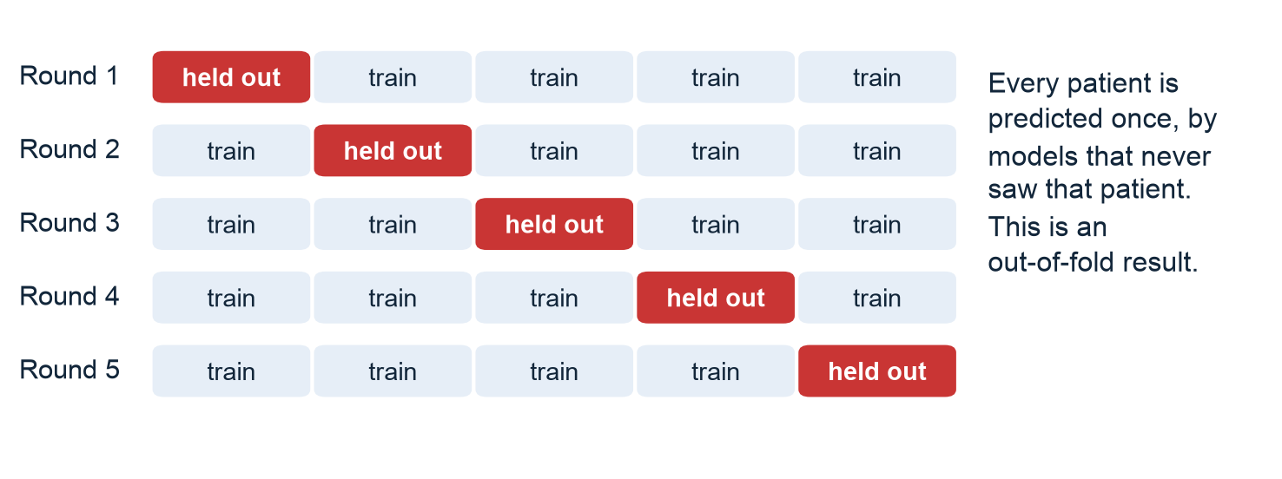
How we measured everything honestly
Main score: C-index
Take two patients where we know who progressed first. Did the model give that patient the higher risk?
0.5
1.0
Every patient is predicted by models that never saw them.
A tested guard blocks outcome columns from every input.
coin flip
perfect
Notes:
Thank you, Sehar. I will start with how we measured everything. We split patients into five groups, train on four, and test on the fifth, so every patient is predicted by models that never saw them. Our main score is the C-index. Take two patients where we know who progressed first, and ask whether the model gave that patient the higher risk. 0.5 is a coin flip and 1.0 is perfect.

Slide 9
The first label failed, so we built a better one
First try
0.54
AUROC, close to chance, because censored patients were counted as negatives
Better question
Did the patient progress within 36 months?
36 months balances enough events against too few patients.
Notes:
Our first try counted censored patients as negatives, and the model was close to chance. So we asked a cleaner question: did the patient progress within 36 months? We tested several horizons. Short ones have too few events, and long ones lose too many patients. 48 months looks slightly higher, but that gap is within noise, so 36 months is the balanced choice. Later, survival models use all 1,083 patients.

Slide 10
No graph model beat the clinical baseline
What a GNN does
Each node learns from its neighbours. After three layers, pathway information reaches the patient.
What we found
Seven GNNs came close, but none beat age, stage, and subtype. Gaps are smaller than the noise.
Notes:
A graph neural network lets each node learn from its neighbours, so after three layers pathway information reaches the patient. We tested seven architectures. The clinical baseline, which uses only age, sex, subtype, and stage, stayed at the top. RGAT and GCN came close, but the gaps are smaller than the variation between folds. Training on survival-focused losses did not change that.

Slide 11
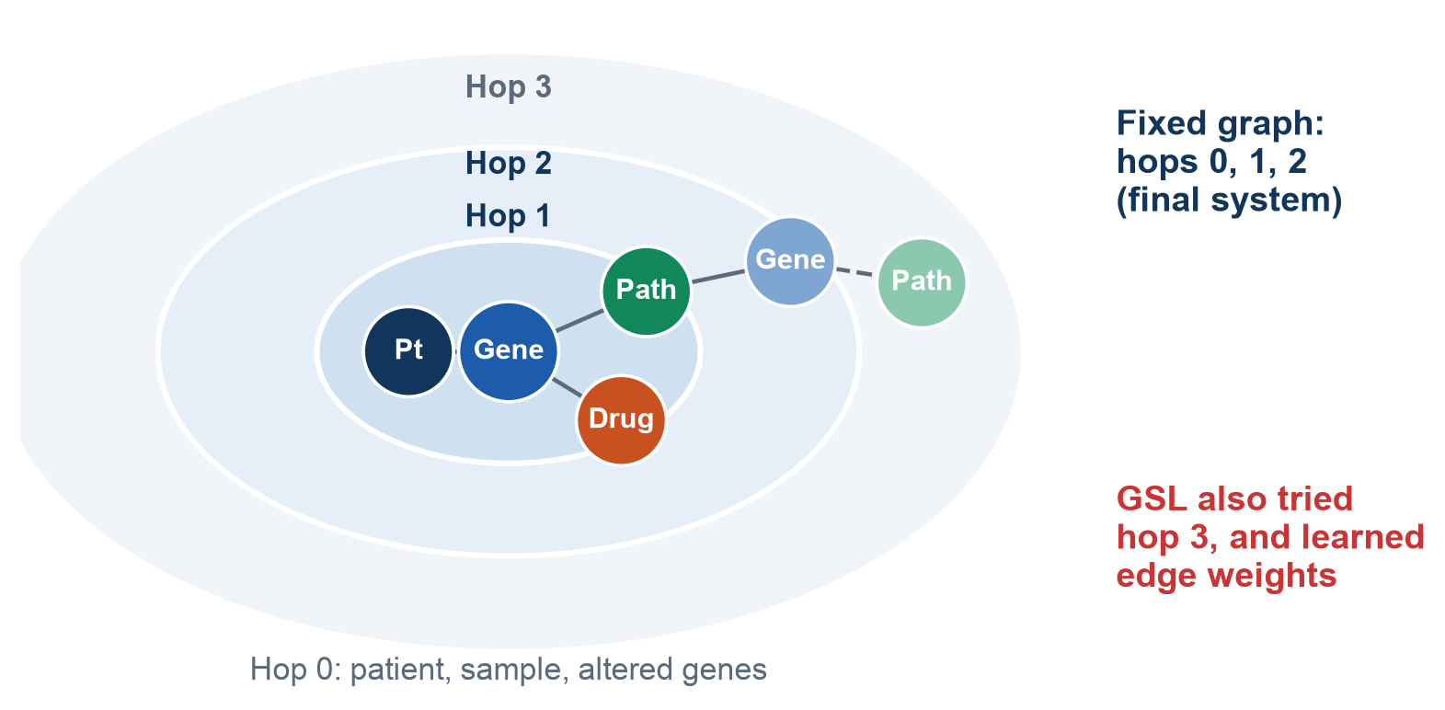
Why we did not use graph structure learning
We tried it twice
First version switched off useful connections, and GCN got worse
Second version recovered, but stayed within noise
Why we left it out
No reliable gain
Reports should show real, stored connections
Only 3 of our 7 models can use it
GSL lets the model learn which graph connections to keep.
Notes:
A natural question is why we did not use graph structure learning. It lets the model learn which connections matter for each patient. We tried it twice. The first version switched off useful connections, and GCN got worse. The second version recovered, but its gain stayed within noise. We left it out because there was no reliable gain, our explanations should show real stored connections, and only three of our seven models can use it. The numbers are in the report.

Slide 12
Other ideas we tested and set aside
Idea | What happened | Decision
RGAT on all patients | Too slow on a laptop | Dropped
Deeper or shallower graphs | Almost no change | Kept 2 hops
SMOTE oversampling | GNNs near chance | Dropped
External GSE2034 graphs | Linear model still won | Same lesson
Random survival forest | Lowest score of all | Baseline only
Notes:
Here are other ideas we tested. RGAT was too slow for all patients on our hardware. Changing graph depth barely mattered. Oversampling did not help. On an external cohort, a linear model again beat the graph models. The random survival forest was the weakest of all, because 145 events is too few for it. The report has the numbers.

Slide 13
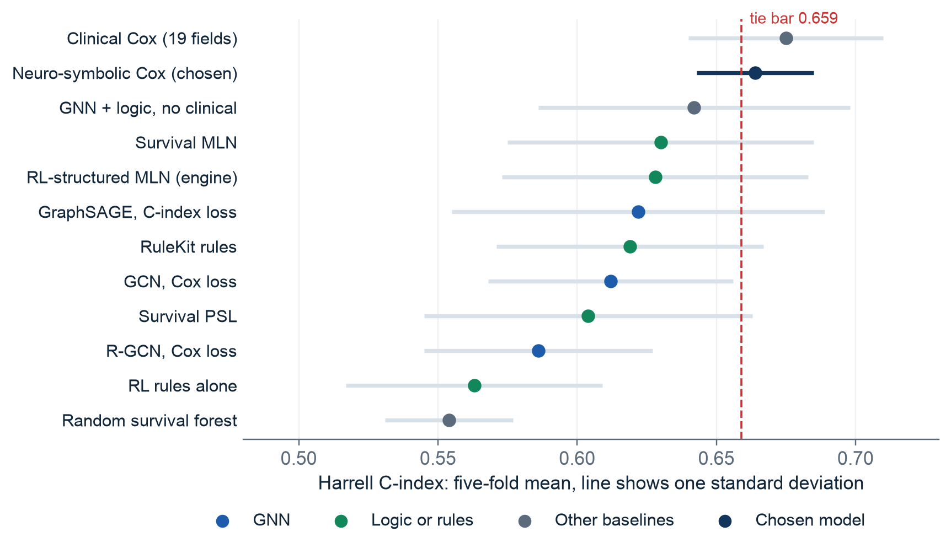
Every model family stops near 0.67
So we changed the goal
With 145 events, clinical facts carry most of the signal.
More model power did not help, so explanation became the goal.
Notes:
This is our main finding. GNNs, logic, forests, and Cox models all finish in the same range, and the lines overlap. With only 145 events, clinical facts carry most of the signal. We accepted that instead of chasing noise. Following our supervisor's direction, the question changed from how to raise the score to how to explain it. Shaurya will explain how.

Slide 14
IF-THEN rules were readable, but limited
Example rule from RuleKit, our baseline
IF nodal stage is N3 AND aneuploidy is below 26.5 THEN higher risk
8
10%
0
Our supervisor's direction
rules per fold
used the knowledge graph
weights: a rule is on or off
Try Markov logic, soft logic, and reinforcement learning.
We built a knowledge graph, but the rules hardly used it.
Notes:
Thank you, Surya. Our first logic layer used RuleKit, which gives readable rules like this one. But it kept only about eight rules, they had no weights, and just 10 percent used the knowledge graph. Our supervisor suggested three directions: Markov logic, soft logic, and reinforcement learning. We built all three.

Slide 15
Idea 1: Markov logic gives every rule a weight
An ordinary rule
A Markov logic formula
Fires or does not fire. Like a voter who can only say yes or no.
Has a learned weight. Like a voter with a volume knob, and many can speak at once.
Our change
422
We learn the weights from survival times, so a patient who has not relapsed yet is never treated as cured. Useless formulas drop to zero.
facts about each patient, 80% from PrimeKG
Notes:
The first idea is Markov logic. An ordinary rule is like a voter who can only say yes or no. A Markov logic formula has a learned weight, like a volume knob, and many can speak at once. Our change is how the weights are learned. A standard version would treat a patient who has not relapsed yet as cured. We learn from survival times instead, and useless formulas drop to zero. All reasoners read the same 422 facts about each patient. The equations are in the report.

Slide 16
Idea 2: soft logic lets similar patients share risk
Soft truth
Reasoning across patients
Facts can be partly true, anywhere from 0 to 1, instead of only true or false.
If a similar patient is high risk, this patient may be too.
≈ 0.01
A real finding: in this cohort, similar patients add nothing beyond a patient's own facts.
weight learned for the similar-patient rule
Notes:
The second idea is soft logic. Facts can be partly true, and one rule lets similar patients share risk. We expected this to help, but the model gave that rule a weight of about 0.01 in every fold. So in this cohort, similar patients add nothing beyond a patient's own facts. That is a finding, and we report it as one.

Slide 17
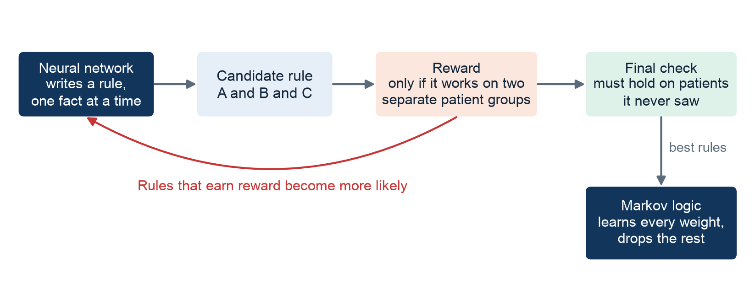
Idea 3: reinforcement learning writes the rules
A rule is rewarded only if it holds on two separate groups of patients.
Alone it overfits: over 20,000 rules tried per fold, so some look good by luck.
Notes:
The third idea is a small neural network that writes rules one fact at a time. It is rewarded only if a rule works on two separate groups of patients, and the rule must then pass patients it never saw. Even so, alone it overfits: it tries over 20,000 rules per fold, so some look good by luck. It searches well but judges badly. That led us to combine it with Markov logic.

Slide 18

Our engine: RL proposes, Markov logic decides
RL searches
It finds multi-step knowledge-graph rules that simple search cannot reach.
Markov logic judges
Good rules earn weight. Bad ones get zero, so RL's weakness stops mattering.
Notes:
So we combined them, and this is the core of our novelty. RL searches for candidate rules, including multi-step knowledge-graph rules. Markov logic then judges them with survival data. Good rules earn weight, and bad ones get zero. Across the five folds the engine kept 176 formulas, and 44 of them came from RL.

Slide 19
Accuracy is a tie; the reasoning is not
The top three are statistically tied, so we chose the one with the richest reasoning.
Notes:
Here is the honest comparison. On the left, the top three are within noise, so we do not claim better accuracy. On the right is the real difference: 69 percent of our formulas use the knowledge graph, against 10 percent for RuleKit. RL alone is higher, but it is not tied on accuracy. So among the tied reasoners we chose the richest one.

Slide 20
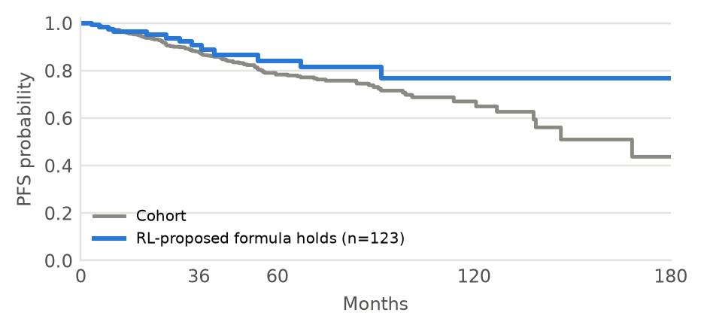
What the system learned, in plain words
-0.30
No lymph-node spread
lowers risk
408 patients
+0.15
N3 nodes, and an altered gene linked to ductal carcinoma
raises risk
43 patients
-0.14
Altered genes in both the VEGFA-VEGFR2 and ion homeostasis pathways, found by RL
Patients who match the RL rule, against all patients. These are associations, not causes.
lowers risk
93 patients
Notes:
Here are real learned formulas, in plain words. No lymph-node spread lowers risk, as doctors would expect. The second joins N3 stage with a knowledge-graph link and raises risk. The third was proposed by RL and joins two pathways, which RuleKit could not express this way. On the right is the survival curve for patients who match it. These are associations, not causes.

Slide 21




Our novelty
Weighted logic
Survival-aware logic
RL finds the rules
About 35 weighted formulas instead of 8 on/off rules
Weights learned from survival times, so censoring is respected
With a reward that guards against lucky rules
Knowledge-graph reasoning
Rules inside explanations
An honest comparison
69% of formulas use PrimeKG, against 10%
Every path combines neural and logic evidence
All three methods tested, failures included
Notes:
To sum up the novelty. Weighted formulas replaced on-off rules. The logic learns from survival times, so censoring is respected. Reinforcement learning finds the rules, with a reward that guards against luck. Most formulas reason over the knowledge graph, and they now feed every explanation. And we tested all three methods fairly, including the ones that did not work. Vishesh will now show how this reaches the patient.

Slide 22
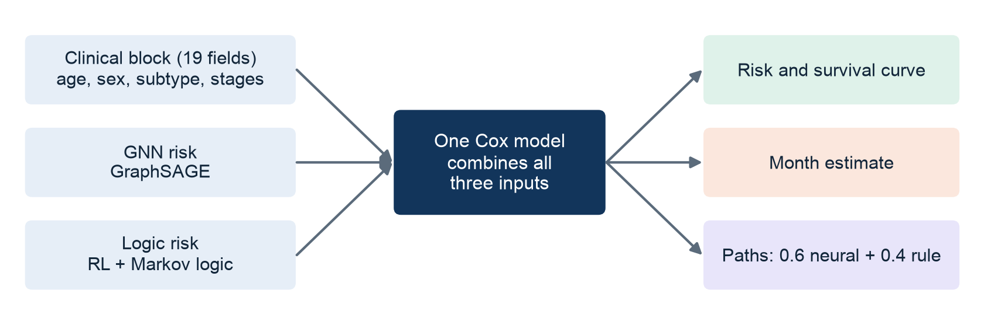
The final model is tied with clinical Cox and can explain itself
0.664
0.675
The gap is smaller than the noise, so they are tied. GNN and logic add explanation, not accuracy.
our model
best clinical model
Notes:
Thank you, Shaurya. The final prediction comes from one Cox model with three inputs: clinical data, the GNN risk, and the logic risk. It reaches 0.664, against 0.675 for the best clinical model. That gap is smaller than the noise, so the two are statistically tied. The GNN and logic add explanation, not accuracy, and we say so openly. We pay nothing measurable, and we gain reasons.

Slide 23
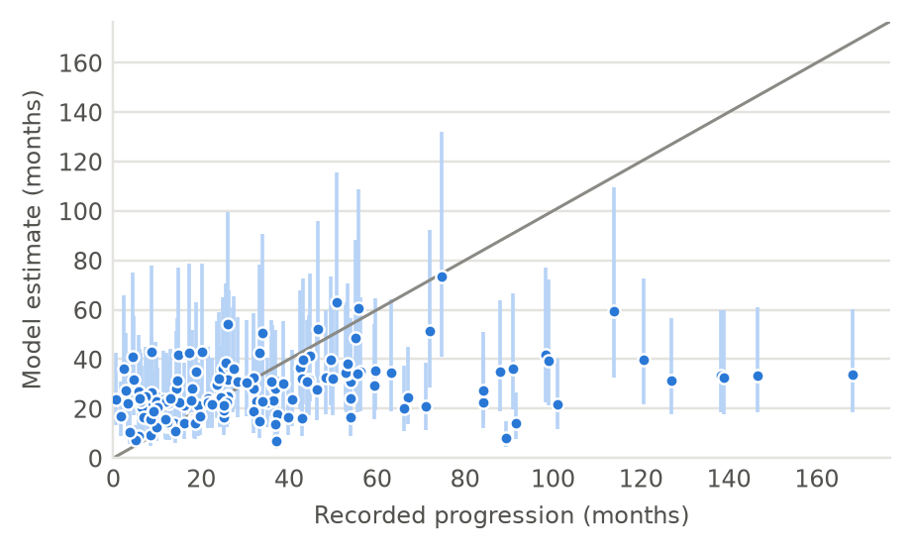
Estimating the month of progression
48%
33%
within 12 months of the true month (a constant guess gets 37%)
in the right time window (a constant guess gets 19%)
Most patients never progress, so we estimate time only for those who do
Learned from past progressors only
Coarse for very early or very late cases, so reports always show the true month beside it
Notes:
Next, the month of progression. Most patients never progress, so we estimate the month only for those who do, using a time-to-event model learned from past progressors. It lands within 12 months for 48 percent of progressors, against 37 percent for a constant guess. It is coarse, so reports always print the true month beside it.

Slide 24
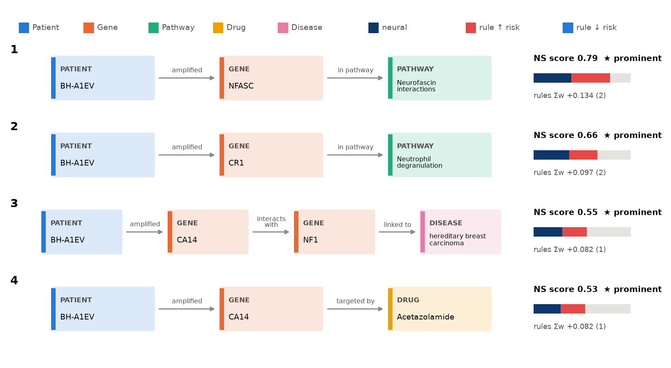
Each path shows why, using two kinds of evidence
Path score = 0.6 × neural + 0.4 × rule
Neural: how much the GNN relied on this path
Rule: learned formulas that hold for this patient and involve this path
Reports show the strongest 3 to 5 paths
Notes:
Each path is a real walk in the patient's graph, from an altered gene to a pathway, drug, or disease. Its score combines two things: how much the GNN relied on the path, and the learned formulas that hold for this patient and involve the path. The 0.6 and 0.4 follow our supervisor's design. Paths show what the model relied on, and they are not causal claims.

Slide 25
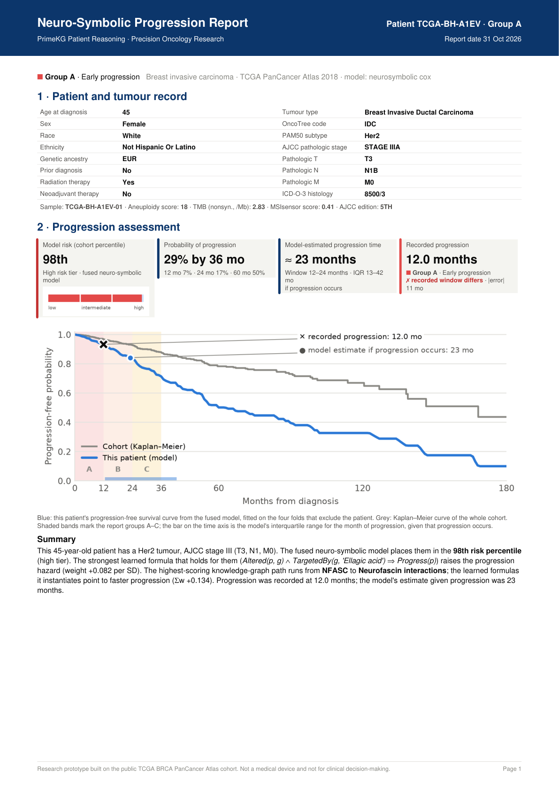
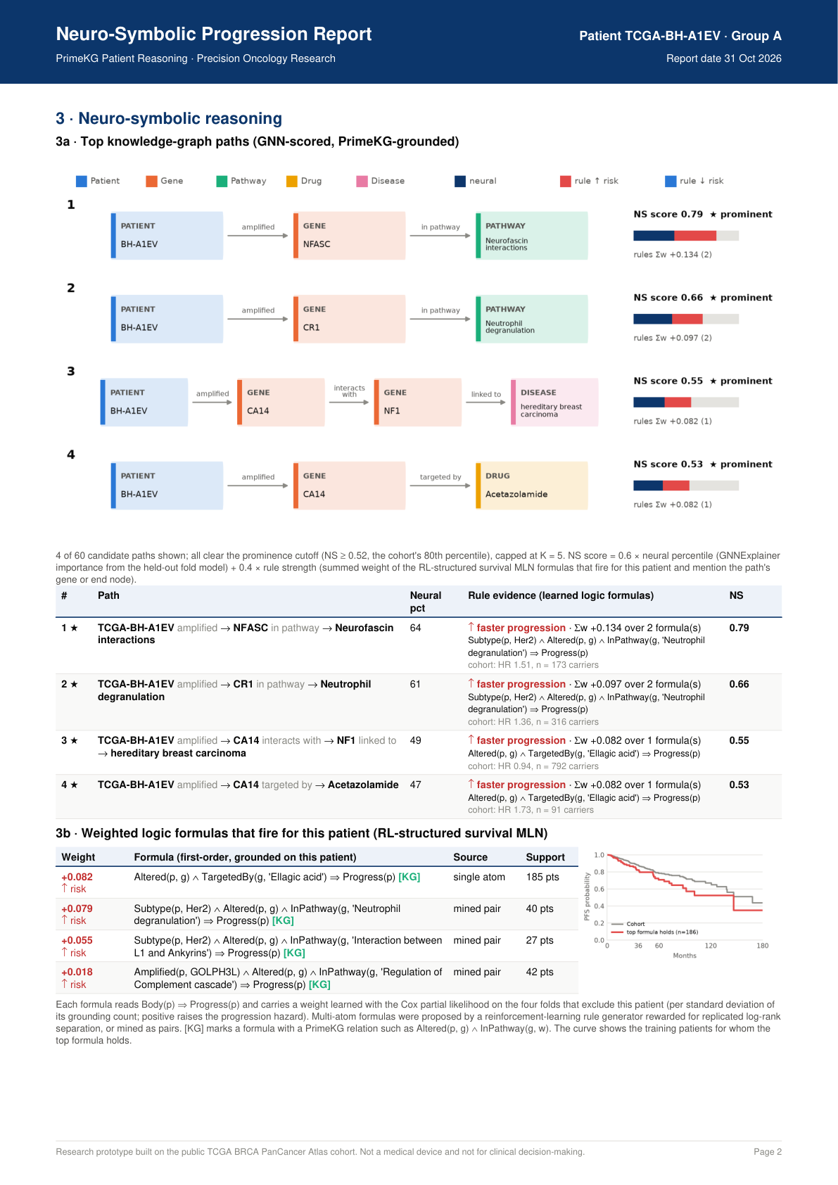
A report for every patient, grouped by progression time
Group | Recorded | Patients
A | up to 12 months | 32
B | 12 to 24 months | 30
C | 24 to 36 months | 27
D | over 36 months | 56
N | no progression | 938
1,083 PDF reports: record, risk, month, survival curve, paths, and formulas.
Notes:
The system writes a two to three page PDF for all 1,083 patients, grouped by when they progressed. The first page gives the record, risk, month estimate, and survival curve. The second gives the paths and the formulas that fire. Reports for patients with no recorded progression state that this is not proof of remission, and drug links are marked as research context, not treatment advice.

Slide 26
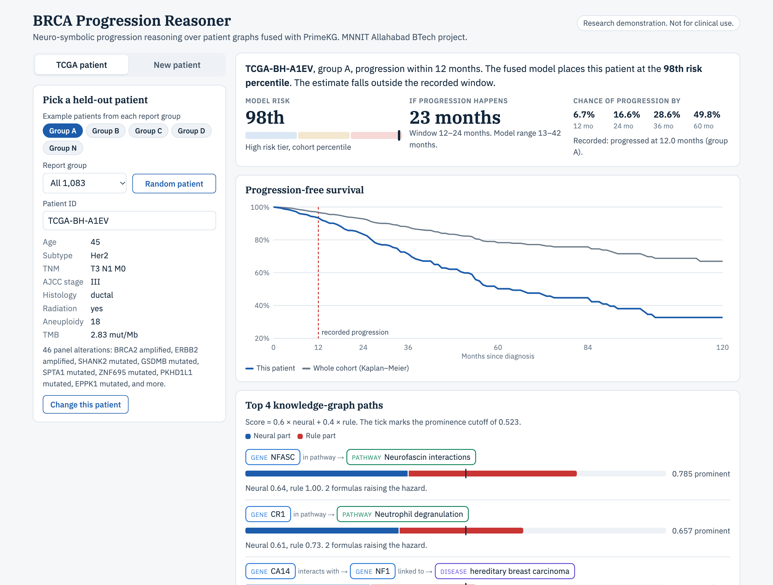
Live demo: the model running in the browser
Two ways in
Pick any of the 1,083 real patients
Or start from a synthetic example and change a few fields
Checked
It matches the pipeline's risk for all 1,083 patients.
Open the demo
Notes:
Now the demo. Open the link, or demo/index.html if the internet is unavailable. Step one: show TCGA-BH-A1EV, at the 98th percentile, and point out that its 23-month estimate misses the recorded window, which shows we do not hide errors. Step two: read one path and one formula. Step three: press Change this patient, set N stage to N0, and watch the result update. Step four: open New patient and select the Basal-like example. For new patients the GNN term is held at its average, because a GNN cannot run in the browser.

Slide 27
Limitations we state openly
Accuracy ceiling
Coarse timing
Scores stop near 0.67 with only 145 events.
Within a year for about half of progressors.
Reasoning, not accuracy
Not causal
Logic explains more, but does not score higher.
Paths show what the model used, not proven biology.
Not treatment advice
One cohort
Drug links are research context only.
No external validation of the reports yet.
Notes:
We want to be direct about the limits. Accuracy stops near 0.67. Timing is coarse. The logic adds reasoning, not accuracy. Paths are not causal, and drug links are not treatment advice. We used one cohort, and the reports have not been validated externally. This is a research prototype.

Slide 28
Conclusion and future work
What we delivered
Future work
Let RL walk knowledge-graph paths directly
Add gene expression data
Validate on another cohort such as METABRIC
Ask oncologists to rate the reports
A leakage-checked pipeline from raw data to patient knowledge graphs
A survival-aware logic engine with RL-proposed formulas
A model tied with the best clinical model, and able to explain itself
1,083 explained reports and a live demo
Notes:
To conclude: we built a complete pipeline, and turned a saturated prediction problem into an explained one. On this cohort, knowledge-graph reasoning adds explanation rather than accuracy, and the system is designed around that finding. Next, we would let RL walk the knowledge graph directly, add more data, validate on another cohort, and ask oncologists to assess the reports.

Slide 29
Thank you
We welcome your questions.
Shaurya Pratap Singh, Surya Pratap Singh, Vishesh Vigh, Sehar Majid Abdi
Supervisor: Dr. Shashwati Banerjea
Notes:
Thank you. We welcome your questions. Any of us can take them. The derivations are in our report, and a backup slide has all the model scores.

Slide 30
Backup: all models
Model | C-index | Model | C-index
Clinical Cox (19 fields) | 0.675 ± 0.035 | GraphSAGE, C-index loss | 0.622 ± 0.067
Clinical Cox (extended) | 0.667 ± 0.042 | RuleKit rules | 0.619 ± 0.048
Neuro-symbolic Cox | 0.664 ± 0.021 | GCN, Cox loss | 0.612 ± 0.044
Neuro-symbolic Cox (ext.) | 0.662 ± 0.042 | Survival PSL | 0.604 ± 0.059
GNN + logic, no clinical | 0.642 ± 0.056 | GraphSAGE, Cox loss | 0.603 ± 0.062
Survival MLN | 0.630 ± 0.055 | R-GCN, Cox loss | 0.586 ± 0.041
RL-structured MLN | 0.628 ± 0.055 | RL rules | 0.563 ± 0.046
 |  | Random survival forest | 0.554 ± 0.023
Notes:
Backup slide for exact numbers. All values are five-fold means on the same patients.

