Slide 1
MARKETPULSE
AI-Powered Market Sentiment & Financial-Literacy Platform
Indian markets (NSE/BSE) with global context — one dashboard that turns scattered market signals into a clear, explained Bullish / Bearish / Uncertain view.
AI for Finance
PRISM-instrumented
Decision support, not advice
Round 1 · Pitch Deck
Notes:
Open with the hook: over 1.9 crore new demat accounts since 2020 — mostly beginners deciding on tips. The data they need already exists; the understanding doesn't. MarketPulse brings the signals together, explains them in plain language, and — unlike any generic chatbot — is instrumented with PRISM so every AI explanation is monitored, evaluated and improved.

Slide 2
SLIDE 1
Problem Statement
What real-world problem are we trying to solve?
• Beginners decide on incomplete info, social-media tips & emotional reactions to news
Investors tend to invest on their raw emotions and gut feelings, even operate and work on wrong data and indicators
The data and info and too much spread across the internet and its very hard and time consuming for a regular trader to check and read all information and arrive to a final conclusion.
• Key signals — volume, volatility, global trends, news — are public but scattered across platforms
• Without financial knowledge or time, these signals cannot be interpreted together
• Result: panic buying, tip-chasing and avoidable losses.
• New risk: generic AI chatbots hallucinate numbers and cannot be verified
Still 90% investors in Indian market are losing making, we then to improve their decision making, and make sure they become more literate towards stock market investing.
Volume
Volatility (VIX)
?
Global trends
News flow
Bullish or Bearish?
MarketPulse · AI for Finance · Decision support — not investment advice
1
Notes:
Frame the gap: the data exists, the understanding doesn't. Add the 2026 twist: beginners now also ask generic AI chatbots, which sound confident but hallucinate numbers and give no way to verify. Two problems: scattered signals, and untrustworthy AI explanations.

Slide 3
SLIDE 2
Existing Challenges
What are the limitations, risks, or gaps in current solutions?
• Scattered tools: broker apps, screeners and news feeds each show one slice — numbers without meaning
• Tip culture: unverified, herd-driven, zero accountability
• Generic LLMs: no live market data, no evidence, and they blur education with advice
• Black-box scores: sentiment numbers with no visible reasoning
• No closed loop anywhere: nobody checks whether AI explanations were actually correct — no monitoring, no failure detection, no validated improvement
Maximum current operating solution software that are available online, don’t show their logic and they are basically build on one for few indexes that only works for momentum trading, what we offer here is a wide range of indicators and even live news sentiments around the world in one go , that will eventually improve the decision making.
✗ Broker apps
one broker's view only
✗ Tip culture
unverified forwards
✗ Generic LLMs
stale, unverifiable
✗ Black-box scores
no reasoning shown
No system monitors the AI itself.
MarketPulse · AI for Finance · Decision support — not investment advice
2
Notes:
Land the last bullet hard — it sets up PRISM as the differentiator: every current solution, including AI ones, ships without a monitoring and evaluation loop.

Slide 4
SLIDE 3
Proposed Solution
What solution are we proposing and how does it solve the problem?
• MarketPulse: AI decision-support dashboard for Indian markets (NSE/BSE) with global-market context
• 20+ validated indicators — 50/200-DMA trend, MACD, RSI, India VIX, market breadth, volume profile, 52-week structure, global cues (DXY, crude, gold, US yields), news sentiment — fused into one Bearish → Bullish score
• Zero black box: every signal explained in plain English with its “why”
• Grounded AI: the LLM may only explain computed signals — never invent data — behind an advice-safety guardrail
• Literacy layer: “What is this?” explainers on every card, glossary, beginner mode
What we do is pretty simple, we see all possible data and news regarding the stock and give a final suggestion about the stock’s future,
We will check many indicators and, even the news and market sentiment will be taken into the account.
We will even share and explain the logic behind our suggestion and will improve the decision making of the user
MarketPulse — today
+62
Optimistic
62
Trend
+ why: plain-English reason
Volatility
− why: plain-English reason
News
+ why: plain-English reason
Global cues
− why: plain-English reason
MarketPulse · AI for Finance · Decision support — not investment advice
3
Notes:
Emphasize transparency as the design principle: every number the AI says can be traced to a visible signal on screen. The score is computed by rules — the AI explains it, it doesn't invent it.

Slide 5
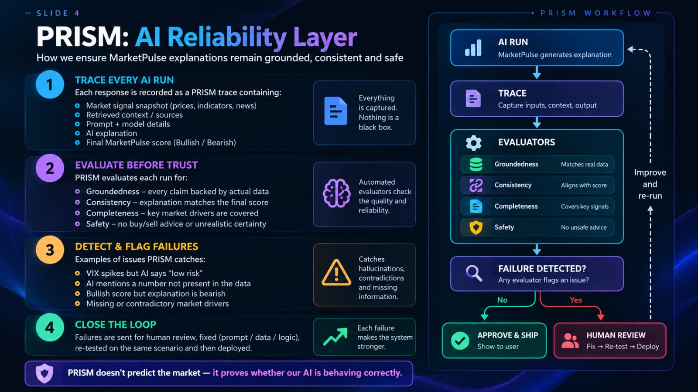
SLIDE 4
PRISM Usage
How PRISM is used to monitor, evaluate, detect failures, and improve the AI system
• Connect: every AI explanation run is streamed to PRISM via the PRISM SDK / OpenTelemetry — user goal, signal snapshot, prompt, output and final score captured as one session
• Monitor & Evaluate 100% of runs: custom evaluators — Groundedness (every number must match the signal payload) · Consistency (narrative zone = computed zone) · Advice-safety guardrail (zero buy/sell language) · Completeness (cites top drivers)
• Detect failures: PRISM clusters recurring failures (contradicts a VIX spike, hallucinated metric, stale cache), classifies root causes, flags low-confidence runs for human review
• Improve: failures → backlog → fix (prompt diff / lexicon update) → human approval gate → re-tested with the same scenarios → validated on the six-dimension scorecard
• Pre-launch: PRISM Synthetic Scenarios stress-test crash days, contradictory signals and missing data
PRISM Reliability Scorecard
illustrative monthly report
78
/100 (+6 MoM)
82
Task success & resolution
weight 25%
Correctness & groundedness
weight 20%
79
Guardrails & policy adherence
weight 20%
91
User friction & satisfaction
weight 15%
74
Stability & error-free execution
weight 10%
88
Improvement velocity
weight 10%
61
MarketPulse · AI for Finance · Decision support — not investment advice
4
Notes:
Key line (PRISM's own philosophy): 'A request can return 200 OK and still fail the user.' Our score means nothing unless an evaluator can verify it. Walk the loop: narrative said 'bullish momentum' while VIX jumped 15% → consistency evaluator failed it → root cause: prompt under-weighted volatility → prompt v2 → same scenario re-run → pass → reliability score +1.

Slide 6
SLIDE 5
System Workflow
Input → AI/RAG/Agent System → PRISM Monitoring & Evaluation → Failure Detection → Improvement
Live Inputs
indices · India VIX · volume
global cues · news - NSE/BSE-
AI System
Signal Engine
indicator engine → signal fusion
→ grounded narrative
20+indicators(Volume, Breath, VIX,
DMA, and more )
OUTPUT= Bullish and Bearish + signal reasons
PRISM Monitor
& Evaluate
traces · evaluators
guardrail events
Grounded-ness,
Safety
consistency
Failure Detection
clustering · root cause
low-confidence flags
Improvement
human-gated fix → re-test
→ validated delta
validated improvements (human-gated) feed back into the AI system — the loop closes
30-second example: narrative said “bullish momentum” while India VIX jumped 15% → PRISM consistency evaluator failed the run → root cause: prompt under-weighted volatility → prompt v2 → same scenario re-run → pass → reliability score +1.
MarketPulse · AI for Finance · Decision support — not investment advice
5
Notes:
One diagram, four boxes plus a feedback arrow — exactly the required workflow. Close the loop verbally with the concrete example at the bottom of the slide.

Slide 7
SLIDE 6
Impact & Future Scope
Key benefits, real-world impact, scalability, and future enhancements
• Impact: literate, informed first-time investors — decisions based on evidence, not tips or panic
• Trust: AI explanations that are auditable — every number traceable to a visible signal, guarded by advice-safety checks
• Measurable: PRISM reliability score and failure-to-fix velocity tracked monthly as an executive artifact
• Scale: 100% free data stack (Yahoo Finance, Google News, NSE) + serverless deployment → near-zero marginal cost per user
Biggest Impact : Better decisions
Beginners understand why the market signal is bullish/bearish instead of following random tips
People will invest better , learn quicker, and be efficient enough.
Future scope
US market coverage
Portfolio-level monitoring
Hindi & regional languages
Daily digest alerts
Voice mode
Bias evaluators
Mobile app
Paper-portfolio tracking
“We don't promise returns — we promise that every explanation we show can be proven correct.”
MarketPulse · AI for Finance · Decision support — not investment advice
6
Notes:
Close on the trust line: beginners don't fear markets because markets are risky — they fear them because nobody explains them. MarketPulse explains, and PRISM proves the explanations keep getting better.

