Slide 1
Polymorphism

Slide 2
Polymorphism
One name multiple forms
Concept of polymorphism is implemented using overloaded functions and operators.
The overloaded member functions are selected for invoking by matching the arguments, both type and number.
This information is known to the compiler at compile time.
Compiler is able to select the appropriate function at compile time hence called early binding or static binding or compile time polymorphism.

Slide 3
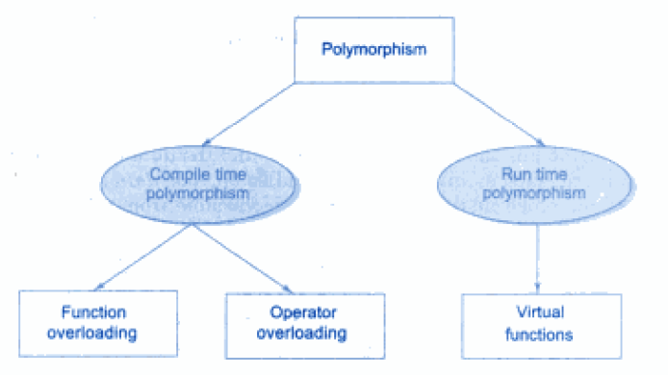
Polymorphism

Slide 4
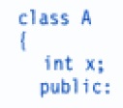
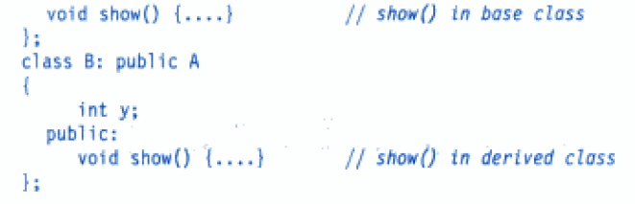
Example

Slide 5
Run Time Polymorphism
At run time, when it is known what classes objects are under consideration, the appropriate version of the function is invoked.
Since the function is linked with a particular class much after compilation, this is called late binding.
Also called as run time polymorphism.

Slide 6
Pointers To Objects
A pointer can point to an object created by a class.
Example
item x;
Where item is a class and x is an object defined to be of type item.
We can define a poiner it_ptr of type item as follows:
item *it_ptr;

Slide 7
Object Pointers
Object pointers are useful in creating objects at run time.
We can also use an object pointer to access the public members of an object.

Slide 8
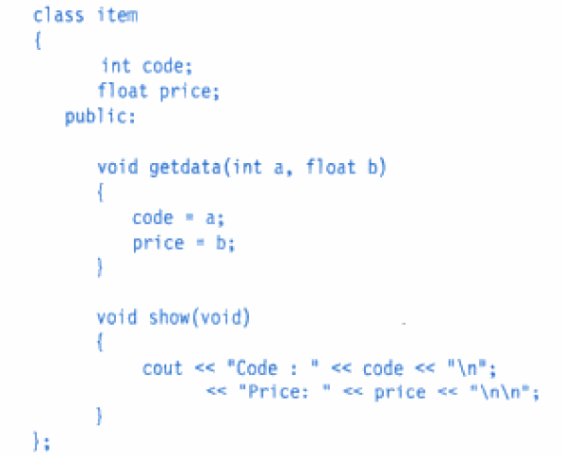
Example

Slide 9

Object Pointers
Declare an item variable x and a pointer to x as follows:
The pointer ptr is initialized with the address of x.

Slide 10
Accessing member functions
We can refer to member function of item in two ways, one by using dot operator and the object, and another by using the arrow operator and the object pointer.

Slide 11
Create objects using pointers and new operator

Slide 12
Program : Pointers to Objects

Slide 13
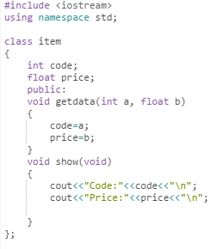
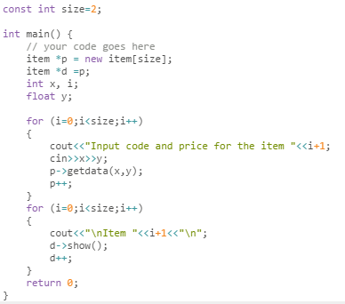

Slide 14
Output
Input code and price for the item 1: 40 500
Input code and price for the item 2: 60 600
Item 1
Code:40
Price:500
Item 2
Code:60
Price:600

Slide 15
Program : Array Of Pointers To Objects

Slide 16
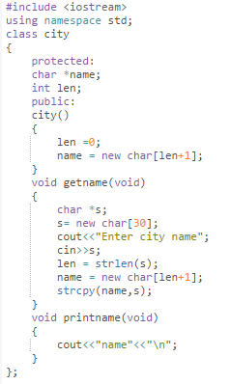
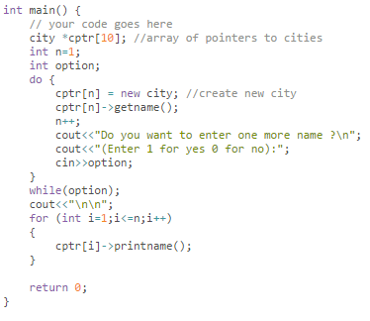

Slide 17
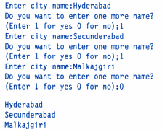
Output

Slide 18
Pointers To Derived Classes

Slide 19
Pointers To Derived Classes
We can use pointers not only to the base objects but also to the objects of derived classes.
Pointers to objects of base class are types-compatible with pointers to objects of a derived class.
Therefore, a single pointer variable can be made to point to objects belonging to different classes.
For example, if B is a base class and D is a derived class from B, then a pointer declared as a pointer to B can also be pointer to D.

Slide 20
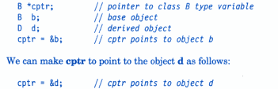
Pointers To Derived Classes

Slide 21
Pointers To Derived Classes
Valid with c++ because d is an object derived from the class B.
Problem: in using cptr to access the public members of the derived class D.
Using cptr, we can access only those members which are inherited from B and not the members that originally belong to D.
In case a member of D has the same name as one of the members of B, then any references to that member by cptr will always access the base class member.

Slide 22
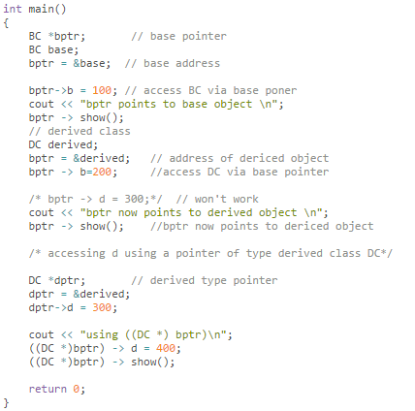
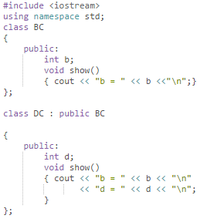

Slide 23
Output
bptr points to base object
b = 100
bptr now points to derived object
b = 200
using ((DC *) bptr)
b = 200
d = 400

Slide 24
Virtual Function
Polymorphism refers to the property by which objects belonging to different classes are able to respond to the same message, but in different forms.
Essential requirement: ability to refer to objects without any regard to their classes.
This necessitates use of single pointer variable to refer objects of different classes.
Here, we use the pointer to base class to refer to all the derived objects.

Slide 25
Virtual Function
Base pointer, even when it is made to contain the address of a derived class, always executes the function in the base class.
The compiler ignores the contents of the pointer and chooses the member function that matches the type of the pointer

Slide 26
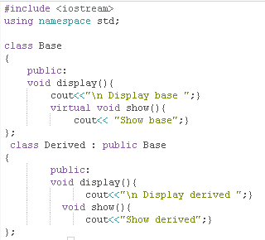
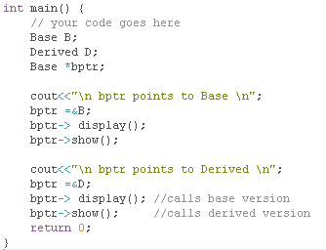

Slide 27
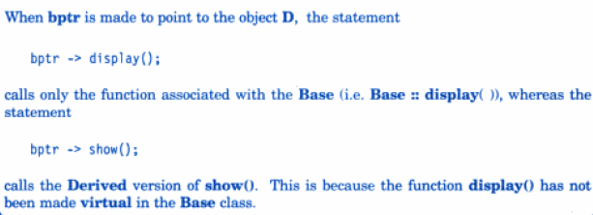
Output
bptr points to Base
Display base
Show base
bptr points to Derived
Display base
Show derived

Slide 28
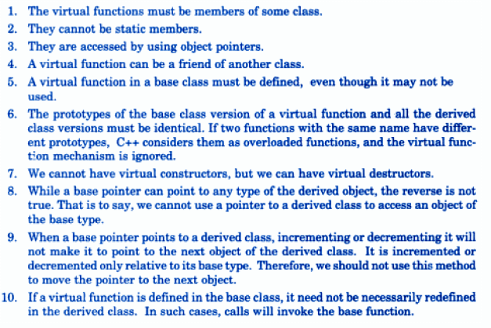
Rules of Virtual Functions

