Slide 1
Inheritance

Slide 2
Inheritance
Reusability is another important feature of OOP.
It is a good practice to reuse something that already exists rather than trying to create the same all over again.
For instance, the reuse of a class that has already been tested, debugged and used many times can save the effort of developing and testing the same again.

Slide 3
Inheritance
The mechanism of deriving a new class from an old one is called inheritance.
The old class is referred to as the base class and the new one is called the derived class or subclass.
The derived class inherits some or all of the traits from the base class.

Slide 4
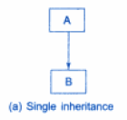
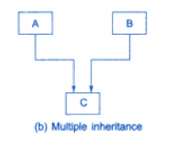
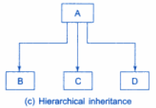
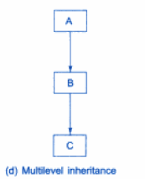
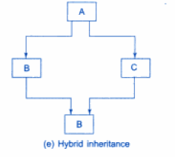
Forms of Inheritance

Slide 5
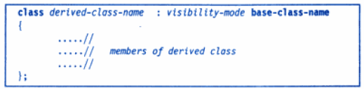
Defining Derived Classes
A derived class can be defined by specifying its relationship with the base class in addition to its own details.
The general for of deriving a derived class is :

Slide 6
Defining Derived Classes
The colon indicates that the derived class name is derived from the base class name.
The visibility mode is optional
The default visibility mode is private.
Visibility mode specifies whether the feature of the base class are privately derived or publicly derived.

Slide 7
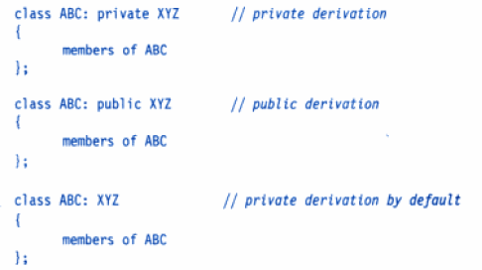
Examples

Slide 8
Single Inheritance
Let us consider a simple example.
In the program we have a base class B and a derived class D.
The class B contains one private data member, one public data member, and three public member functions.
The class D contains one private data member and two public member functions.

Slide 9
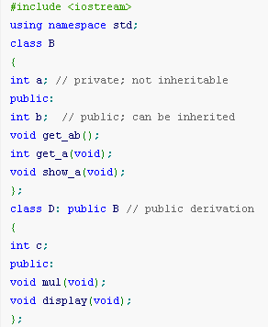
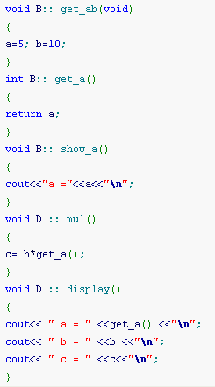

Slide 10
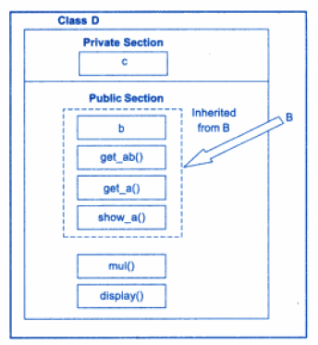
Adding more members to a class by Public derivation

Slide 11
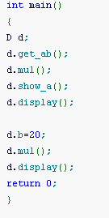

Slide 12
Output
a =5
a = 5
b = 10
c = 50
a = 5
b = 20
c = 100

Slide 13
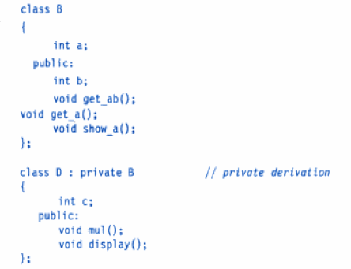
Case: Private Declaration

Slide 14
Private Declaration
The members of the derived class D is shown as follows.
In private derivation, the public members of the base class become private members of the derived class.
Therefore, the objects of D cannot have direct access to the public member functions of B.

Slide 15
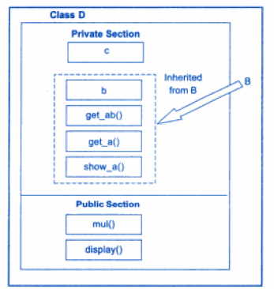
Adding more members to the class (Private Declaration)

Slide 16

Private Declaration
The statements will not work.

Slide 17
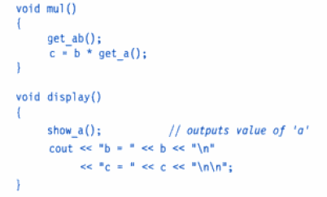
Private Declaration
However, these functions can be used inside mul() and display() like normal functions as shown below.

Slide 18
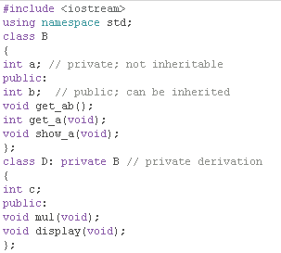
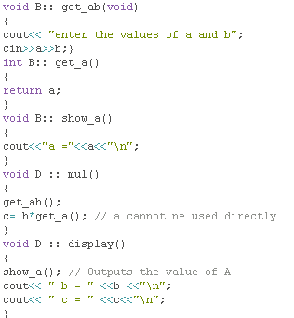

Slide 19
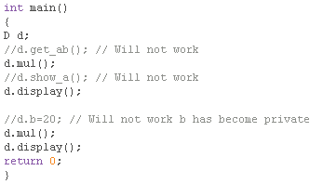

Slide 20
Output
Enter the values of a and b : 5 10
A= 5
B=10
C= 5
Enter the values of a and b : 12 20
A= 12
B=20
C=240

Slide 21
Example1: Inheritance using Public Specifier

Slide 22
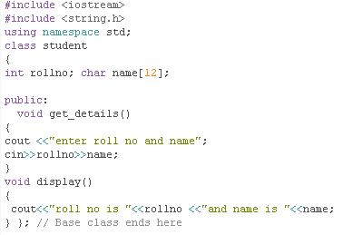
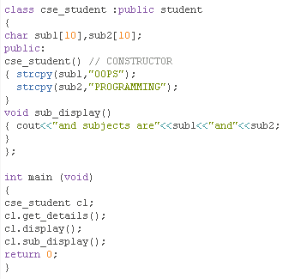
Public members of base class are accessed as public of derived

Slide 23
Output
enter roll no and name 12 ABC
roll no is 12
and name is ABC
and subjects are OOPS and
PROGRAMMING

Slide 24
Example2: Inheritance using Private Specifier

Slide 25
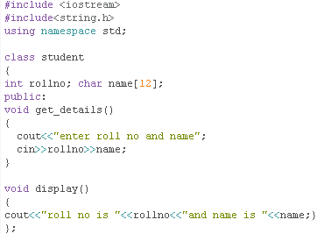
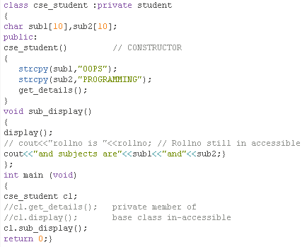

Slide 26
Output
enter roll no and name100 ABC
roll no is 100 and name is ABC
and subjects are OOPS and PROGRAMMING

Slide 27
Making a Private Member Inheritable

Slide 28

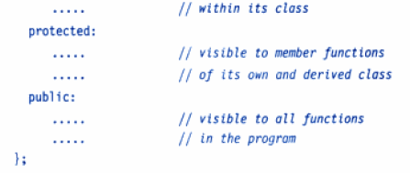
Protected Access Specifier

Slide 29
“Protected” Access Specifier
A protected member of a class behaves similar to private members.
It is accessible by the member functions within its class and any class immediately derived from it.
Thus protected members of a class are despite being private to it can be inherited by some other class.

Slide 30
Protected Member inherited in Public Mode
becomes protected in the derived class too
therefore is accessible by the member functions of the derived class.

Slide 31
Protected Member inherited in Private Mode
It becomes private in the derived class.
Although it is available to the member functions of the derived class, it is not available for further inheritance (since private members cannot be inherited).

Slide 32
Protected Member inheriting in “protected mode”
Both public and protected members of base class become protected members of derived class.
Private members of base class remain private to it and hence in-accessible to derived class.

Slide 33
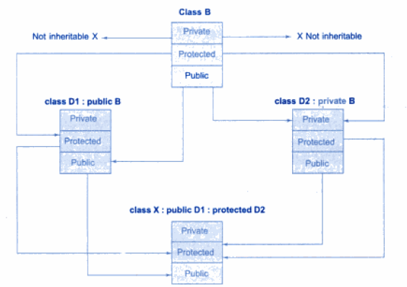
Effect of Inheritance on the Visibility of members

Slide 34
#include"iostream.h"
#include"conio.h"
class student
{
protected:
int rollno; char name[12];
void get_details()
{ cout<<"enter roll no and name";
cin>>rollno>>name;}
public:
student()
{ get_details();}
void display()
{ cout<<endl<<"roll no is "<<rollno<<"and name is "<<name<<endl; } };

Slide 35
class cse_student :public student
{
char sub1[10],sub2[10];
public:
cse_student()
{
strcpy(sub1,"OOPS");
strcpy(sub2,"PROGRAMMING");
get_details(); // valid as get_details is PROTECTED and not PRIVATE
}
void display1()
{
cout<<"rollno and name are"<<rollno<<"\t"<<name;
cout<<endl<<"and subjects are"<<sub1<<"and"<<sub2;
}
};

Slide 36
***FIND THE PROBLEM/ERROR***
***WHICH STATEMENTS ARE INVALID**
int main (void)
{
student s;
s.get_details();
s.display();
cse_student c1;
c1.get_details();
c1.display();
c1.display1();
return 0;
}

Slide 37
**FIND OUTPUT**
int main (void)
{
student s;
//s.get_details(); // get_details is private to student
s.display(); // valid being PUBLIC to student
cse_student c1;
//c1.get_details(); //get_details is private to cse_student
//c1.display(); //valid ,display() is public to cse_student
c1.display1();
return 0;
}

Slide 38
Output
enter roll no and name123 angel
roll no is 123and name is angel
enter roll no and name45 angel2
rollno and name are45 angel2
and subjects are OOPS and PROGRAMMING

Slide 39
Visibility of inherited members
Base class visibility | Derived class visibilty
 | Public derivation | Private derivation | Protected Derivation
Private | Not inherited | Not Inherited | Not Inherited
Protected | Protected | Private | Protected
Public | Public | Private | Protected

Slide 40
Multilevel Inheritance

Slide 41
Multilevel Inheritance
When a class is derived from another derived class is called multilevel inheritance.
It is implemented by defining at least three classes.

Slide 42
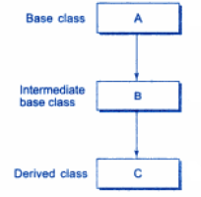
Multilevel Inheritance

Slide 43

Example: A Derived class with multilevel inheritance

Slide 44
Example:
Assume that the test results of a batch of students are stored in three different classes.
Class student stores the roll number, (Input & display roll no)
Class test stores the marks obtained in two subjects (Input & display Marks)
Class result contains the total marks obtained in the test. ( Display rollno, Marks and total Marks)
The class result can inherit the details of the marks obtained in the test and the roll-number of students through multilevel inheritance.

Slide 45
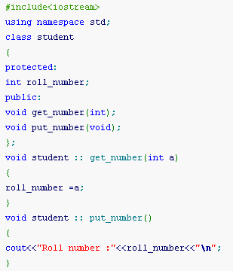
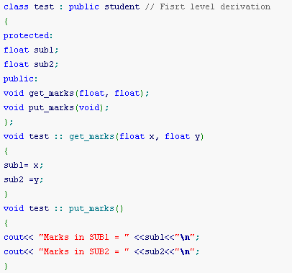

Slide 46
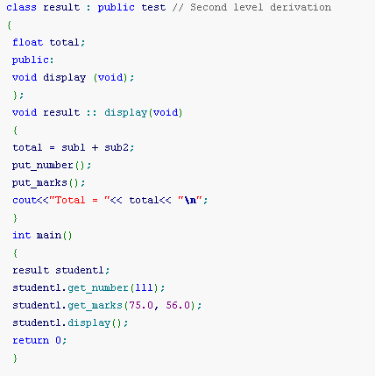

Slide 47
Output
Roll number :111
Marks in SUB1 = 75
Marks in SUB2 = 56
Total = 131

Slide 48
Multiple Inheritance

Slide 49
Multiple Inheritance
A class can inherit the attributes of two or more classes. This is known as multiple inheritance.
It allows us to combine the features of several existing classes as starting point for defining new classes.
It is like a child inheriting the physical features of one parent and the intelligence of another.

Slide 50
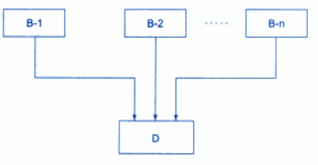
Multiple Inheritance

Slide 51
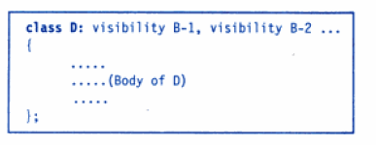
Syntax of Derived class with Multiple Inheritance
The visibility may be either public or private.
The base classes are separated by comma.

Slide 52
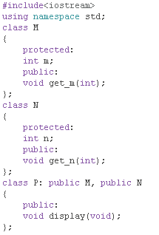
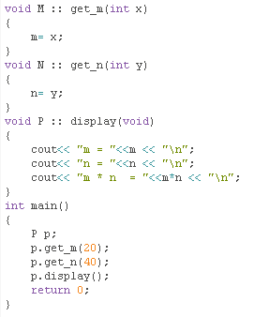

Slide 53
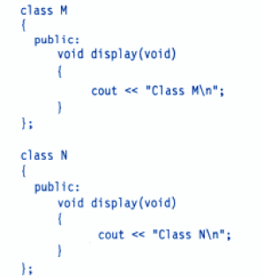
Ambiguity Resolution In Inheritance
At sometimes, we may face a problem in using the multiple inheritance , when a function with the same name appears in more then one base class.

Slide 54
Ambiguity Resolution In Inheritance
Which display() function is used by the derived class when we inherit these two classes?
We can solve this problem by defining a named instance within the derived class, using the class resolution operator.

Slide 55
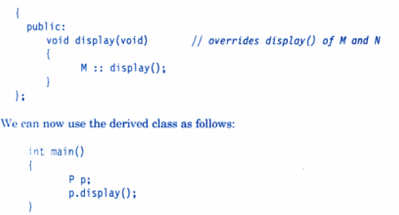
Ambiguity Resolution In Inheritance

Slide 56
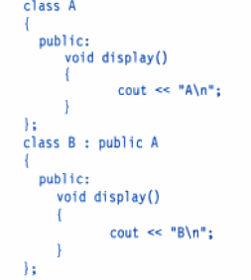
Ambiguity in Single Inheritance

Slide 57

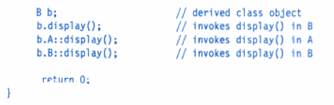

Ambiguity in Single Inheritance

Slide 58
Hierarchical Inheritance

Slide 59
Hierarchical Inheritance
When more than one classes are derived from a single base class, such inheritance is known as Hierarchical Inheritance, where features that are common in lower level are included in parent class.

Slide 60
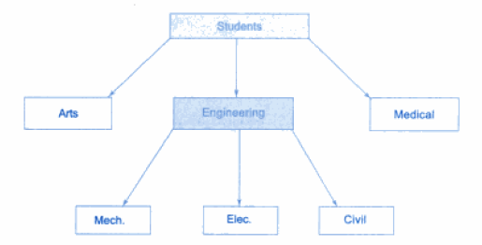
Hierarchical classification of Students

Slide 61
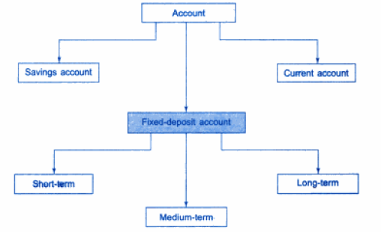
Classification of bank accounts

Slide 62
Example
#include<iostream.h>
#include<conio.h>
#include<string.h>
class college
{
protected:
char name[12];
void disp()
{
cout<<"name of college is"<<name<<endl;}
public:
college()
{cout<<"constructor of college is called"<<endl;
strcpy (name, "PIET");
}};
class cse_dept : public college
{
int faculty;
public:
void get_faculty()
{
cout<<"enter no of faculty members in CSE" <<endl;
cin>>faculty;}
void display()
{ disp(); // now a protected member of cse_dept
cout<<"no of teachers in CSE "<<faculty<<endl;
}
};

Slide 63
class ece_dept : public college
{
int faculty;
public:
void get_faculty()
{
cout<<"enter no of faculty members in ECE"<<endl;cin>>faculty;}
void display()
{
disp();// now a protected member of ece_dept
cout<<"no of teachers in ECE "<<faculty<<endl;}};
void main()
{
clrscr();
cse_dept C; C.get_faculty();
ece_dept E;
E.get_faculty();
C.display();
E.display();
}

Slide 64
OUTPUT
constructor of college is called
constructor of college is called
enter no of faculty members in CSE
12
enter no of faculty members in ECE
36
name of college is PIET
no of teachers in CSE 12
name of college is PIET
no of teachers in ECE 36

Slide 65
Virtual Class
Consider a situation where all the three kinds of inheritance, namely multilevel, multiple and hierarchical inheritance are involved.

Slide 66
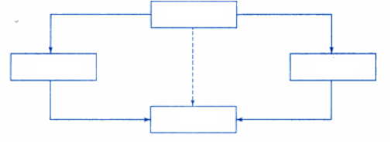
Multipath Inheritance
A
B
C
D
For example the ‘D’ has two direct base classes ‘B’ and ‘C’ which themselves have a common base class ‘A’.
Class ‘D’ inherits the properties of ‘A’ is sometimes referred to as indirect base class.

Slide 67
Problems:
All the public and protected members of ‘A’ are inherited into ‘D’ twice, first via ‘B’ and again via ‘C’.
Thus ‘D’ would have duplicate sets of the members inherited from ‘A’.
This introduces ambiguity and should be avoided.

Slide 68
Solution
The duplication is due to multiple paths.
It can be avoided by making the common base class (ancestor class) as virtual base class while declaring the direct or intermediate base classes

Slide 69
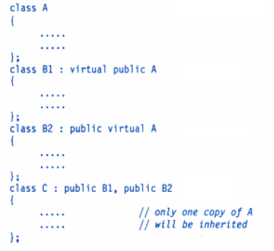
Example

Slide 70
Virtual Base class
When a class is made a virtual base class, C++ takes necessary care to see that only one copy of that class is inherited, regardless of how many inheritance paths exist between the virtual base class and a derived class.

Slide 71
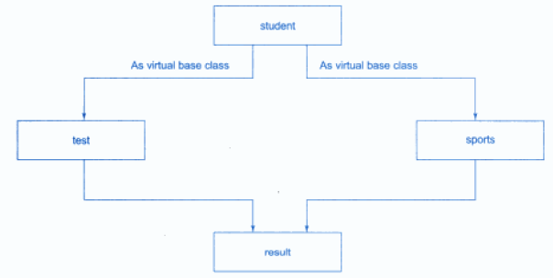
Virtual Base class
Assume that the class sports derives the roll_number from the class student.

Slide 72
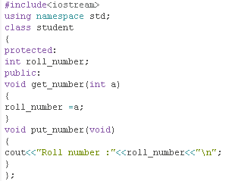
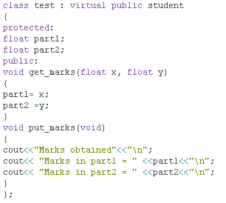

Slide 73
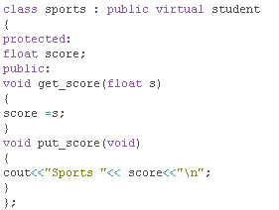
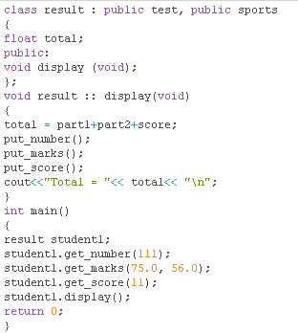

Slide 74
Output
Roll number :111
Marks obtained
Marks in part1 = 75
Marks in part2 = 56
Sports 11
Total = 142

Slide 75
Abstract class
An interface describes the behavior or capabilities of a C++ class without committing to a particular implementation of that class.
The C++ interfaces are implemented using abstract classes.
A class is made abstract by declaring at least one of its functions as pure virtual function. A pure virtual function is specified by placing "= 0" in its declaration

Slide 76
Abstract Class
The purpose of an abstract class is to provide an appropriate base class from which other classes can inherit.
Abstract classes cannot be used to instantiate objects and serves only as an interface.
Attempting to instantiate an object of an abstract class causes a compilation error.

Slide 77
Abstract Classes
Sometimes implementation of all function cannot be provided in a base class because we don’t know the implementation.
Such a class is called abstract class.
For example:
Let Shape be a base class.
We cannot provide implementation of function draw() in Shape, but we know every derived class must have implementation of draw().

Slide 78
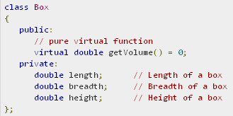
Pure Virtual Function
A class is made abstract by declaring at least one of its functions as pure virtual function.
A pure virtual function is specified by placing "= 0" in its declaration as follows:

Slide 79
Purpose of Abstract Class
The purpose of an abstract class (often referred to as an ABC) is to :
provide an appropriate base class from which other classes can inherit.
Abstract classes cannot be used to instantiate objects and serves only as an interface.
Attempting to instantiate an object of an abstract class causes a compilation error.

Slide 80
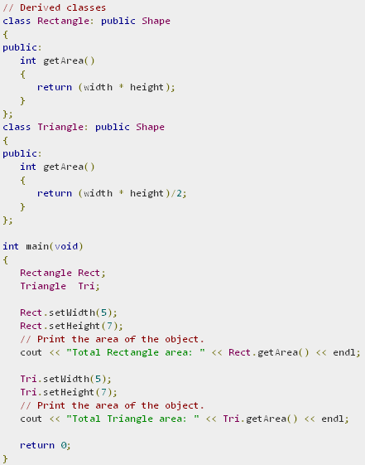
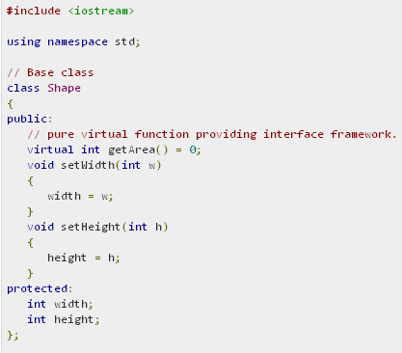

Slide 81
Output
Total Rectangle area: 35
Total Triangle area: 17

Slide 82
Constructors in Derived Classes

Slide 83
Constructor in Derived Classes
Base class constructors are always called in the derived class constructors.
Whenever you create derived class object, first the base class default constructor is executed and then the derived class's constructor finishes execution.

Slide 84
Points to Remember
Whether derived class's default constructor is called or parameterised is called, base class's default constructor is always called inside them.
To call base class's parameterised constructor inside derived class's parameterised constructor, we must mention it explicitly while declaring derived class's parameterized constructor.

Slide 85
Constructors in Derived Classes
Key point: If no base class constructor takes any arguments, the derived class need not have a constructor function.
If any base class contains a constructor with one or more arguments, then it is mandatory for the derived class to have a constructor and pass the arguments to the base class constructors.

Slide 86
Constructors in Derived Classes
The constructor of the derived class receives the entire list of values as its arguments and process them on to the base constructors in the order in which they are declared in the derived class.
The base class constructors are called and executed before executing the statements in the body of the derived constructor.

Slide 87
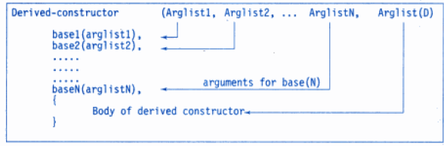
General Form of Derived Constructor
The header line of the derived constructor function contains two parts separated by a colon(:).
The first part provides the declaration of the arguments that are passed to the derived-constructor
The second part lists the function calls to the base constructors

Slide 88
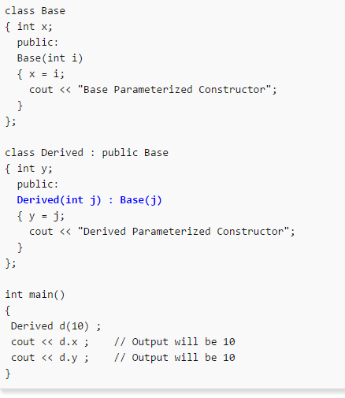

Slide 89
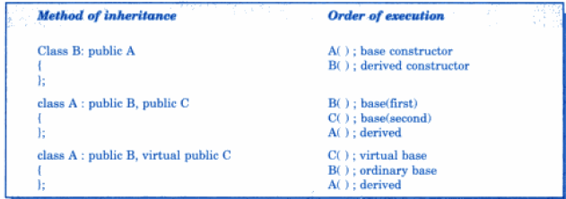
General Form of Derived Constructor

Slide 90




Slide 91

Output
beta initialized
alpha initialized
gamma initialized
x = 5
Y = 10.75
m =20
n=30

Slide 92
Polymorphism

Slide 93
Polymorphism
One name multiple forms
Concept of polymorphism is implemented using overloaded functions and operators.
The overloaded member functions are selected for invoking by matching the arguments, both type and number.
This information is known to the compiler at compile time.
Compiler is able to select the appropriate function at compile time hence called early binding or static binding or compile time polymorphism.

Slide 94


Example

Slide 95
Run Time Polymorphism
It would be nice if the appropriate function could be selected while program is running .. this is called late binding.
Also called as run time polymorphism.

Slide 96

Polymorphism

Slide 97
Pointers and classes

Slide 98
Pointers To Objects
A pointer can point to an object created by a class.
Example
item x;
Where ,item is a class and x is an object defined to be of type item.
We can define a poiner it_ptr of type item as follows:
item *it_ptr;

Slide 99
Object Pointers
Object pointers are useful in creating objects at run time.
We can also use an object pointer to access the public members of an object.

Slide 100

Example

Slide 101

Object Pointers
Declare an item variable x and a pointer to x as follows:
The pointer ptr is initialized with the address of x.

Slide 102
Accessing member functions
We can refer to member function of item in two ways, one by using dot operator and the object, and another by using the arrow operator and the object pointer.

Slide 103
Create objects using pointers and new operator

Slide 104
Program : Pointers to Objects

Slide 105



Slide 106
Input code and price for the item 1: 40 500
Input code and price for the item 2: 60 600
Item 1
Code:40
Price:500
Item 2
Code:60
Price:600

Slide 107
Program : Array Of Pointers To Objects

Slide 108



Slide 109

Output

Slide 110
Pointers To Derived Classes
We can use pointers not only to the base objects but also to the objects of derived classes.
Pointers to objects of base class are type-compatible with pointers to objects of a derived class.
Therefore, a single pointer variable can be made to point to objects belonging to different classes.

Slide 111

Pointers To Derived Classes
For example, if B is a base class and D is a derived class from B, then a pointer declared as a pointer to B can also be pointer to D.

Slide 112
Pointers To Derived Classes
This is perfectly valid with c++ because d is an object derived from the class B.
Problem: in using cptr to access the public members of the derived class D.
Using cptr, we can access only those members which are inherited from B and not the members that originally belong to D.
In case a member of D has the same name as one of the members of B, then any references to that member by cptr will always access the base class member.

Slide 113



Slide 114
Output
bptr points to base object
b = 100
bptr now points to derived object
b = 200
using ((DC *) bptr)
b = 200
d = 400

