Slide 1
File Handling in C – A review
Jaypee Institute of Information Technology University, Noida

Slide 2
Why Files are required:
scanf and printf function:
Used to read and write data.
Console oriented I/O functions ,which always use terminals (keyboard and screen) as the target place.
This works fine for small data.
Jaypee Institute of Information Technology University, Noida

Slide 3
Major problems with scanf() , printf():
1. It becomes cumbersome and time consuming to handle large volumes of data through terminals.
2. The entire data is lost when either the program is terminated or the computer is turned off.
This can be overcome by storing data on disks and read whenever necessary, without destroying the data.
Jaypee Institute of Information Technology University, Noida

Slide 4
Introduction
Files are places where data can be stored permanently.
Some programs expect the same set of data to be fed as input every time it is run.
  Cumbersome.
  Better if the data are kept in a file, and the program reads from the file.
Programs generating large volumes of output.
  Difficult to view on the screen.
  Better to store them in a file for later viewing/ processing
Jaypee Institute of Information Technology University, Noida

Slide 5
Files
C views each file as a sequence of bytes
  File ends with the end-of-file marker
  Opening a file returns a pointer to a FILE structure
Jaypee Institute of Information Technology University, Noida

Slide 6
Basic File Operations
Opening a file
Reading data from a file
Writing data to a file
Closing a file
Jaypee Institute of Information Technology University, Noida

Slide 7
Defining and opening a file:
To store a data in a file , we must specify
1)File name 2) Data Structure 3) Purpose
Filename:
String of characters specifying the filename.
Data Structure:
Data Structure of a file is defined as FILE in the library of
standard I/O function definitions.
All files should be declared as type FILE before they are used.
FILE is a defined data type.
Purpose:
When we open a file, we must specify what we want to do with
file.
Jaypee Institute of Information Technology University, Noida

Slide 8
The general format for declaring and opening a file:
data type
FILE *fp;
fp = fopen(“filename”, “mode”);

Slide 9
Opening a File
A file must be “opened” before it can be used.
    FILE *fp;
  fp = fopen(“filename”,”mode”);
  fp is declared as a pointer to the data type FILE.
  filename is a string - specifies the name of the file.
  fopen returns a pointer to the file which is used in all subsequent file operations.
  mode is a string which specifies the purpose of opening the file:
      “r” :: open the file for reading only
      “w” :: open the file for writing only
      “a” :: open the file for appending data to it
Jaypee Institute of Information Technology University, Noida

Slide 10
MODES
r - open a file in read-mode, set the pointer to the beginning of the file.
w - open a file in write-mode, set the pointer to the beginning of the file.
a - open a file in write-mode, set the pointer to the end of the file.
rb - open a binary-file in read-mode, set the pointer to the beginning of the file.
wb - open a binary-file in write-mode, set the pointer to the beginning of the file.
ab - open a binary-file in write-mode, set the pointer to the end of the file.
r+ - open a file in read/write-mode, if the file does not exist, it will not be created.
w+ - open a file in read/write-mode, set the pointer to the beginning of the file.
a+ - open a file in read/append mode.
r+b - open a binary-file in read/write-mode, if the file does not exist, it will not be created.
w+b - open a binary-file in read/write-mode, set the pointer to the beginning of the file.
a+b - open a binary-file in read/append mode.
Jaypee Institute of Information Technology University, Noida

Slide 11
When try to open a file, one of the following things happen
S.No | Mode | File exists | File does not exists
1. | Writing | the contents are Deleted | a file with the specified name is created
2. | Appending | the file is opened with the current contents safe. | A file with the specified name is created
3. | Reading | the file is opened with the current contents safe. | error occurs.

Slide 12
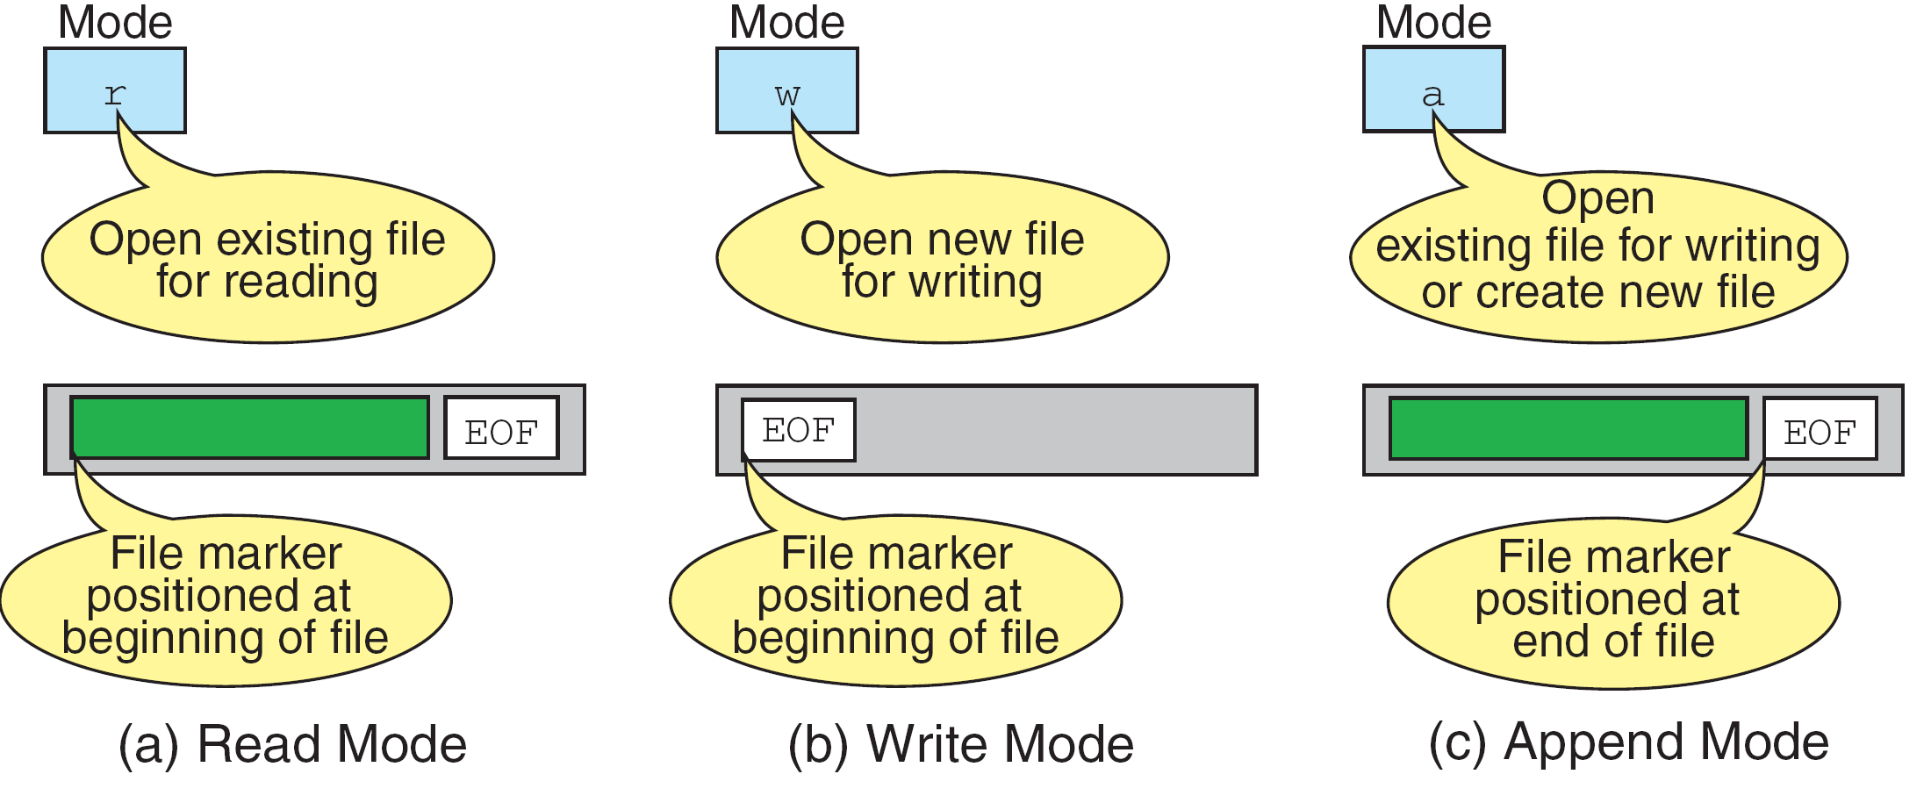
More on File Open Modes

Slide 13
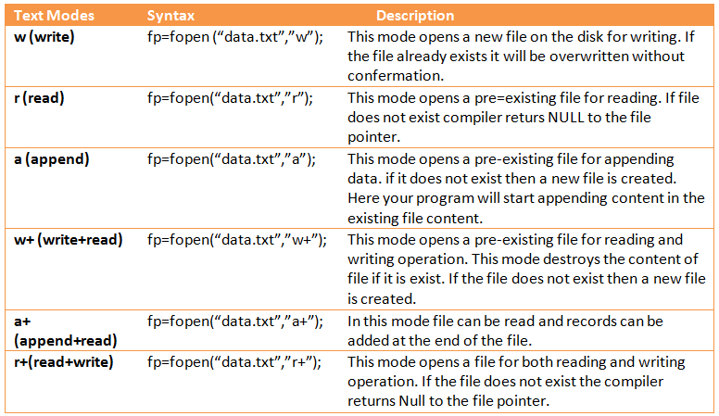
File Modes

Slide 14
Contd.
Points to note:
  Several files may be opened at the same time.
  For the “w” and “a” modes, if the named file does not exist, it is automatically created.
  For the “w” mode, if the named file exists, its contents will be overwritten.
Jaypee Institute of Information Technology University, Noida

Slide 15
Closing a File
After all operations on a file have been completed, it must be closed.
  Ensures that all file data stored in memory buffers are properly written to the file.
General format: fclose (file_pointer) ;
    FILE *xyz ;
    xyz = fopen (“test.txt”, “w”) ;
    …….
    fclose (xyz) ;
Jaypee Institute of Information Technology University, Noida

Slide 16
Closing a File (Contd..)
  fclose( FILE pointer )
    Closes specified file
    Performed automatically when program ends
    Good practice to close files explicitly
    system resources are freed.
    Also, you might not find that all the information that you've written to the file has actually been written to disk until the file is closed.
Jaypee Institute of Information Technology University, Noida

Slide 17
INPUT/OUTPUT OPERATIONS ON FILES
Jaypee Institute of Information Technology University, Noida

Slide 18
Function getc and putc
Read/Write functions in standard library
  getc
    Reads one character from a file
    Takes a FILE pointer as an argument
    fgetc( stdin ) equivalent to getchar()
Format of getc :
char ch;
FILE *fp;
    …..
    ch = getc(fp) ;
  getc will return an end-of-file marker EOF, when the end of the file has been reached
Jaypee Institute of Information Technology University, Noida

Slide 19
Function getc and putc
The simplest file input-output (I/O) function are getc and putc.
  . putc
    Writes one character to a file
    Takes a FILE pointer and a character to write as an argument
    fputc( 'a', stdout ) equivalent to putchar( 'a' )
Format of putc
char ch; FILE *fp;
    ……
    putc (ch, fp) ;
Jaypee Institute of Information Technology University, Noida

Slide 20
/*PROGRAM FOR VARIOUS MODES IN FILE HANDLING */
#include<stdio.h>
main()
{
FILE *f1;
char c;
printf("\nData input\n");
f1=fopen("TESTFILE","w"); /*OPEN THE FILE INPUT*/
while((c=getchar())!=EOF /*GET A CHARACTER FROM KEYBOARD*/
putc(c,f1); /*WRITE A CHARACTER TO THE FILE 'TESTFILE'*/
fclose(f1); /*CLOSE THE FILE 'TESTFILE'*/
printf("\nData output\n");
f1=fopen("TESTFILE","r"); /*REOPEN THE FILE 'TESTFILE'*/
while((c=getc(f1))!=EOF) /*READ A CHARACTER FROM 'TESTFILE'*/
printf("%c",c); /*DISPLAY A CHARACTER ON SCREEN*/
fclose(f1); /*CLOSE THE FILE 'TESTFILE'*/
getch();
}
Jaypee Institute of Information Technology University, Noida

Slide 21
getw and putw functions
The getw and putw are integer-oriented functions.
Deals with integer data only.
The general format:
  putw(integer,fp)
getw(fp)
Jaypee Institute of Information Technology University, Noida

Slide 22
/*PROGRAM FOR HANDLING OF INTEGER DATA FILES*/
#include<stdio.h>
#include<conio.h>
void main()
{
FILE *f1;
int number, i;
clrscr();
printf("\ncontents of DATA file\n");
f1=fopen("DATA","w"); /*create DATA file*/
for(i=0;i<=30;i++)
{
scanf("%d",&number);
if(number == -1 ) break;
putw(number,f1); /*Write the integer value to file 'fl'*/
}
fclose(f1);
Jaypee Institute of Information Technology University, Noida

Slide 23
f1=fopen("DATA","r");
printf("\ncontents of DATA file\n");
while((number = getw(f1))! =EOF) /*read the integer value from file 'f1'*/
printf("\n%d", number);
fclose(f1);
getch();
}
Output:
contents of DATA file
111 222 333 444 555 -1
contents of DATA file
111 222 333 444 555
Jaypee Institute of Information Technology University, Noida

Slide 24
Function fgets and fputs
These are useful for reading and writing entire lines of data to/from a file.
If str is a pointer to a character array and n is the maximum number of characters to be stored, then
fgets (str, n, input_file);
will read an entire line of text (max chars = n) into buffer until the newline character
fputs writes the characters in str until a NULL is found. The NULL character is not written to the output_file. fputs (str, output_file);
Jaypee Institute of Information Technology University, Noida

Slide 25
For Example:
1) char s[100];
fgets(s, sizeof(s), stdin); // read a line from stdin
2) fp = fopen("datafile.dat", "r");
fgets(s, 100, fp); // read 100 bytes from the file datafile.dat
Fclose(fp);
Jaypee Institute of Information Technology University, Noida

Slide 26
fprintf and fscanf functions
handle a group of mixed data simultaneously on files.
General format:
  fscanf (file_pointer, control_string, list) ;
  fprintf (file_pointer, control_string, list) ;
Examples:
fscanf (fp, “%d %s %f”, &roll, dept_code, &cgpa);
fprintf ( fp, “%s%d%f” ,name,age,7.5);
Jaypee Institute of Information Technology University, Noida

Slide 27
/*PROGRAM FOR HANDLING OF FILES WITH MIXED DATA TYPES*/
#include<stdio.h>
void main()
{
FILE *f1;
int numint;
float numreal;
char name[10];
f1 = fopen("MIX","w");
printf("\nINPUT TO THE FILE 'MIX'\n");
printf("\nEnter a integer number,a real number and a name\n");
fscanf(stdin,"%d%f%s",&numint,&numreal,name);
fprintf(f1,"\n%d\n%f\n%s",numint,numreal,name);
fclose(f1);
Jaypee Institute of Information Technology University, Noida

Slide 28
f1 = fopen("MIX","r");
printf("\nOUTPUT FROM THE FILE 'MIX'\n");
fscanf(f1,"%d%f%s",&numint,&numreal,name);
fprintf(stdout,"\n%d\n%4.5f\n%s",numint,numreal,name);
fclose(f1);
getch();
}
Output:
INPUT TO THE FILE 'MIX'
Enter a integer number,a real number and a name
111 12.3 bharat
OUTPUT FROM THE FILE 'MIX'
111 12.300000 bharat
Jaypee Institute of Information Technology University, Noida

Slide 29
Question
Create an inventory database having item name, item number, price and quantity.
Input the item details in a file.
Read all details and print it on screen.
Jaypee Institute of Information Technology University, Noida

Slide 30
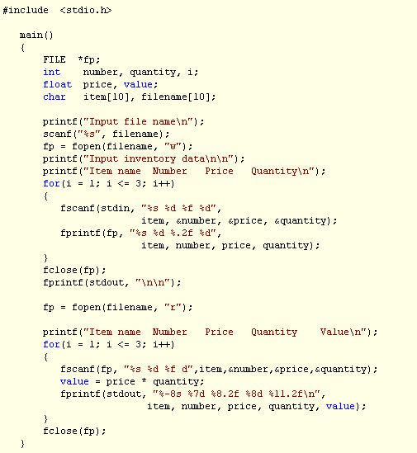

Slide 31
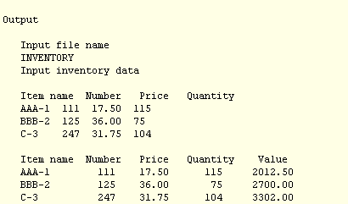

Slide 32
Modes : Text and Binary

Slide 33
Text File and Binary Files
The data may be stored inside a text file or binary file.
A text file contains only textual data like alphabets, digits and special symbol.
Respective ASCII code of each character are stored in text file.
A binary file is a collection of bytes.
For example: A c program ‘Myprogram.c’ is stored in a text file and the compiled version of this program ‘Myprogram.exe’ is stored in binary file.

Slide 34
Text Mode:
FILE *fp;
fp = fopen("afile.txt", "r");
Text mode is the default file open mode

Slide 35
Binary Mode :
In binary mode, your program can access every byte in the file.
    FILE *fp;
    fp = fopen("afile.txt", "rb");
The "r" in the second argument to fopen() opens the file for reading, and the "b" specifies binary mode.

Slide 36
Binary v/s Text
There are three main areas where text and binary mode files are different. These are:
Handling of newlines
Representation of end of file
Storage of numbers

Slide 37
Handling of newlines
In text mode, a newline character is converted into the carriage return-linefeed combination before being written to the disk. Likewise, the carriage return-linefeed combination on the disk is converted back into a newline when the file is read by a C program.
If a file is opened in binary mode, as opposed to text mode, these conversions will not take place.

Slide 38
Representation of end of file
In text mode, a special character, is inserted after the last character in the file to mark the end of file.
As against this, there is no such special character present in the binary mode files to mark the end of file.
The binary mode files keep track of the end of file from the number of character present in the directory entry of the file.

Slide 39
Storage of numbers
In text file, the text and characters are stored one character per byte. But numbers are stored as strings of characters.
Thus, 65112, even though it occupies 4 bytes in memory, when transferred to the disk using fprintf(), would occupy 5 bytes, one byte per character.
In Binary mode , file occupies less storage space

Slide 40
fread
This Function is Used in Binary Mode.
Function Reads Block of Data from Binary Mode File and Assigns it to the Region of Memory Specified.
Returns : Total number of Values Read.

Slide 41

Syntax
First Argument:
  “Buffer” is Variable of Pointer Type.
  Data read is Assigned to “Buffer” which Holds Starting Address of the Block.
Second Argument:
  Size Specifies the Size in Bytes of Individual Data Item being read. Can be calculated using sizeof operator
Third Argument:
  Count Specifies “Number of Items to Be Read”
Fourth Argument:
  Pointer to file from which data needs to be read

Slide 42

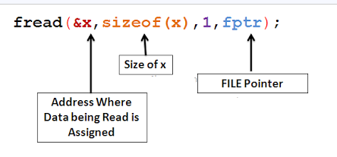
Example: To Read Variable x of type Float to File

Slide 43
fwrite
This Function is Used in Binary Mode.
Function Writes Block of Data to Binary Mode File.[i.e Writes Block to Binary File]

Slide 44

Syntax
First Argument:
  “Buffer” is Variable of Pointer Type.
  “Buffer” Holds Starting Address of the Block to be Written on File.
Second Argument:
  Size Specifies the Size in Bytes of Individual Data Item.
Third Argument:
  Count Specifies “Number of Items to Be Written Onto File.
Fourth Argument:
  Pointer to file from in data needs to be written

Slide 45

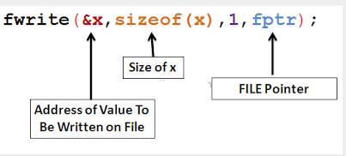
Examples : To Write Variable x of type Float to File

Slide 46

Example: Write Array of 100 Elements
100 Specifies That Write 100 Floating Values to File Starting From Address Specified in Variable ‘x’.

Slide 47
Example
Writing structure to a file.

Slide 48
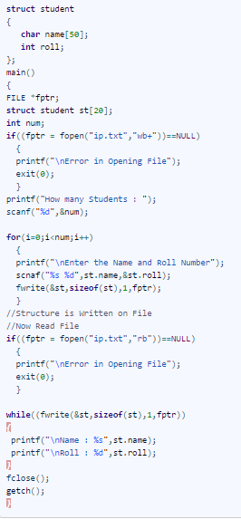

Slide 49
feof function:
•Used to test for an end of file condition.
•It takes a FILE pointer as its only argument.
•Return a nonzero integer value if all of the data from
the specified file has been read.
•Otherwise returns zero.
Example:
if(feof(fp))
printf(“\nEnd of data\n”);
Jaypee Institute of Information Technology University, Noida

Slide 50
Practicing File Handling in C

Slide 51
(1) What will happen if you execute following program?
#include<stdio.h>
int main(){
FILE *fp1,*fp2;
fp1=fopen("day.text","r");
fp2=fopen("night.txt","r");
fclose(fp1,fp2);
return 0;
}

Slide 52
Output: Compiler error
Explanation: We cannot close more than one file using fclose function.

Slide 53
(2)What will happen if you execute following program?
#include<stdio.h>
int main(){
unsigned char c;
FILE *fp;
fp=fopen("try","r");
while((c=fgetc(fp))!=EOF)
printf("%c",c);
fclose(fp);
return 0;
}

Slide 54
Output:
It will print the content of file text.txt but it will enter in infinite loop because macro EOF means -1 and at the end of file function fgetc will also return -1 but c can store only unsigned char. It will store any positive number according to rule of cyclic nature of data type. Hence condition will be always true.

Slide 55
(2) What will happen if you execute following program?
#include<stdio.h>
int main(){
char *str;
FILE *fp;
fp=fopen("c:\tc\bin\test.txt","r");
while(fgets(str,15,fp)!=NULL)
printf("%s",str);
fclose(fp);
return 0;
}

Slide 56
Output: It will print NULL.
Explanation: As we know \ has special meaning in c programming. To store \ in a string data type there requirements of two forward slash i.e. \\.

Slide 57
(3)What will be output of following program?
#include<stdio.h>
int main(){
FILE *fp;
char *str;
fp=fopen("c:\\tc\\bin\\world.txt","r");
while(fgets(str,5,fp)!=NULL)
puts(str);
fclose(fp);
return 0;
}
//world .txt
Who are you?

Slide 58
Output: Who a
Explanation: It will print only first five character of including blank space of file world.txt

Slide 59
What will be output of following program?
#include<stdio.h>{
char *str="i know c .";
while(*str)
{
putc(*str,stdout);
fputchar(*str);
printf("%c",*str);
str++;
}
return 0;
}

Slide 60
Output: iii kkknnnooowww ccc ...
Explanation: We are using three functions to print or write in stream.
1. putc is function it can print one character on any stream. Since here stream is stdout so it will print on standard output screen.
2. fputchar function can print one character on standard output screen.
3. printf function can print one character on standard output screen.

Slide 61
What will be output of following program?
#include<stdio.h>
int main(){
char c;
FILE *fp;
fp=fopen("myfile.txt","w");
while((c=fgetc(fp))!=EOF)
printf("%c",c);
fclose(fp);
return 0;
}
//myfile.txt
I am reading file handling from cquestionbank.blogspot.com

Slide 62
Output: nothing
Explanation:
Mode w allow us write on the file but we cannot read the content and it truncates (delete) the content of file. So content of file will be also deleted.

